Slide 1
Introduction to Statistical Investigations
Second Edition
Tintle, Chance, Cobb, Rossman, Roy, Swanson, VanderStoep
Chapter 1
Significance: How Strong is the Evidence?
This slide deck contains animations. Please disable animations if they cause issues with your device.
Copyright ©2021 John Wiley & Sons, Inc.

Slide 2
Unit 1 Overview
Significance – How strong is the evidence of an effect? (Chapter 1)
Generalization – How broadly do the conclusions apply? (Chapter 2)
Estimation – How large is the effect? (Chapter 3)
Causation – Can we say what caused the observed difference? (Chapter 4)

Slide 3
Chapter 1
Significance: How Strong is the Evidence?

Slide 4
Section 1.1: Introduction to Chance Models
Organ Donation Study (Preliminaries)
  78.6% in neutral group agreed
  41.8% in the opt-in group agreed
The researchers found these results to be statistically significant.
This means that if the recruitment method made no difference in the proportion that would agree, results as different as we found would be unlikely to arise by random chance.
We are going to start to investigate how to determine whether results are unlikely to occur by random chance (or are statistically significant).

Slide 5
Example 1.1
Can Dolphins Communicate?
More specifically, we will look at a study done to see whether dolphins can communicate the abstract idea of left and right.

Slide 6
Example 1.1: U.S. Navy Marine Mammal Program
The dolphin communication study that we will be looking at was done under a contract with the Navy in the 1960s.

Slide 7



Example 1.1: Can Dolphins Communicate Abstract Ideas?
Dr. Jarvis Bastian tested to see whether his dolphins, Buzz and Doris, could communicate the idea of left and right.
Doris
Buzz

Slide 8
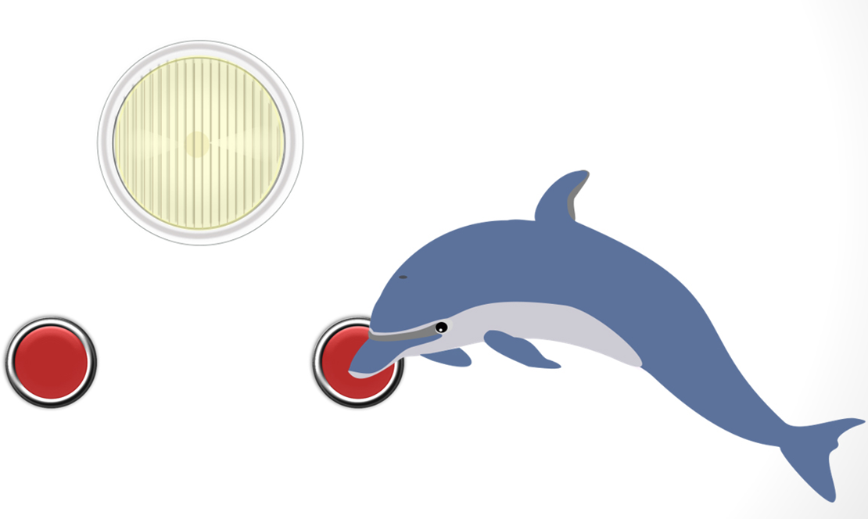
Example 1.1: Step 1: Learn the Signals (1 of 2)
Dr. Bastian put a light with a button on each side of it in a pool.
He wanted Buzz and Doris to learn the signals.
The dolphins were taught that if the light was on, and if they pushed the button on the right, they would be rewarded with a fish.

Slide 9
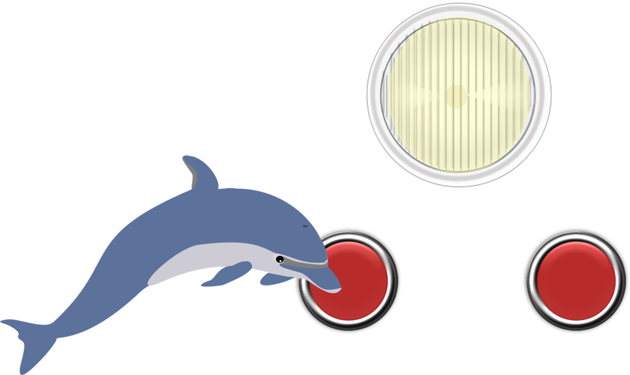
Example 1.1: Step 1: Learn the Signals (2 of 2)
The dolphins were also taught that if the light was flashing, and if they pushed the button on the left, they would be rewarded with a fish.

Slide 10
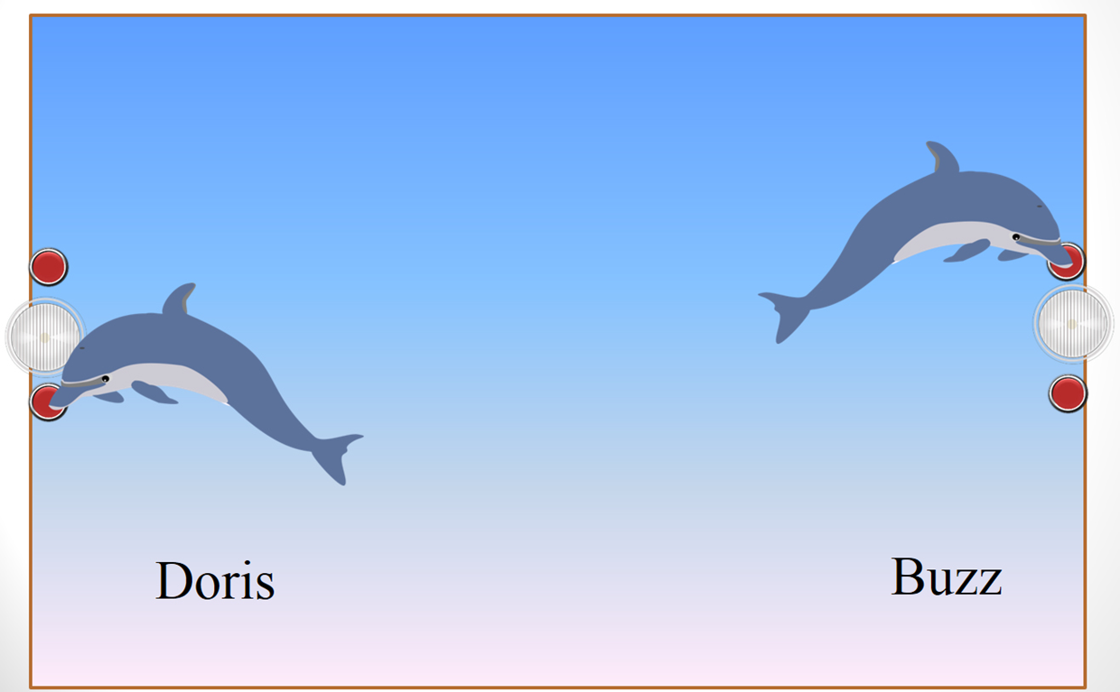
Example 1.1: Step 2: Learn the Order
The dolphins then had to learn the order.
The only way they would be rewarded was if Buzz pushed the correct button on his side of the pool first and Doris pushed the correct button on her side of the pool second.

Slide 11
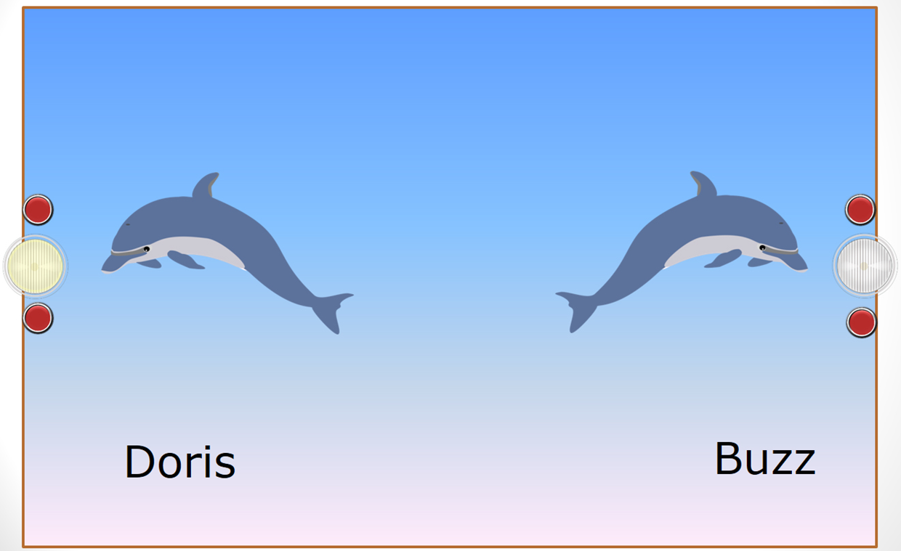
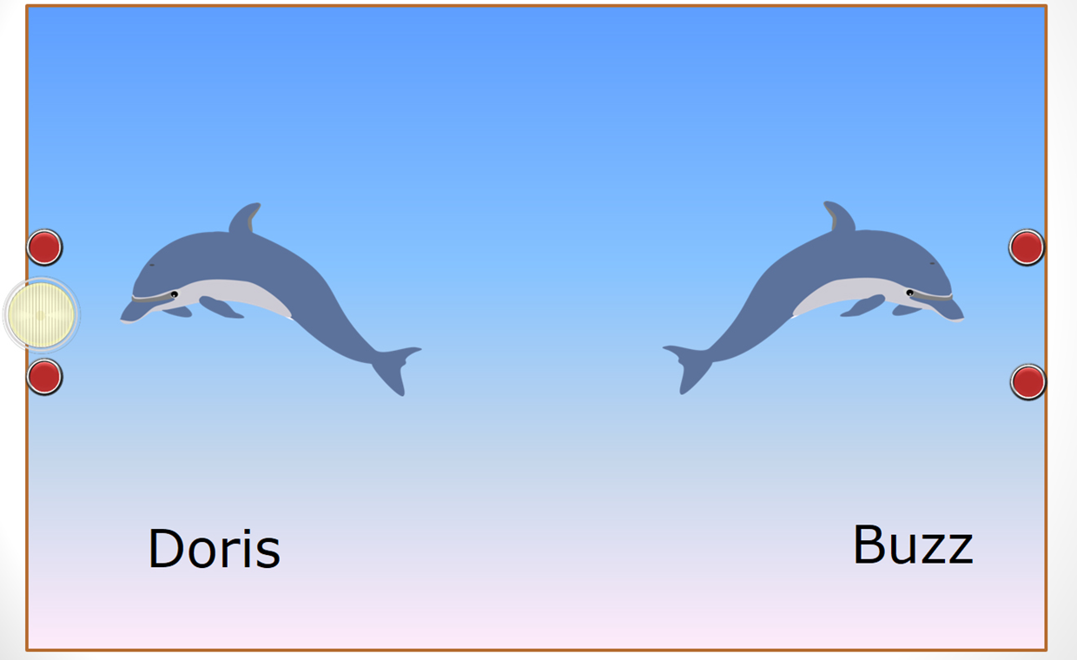
Example 1.1: Step 3: Communicate! (1 of 5)
Next the dolphins were forced to communicate to earn their reward.
To do this, Buzz’s light was taken away.

Slide 12
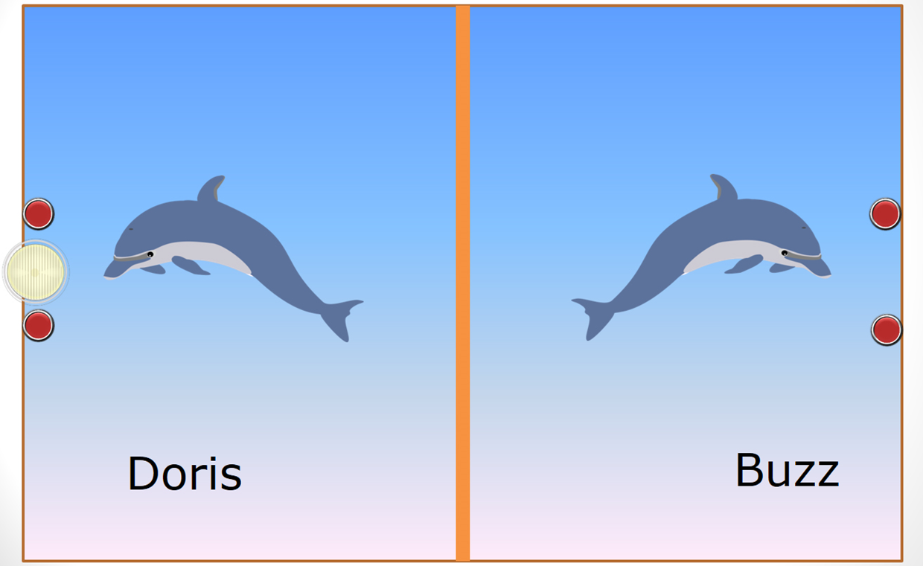
Example 1.1: Step 3: Communicate! (2 of 5)
A thick canvas curtain was placed down the middle of the pool.
Buzz couldn’t see Doris’s light and his was gone.

Slide 13
Example 1.1: Step 3: Communicate! (3 of 5)
The light is flashing, but Doris is waiting for Buzz to push his button first.
However, Buzz does not see any light.

Slide 14
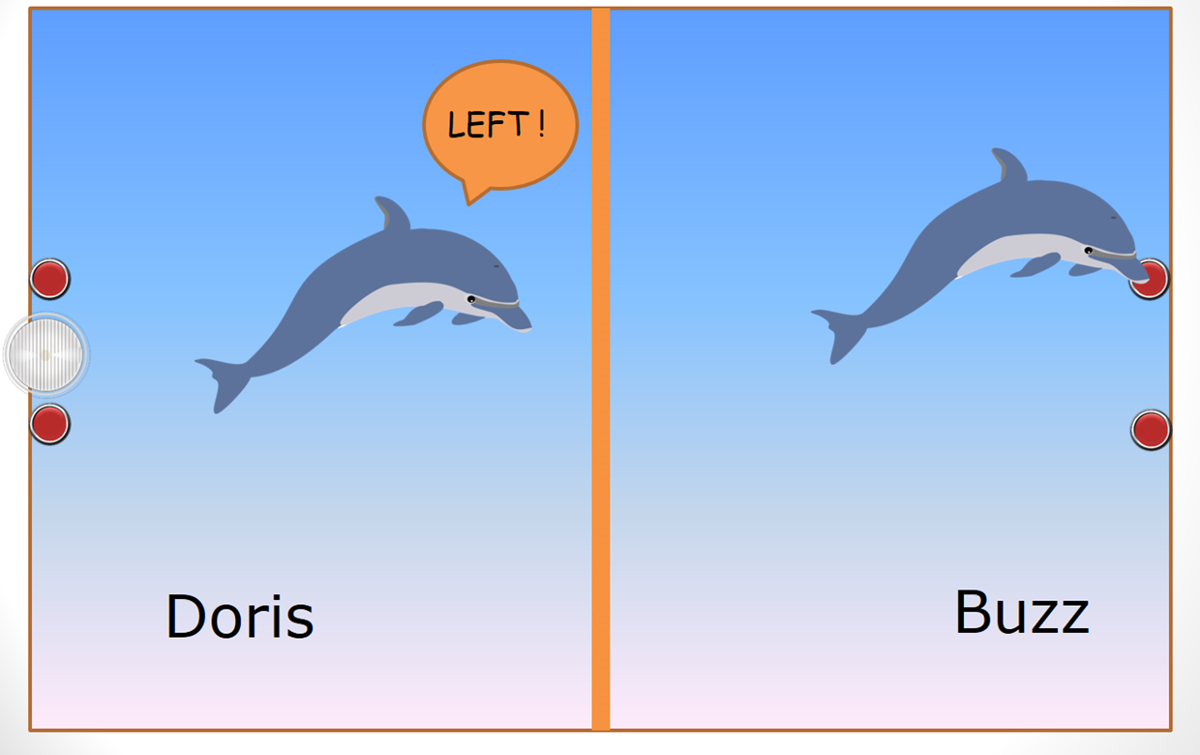
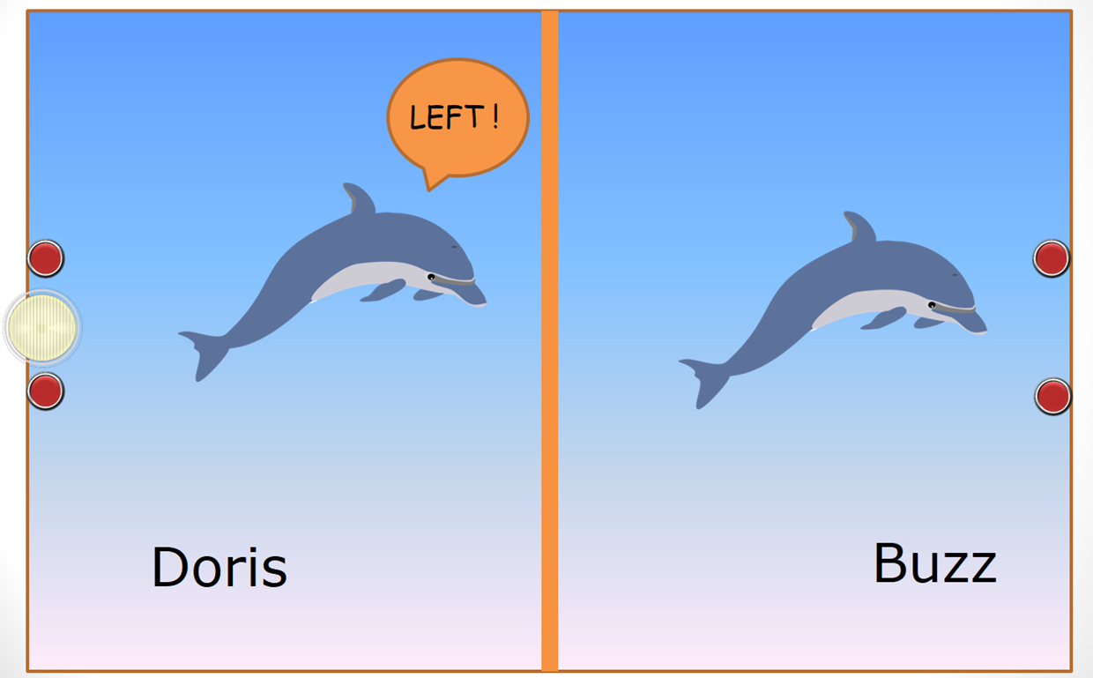
Example 1.1: Step 3: Communicate! (4 of 5)
Doris swims over to the canvas curtain and squeaks something to Buzz.
Buzz hears it and pushes his button on the left.

Slide 15
Example 1.1: Step 3: Communicate! (5 of 5)
It appears as though Doris has successfully communicated the idea of pushing the button on the left to Buzz.
Now we need to test to see whether this was just a fluke or that Doris and Buzz are really communicating.
Dr. Bastian tested them on many different sets of trials.
We will focus on one set of trials, in particular.

Slide 16
Example 1.1: The Statistic
In one set of trials, Buzz chose the correct button 15 out of 16 times.
So our sample proportion is
Based on the results, do you think Buzz knew which button to push or was he guessing?
Why do you think so?

Slide 17
Example 1.1: Possible Explanations
There are two possible reasons why Buzz chose the correct button so many times.
  He is just randomly guessing and got 15 out of 16 correct just by chance.
  He was doing something other than just guessing and was understanding what Doris was telling him.
We want to model randomly guessing and see how Buzz’s result fit in this model.
How might we model the situation where Buzz is just guessing (our chance model)?

Slide 18
Example 1.1: Simulation vs. Real Study
Table: Parallels between real study and physical simulation

Slide 19
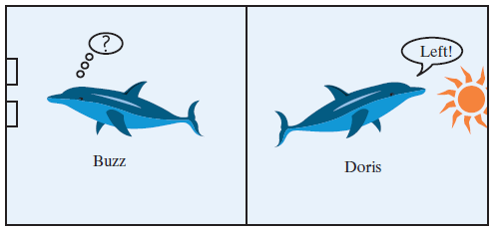
Example 1.1: Modeling Doris and Buzz
Do the simulation by flipping coins and putting results on the board.
Where does 15 out of 16 lie in the distribution that was produced?
Then use the One Proportion applet to get a distribution of results that could have happened by chance if Buzz was just guessing.

Slide 20
Example 1.1: Three S Strategy
Statistic: Compute the statistic from the observed data.
Simulate: Identify a model that represents a chance explanation. Repeatedly simulate values of the statistic that could have happened when the chance model is true and form a distribution.
Strength of evidence: Consider whether the value of the observed statistic is unlikely to occur when the chance model is true.
Notes:
Delete ( 1 of 2)

Slide 21
Example 1.1: Terminology
What are the observational units in the Buzz and Doris Experiment? How many are there?
What is the variable? Is it categorical or quantitative?
The statistic is the number of times Buzz pushed the correct button in 16 attempts.
The parameter is Buzz’s probability (long-run proportion) of choosing the correct button.

Slide 22
Example 1.1: Doris and Buzz Redo
Instead of a canvas curtain, Dr. Bastian constructed a wooden barrier between Buzz and Doris.
When tested, Buzz pushed the correct button only 16 out of 28 times.
Are these results statistically significant?
Is it plausible Buzz is just guessing?
Let’s go to the applet to check this out.
Doris and Buzz Music Video (Music Video)

Slide 23
Learning Objectives for Section 1.1 (1 of 2)
Recognize the difference between parameters and statistics.
Describe how to use coin tossing to simulate outcomes from a chance model of the random choice between two events.
Use the One Proportion applet to carry out the coin tossing simulation.

Slide 24
Learning Objectives for Section 1.1 (2 of 2)
Identify whether or not study results are statistically significant and whether or not the chance model is a plausible explanation for the data.
Implement the 3S strategy: find a statistic, simulate results from a chance model, and comment on strength of evidence against observed study results happening by chance alone.
Differentiate between saying the chance model is plausible and the chance model is the correct explanation for the observed data.

