Slide 1
Introduction to Statistical Investigations
Second Edition
Tintle, Chance, Cobb, Rossman, Roy, Swanson, VanderStoep
Chapter 3.1-3.3
Estimation
Statistical Inference: Confidence Intervals
This slide deck contains animations. Please disable animations if they cause issues with your device.
Copyright ©2021 John Wiley & Sons, Inc.

Slide 2
Chapter 3 Overview
So far, we can only say things like
“We have strong evidence that the probability Harley chooses the correct cup is > 0.5.”
”Students overestimate the length of the Jackson 5’s song ‘ABC.’”
We want a method that estimates what the parameter actually is.

Slide 3
Can Dogs Sniff Out Cancer?
Marine, a dog originally trained for water rescues, was tested to see if she could detect if a patient had colorectal cancer by smelling a sample of the patient’s breath.

Slide 4
Can Dogs Sniff Out Cancer?
In each trial, she first smells a bag from a patient with colorectal cancer.
Then she smells 5 other samples; 4 from normal patients and 1 from a person with colorectal cancer.
Marine correctly identified the bag from the cancer patient in 30 out of 33 trials. So our sample proportion is 30/33 = 0.909.

Slide 5
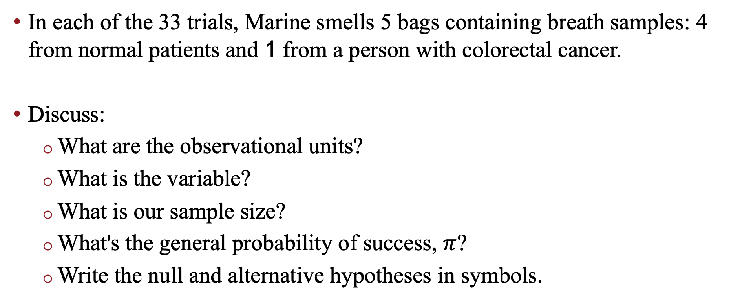
Can Dogs Sniff Out Cancer?
In each of the 33 trials, Marine smells 5 bags containing breath samples: 4 from normal patients and 1 from a person with colorectal cancer.
Discuss:
What are the observational units?
What is the variable?
What is our sample size?
What's the general probability of success, $π$?
Write the null and alternative hypotheses in symbols.

Slide 6
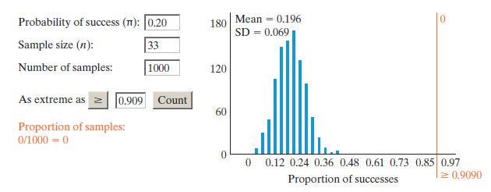
Can Dogs Sniff Out Cancer?
Our sample proportion lies more than 10 standard deviations above the mean and hence our p-value is 0.

Slide 7
Can Dogs Sniff Out Cancer?
It’s not very interesting to say “Marine picks the correct bag more than 20% of the time.”
Can we say for certain that Marine picks the correct bag 90.9% of the time?
Is it plausible that Marine actually picks the correct bag 70% of the time and just had a lucky day?

Slide 8
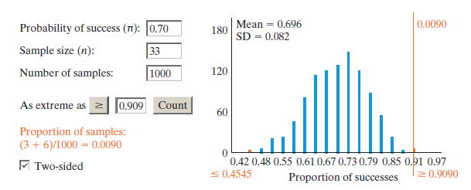

Can Dogs Sniff Out Cancer?
Let's try:
H₀: $π$ = 0.70 H_{a}: $π$ ≠ 0.70
We get a small p-value (0.0090) so we can rule out 0.70 as a value for $π$.

Slide 9

Can Dogs Sniff Out Cancer?
What about 0.80?
Is an observed statistic of 0.909 unlikely if $π$ = 0.80?

Slide 10
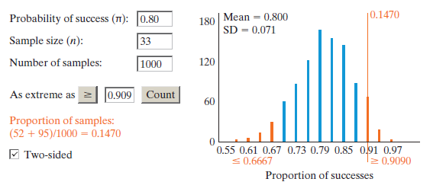
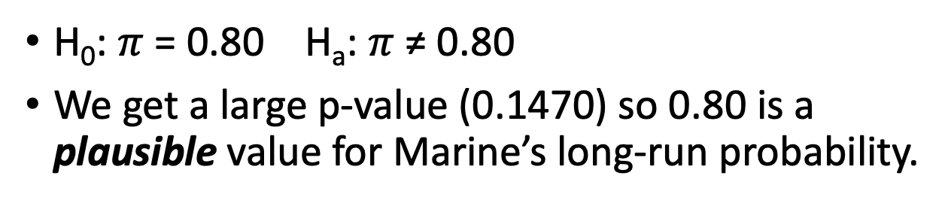
Can Dogs Sniff Out Cancer?
H₀: $π$ = 0.80 H_{a}: $π$ ≠ 0.80
We get a large p-value (0.1470) so 0.80 is a plausible value for Marine’s long-run probability.

Slide 11
A range of plausible values
Small p-value => the value in H₀ is not plausible. (We can conclude H_{a}.)
Large p-value => the value under H₀ is plausible. (We can’t conclude H_{a}.)
The significance level α determines whether a p-value is small or large.

Slide 12
A range of possible values
We can use the One Proportion applet to find a range of plausible values for Marine’s long-term probability of choosing the correct bag.
We do this by keeping the sample proportion the same and varying π.
You will do this in today’s Exploration.

Slide 13
Exploration 3.1

Slide 14
3.2 and 3.3

Slide 15
Overall Goal
Estimate the population proportion or population mean.
How to do this:
Collect a sample
Obtain a sample proportion or sample mean (depending on what we are measuring)
Determine where the population proportion or mean lies with a certain level of confidence.
It's tedious to construct the confidence interval by trial and error.

Slide 16
Solution: Theory
We will use a theory-based method to accomplish this.

Slide 17
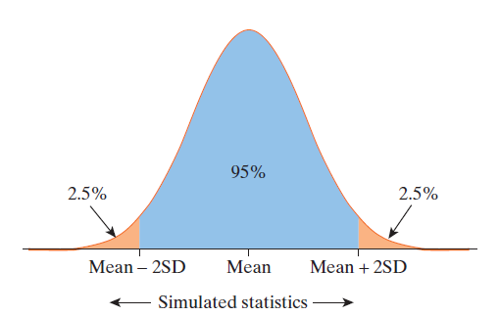
Example 3.2: 2SD Method (1 of 4)
When a null distribution is bell-shaped, about 95% of the statistics will fall within 2 standard deviations of the mean with the other 5% outside this region

Slide 18
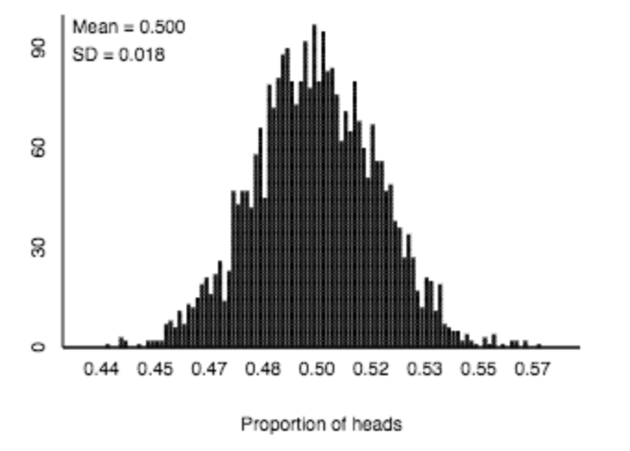
Example 3.2: Where Do We Get the SD?
A null distribution for a poll about cyberbullying with n = 743 and π = 0.50 gives a SD of 0.018.

Slide 19

Example 3.2: 2SD Method (2 of 4)
So we could say that a parameter value is plausible if it is within 2 standard deviations (SD) from our best estimate of the parameter, our observed sample statistic.
This gives us the simple formula for a 95% confidence interval of

Slide 20
Example 3.2: 2SD Method (3 of 4)
If our observed statistic is 0.59,
Using the 2SD method to create an approximate 95% confidence interval we get:
0.59 ± 2(0.018)
0.59 ± 0.036
The 0.036 in the above is called a margin of error.
The interval can also be written as we did before using just the endpoints; (0.554, 0.626)
This is approximately what we got with our range of plausible values method (a bit wider).

Slide 21
Example 3.2: 2SD Method (4 of 4)
We used and π = 0.50 and n = 743 to develop the null distribution we used to get the standard deviation needed for our 2SD method.
While the sample size of 743 came from the survey, the parameter of 0.50 did not.
We used 0.50 because using that gives us the largest possible standard deviation and largest possible margin of error.
This means we are at least 95% confident that our interval contains the population parameter.

Slide 22

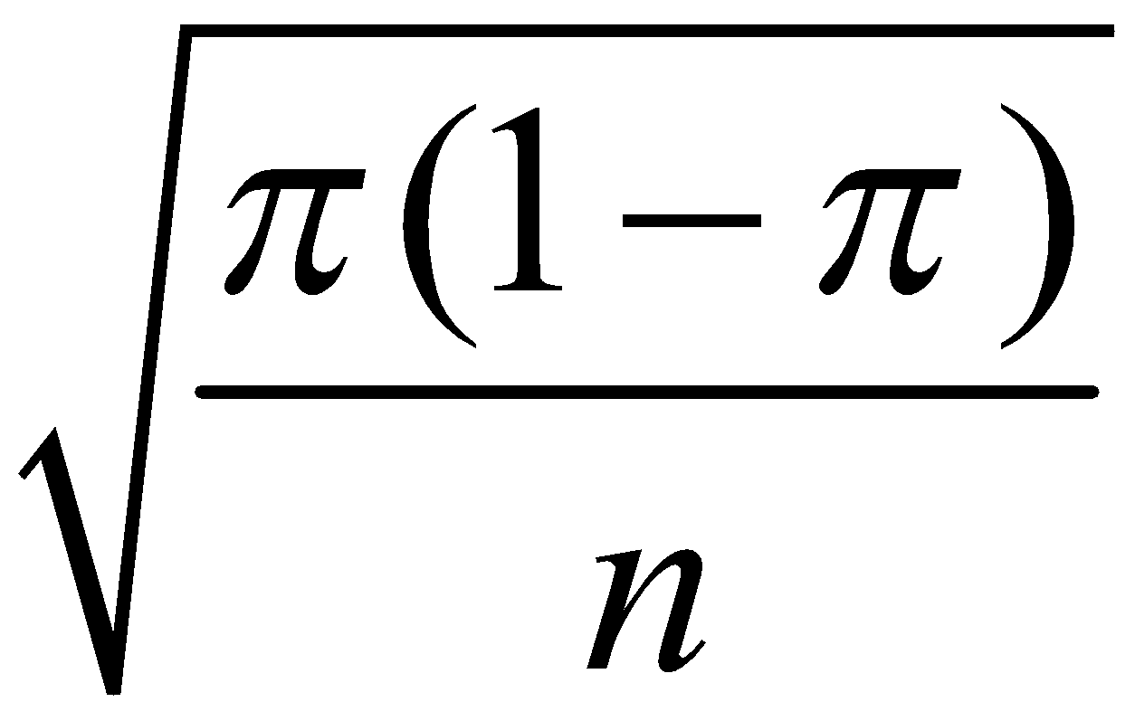
Example 3.2: Theory-Based Methods (1 of 2)
The 2SD method only gives us an approximate 95% confidence interval
If we want a different level of confidence, we can use the range of plausible values (hard) or theory-based methods (easy).
In Chapter 1, we saw that the SD of
was:

Slide 23

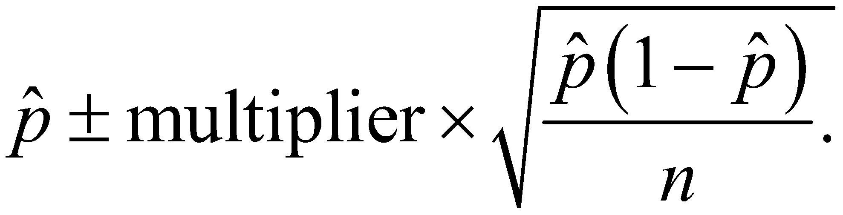
Example 3.2: Theory-Based Methods (2 of 2)
We don’t know the value of the parameter, π, so we substitute
in its place.
We also might want to adjust the confidence level, so we will not always use 2 (or approximately 2) for our multiplier.
Therefore we can develop a formula for confidence intervals:

Slide 24
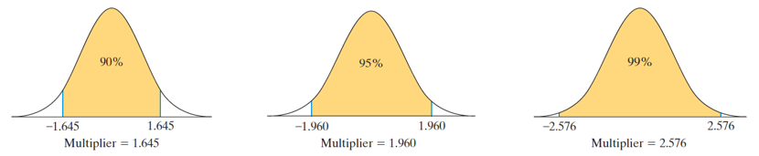
Example 3.2: How is the multiplier found?
The multiplier comes from the standard normal distribution (with mean 0 and standard deviation 1).
Below shows corresponding multipliers for different confidence levels.

Slide 25
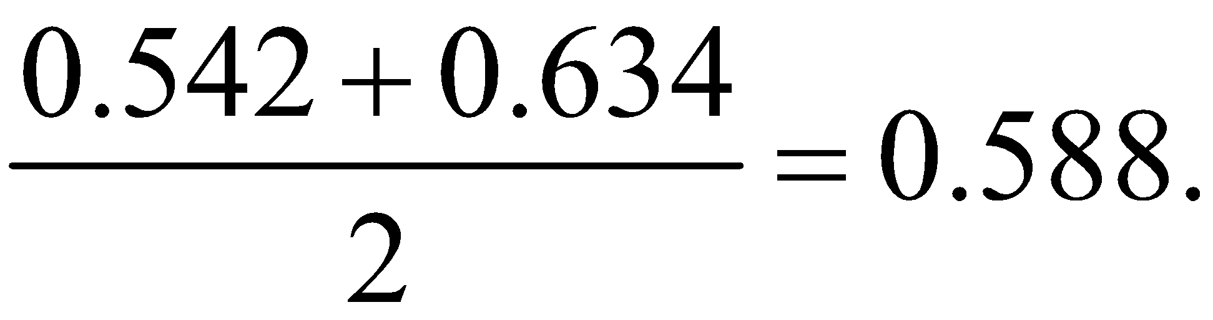
Example 3.2: Two ways to write a Confidence Interval
Suppose you are told a 95% confidence interval for some population proportion is 0.542 to 0.634. How do you rewrite it in terms of center ± margin of error?
The center (which should be the statistic) is halfway between the endpoints:
The margin of error is distance from an endpoint to the center: 0.634 – 0.588 = 0.046.
We rewrite the interval as 0.588 ± 0.046.

Slide 26
What about quantitative variables?

Slide 27

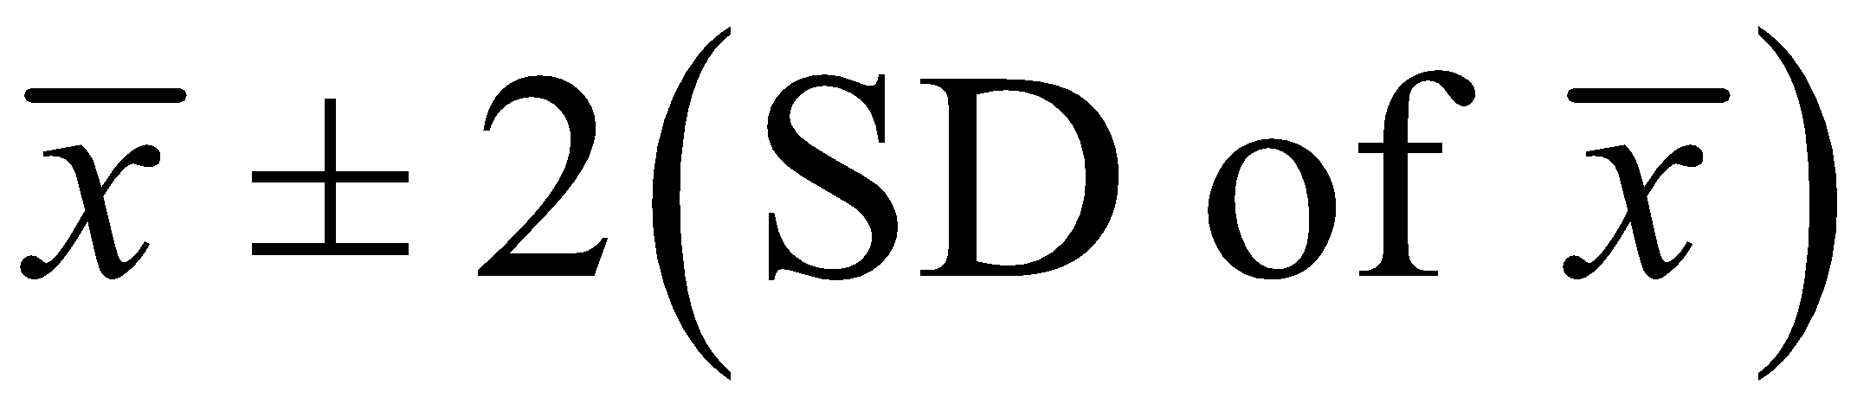
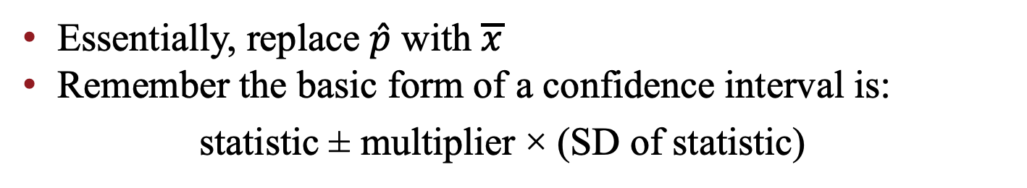
Example 3.3: Confidence Intervals (1 of 2)
Essentially, replace $\hat{p}$ with $\overline{x}$
Remember the basic form of a confidence interval is:
statistic ± multiplier × (SD of statistic)
In our case, the statistic is
so we write our 2SD confidence interval as:

Slide 28
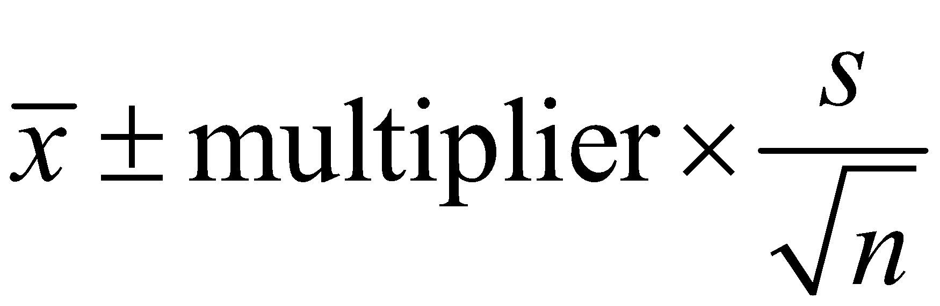

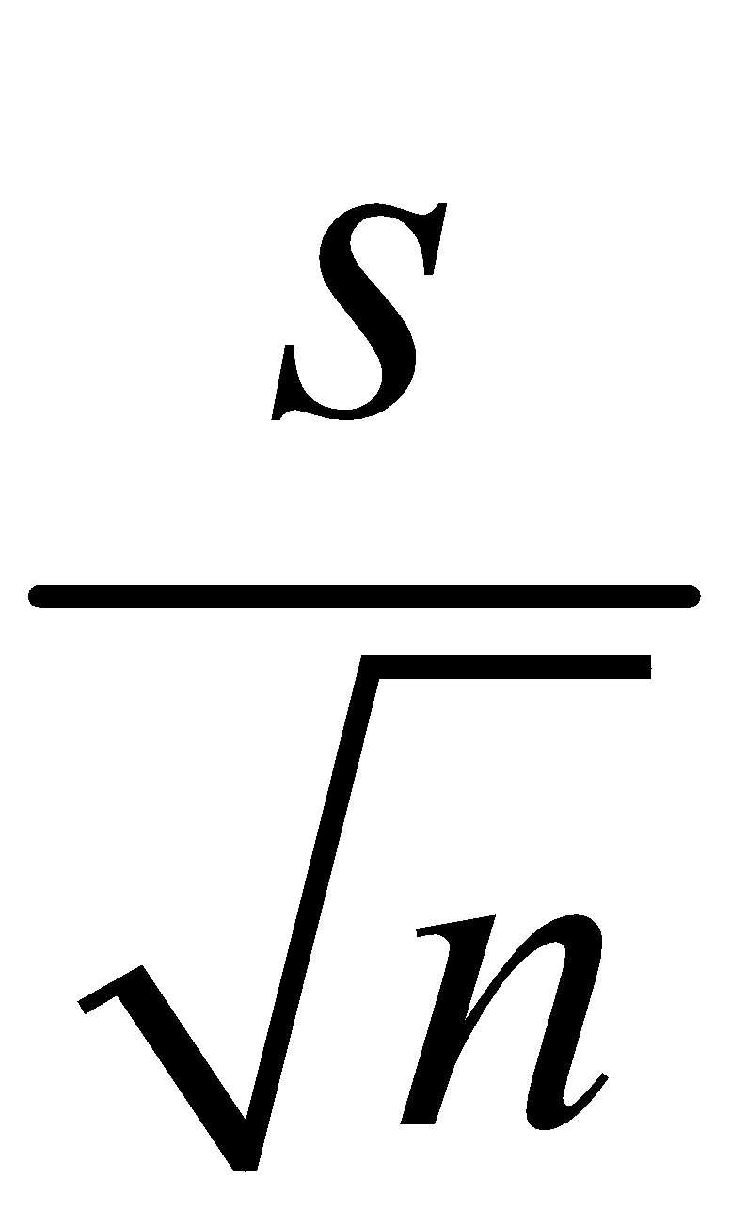
Example 3.3: Confidence Interval (1 of 3)
The confidence interval for a population mean has the form:
Where
​
is the center (our best estimate for the population mean)
is the predicted value of the standard deviation of the null
distribution (also called the standard error of the statistic)
​
Multiplier is a number that is dependent upon the confidence level

