Slide 1
Introduction to Statistical Investigations
Second Edition
Tintle, Chance, Cobb, Rossman, Roy, Swanson, VanderStoep
Chapter 5
Comparing Two Proportions
This slide deck contains animations. Please disable animations if they cause issues with your device.
Copyright ©2021 John Wiley & Sons, Inc.

Slide 2
So begins Unit 2
Previously, we examined single proportions/single means.
Now, we'll look at 2 proportions.

Slide 3
Single Proportion Example
In 2008, researchers observed car occupants (drivers and passengers), recorded whether they were wearing seatbelts.
National Occupant Protection Use Survey (NOPUS) collects data nationwide by sending trained observers to randomly sampled roadways.
They observe passenger vehicles between the hours of 7 a.m. and 6 p.m. while standing at the roadside or riding in a vehicle in traffic.
Observers use hand-held clickers to count use of shoulder belts by drivers and right-front passengers.
 | 2008
Wearing seat belt | 140,270
Not wearing seat belt | 28,730
Total | 169,000

Slide 4
Two Proportion Example
Repeat the study in 2018. We get the following table:
 | 2008 | 2018 | Total
Wearing seat belt | 140,270 | 115,525 | 255,795
Not wearing seat belt | 28,730 | 13,409 | 42,139
Total | 169,000 | 128,934 | 297,934

Slide 5
What to do with this information?
Conditional proportions
Two options:
Column proportion: 140,270 / 169,000 = 0.83 and 115,525 / 128,934 = 0.896
Row proportion: 140,270 / 255,795 = 0.548 and 115,525 / 255,795 = 0.451
 | 2008 | 2018 | Total
Wearing seat belt | 140,270 | 115,525 | 255,795
Not wearing seat belt | 28,730 | 13,409 | 42,139
Total | 169,000 | 128,934 | 297,934

Slide 6
What can't you do with this information?
Column proportion: 140,270 / 169,000 = 0.83 and 115,525 / 128,934 = 0.896
Row proportion: 140,270 / 255,795 = 0.548 and 115,525 / 255,795 = 0.451
Can't compare 0.83 and 0.896: Sample size is different.
Also can't compare 0.548 and 0.451 for the same reason.

Slide 7
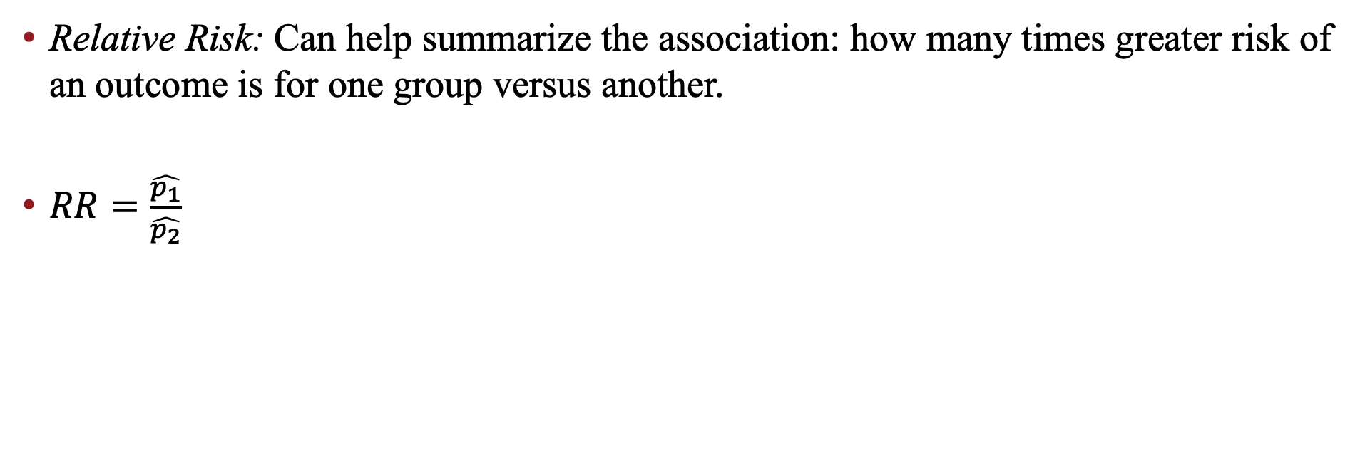
Moving Forward
Relative Risk: Can help summarize the association: how many times greater risk of an outcome is for one group versus another.
$RR=\frac{\hat{p_{1}}}{\hat{p_{2}}}$

Slide 8
Exploration: Murderous Nurse

