Slide 1
Introduction to Statistical Investigations
Second Edition
Tintle, Chance, Cobb, Rossman, Roy, Swanson, VanderStoep
Chapter 1.3
Significance: How Strong is the Evidence?
This slide deck contains animations. Please disable animations if they cause issues with your device.
Copyright ©2021 John Wiley & Sons, Inc.

Slide 2
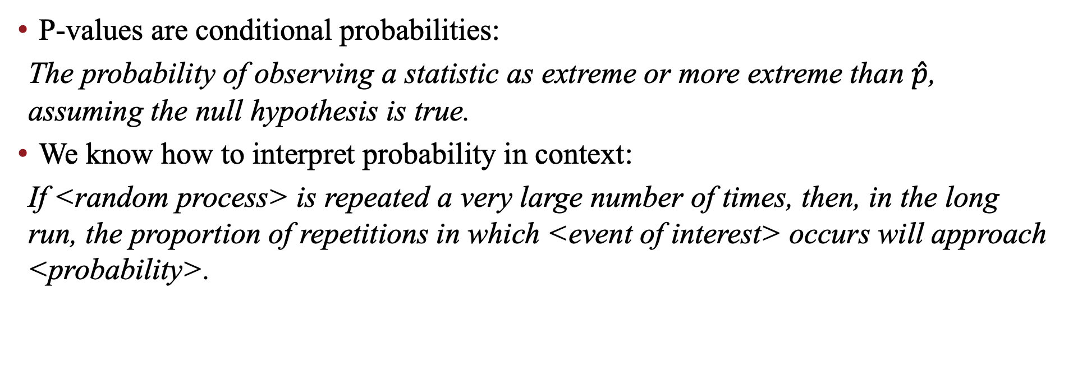
Review: Interpreting p-values
P-values are conditional probabilities:
The probability of observing a statistic as extreme or more extreme than $\hat{p}$, assuming the null hypothesis is true.
We know how to interpret probability in context:
If <random process> is repeated a very large number of times, then, in the long run, the proportion of repetitions in which <event of interest> occurs will approach <probability>.

Slide 3
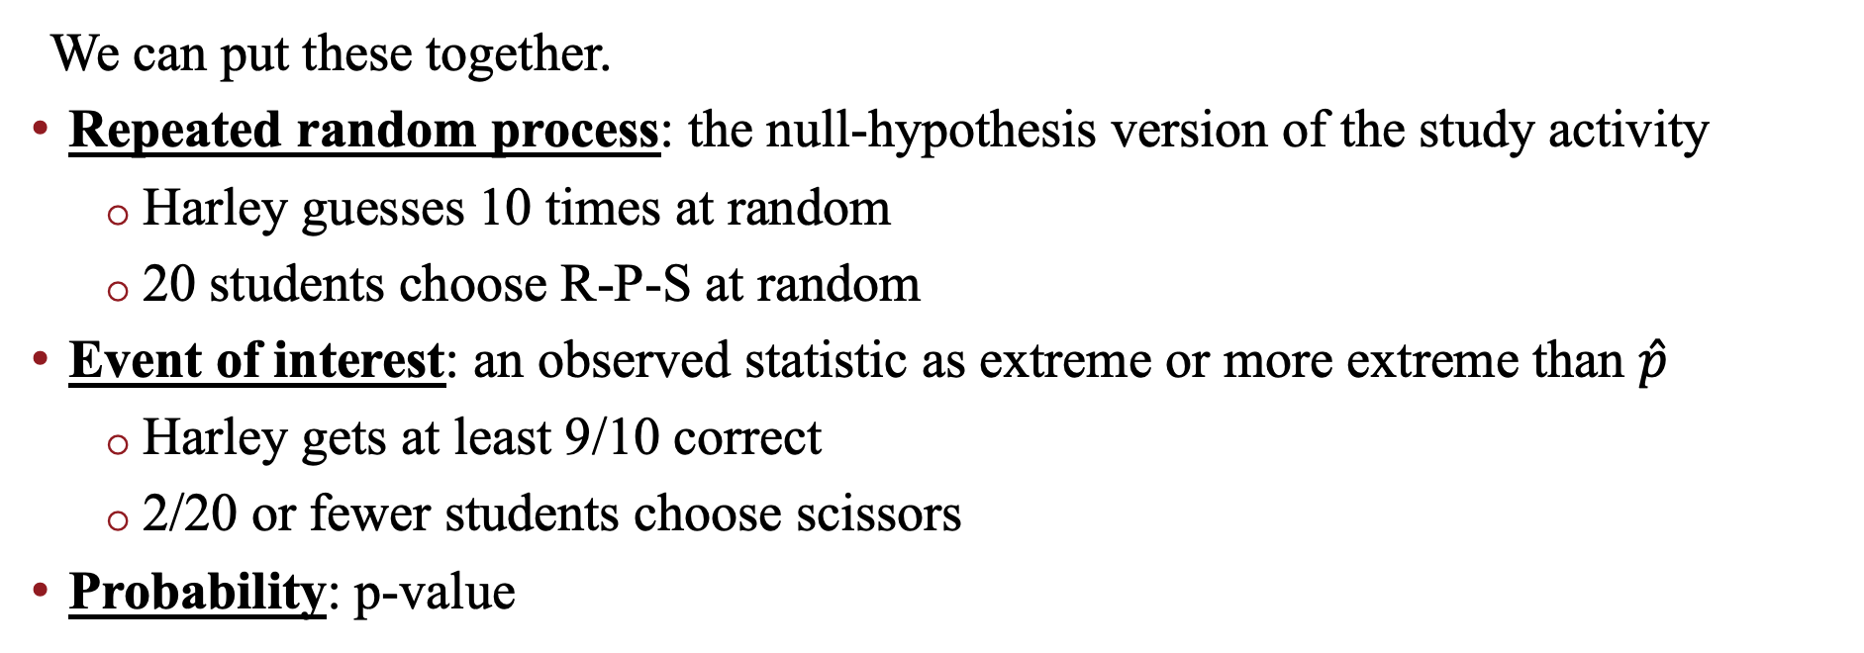
Interpreting p-values
We can put these together.
Repeated random process: the null-hypothesis version of the study activity
  Harley guesses 10 times at random
  20 students choose R-P-S at random
Event of interest: an observed statistic as extreme or more extreme than $\hat{p}$
  Harley gets at least 9/10 correct
  2/20 or fewer students choose scissors
Probability: p-value

Slide 4
Interpreting p-values
What does it mean to say “the p-value for the Harley study was 0.01”?
If Harley guesses 10 times at random, and this process is repeated a very large number of times, then, in the long run, the proportion of repetitions in which Harley gets at least 9/10 correct will approach 0.01.
Now you try for “the p-value for the R-P-S study was 0.149.”

Slide 5
Alternative Measure of Strength of Evidence
Section 1.3

Slide 6
Strength of Evidence
P-values are one measure for the strength of evidence.
Another approach is to standardize our observed statistic.
Standardizing gives a quick, informal way to evaluate strength of evidence.

Slide 7
Describing a Distribution
Some aspects to look for in a distribution:
  Shape
  Center
  Variability (how spread out is the data?)
  Unusual observations

Slide 8
Describing a Distribution
For our null distribution:
  Shape: bell-curve (“normal”)
  Center: mean (average)
  Variability: standard deviation (SD)
  Unusual observations: none

Slide 9
Standard Deviation
We can think of the standard deviation as the distance a typical value in the distribution is away from the mean of the distribution.

Slide 10
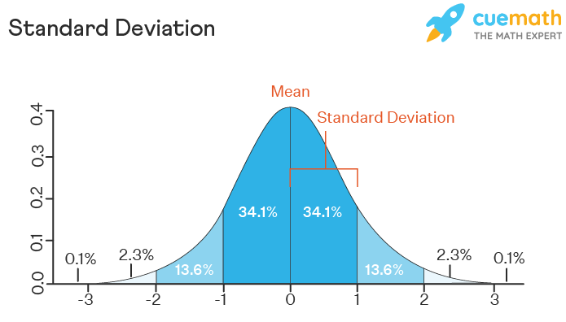
What's a summary statistic?

Slide 11
Describing a Distribution
There are two main ways to find the mean and SD of a null distribution:
  Have the applet compute them. (Click “Summary Stats” box in One Proportion applet.)
  Use an appropriate theory-based approach (Section 1.5).

Slide 12
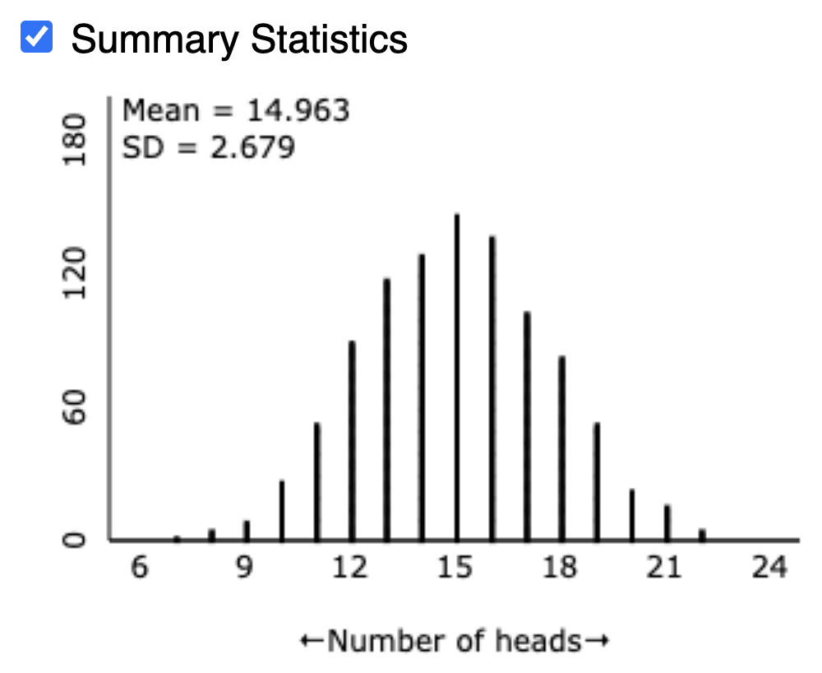
Describing a Distribution
z=

Slide 13
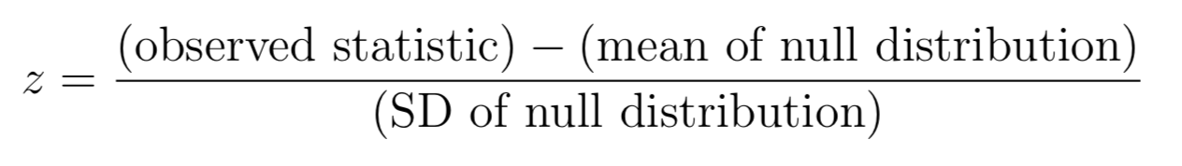
The Standardized Statistic
The standardized statistic (denoted z) is the number of standard deviations an observed statistic falls above or below the mean of a null distribution.
Measure how far the observed value is from the mean of the distribution, using standard deviation units.

Slide 14
The Standardized Statistic
Standardized Statistic | Evidence Against Null
between −1.5 and 1.5 | not much
below −1.5 or above 1.5 | moderate
below −2 or above 2 | strong
below −3 or above 3 | very strong
very
strong
weak
weak
very
strong
strong
strong
-3
-2
-1
0
1
2
3
Strength of evidence against H₀ for various values of z

