Slide 1

Oracle SQL Project Two Business Queries
By Stanley Rosenfield

Slide 2
SQL Code Business Objective:
Compare UK and US employee salaries by Department
with higher salary on top
In this query that follows, the first join operator
uses location_id column to link both departments
and locations tables together.
The second join operator uses department_id column
to link the employees and departments tables to add
additional columns; such as employee names and salary.

Slide 3
Business Objective: To compare UK and US employee salaries by dept, greater salary on top Oracle SQL Query:
select
e.first_name, e.last_name, e.salary, d.department_name, h.city, h.state_province, h.country_id
from
hr.departments d
join hr.locations h
on d.location_id=h.location_id
join hr.employees e
on d.department_id=e.department_id
where country_id='US' or country_id='UK'
order by department_name, salary desc;

Slide 4

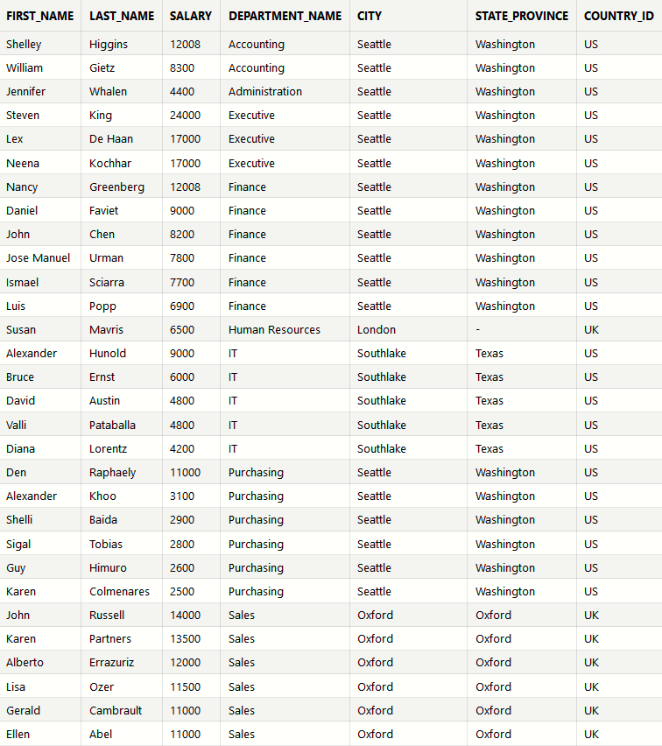
Output/Results (Excerpt):
Download CSV 103 rows selected.

