Slide 1
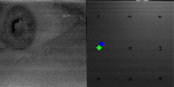
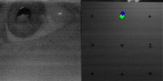
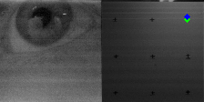
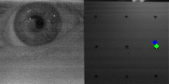
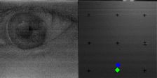
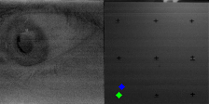
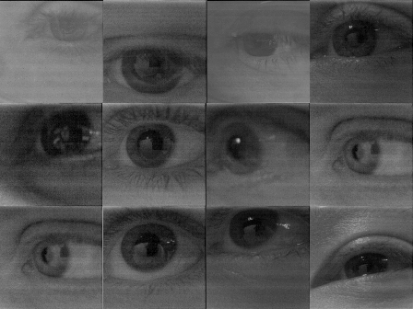
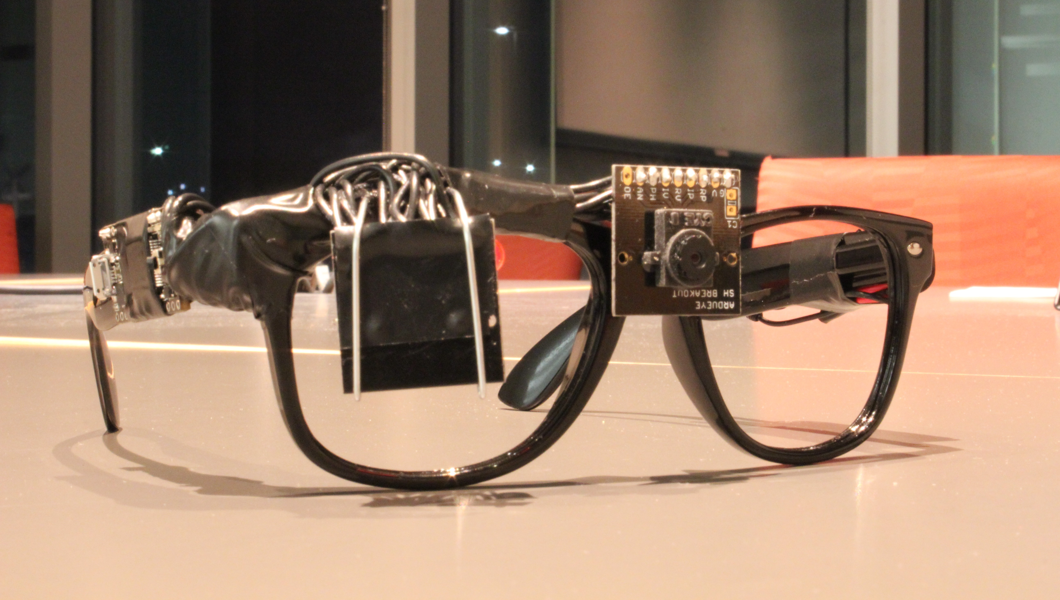
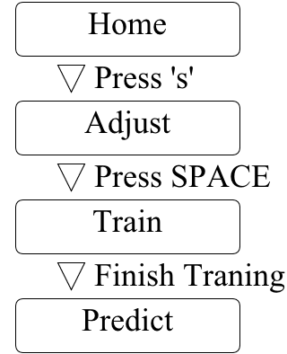
InSight: Seeing through Another's Eyes
Russ Bielawski, Joe Romeo, Justin Paupore
Design of Wireless Gaze Tracking Eyeglasses
Potential Applications:
Accessibility device for the disabled
Mental illness detection and treatment
Design Requirements
Wireless
Low-Cost
Long Battery Life
Results: Coarse Granularity Gaze Tracking
Using the Demo
Sponsor
  Results: Low-Cost, Low-Weight, Low-Power
Built with COTS parts, InSight costs is a fraction of current off-the-shelf eye tracking headgear.
Theoretical Battery Life: ~10hrs
Weight: <100g

