Slide 1
RUN THE BUSINESS SIDE
OF YOUR PRACTICE
FROM ONE PLACE
SE MANAGER
Project management for the small structural firm. Leads, clients, projects, folders, proposals and pipeline, captured once and kept in one record.
the SE MGMT team
Notes:
Every small structural firm runs two businesses: the engineering, and everything around it. Leads, clients, project numbers, folders, proposals, who owes what. Most of us run that second business out of an inbox, a spreadsheet and memory. SE Manager puts it in one place. Let me show you what that looks like. (About 15 seconds.)

Slide 2
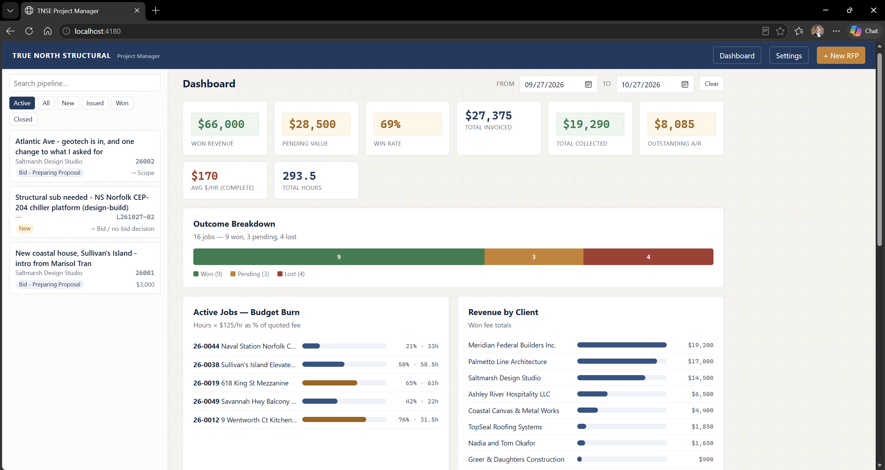

Slide 3
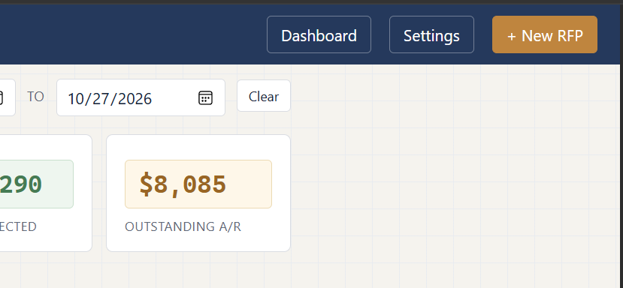

Slide 4
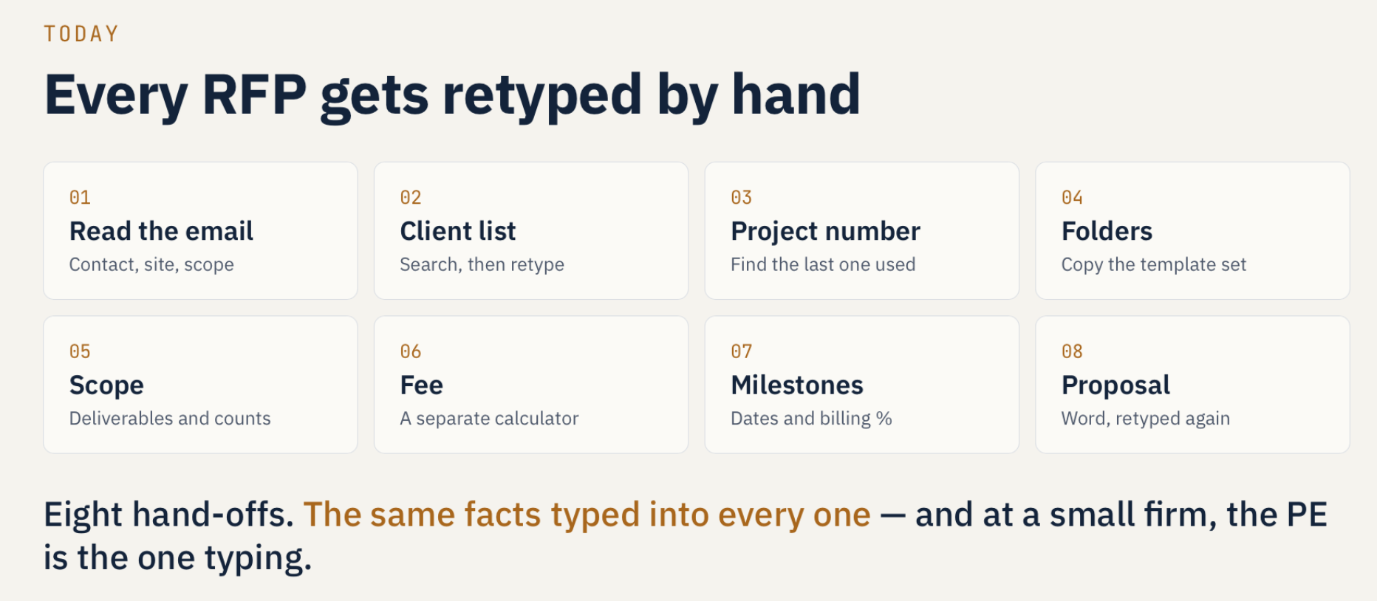

Slide 5
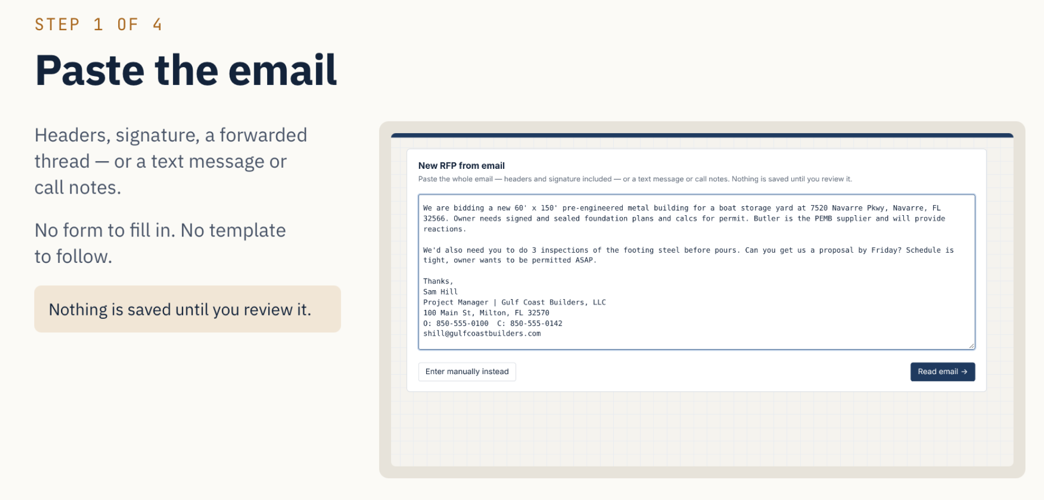

Slide 6
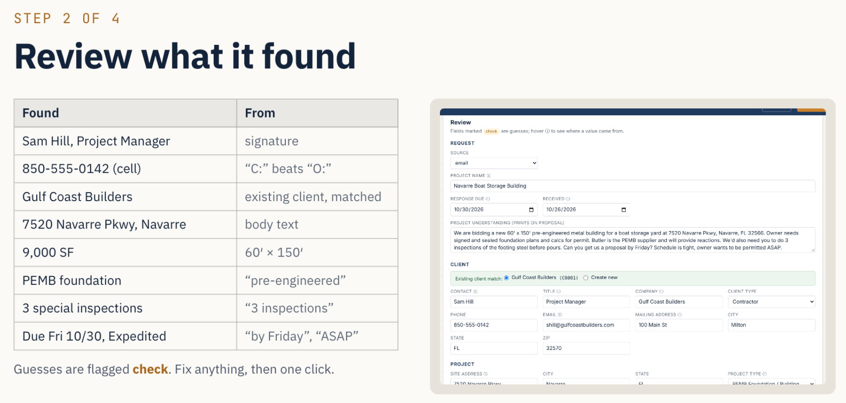

Slide 7
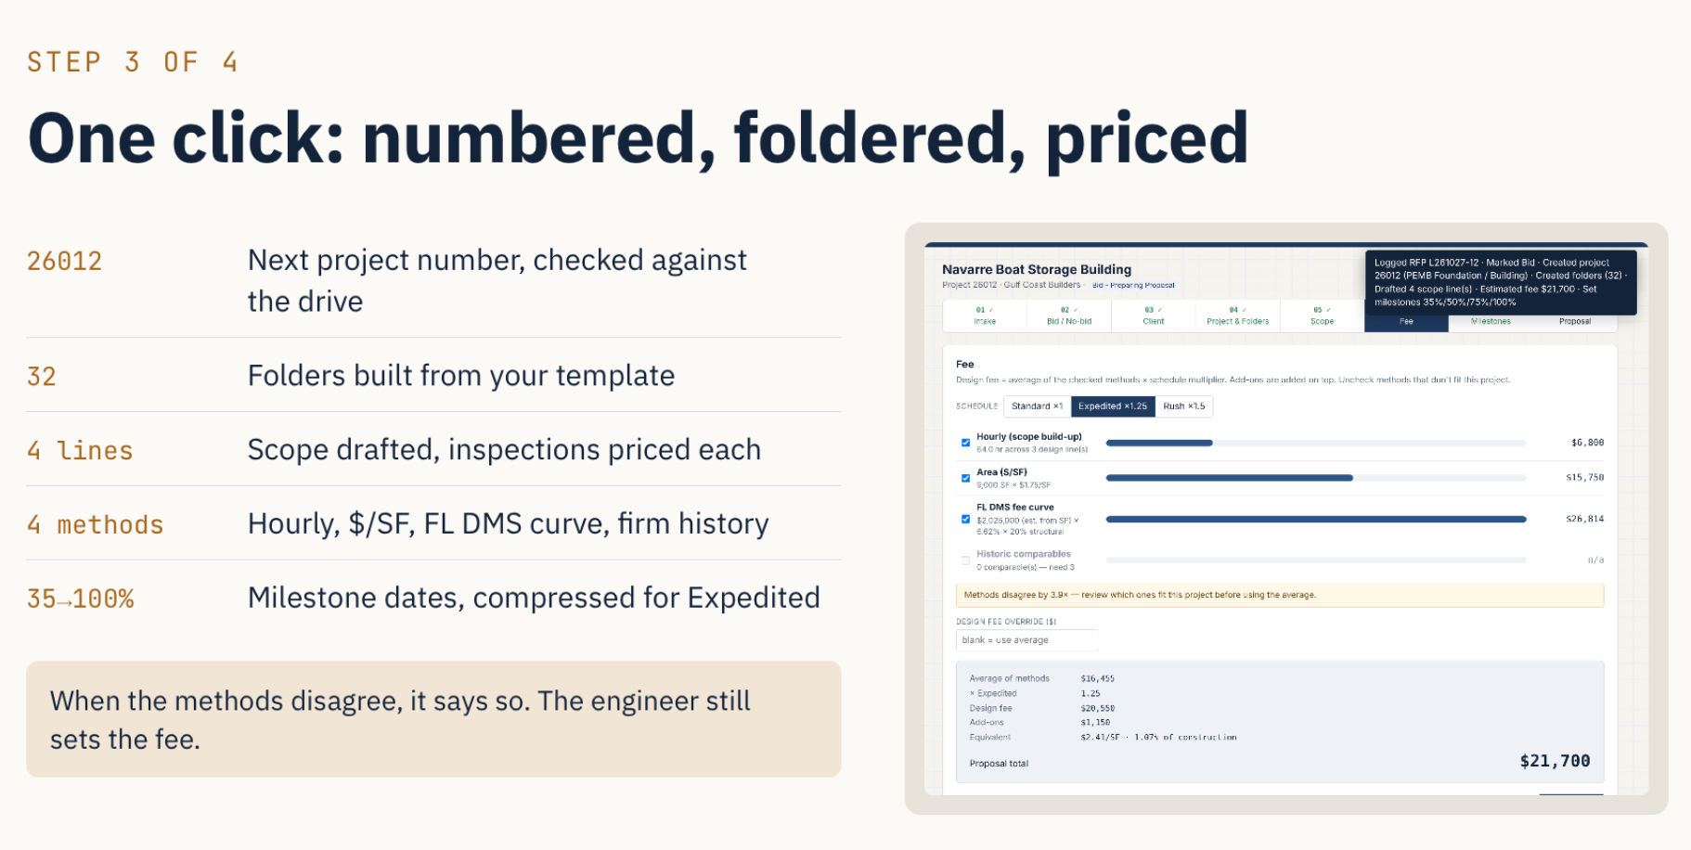

Slide 8
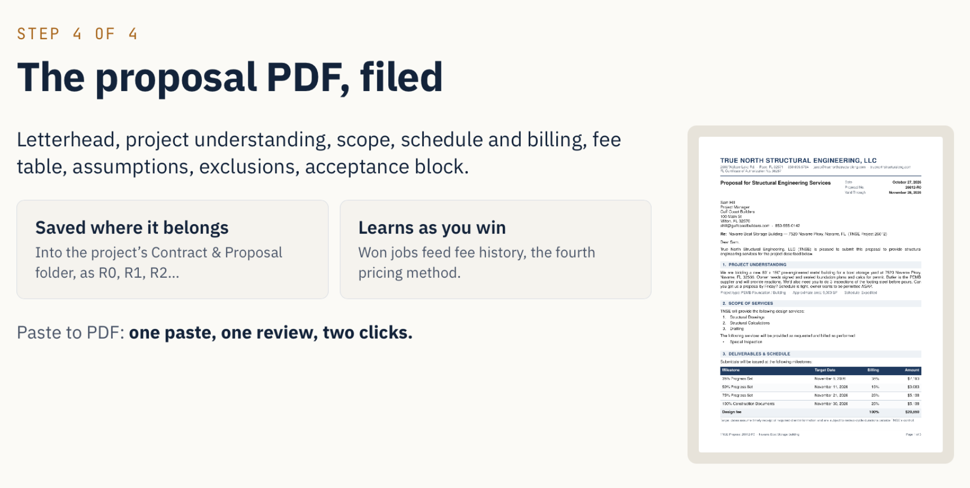

Slide 9
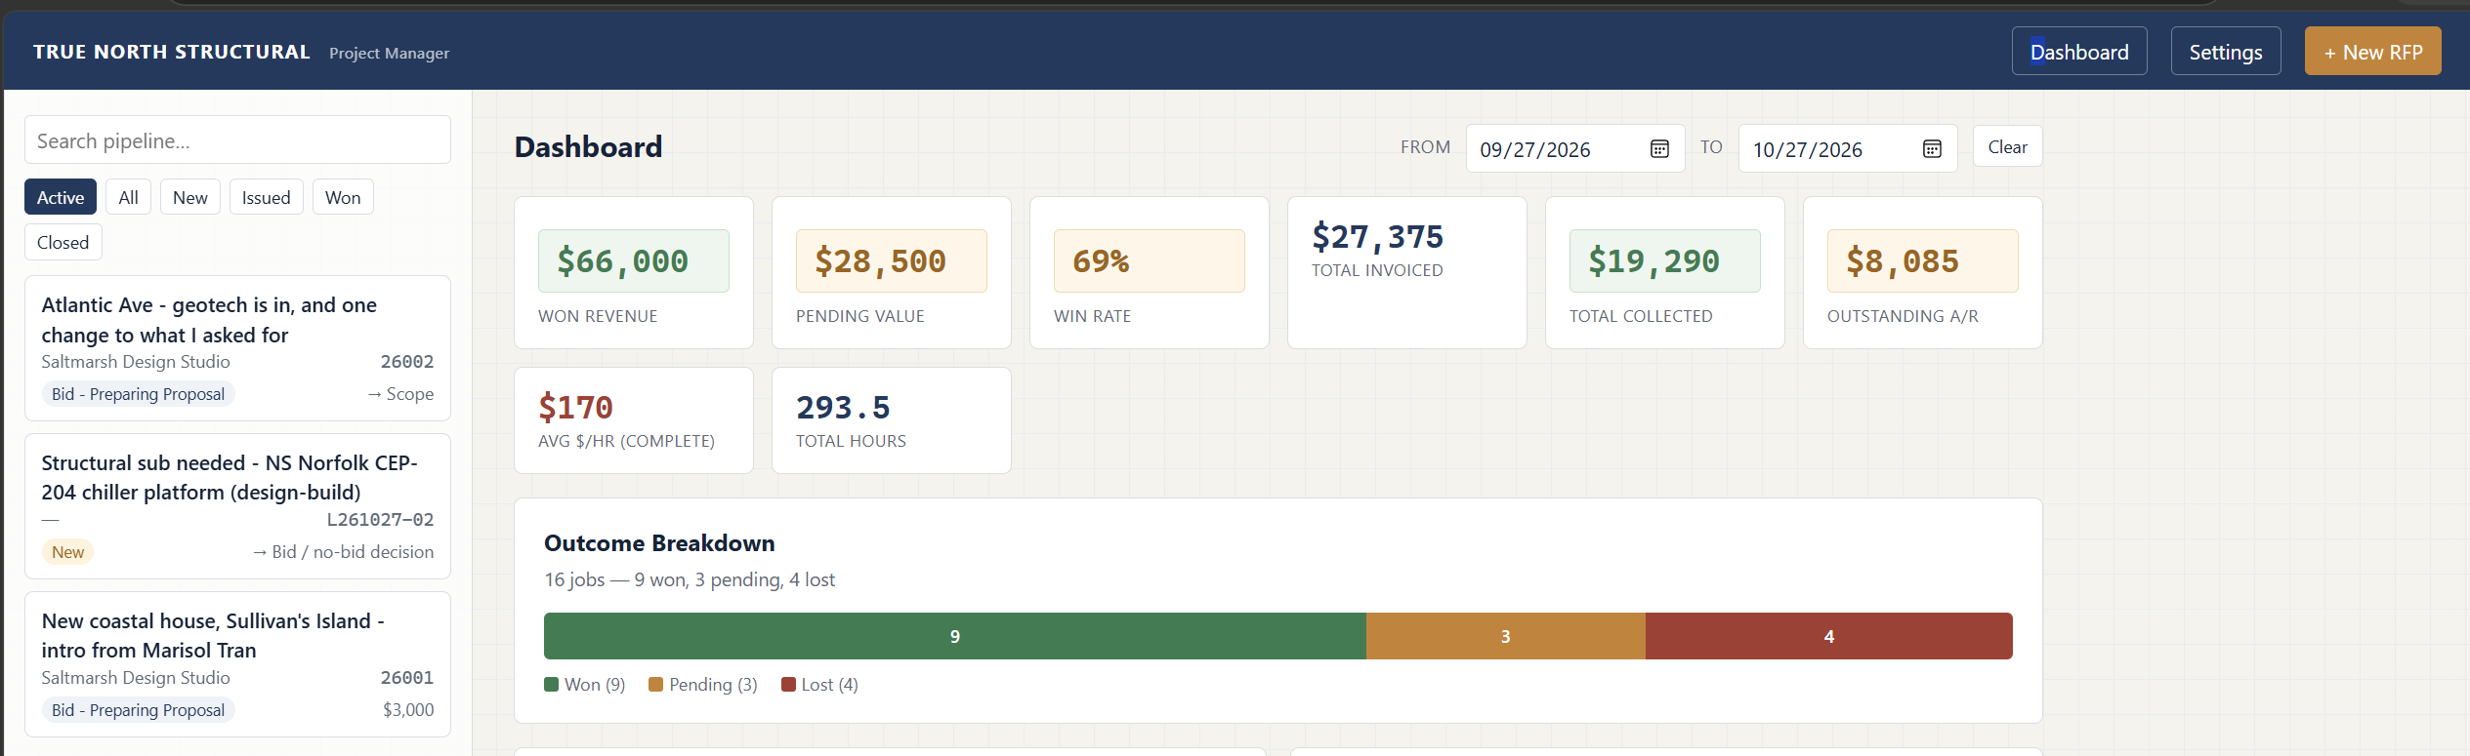

Slide 10
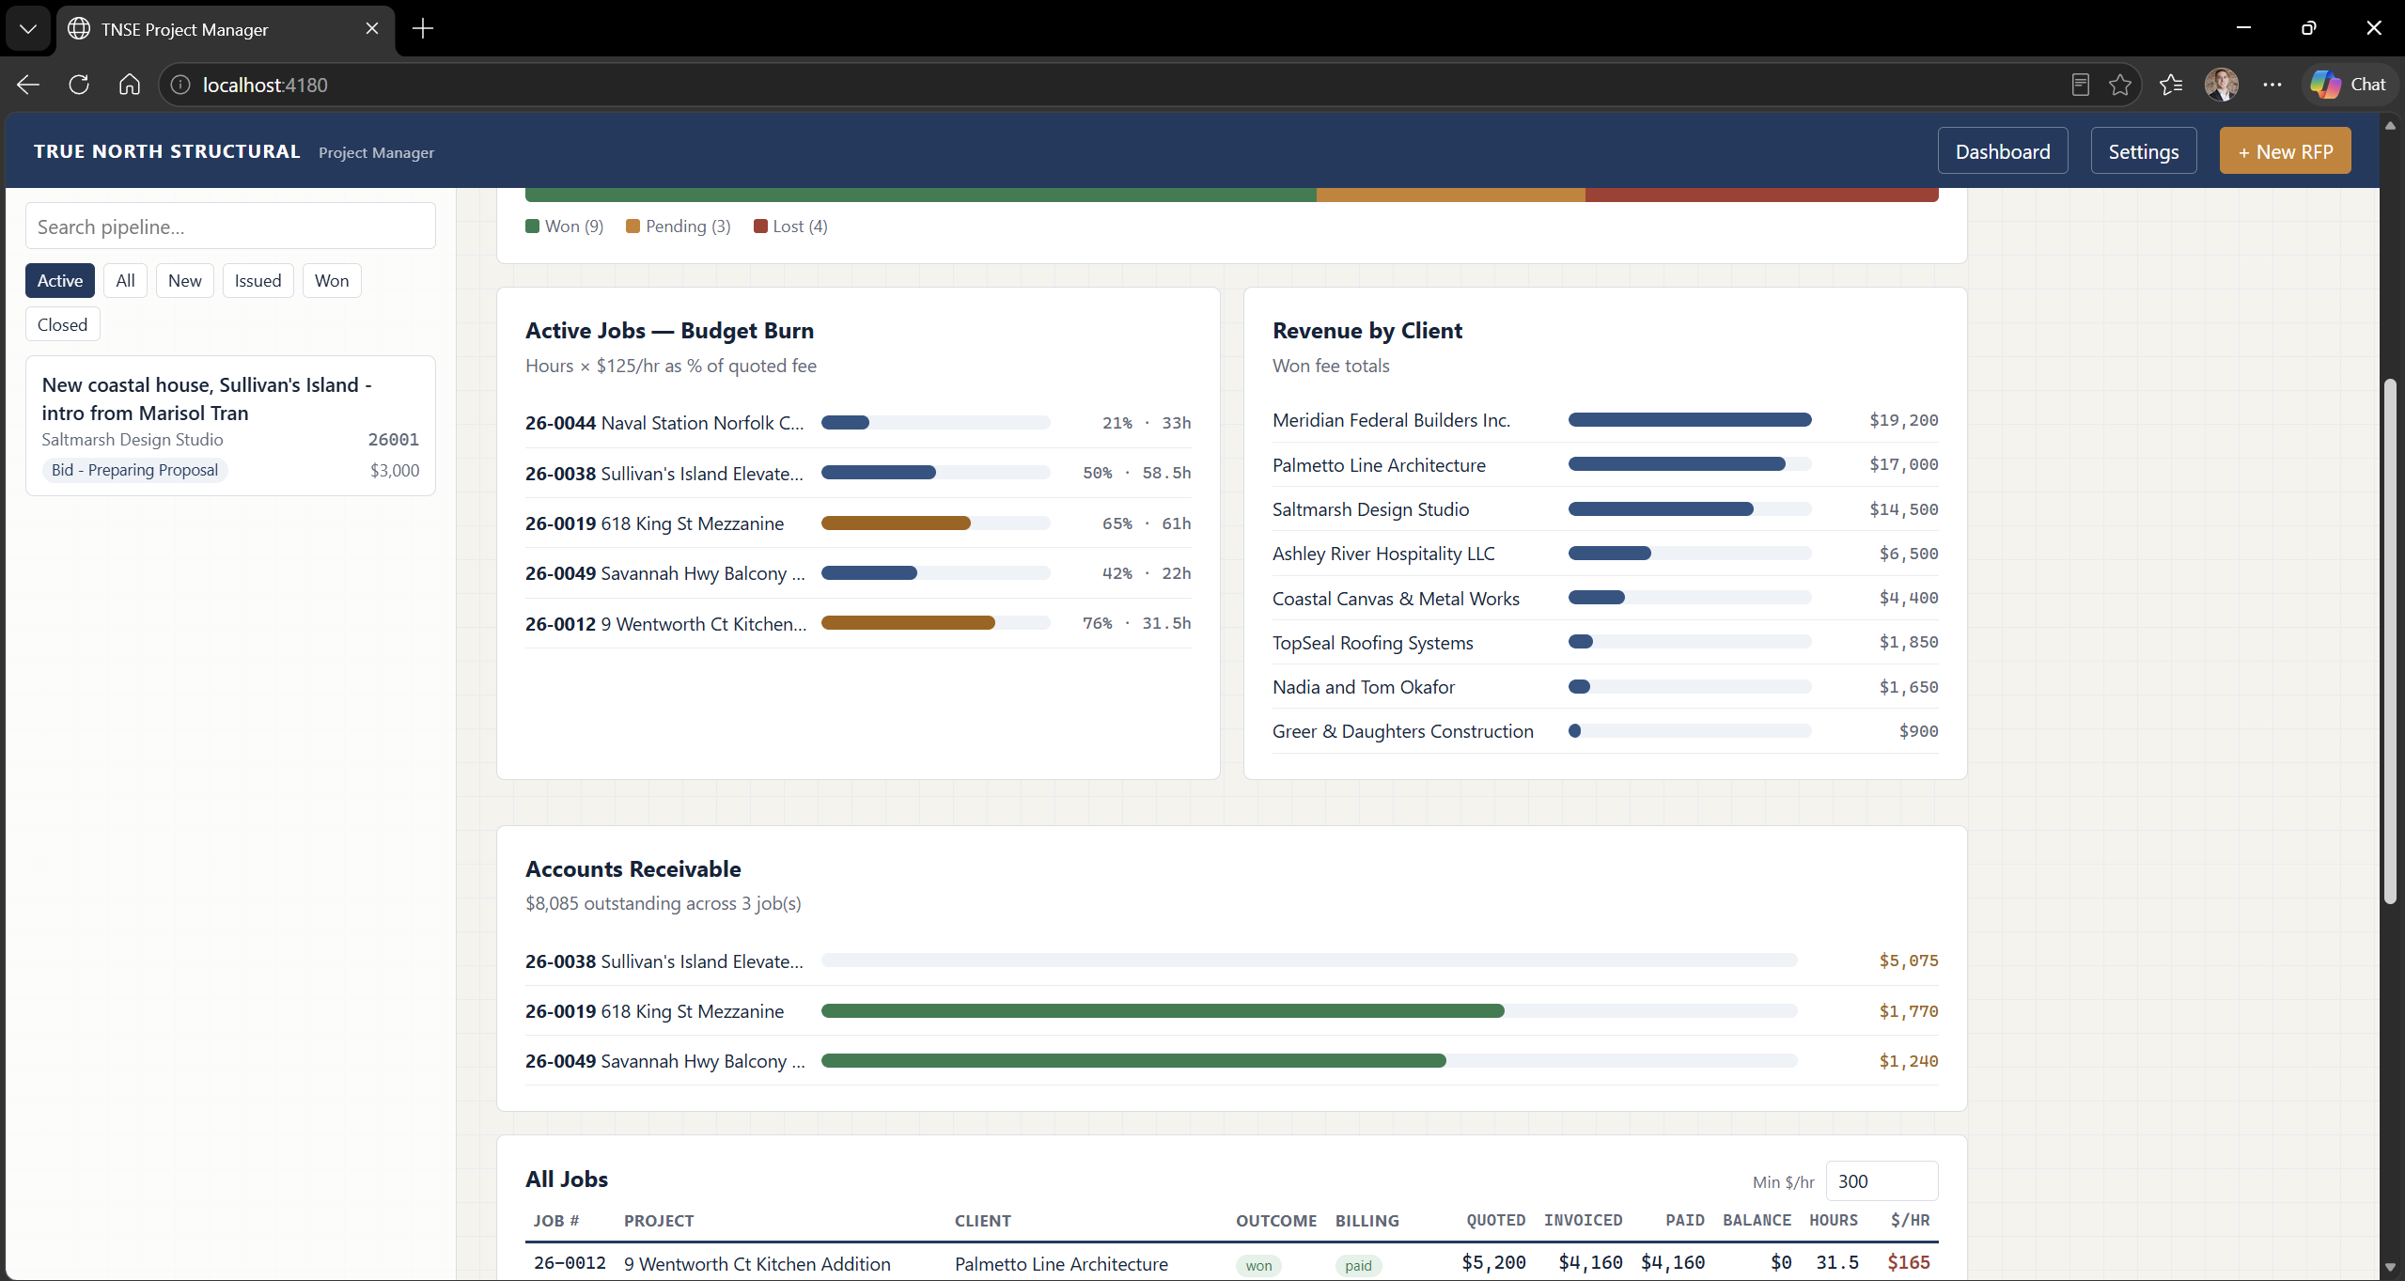
Notes:
Brett

Slide 11
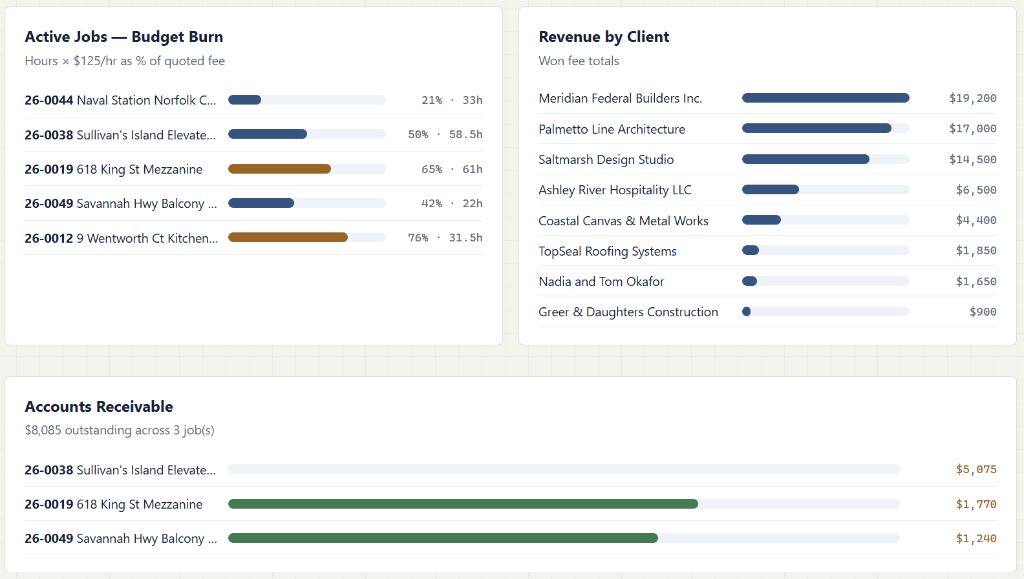
Notes:
Brett

Slide 12
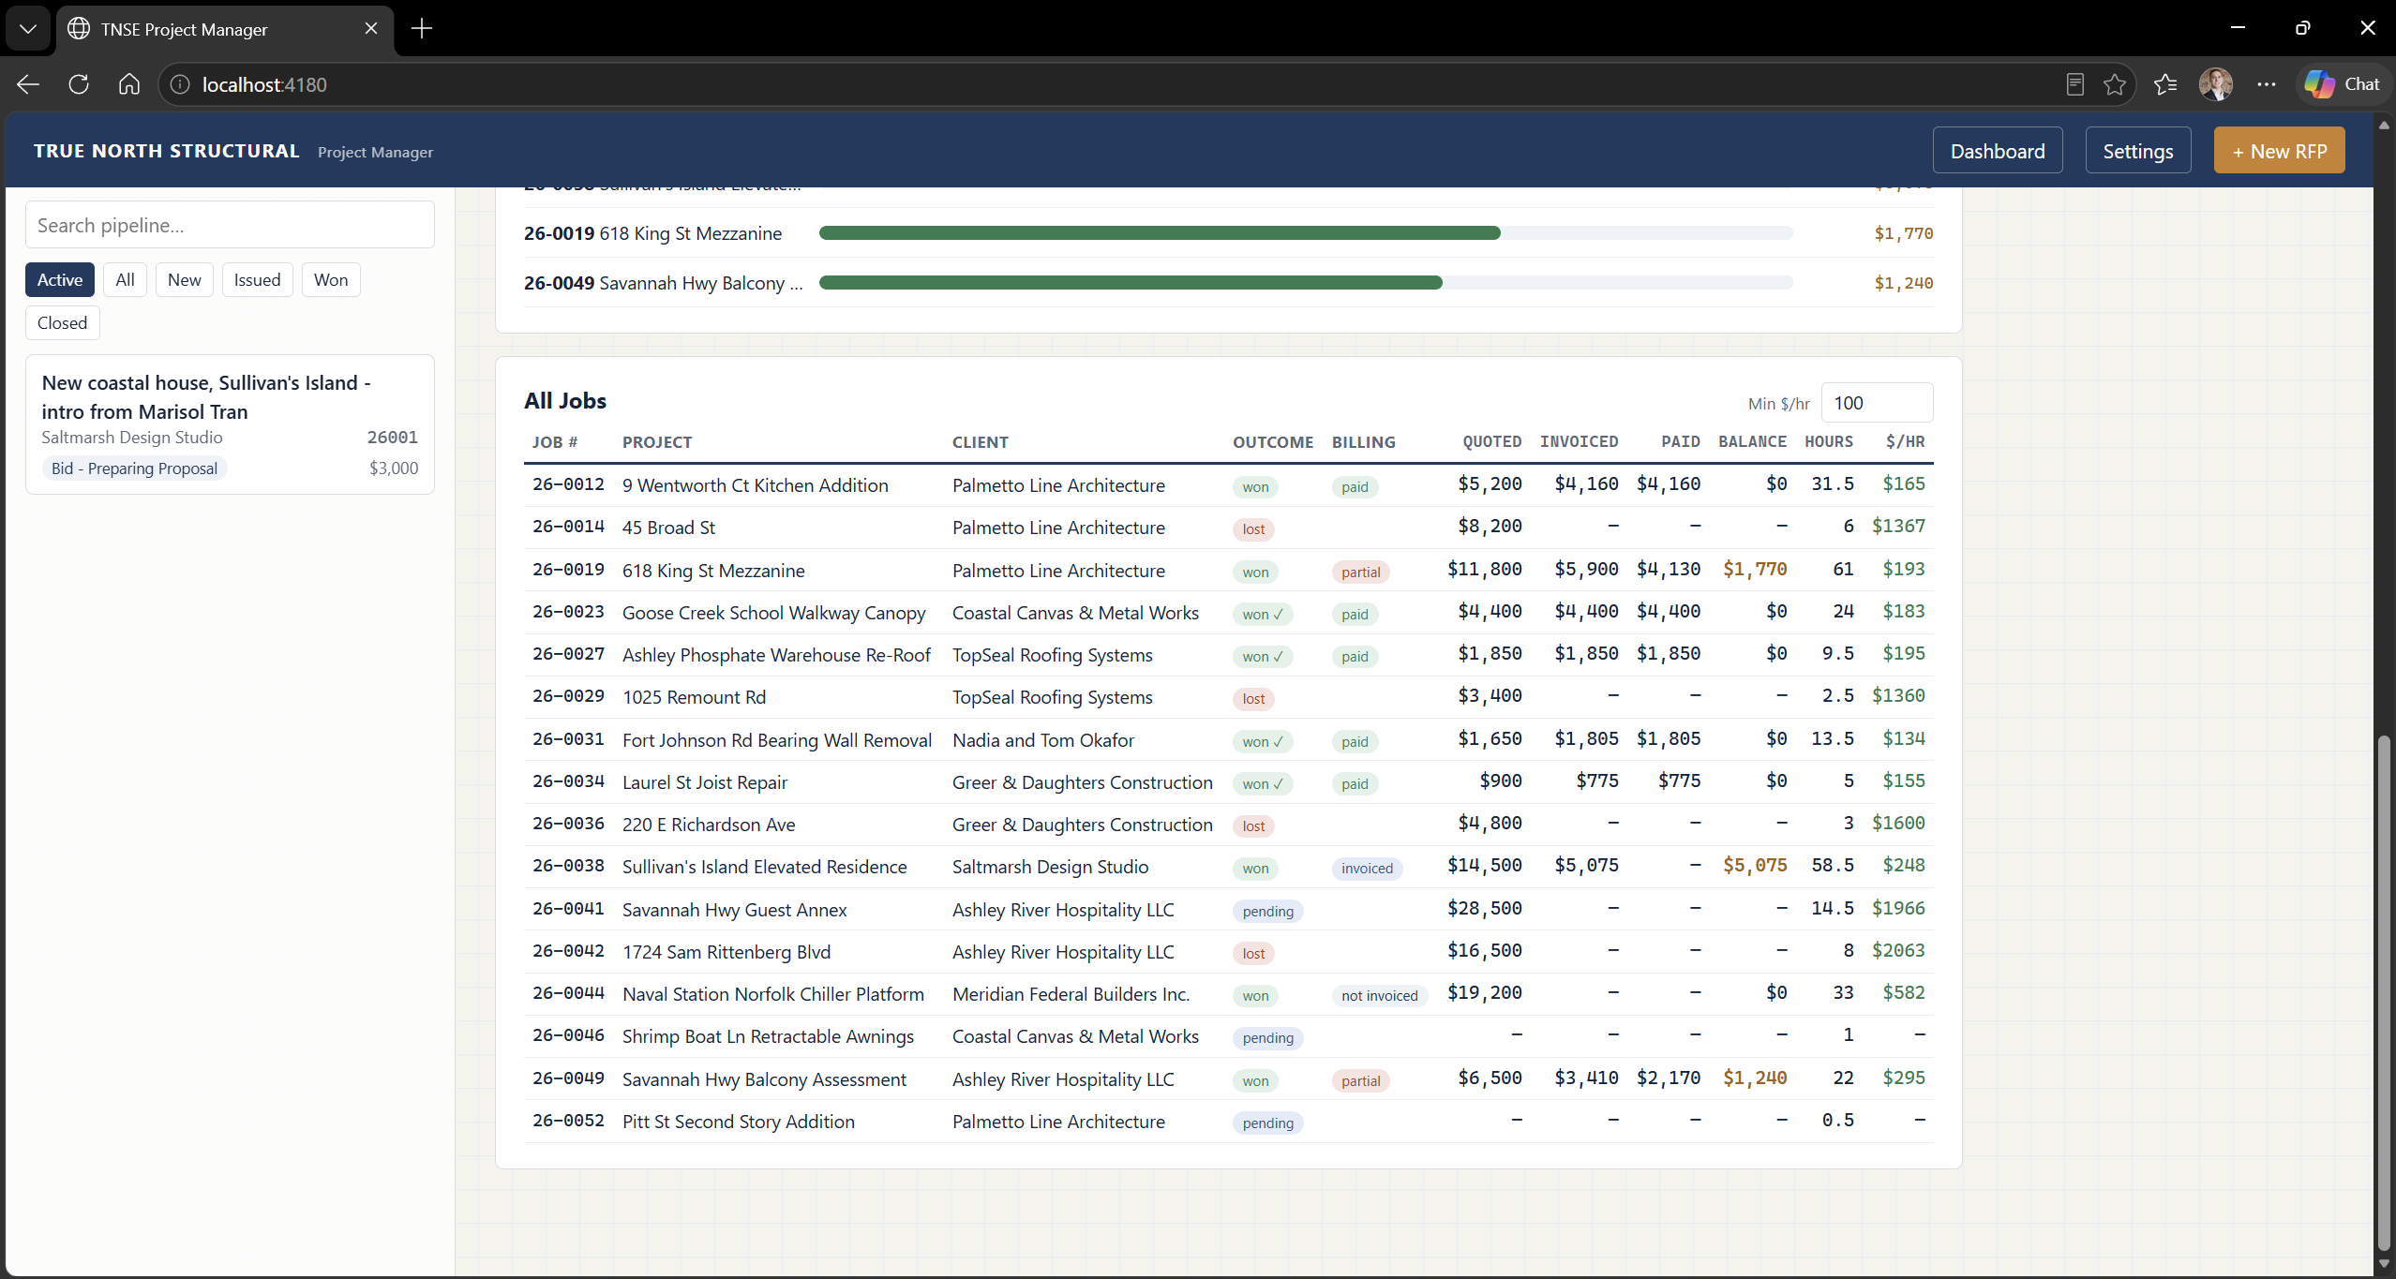
Notes:
Chong

Slide 13
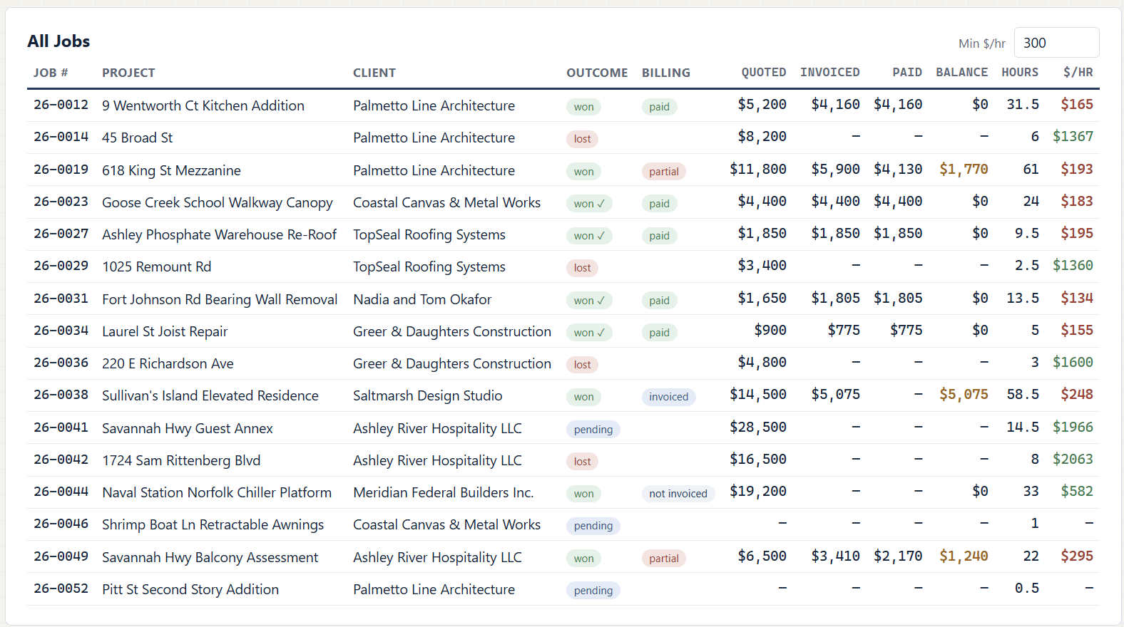
Notes:
Chong

