Slide 1

Santiago LUIS Rovere
DESIGN AND IMPLEMENTATION OF a CLIMATE DATA PROCESSING TOOL
Software engineer and data scientist

Slide 2
OBJECTIVES
DESIGN AND IMPLEMENT AN APPLICATION THAT INCLUDES THE FOLLOWING COMPONENTS:
Highly scalable Database
To store climate information coming from weather stations (conventional and automatic).
QUALITY CHECK processes
To analyze climatological data derived from weather stations and report anomalies that may be errors.
Data correction interface
To ratify or rectify anomalies reported by quality-check process.
ANALYSIS AND FORECAST TOOLS
To gain insight of the climate time-series and predict weather conditions based on current and past conditions.

Slide 3
PROOF OF CONcept
Database
Including conventional weather stations in Argentina and daily observations of maximum temperature from Jan 1st, 2000 to Dec 31st,2019.
ANOMALY DETECTION process
Based on GESD (Generalized Extreme Studentized Deviate) - https://github.com/twitter/AnomalyDetection.
Data correction interface
For correcting or confirming observed values reported as “suspicious” by anomaly detection process.
ANALYSIS TOOL
For analyzing trend, seasonality and remainder of maximum temperature time-series.

Slide 4



PROOF OF CONCEPT - ARCHITECTURE
Frontend Tier
Backend Tier
Data Tier
Web application for checking, correcting and analyzing climate date
Classes for handing communications to database
NoSQL distributed database deployed over Google Cloud
REST API

Slide 5
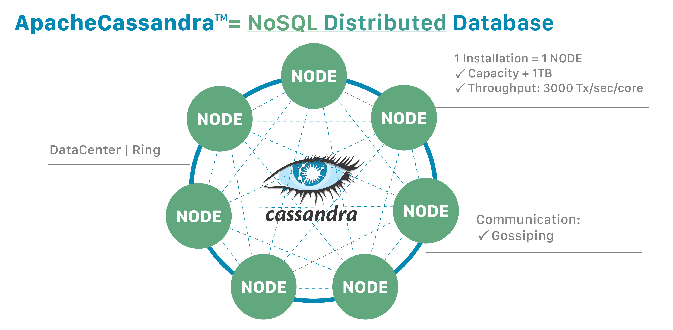
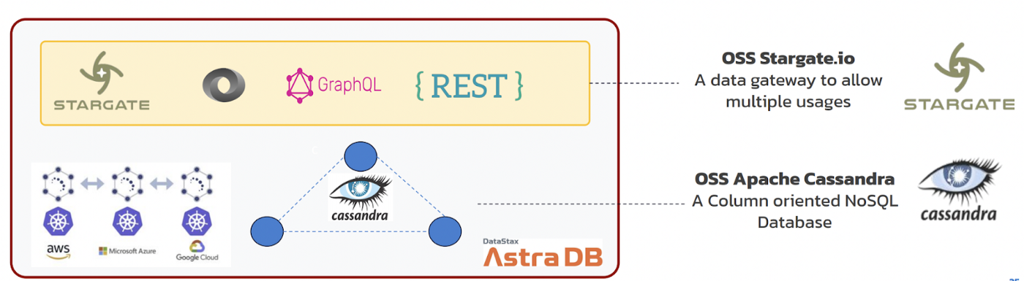
PROOF OF CONCEPT – ARCHITECTURE - ASTRA DB
What is Astra DB?
It is a flexible database-as-a-service (DBaaS) solution that simplifies cloud-native Apache Cassandra® application development, reducing deployment time from weeks to minutes. It delivers a combination of serverless, pay-as-you-go pricing with the freedom and agility of multi-cloud and open-source software.
WHAT IS CASSANDRA?
Apache Cassandra is an open-source NoSQL distributed database known for its high scalability and availability. Cassandra databases easily scale when an application is under high stress, and the distribution also prevents data loss from any given datacenter’s hardware failure.

Slide 6
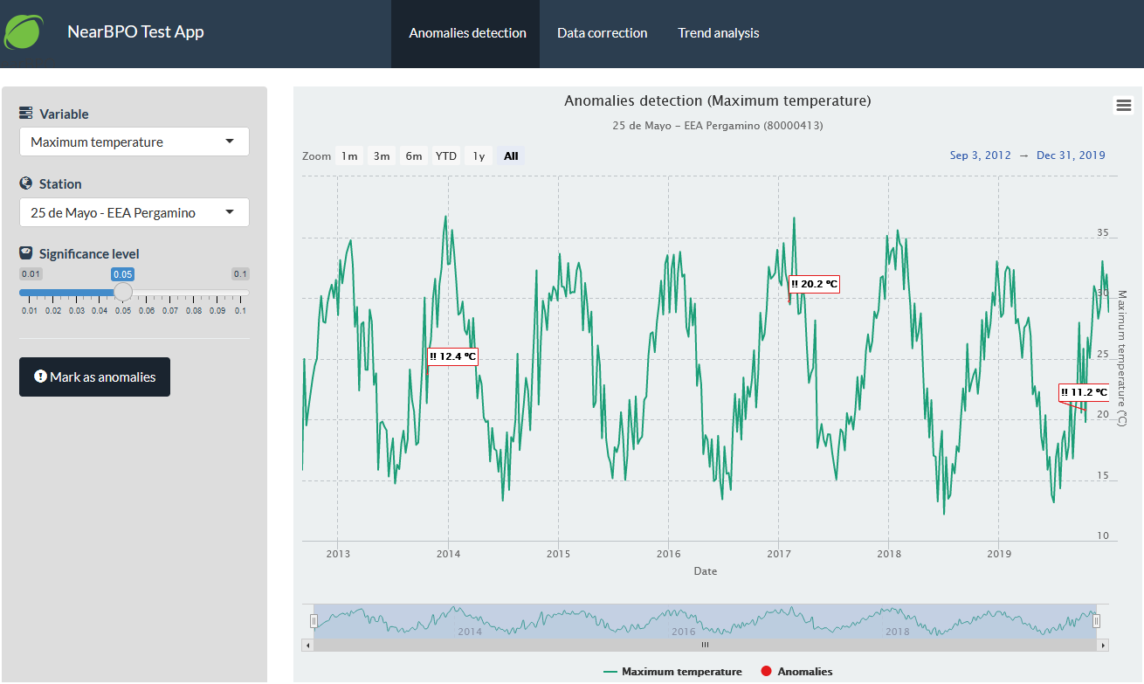
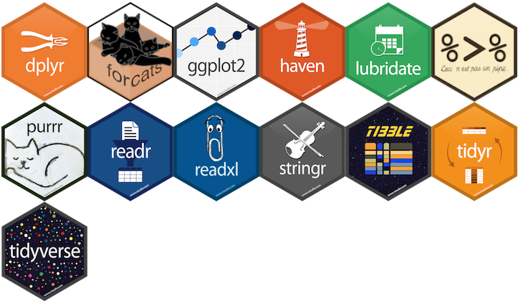
PROOF OF CONCEPT – ARCHITECTURE – r/SHINY
What is R?
It is an open-source programming language and software environment for statistical analysis, graphics representation and reporting. R is one of the most popular languages used to retrieve, clean, analyze, visualize and present data.
WHAT IS SHINY?
Shiny is an R package that makes it easy to build interactive web apps straight from R. Shiny is an easy-to-use framework that allows fast prototyping and a clean structure for building scalable data analytics applications using all the power of R.

