Slide 1

Housing Price Predication and Analysis
Submitted By – Shalini Roy
Internship 32

Slide 2

Housing Price Prediction
Here are some professional predictions for the housing market. Today, data science plays an important role in finding solutions to problems that help businesses increase overall revenue and profits. Making a realistic machine learning model for real estate would thus be extremely beneficial in predicting the selling price of the property as well as the future price development scenario.

Slide 3
Problem Statement
A US-based housing company named Surprise Housing has decided to enter the Australian market. The company uses data analytics to purchase houses at a price below their actual values and flip them at a higher price. For the same purpose, the company has collected a data set from the sale of houses in Australia.
We are required to build a model using Machine Learning in order to predict the actual value of the prospective properties and decide whether to invest in them or not. For this company wants to know:
Which variables are important to predict the price of variable?
How do these variables describe the price of the house?

Slide 4
Mathematical Models to Solve the Issue
The project's goal is to forecast home prices using a regression-based algorithm. This research employs a variety of algorithms. The algorithms work on the basis of their own mathematical equation.
This project employs two distinct data sets for training and testing. The training and testing data are first subjected to several data pre-processing stages, including data cleaning, data visualisation, and feature-label relationship analysis. Then, extraneous features are removed. The final model is chosen when developing a model based on the accuracy score, RMSE value, hyperparameter tuning, and cross validation score of several algorithms. then select the most important feature from among all features

Slide 5
Background Concepts of the Domain Problem
Machine learning approaches such as predictive modelling, market mix modelling, and recommendation systems are used by housing organizations to achieve their commercial goals. The source of our problem is one of these housing companies. It is necessary to model the cost of housing using the relevant independent variables. The model will then be used by management to determine how prices fluctuate depending on the variables. As a result, they can influence the company's strategy and focus on areas with high returns. Furthermore, using the model will assist management in better understanding how prices change in a new market.

Slide 6
Sources of data and their formats
Training data is used to train the model. It has 1168 rows and 81 columns. The model will be trained using this dataset. It has a single target variable and 80 distinct characteristics (SalePrice).
In contrast, test data has 292 rows and 80 columns. After selecting the appropriate model, the model predicts the target variable for the test data.
The data format is determined using the info() method. There are 43 category columns among the 81 columns.

Slide 7
Exploratory Data Analysis
Feature analysis observation exploration.

Slide 8
Project Flow Tasks Perform
Feature Engineering for extraction of few new features out of existing features
Check the presence of duplicate or any data error.
Missing values present in data set.
Imputation of missing value with mean, median or mode is performed.
Feature selection
Finding Final model with respect to best R2 Score, RMSE
Label Encoding of Categorical features
Splitting of dataset into input & target feature
Standard Scaling of data

Slide 9
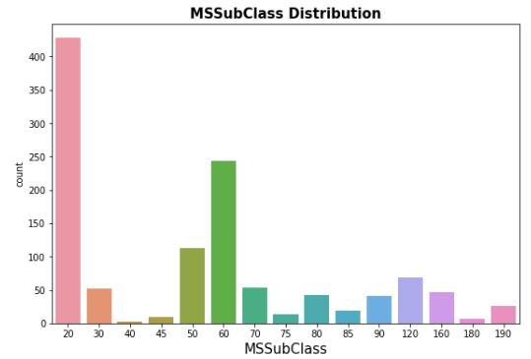
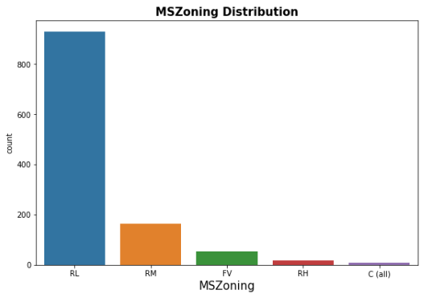
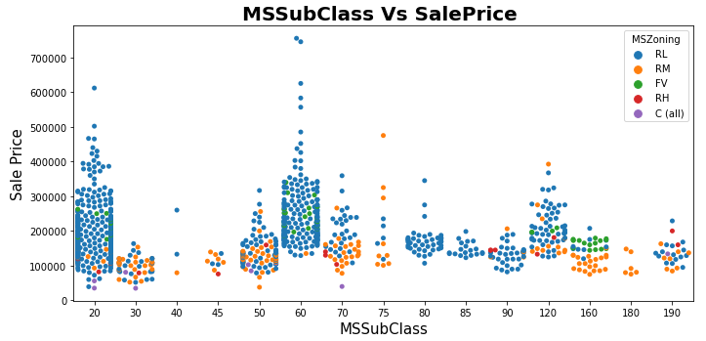

Slide 10
Observations:
For MSSubClass class 20 and 60, SalePrice is high and maximum MSZoning is Residential Low Density
79.5% of house are in Residential Low Density followed by 14 % of house are in Residential Medium Density area.
Floating Village Residential is only 4.5%
Very few house (0.8%) are in Commercial zone.

Slide 11
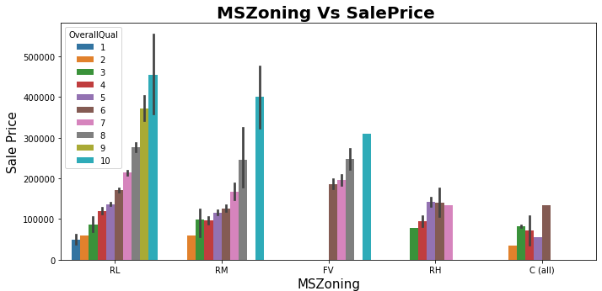
Observations:
1. Max property have overall condition rating of either 6 to 7.
2. Average selling price for RL zone property is 200000-500000.
3. In Commercial zone the property price is minimum.
4. Sale Price inside RL Zone is much higher than other zone.
5. It is clear that if OverallQual increased, SalePrice also increased.

Slide 12
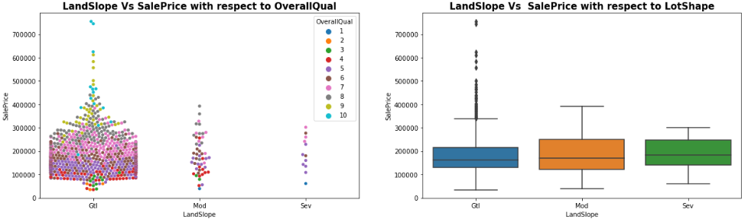
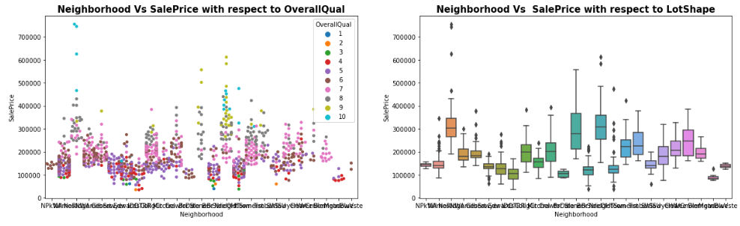

Slide 13
Observations:
72.1% of house comes with inside Lot configuration.
Cheapest property are in Inside lot configuration.
Only 2 are in Frontage on 3 sides of property.
95% LandSlope is Gentle slope.
1% properties come with severe slope and the average price is high compare to Gentle slope.
Max Neighborhood is Names with 182 values
Around 90% property is in Level land contour type. It is quite obvious also!!
Banked area is the less costly area compare to others.

Slide 14
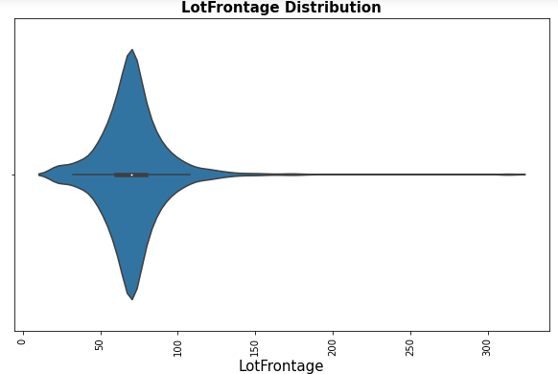
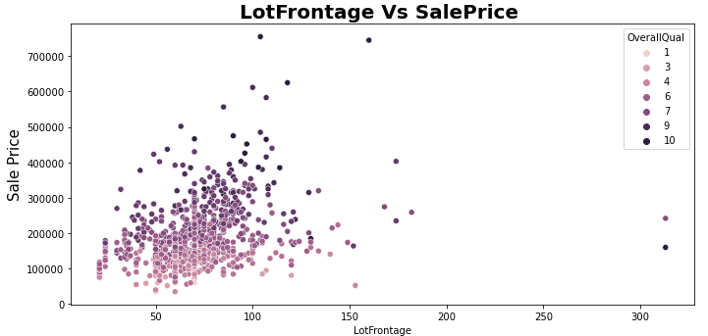
1. Average LotFrontage is around 50-80 2. A lot of outliers are present. 3. There is No Significant relationship found between SalePrice & LotFrontage.

Slide 15
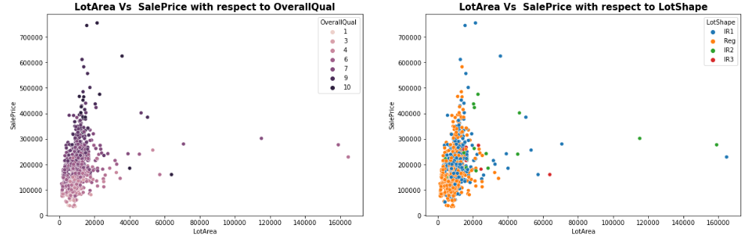
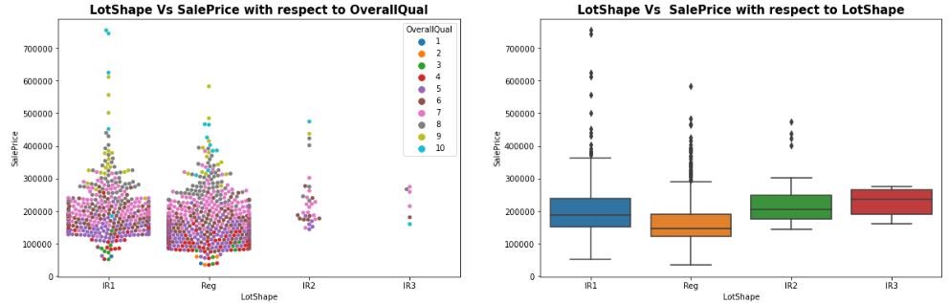
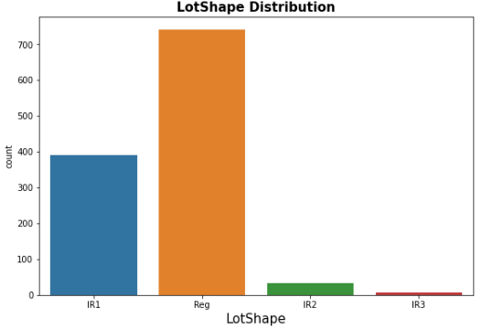

Slide 16
Observations:
Average LotArea is around 0-25000
A lot of outliers are present.
As OverallQual increased, saling price of the property also increased.
No relation is found between LotArea and SalePrice with respect to LotShape.
Min LotShape is Irregular.
63.4% LotShape is Regular followed by Slightly irregular and there is some outliers also with very high price range
There is no relationship between LotShape and selling price.

Slide 17
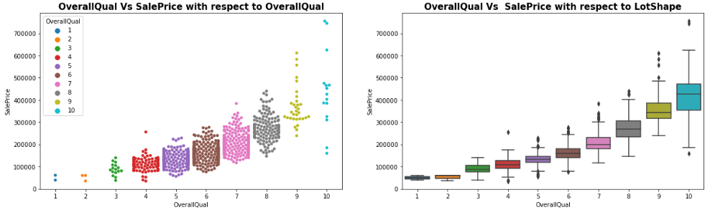
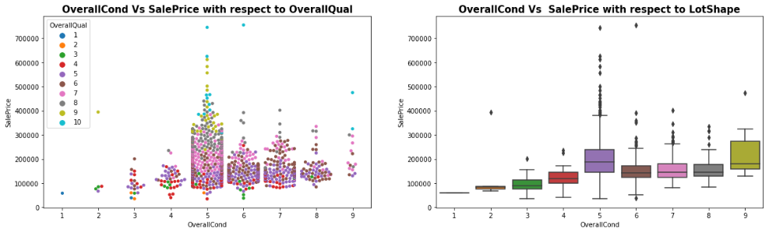

Slide 18
Observations:
Max OverallQual is with rating 5-7.
For OverallCond the max value is 5.
As usual if Overall Quality is increased, price is also increased.
Price is max for OverallCond 5

Slide 19
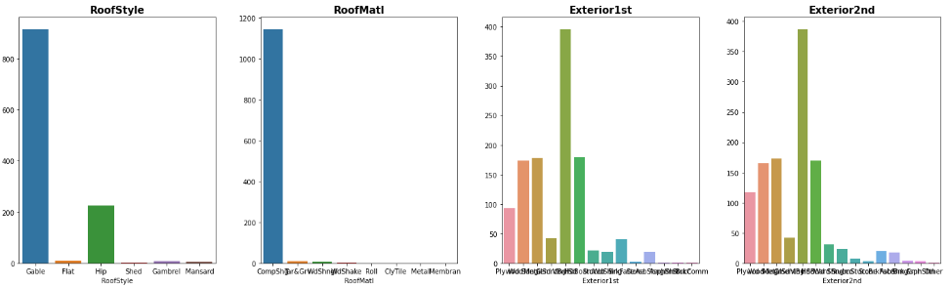
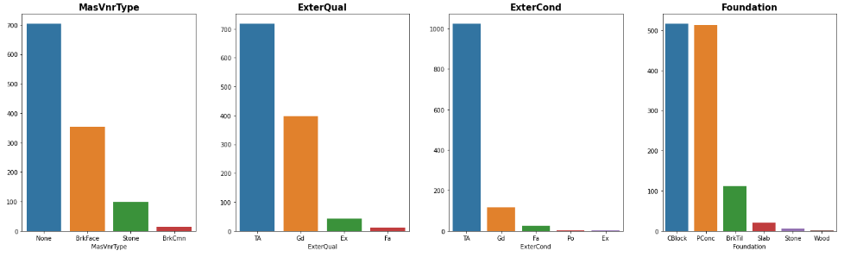

Slide 20
Observations:
1. 78.3% house is with Gable RoofStyle followed by 19.3 % house is with Hip Style.
2. 98% material is Standard (Composite) Shingle and other 7 types are only 2% togetherly.
3. Around 33% material is Vinyl Siding as Exterior covering on house for both Exterior1st and Exterior2nd.
4. Around 60% of house comes with None as Masonry veneer type. Maybe there is some mistake during entry the data.
5. Around 60% of house comes with Average quality of the material on the exterior.

Slide 21
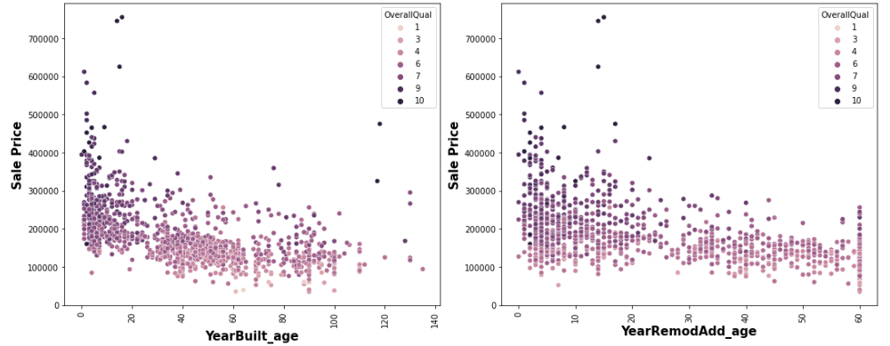
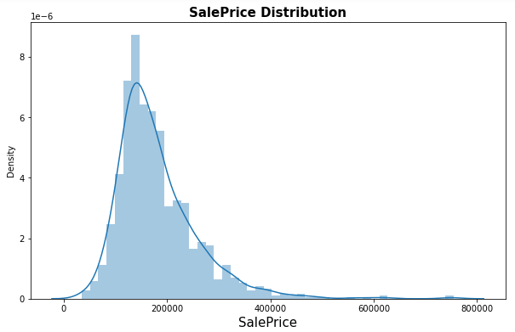
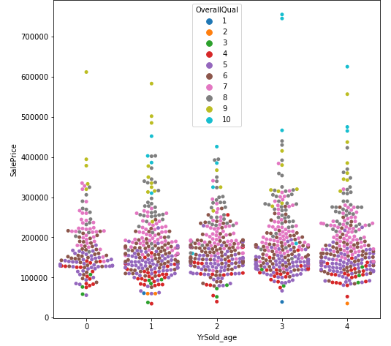
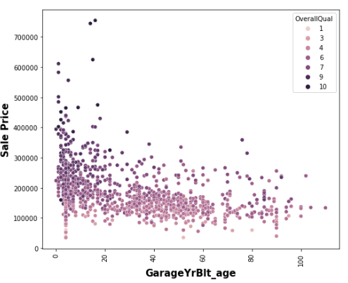

Slide 22
Observations:
1. The selling price of new property is higher than old one.
2. 10 years after Remodelling the properties, the price start decreasing.
3. The selling price of new garage is also higher than old one.
4. Average SalePrice is 100000 to 300000.
5. As OverallQual increased, SalePrice is also increased.

Slide 23
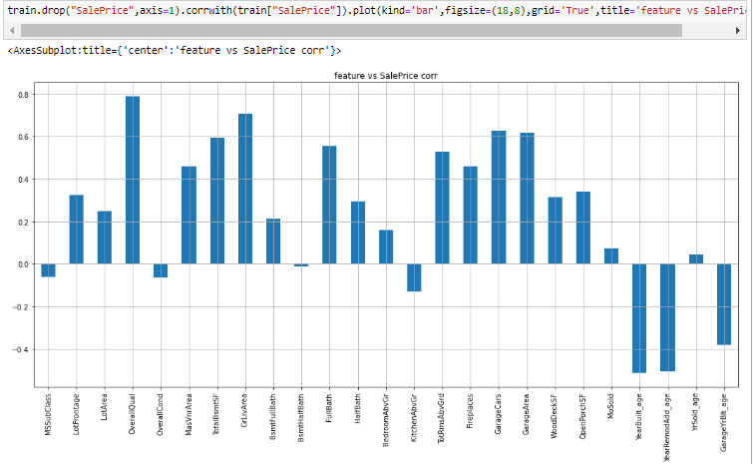
Correlation:
All of the characteristics are related to the target. Target variable sales are highly correlated with overall quality and total ground area.

Slide 24
Machine Learning Algorithm Used
The different regression algorithm used in this project to build ML model are as below:
RandomForestRegressor
DecisionTreeRegressor
SupportVectorRegressor
GradientBoostingRegressor
AdaBoostRegressor
KNeighborsRegressor
RandomForestRegressor

Slide 25
ML Model Building Flow
ML Model Training on Various Algorithms
Finding Best Random state
Using test train split to Divide Training Data
Every model is hyper-parameter tuned.
Apply 5 Fold Cross Validation with every different Model
Saving final Model
Use 5 Fold Cross Validation on each unique model.
The Best Model is Chosen Using Evaluation Criteria

Slide 26
Principal Findings and Study Conclusions
Tables of Findings using different algorithms after Hyper Parameter Tuning
Algorithm | R2 Score | RMSE Value | CV Score | Standard Deviation
Linear Regression | 0.881 | 25567 | 0.789 | 0.052
Decision Tree Regressor | 0.788 | 34163 | 0.733 | 0.059
KNeighbors Regressor | 0.862 | 27563 | 0.789 | 0.030
Random Forest Regressor | 0.905 | 22793 | 0.833 | 0.034
SVR | 0.631 | 45080 | 0.595 | 0.038
Gradient Boosting Regressor | 0.922 | 20728 | 0.846 | 0.018
Ada Boost Regressor | 0.827 | 30823 | 0.766 | 0.033

Slide 27
Conclusion:
The highest R2 Score, lowest RMSE Value, highest CV Score, and lowest Standard Deviation are provided by the Gradient Boosting Regressor. As a result, the best model is determined to be the Gradient Boosting Regressor. The total R2 score is 0.922, or 92.2%.

Slide 28


