Slide 1
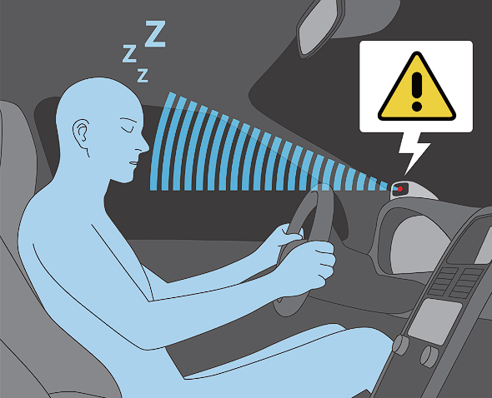

Drowsiness Detection Systems in Vehicles
Drowsiness detection systems in vehicles have become increasingly important to ensure road safety and prevent accidents caused by driver fatigue. Traditional methods rely on physiological signals like eye movements and head position, but they may not always be reliable. This paper proposes a novel approach using facial expressions and neural networks for drowsiness detection in vehicles.
by
SayakRoy (21BCE5674)
Sayan Nath (21BCE5133)
Souhardya Das (21BCE1006)

Slide 2

Advancements in Sentiment Analysis Techniques
Sentiment analysis, also known as opinion mining, is a growing field of research that aims to automatically classify and analyze sentiments expressed in text data. This paper explores the latest advancements in sentiment analysis techniques, including machine learning algorithms and natural language processing methods.

Slide 3
Traditional Methods vs. Novel Approach
1
Traditional Methods
Traditional methods rely on physiological signals like eye movements and head position for drowsiness detection in vehicles.
2
Novel Approach
The proposed system utilizes facial expressions and neural networks to accurately identify signs of drowsiness in real-time.

Slide 4
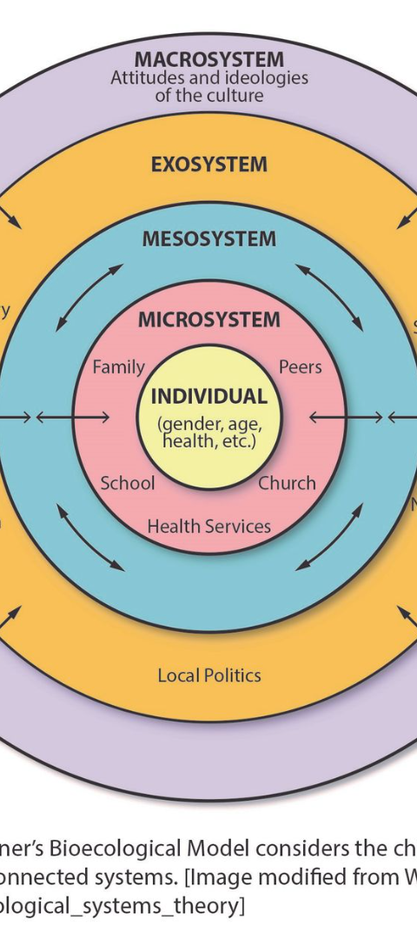
Novelties and Areas of Exploration
1
Multi-modal Data Fusion
2
Dynamic Threshold Adjustment
Incorporating multiple data sources such as facial expressions, eye movements, head position, and physiological signals to enhance the accuracy and robustness of drowsiness detection.
Developing adaptive algorithms that dynamically adjust the threshold for drowsiness detection based on individual driver characteristics, environmental conditions, and driving context.
3
Real-time Feedback and Intervention
Integrating the drowsiness detection system with vehicle control mechanisms to provide real-time feedback to the driver, such as audible alerts, seat vibrations, or automated steering correction.

Slide 5

Personalization and User Profiles
Machine Learning Techniques
Sleep Quality and Fatigue Tolerance
Implementing machine learning techniques to create personalized user profiles for each driver, allowing the system to adapt its detection algorithms and sensitivity levels based on individual patterns of behavior.
Adapting the system based on individual sleep quality and fatigue tolerance to improve the accuracy of drowsiness detection.

Slide 6
Application Areas
Automotive Industry
Fleet Management
Public Transportation
Integration of the system into vehicles to enhance driver safety by alerting drivers when they show signs of drowsiness.
Implementation of the system in commercial fleets to monitor driver alertness and reduce the likelihood of fatigue-related accidents.
Deployment of the system in buses, trains, and other public transportation vehicles to ensure the safety of passengers.

Slide 7
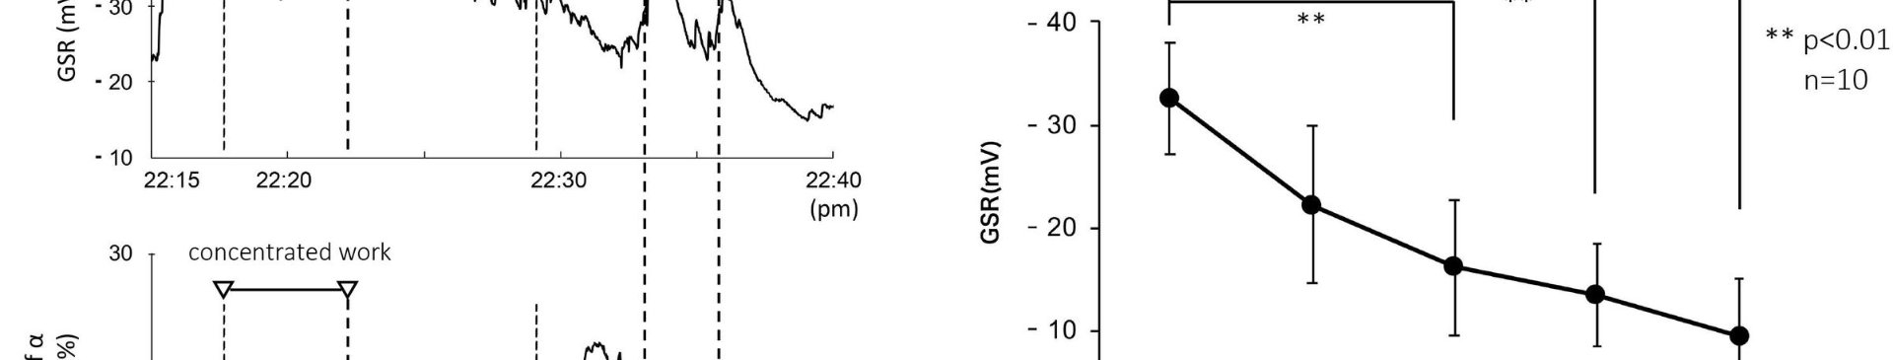
Research and Development
1
Experimental Settings
2
Advancements in Driver Safety
Use of the system in research studies and experimental settings to gather data on driver behavior, fatigue patterns, and the effectiveness of interventions.
Contributing to advancements in the field of driver safety and human-computer interaction through research and development.

Slide 8
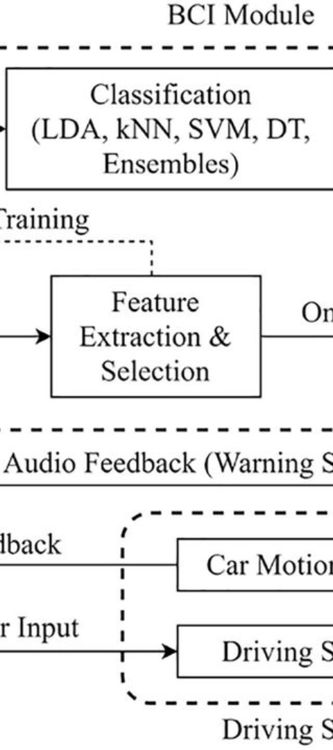
Block Diagrams
1
System Architecture
2
Functional Components
Visual representation of the system's architecture and components for drowsiness detection in vehicles.
Illustration of the functional components and their interactions within the drowsiness detection system.

Slide 9
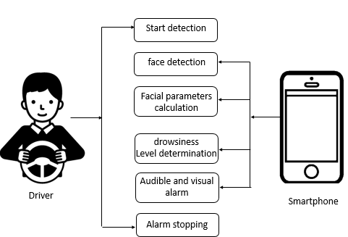

Slide 10
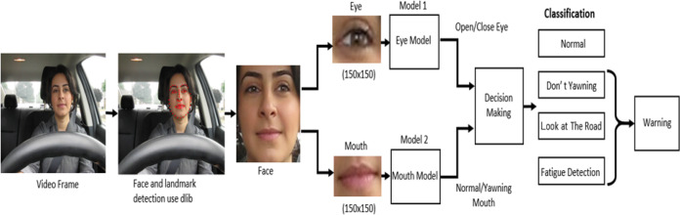

Slide 11

Literature Review: Emerging Trends in Traffic Safety
This comprehensive literature review examines the latest research and advancements in traffic safety, including topics such as intelligent transportation systems, driver behavior analysis, and accident prevention strategies. It provides valuable insights for policymakers, researchers, and industry professionals in the field of transportation.

Slide 12
Literature Paper Reviews
Drowsy Driver Detection System Using Eye Blink Patterns
A Drowsy Driver Detection System Based on a New Method of Head Posture Estimation
IOT based Real-time Drowsy Driving Detection System
The proposed system detects eye blinks with a 94% accuracy and a 1% false positive rate.
Taner Danisman, Ian Marius Bilasco, Chabane Djeraba, Nacim Ihaddadene
2010
Discusses different approaches used in designing systems to detect driver fatigue and alert the driver beforehand to prevent accidents.
Md. Yousuf Hossain, Fabian Parsia George
2018
The proposed method exhibits high performances and robustness in detecting drowsiness.
Ines Teyeb, Olfa Jemai, Mourad Zaied, and Chokri Ben Amar
2014

Slide 13
Literature Paper Reviews
Real-Time Driver-Drowsiness Detection System Using Facial Features
Driver Drowsiness Detection System Based on Visual Features
Intelligent Video-Based Drowsy Driver Detection System
The paper introduces DriCare, a system utilizing commercial camera technology and facial analysis to detect driver drowsiness, showing improved accuracy over existing methods.
A comprehensive overview of research challenges and methodologies in detecting driver drowsiness, including various approaches like physiological signals and image processing.
presents a method for detecting drowsy drivers using facial image processing, achieving high detection rates and fast processing speeds, may face challenges with obscured faces or non-eye-related drowsiness indicators.

Slide 14

Embedded Software Implementation
Driver Eyes Detection
Drowsy Driver Detection
Includes pre-processing, face detection, face boundary detection, eye-glasses bridge detection, and eyes detection.
Involves edge filtering in ROI, binarization, iris location, open/closed eyes detection, and drowsy detection.

Slide 15
Project Implentation
Drowsy Driver Detection
Involves edge filtering in ROI, binarization, iris location, open/closed eyes detection, and drowsy detection.
Driver Eyes Detection
Includes pre-processing, face detection, face boundary detection, eye-glasses bridge detection, and eyes detection.

Slide 16
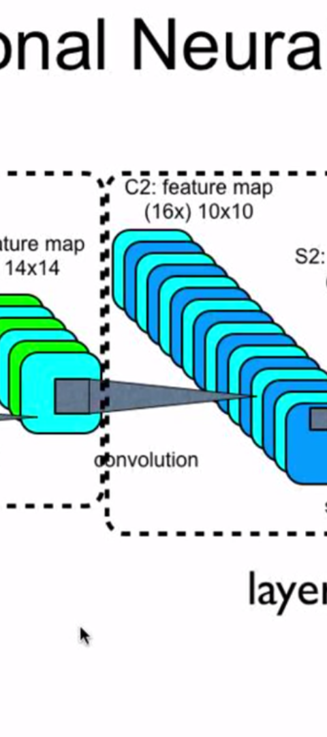


Convolutional Neural Network
Region of Interest Selection
Selecting the region of interest for capturing the driver's facial features.
Eye Region Preparation
Preparing the eye region for analysis and drowsiness detection.

Slide 17
THANK YOU

