Slide 1






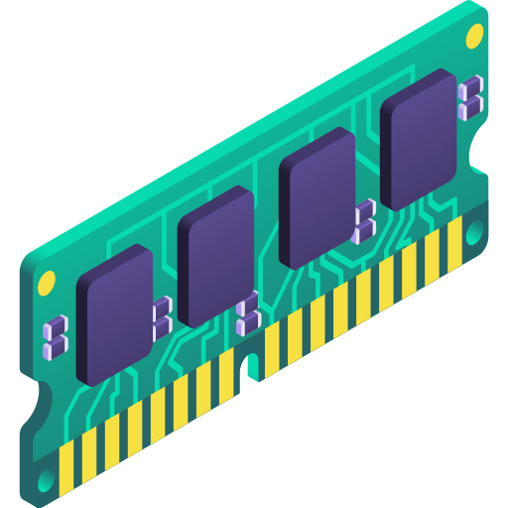
CASPER
Pioneering with grit, bit by bit
Demo: Microarchitectural
Attacks
Shubham Roy royshubham@cse.iitb.ac.in July 2025
Notes:
This recording is for my APS re-evaluation, The topic for this presentation is covert channels in GPU

Slide 2

Outline
Attack1: Flush+Reload
Recap
Code walkthrough
Demo: Timing side channel to infer secret
Attack2: Spectre
Recap
Code walkthrough
Demo: Reading unauthorized memory
Attack3: Rowhammer
Recap
Code walkthrough
Demo: Flipping bits from userspace

Slide 3
Attack1:
Flush+Reload

Slide 4




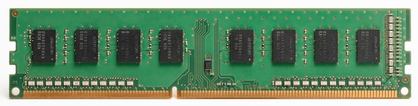
Flush+Reload
Victim
Attacker
accesses the cache block
based on a secret
flushes the cache block
2
LLC
1
3
maps the shared address in cache
reloads the cache block,
hit or miss based on timing
0

Slide 5
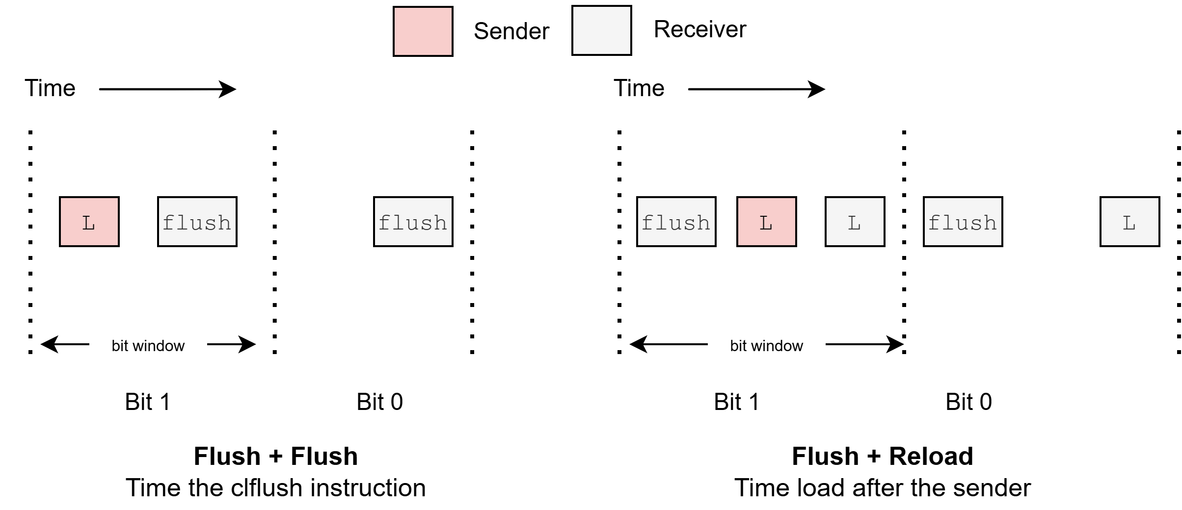
Flush based covert channel in CPU
Recap
Notes:
Differnce latency for flush if hit or miss latency for clflush will vary depending on whether the cache line is present or absent

Slide 6
The Flush+Reload Technique
Exploits cache behavior to leak information on victim access to shared memory
Attacker monitors victim’s access to shared code
Attacker can determine what victim does
Attacker can infer the data the victim operates on

Slide 7


Prerequisite of the attack
Calibrate for LLC miss latency threshold
Find out addresses of interest of the shared library

Slide 8
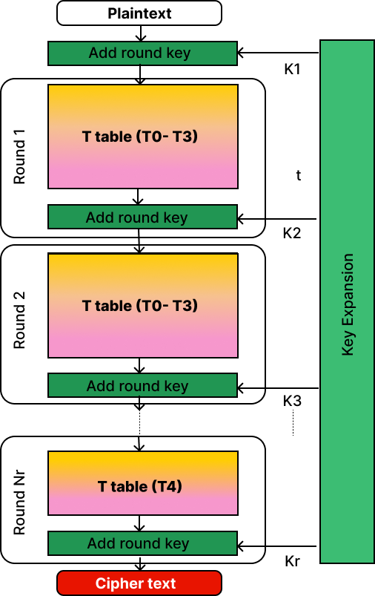
AES algorithm
Background
128-bit Key

Slide 9





Steps to break AES
Victim
Attacker
Flush T0 and allow victim to encrypt a plaintext
Time the probe of T0
Repeat steps 1 and 2 for T1, T2 and T3
Guess the last round key using the cache misses observed
Extract 128-bit encryption key from guessed last round key

Slide 10
Code walkthrough and
Demo

Slide 11
Attack2:
Spectre Attack

Slide 12
1. Misleading Input
2. CPU reads secret character
3. Guess secret from CPU cache
Spectre attack
Attack in Action
Contains any set of information
array1 = [h, e, l, l, o]
input = 400
if ( input < array1.size ) {
secret = array1[input]
y = array2 [ secret * 512 ]
}
holds a much bigger number than 5
is true
speculative execution

Slide 13
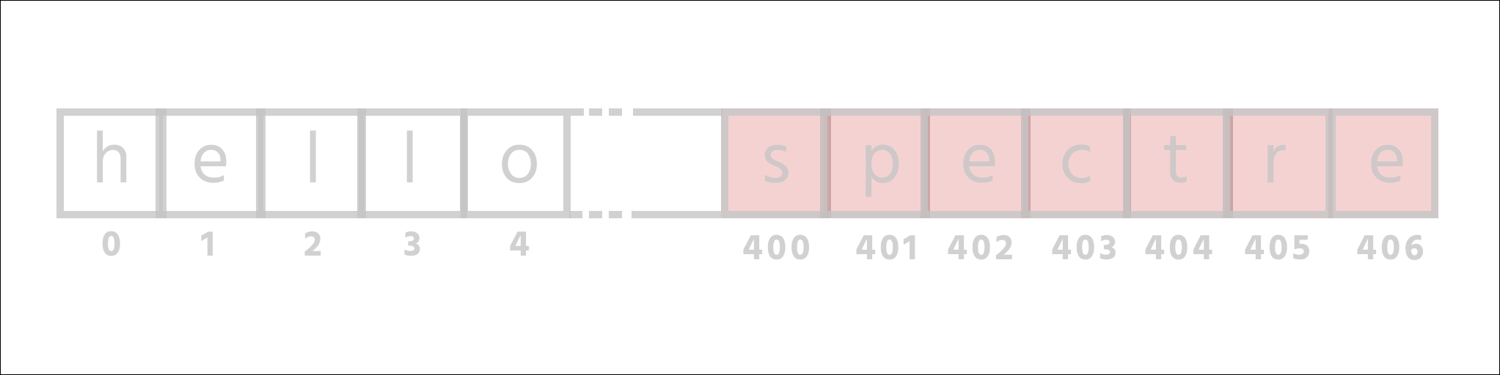
1. Misleading Input
2. CPU reads secret character
3. Guess secret from CPU cache
Spectre attack
Attack in Action
not allowed to access
your data
input = 400 data [ input ]

Slide 14
1. Misleading Input
2. CPU reads secret character
3. Guess secret from CPU cache
Spectre attack
Attack in Action
array1 = [h, e, l, l, o]
input = 400
if ( input < array1.size ) {
secret = array1[input]
y = array2 [ secret * 512 ]
}
speculative was wrong

Slide 15
Why it’s a problem?

Slide 16
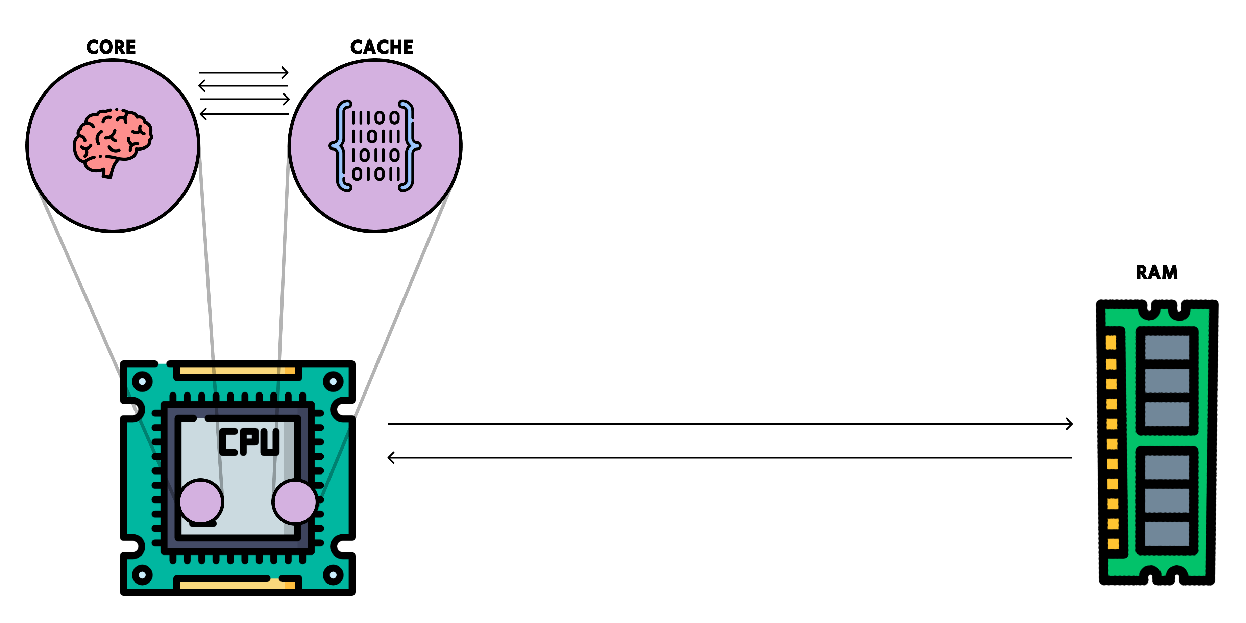

Caches

Slide 17

1. Misleading Input
2. CPU reads secret character
3. Guess secret from CPU cache
Spectre attack
Attack in Action
array2 [0]
array2 [512]
array2 [1024]
array2 [18 * 512]
array1 = [1, 2, 3, 4]
input = 400
if ( input < array1.size )
secret = array1[input]
y = array2 [ secret * 512 ]
}

Slide 18
1. Misleading Input
2. CPU reads secret character
3. Guess secret from CPU cache
Spectre attack
Attack in Action
Secret = s

Slide 19
Spectre attack
Attack recap
1. Misleading Input
2. CPU reads secret character
3. Guess secret from CPU cache

Slide 20
Spectre attack
Attack recap
1. Misleading Input
2. CPU reads secret character
3. Guess secret from CPU cache

Slide 21
Spectre attack
Attack in Nutshell
1. Misleading Input
2. CPU reads secret character
3. Guess secret from CPU cache

Slide 22
Code walkthrough
and
Demo

Slide 23
Attack3:
Rowhammer

Slide 24
Recap
Rowhammer → exploits hardware vulnerability
Goal: Flipping bits in memory without accessing them

Slide 25
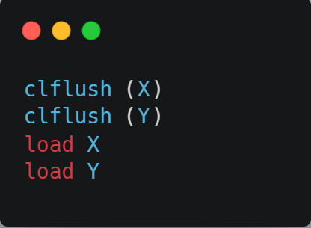
Rowhammer
Attack in action !!
DRAM
1 0 0 1 0 1 0 1 1 1 0 0 0
0 1 1 1 1 0 1 0 1 1 0 0 1
0 1 0 1 0 0 0 0 1 0 0 1 0
0 1 1 1 0 0 1 0 1 0 1 1 0
0 1 1 1 1 1 0 0 1 0 1 1 0
0 1 1 1 0 1 0 1 1 0 1 1 0
X
Y

Slide 26
Rowhammer
Attack in action !!
1 0 0 1 0 1 0 1 1 1 0 0 0
0 1 1 1 1 0 1 0 1 1 0 0 1
0 1 0 1 0 0 0 0 1 0 0 1 0
0 1 1 1 0 0 1 0 1 0 1 1 0
0 1 1 1 1 1 0 0 1 0 1 1 0
0 1 1 1 0 1 0 1 1 0 1 1 0
X
Y

Slide 27
Rowhammer
Attack in action !!
1 0 0 1 0 1 0 1 1 1 0 0 0
0 1 1 1 1 0 1 0 1 1 0 0 1
0 1 0 1 0 0 0 0 1 0 0 1 0
0 1 1 1 0 0 1 0 1 0 1 1 0
0 1 1 1 1 1 0 0 1 0 1 1 0
0 1 1 1 0 1 0 1 1 0 1 1 0
X
Y

Slide 28
Rowhammer
Attack in action !!
1 0 0 1 0 1 0 1 1 1 0 0 0
0 1 1 1 1 0 1 0 1 1 0 0 1
0 1 0 1 0 0 0 0 1 0 0 1 0
0 1 1 1 0 0 1 0 1 0 1 1 0
0 1 1 1 1 1 0 0 1 0 1 1 0
0 1 1 1 0 1 0 1 1 0 1 1 0
X
Y

Slide 29
Rowhammer
Attack in action !!
1 0 0 1 0 1 0 1 1 1 0 0 0
0 1 1 1 1 0 1 0 1 1 0 0 1
0 1 0 1 0 0 0 0 1 0 0 1 0
0 1 1 1 0 0 1 0 1 0 1 1 0
0 1 1 1 1 1 0 0 1 0 1 1 0
0 1 1 1 0 1 0 1 1 0 1 1 0
X
Y

Slide 30

Rowhammer
Attack in action !!
1 0 0 1 0 1 0 1 1 1 0 0 0
0 1 1 1 1 0 1 0 1 1 0 0 1
0 1 0 1 0 0 0 0 1 0 0 1 0
0 1 1 1 0 0 1 0 1 0 1 1 0
0 1 1 1 1 1 0 0 1 0 1 1 0
0 1 1 1 0 1 0 1 1 0 1 1 0
X
Y

Slide 31
Rowhammer
Attack in action !!
1 0 0 1 0 1 0 1 1 1 0 0 0
0 1 1 1 1 0 1 0 1 1 0 0 1
0 1 0 1 0 0 0 0 1 0 0 1 0
0 1 1 1 0 0 1 0 1 0 1 1 0
0 1 1 1 1 1 0 0 1 0 1 1 0
0 1 1 1 0 1 0 1 1 0 1 1 0
1 1 0 1 0 1 1 1 1 1 0 1 0
0 1 1 1 1 0 1 0 1 1 0 0 1
0 0 0 1 0 0 0 1 1 0 1 0 0
0 0 1 1 0 1 1 0 1 1 1 1 0
0 1 1 1 1 1 0 0 1 0 1 1 0
0 1 1 0 0 1 1 1 1 0 1 1 0
X
Y

Slide 32



System Configuration
Intel Haswell
DDR3 RAM

Slide 33


Attack setup
Try to cause bitflip
Attacker
Victim

Slide 34

Steps (Profile Phase)
Is CPU not enough?
Profile DRAM to find aggressor rows
Perform Rowhammer in its own address space
Get aggressor rows and victim row virtual address
Deallocate OS page corresponding to the victim DRAM row
When victim process requests a new OS page, OS will provide the same page

Slide 35

Steps (Attack Phase)
Victim process gets the OS page, corresponding to the DRAM victim row
Attacker performs Rowhammer in its own address space, resulting in bitflips in victim’s address space

Slide 36
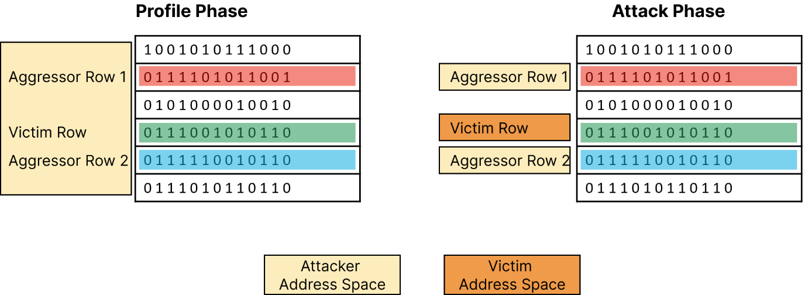
Rowhammer in action

Slide 37
Code walkthrough and
Demo

