Slide 1






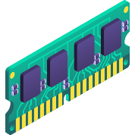
CASPER
Pioneering with grit, bit by bit
Demo: Microarchitectural
Attacks in Action
Shubham Roy royshubham@cse.iitb.ac.in July 2025

Slide 2

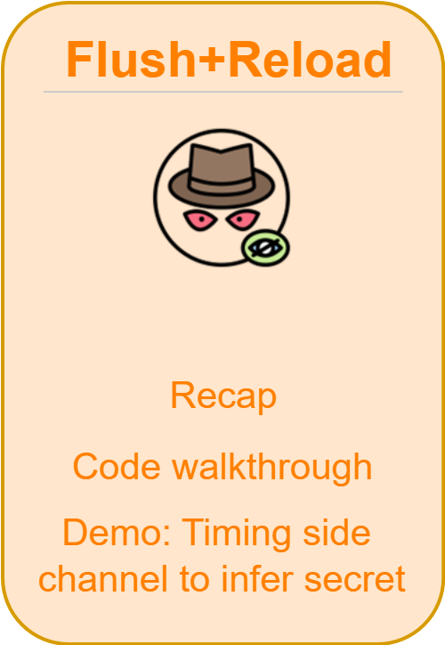
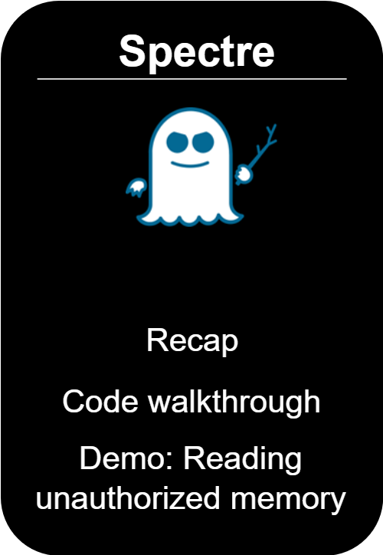
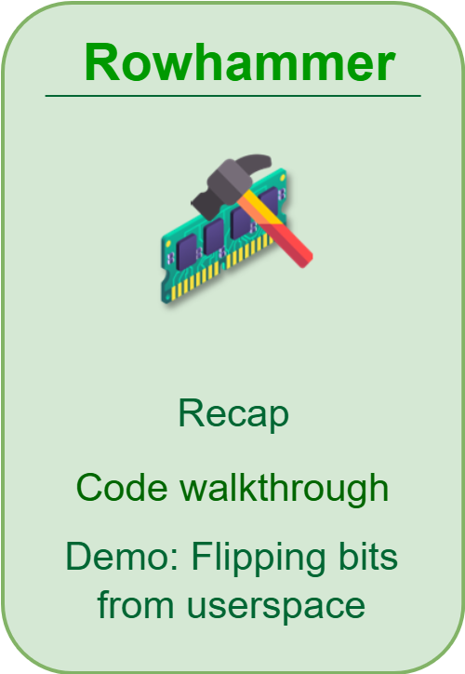
Outline

Slide 3
Attack 1:
Flush+Reload

Slide 4





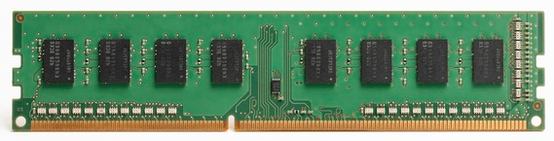
Flush+Reload
Victim
Attacker
accesses the cache block
based on a secret
flushes the cache block
2
LLC
1
3
maps the shared address in cache
0
reloads the cache block,
hit or miss based on timing

Slide 5
The Flush+Reload Technique
Exploits cache behavior to leak information on victim access to shared memory
Attacker monitors victim’s access to shared code
Attacker can determine what victim does
Attacker can infer the data the victim operates on

Slide 6


Pre-requisite of the attack
Calibrate for LLC miss latency threshold
Find out addresses of interest of the shared library

Slide 7
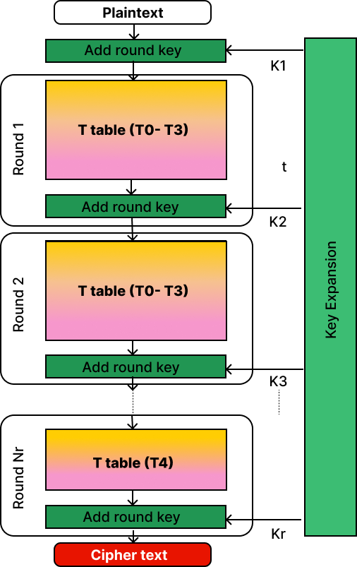
AES algorithm
Background
128-bit Key

Slide 8





Steps to break AES
Victim
Attacker
Step 1: Flush T0 and allow victim to encrypt a plaintext
Step 2: Time the probe of T0
Step 3: Repeat steps 1 and 2 for T1, T2 and T3
Step 4: Guess the last round key using the cache misses observed
Step 5: Extract 128-bit encryption key from guessed last round key

Slide 9
Code walkthrough and
Demo
9

Slide 10
Attack 2:
Spectre Attack
10

Slide 11
1. Misleading input; CPU spec.
2. CPU reads secret character
3. Guess secret from CPU cache
Spectre attack
Attack in Action
Contains any set of information
array1 = [h, e, l, l, o]
input = 400
if ( input < array1.size ) {
secret = array1[input]
y = array2 [ secret * 512 ]
}
holds a much bigger number than 5
is true
speculative execution
11

Slide 12
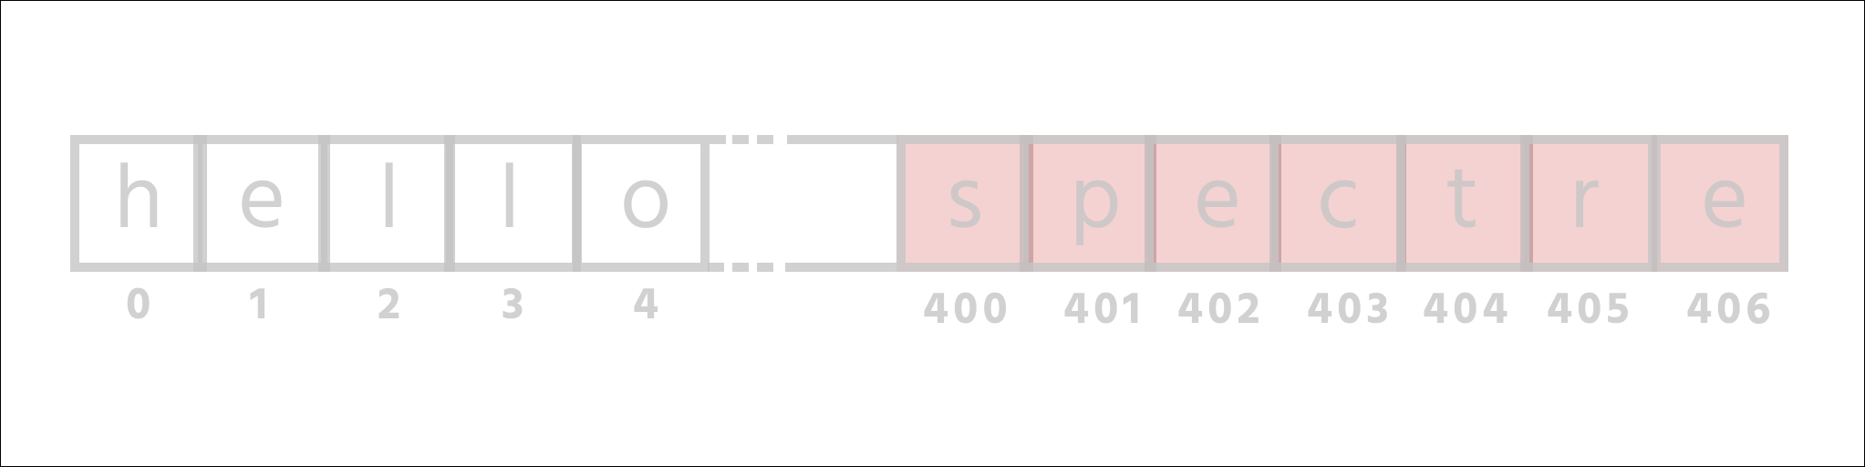
1. Misleading input; CPU spec.
2. CPU reads secret character
3. Guess secret from CPU cache
Spectre attack
Attack in Action
not allowed to access
your data
input = 400 data [ input ]
12

Slide 13
1. Misleading input; CPU spec.
2. CPU reads secret character
3. Guess secret from CPU cache
Spectre attack
Attack in Action
array1 = [h, e, l, l, o]
input = 400
if ( input < array1.size ) {
secret = array1[input]
y = array2 [ secret * 512 ]
}
speculation was wrong
13

Slide 14

Why it’s a problem?
14

Slide 15
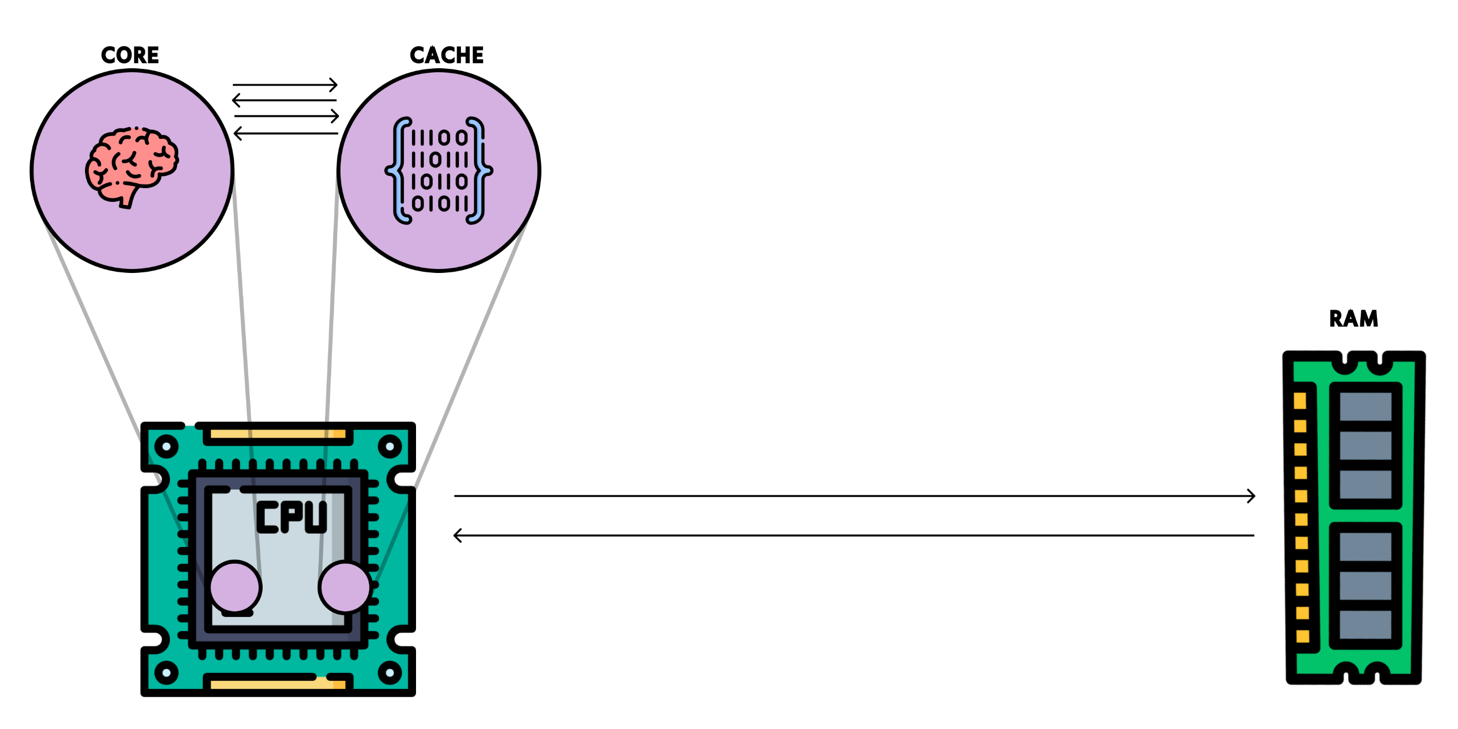

Caches
15

Slide 16


1. Misleading input; CPU spec.
2. CPU reads secret character
3. Guess secret from CPU cache
Spectre attack
Attack in Action
array2 [0]
array2 [512]
array2 [1024]
array2 [18 * 512]
array1 = [1, 2, 3, 4]
input = 400
if ( input < array1.size )
secret = array1[input]
y = array2 [ secret * 512 ]
}
16

Slide 17
1. Misleading input; CPU spec.
2. CPU reads secret character
3. Guess secret from CPU cache
Spectre attack
Attack in Action
Secret = s
17

Slide 18
Spectre attack
Attack recap
1. Misleading input; CPU speculates
2. CPU reads secret character
3. Guess secret from CPU cache
18

Slide 19
Spectre attack
Attack recap
1. Misleading input; CPU speculates
2. CPU reads secret character
3. Guess secret from CPU cache
19

Slide 20
Spectre attack
Attack in Nutshell
1. Misleading input; CPU speculates
2. CPU reads secret character
3. Guess secret from CPU cache
20

Slide 21
Code walkthrough
and
Demo
21

Slide 22
Attack 3:
Rowhammer
22

Slide 23

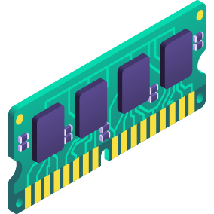
Recap
Rowhammer → exploits hardware vulnerability
Goal: Flipping bits in memory without accessing them

Slide 24
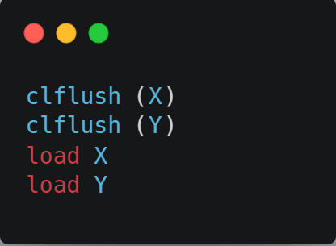
Rowhammer
Attack in action !!
DRAM
1 0 0 1 0 1 0 1 1 1 0 0 0
0 1 1 1 1 0 1 0 1 1 0 0 1
0 1 0 1 0 0 0 0 1 0 0 1 0
0 1 1 1 0 0 1 0 1 0 1 1 0
0 1 1 1 1 1 0 0 1 0 1 1 0
0 1 1 1 0 1 0 1 1 0 1 1 0
X
Y

Slide 25
Rowhammer
Attack in action !!
DRAM
1 0 0 1 0 1 0 1 1 1 0 0 0
0 1 1 1 1 0 1 0 1 1 0 0 1
0 1 0 1 0 0 0 0 1 0 0 1 0
0 1 1 1 0 0 1 0 1 0 1 1 0
0 1 1 1 1 1 0 0 1 0 1 1 0
0 1 1 1 0 1 0 1 1 0 1 1 0
X
Y

Slide 26
Rowhammer
Attack in action !!
DRAM
1 0 0 1 0 1 0 1 1 1 0 0 0
0 1 1 1 1 0 1 0 1 1 0 0 1
0 1 0 1 0 0 0 0 1 0 0 1 0
0 1 1 1 0 0 1 0 1 0 1 1 0
0 1 1 1 1 1 0 0 1 0 1 1 0
0 1 1 1 0 1 0 1 1 0 1 1 0
X
Y

Slide 27
Rowhammer
Attack in action !!
DRAM
1 0 0 1 0 1 0 1 1 1 0 0 0
0 1 1 1 1 0 1 0 1 1 0 0 1
0 1 0 1 0 0 0 0 1 0 0 1 0
0 1 1 1 0 0 1 0 1 0 1 1 0
0 1 1 1 1 1 0 0 1 0 1 1 0
0 1 1 1 0 1 0 1 1 0 1 1 0
X
Y

Slide 28
Rowhammer
Attack in action !!
DRAM
1 0 0 1 0 1 0 1 1 1 0 0 0
0 1 1 1 1 0 1 0 1 1 0 0 1
0 1 0 1 0 0 0 0 1 0 0 1 0
0 1 1 1 0 0 1 0 1 0 1 1 0
0 1 1 1 1 1 0 0 1 0 1 1 0
0 1 1 1 0 1 0 1 1 0 1 1 0
X
Y

Slide 29

Rowhammer
Attack in action !!
DRAM
X
Y

Slide 30
Rowhammer
Attack in action !!
DRAM
1 1 0 0 0 1 1 1 1 1 0 1 0
0 1 1 1 1 0 1 0 1 1 0 0 1
0 0 0 1 0 0 0 1 1 0 1 0 0
0 0 1 1 0 1 1 0 1 1 1 1 0
0 1 1 1 1 1 0 0 1 0 1 1 0
0 1 1 0 0 1 1 1 1 0 0 1 0
X
Y

Slide 31


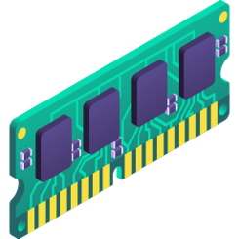
System Configuration
Intel Haswell
DDR3 RAM

Slide 32


Attack setup
Try to cause bitflip
Attacker
Victim

Slide 33

Steps (Profile Phase)
Profile DRAM to find aggressor rows
Perform Rowhammer in its own address space
Get aggressor rows and victim row virtual address
Deallocate OS page corresponding to the victim DRAM row
When victim process requests a new OS page, OS will provide the same page

Slide 34

Steps (Attack Phase)
Victim process gets the OS page, corresponding to the DRAM victim row
Attacker performs Rowhammer in its own address space, resulting in bitflips in victim’s address space

Slide 35
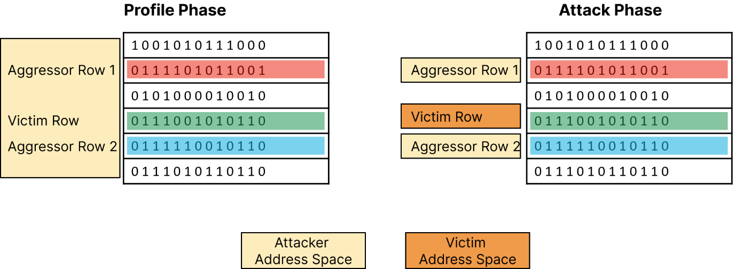
Rowhammer in action

Slide 36
Code walkthrough and
Demo

Slide 37
Thank you

Slide 38
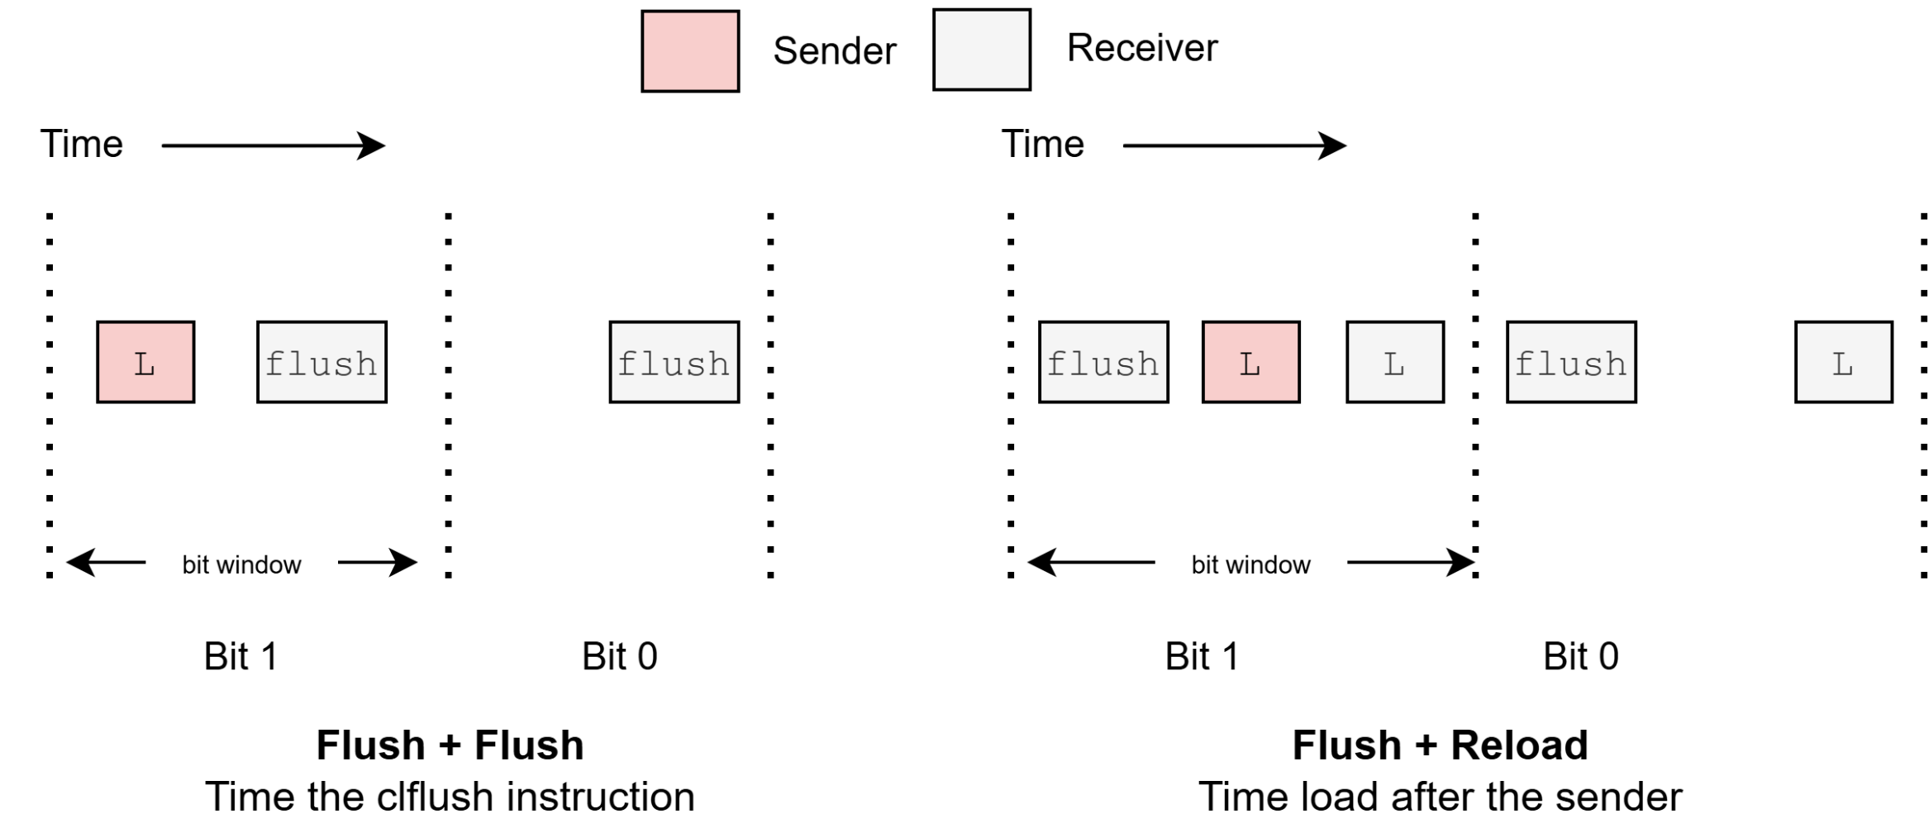
Flush based covert channel in CPU
Recap

