Slide 1
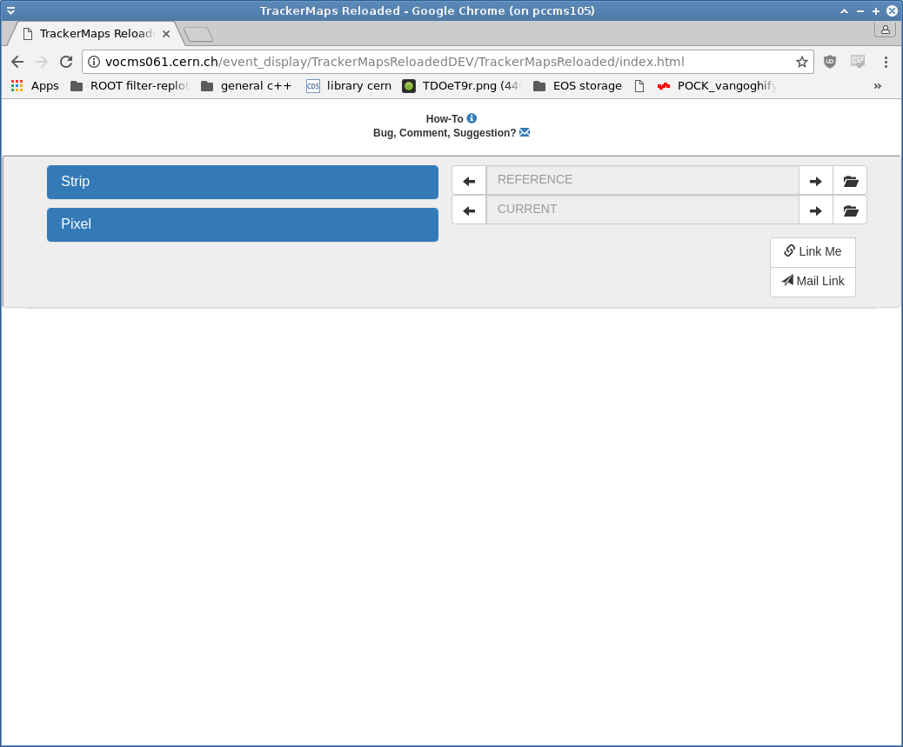
User Interface
Open the dialog
to select the
runs
Select the maps
that you want
to have a look at
Select adjacent
runs
Link Me:
Generates copy-
able URL
Mail Link:
Opens mail client
and pastes the
URL (no need to
click Link Me first)

Slide 2
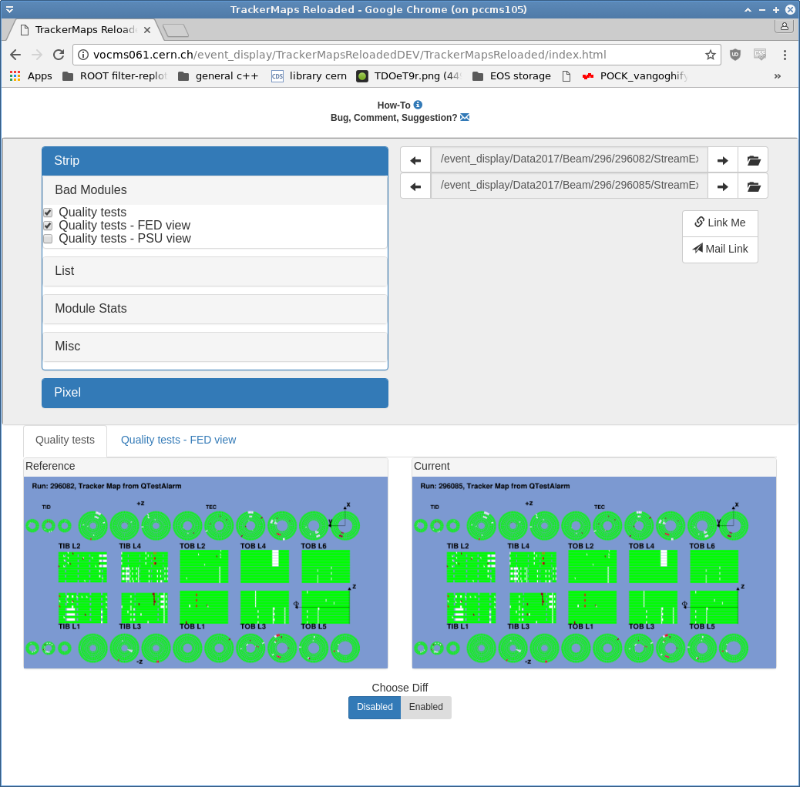
Comparing Maps
Select the maps
that you want
to inspect
Show the
difference
between
Reference
and
Current run

Slide 3
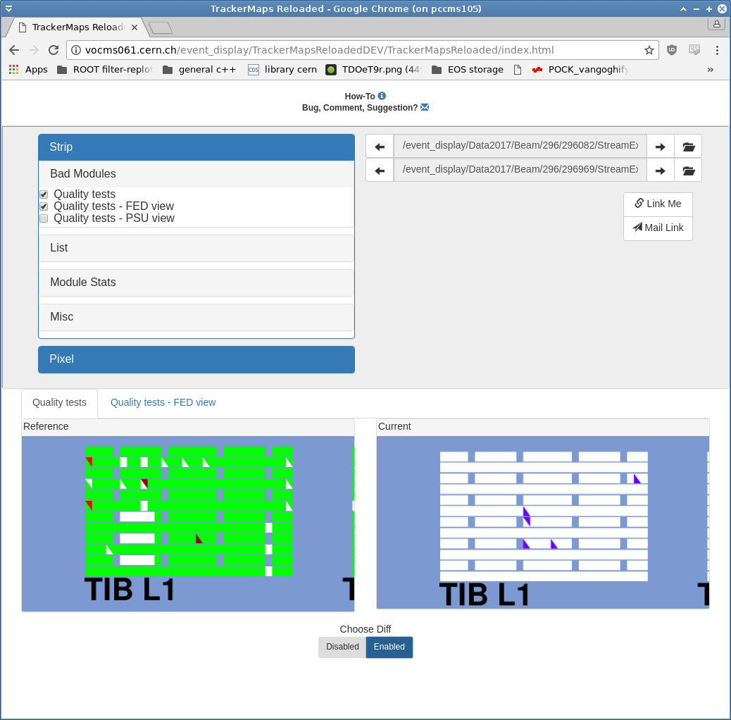
Zooming in Maps
Zoom in the maps
by hovering with
your mouse over
the images
and using the
mouse wheel.
Panning also
works by dragging.
The map views
will be kept
synchronized

Slide 4
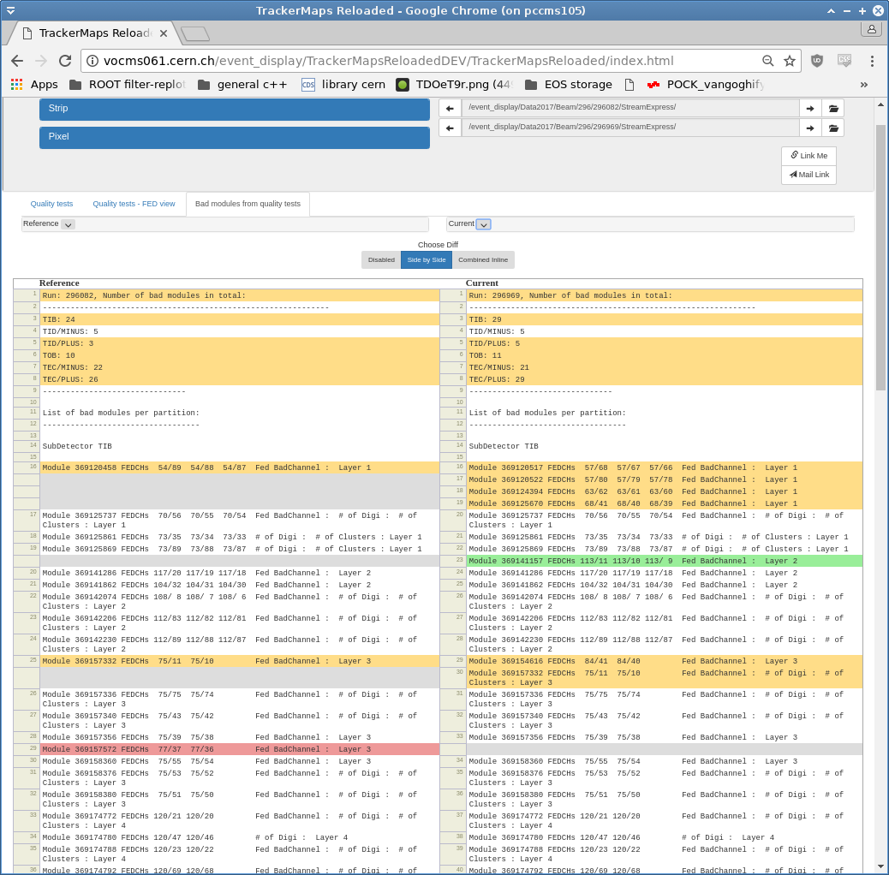
Comparing Logs
Yellow:
There is a difference between
the two lines
Red:
This Line does not exist
in the current log
Green:
This line does not exist in
the reference
Gray:
Placeholder to keep lines
in order

Slide 5
Known Issues
Browsers supported:
  Chrome
  Firefox
  Safari
Browsers NOT supported
  IE / Edge

