Slide 1
Analyse et Modélisation des Systèmes d’Information
Information System Engineering: Analysis and Design
Object-Oriented Modeling
Activity Diagram
Prof. Stéphane Faulkner
Conceptual Modeling

Slide 2
Section overview
What is an activity diagram
Basic concept for the use-case diagram
  Activities
  States
  Transitions
Decision points
Swimlanes
Forks and joins
Iteration
Control Icons
Objects on activity diagrams
How to produce activity diagrams
Conceptual Modeling
Notes:
Azerthhden,b

Slide 3
What is an activity diagram?
Activity diagrams are a means of describing business workflows (business processes), workflows within use-cases, workflows between use-cases and workflows for complex operations
  Workflows: generic term for modelling tasks in terms of a sequence of activities
Activity diagrams consist of activities, states and transitions between activities and states
  An activity is a specification of behavior expressed as a flow of actions
    - Actions are executable statements
    - An activity can consist of one or many actions
  A state is a point where some event needs to take place before activity can continue
  A transition is the movement between activities and/or state. Transitions are supposed to represent actions which occur“quickly” and are not interruptible
Conceptual Modeling

Slide 4
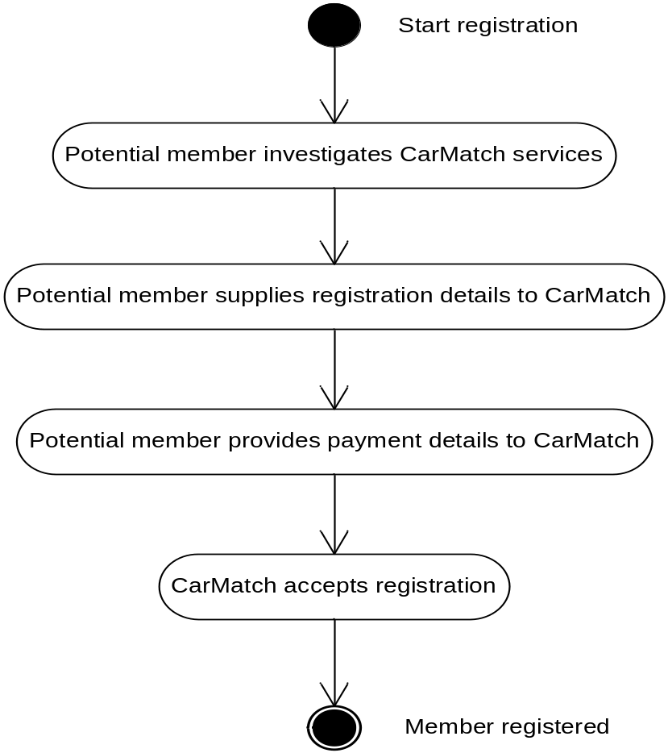
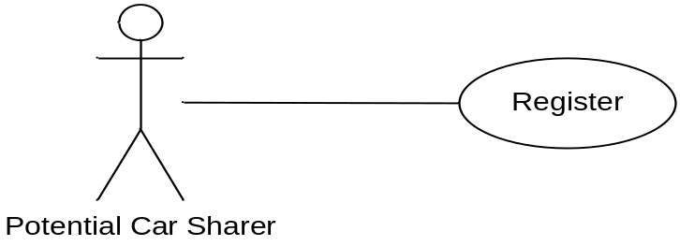
Activity diagram for describing use-cases
Conceptual Modeling

Slide 5
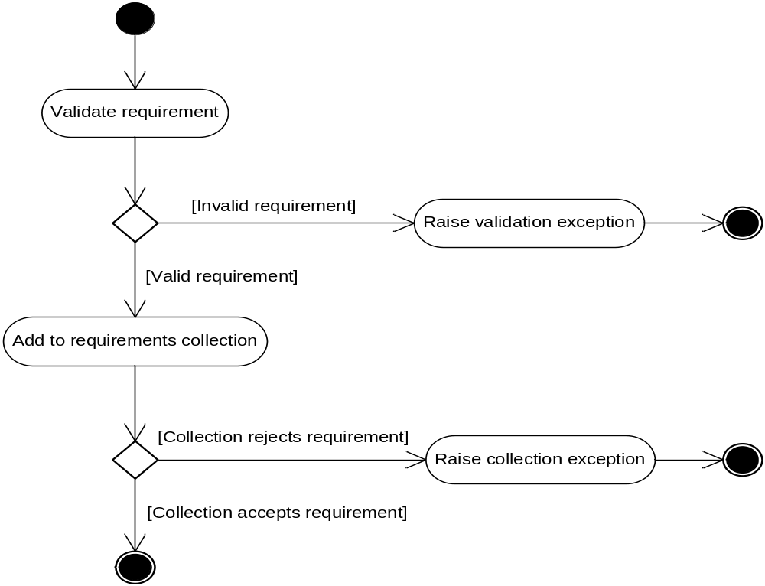
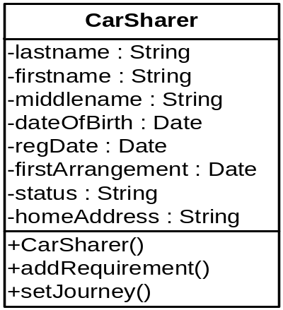
Activity diagram for describing operations
Conceptual Modeling

Slide 6

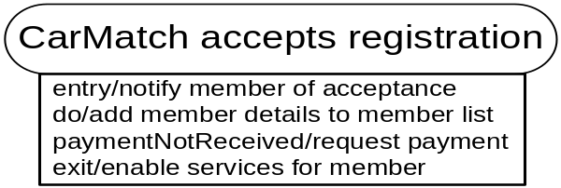
Activities
An activity is a unit of work
  A work can be documented as actions in the activity
There are four ways in which an action can be triggered:
  On Entry: these actions are triggered as soon as the activity starts
  Do: these actions take place during the lifetime of the activity
  On Event: these actions take place in response to an event
  On Exit: these actions take place just before the activity
Conceptual Modeling

Slide 7


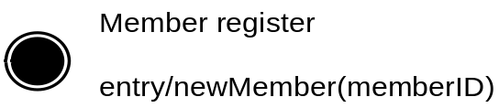
States
States are used to imply waiting, not doing
There are two special states:
  Start state
    - Only one start state is allowed on a diagram
  End state
    - There can be several end states in a worflow
    - End states can have actions to trigger events that start other process
Conceptual Modeling

Slide 8

Transitions
A transition occurs when all the actions of an activity have been completed or when an event triggers the exit from a particular state or activity
A triggerless transition:
A triggered transition:
Conceptual Modeling

Slide 9
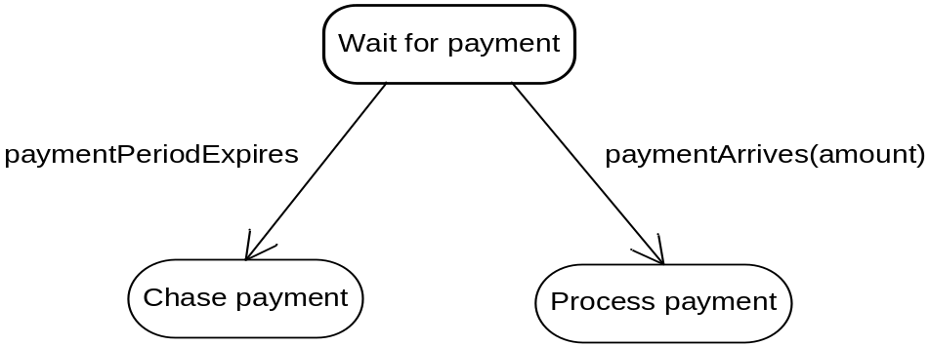
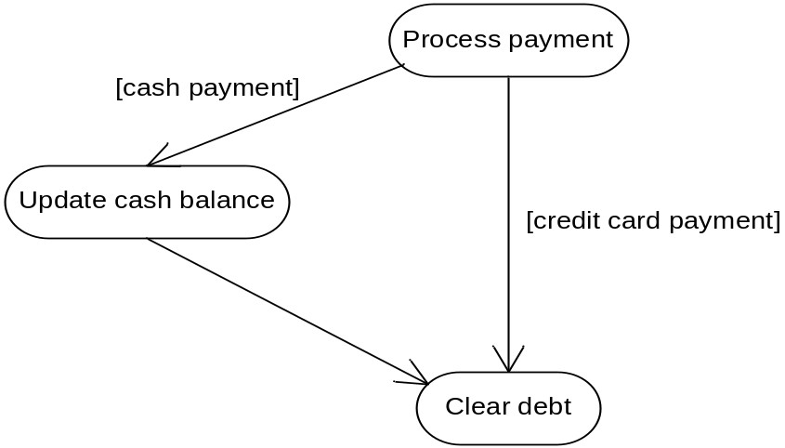
Multiple transitions
triggered transitions
triggerless transitions
Conceptual Modeling

Slide 10
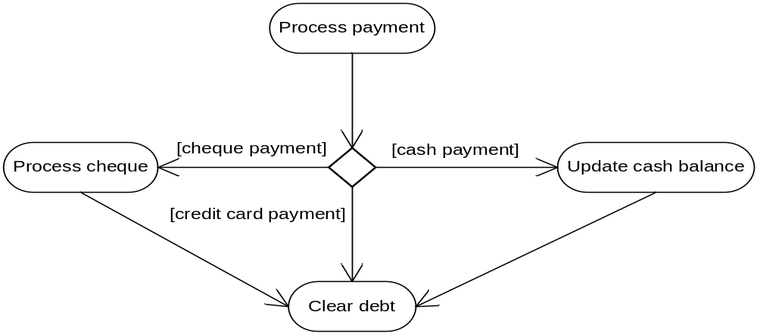
Decision points
A decision point is a point in a workflow where the exit transition from a state or activity may branch in alternative directions depending on a condition
Conceptual Modeling

Slide 11
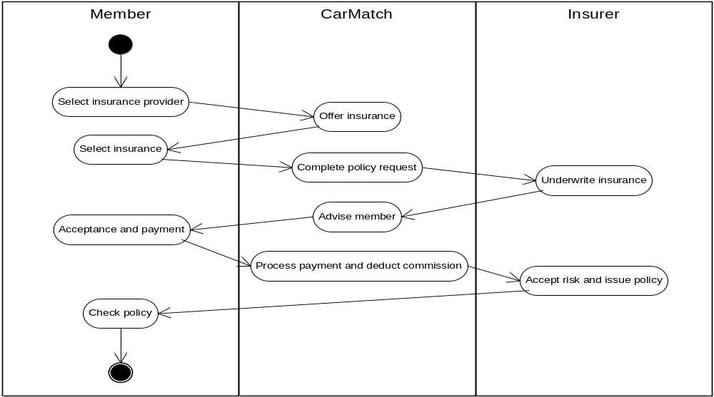
Swimlanes
Swimlane is a useful notation for indicating where an activity takes place in a complex system
Conceptual Modeling

Slide 12
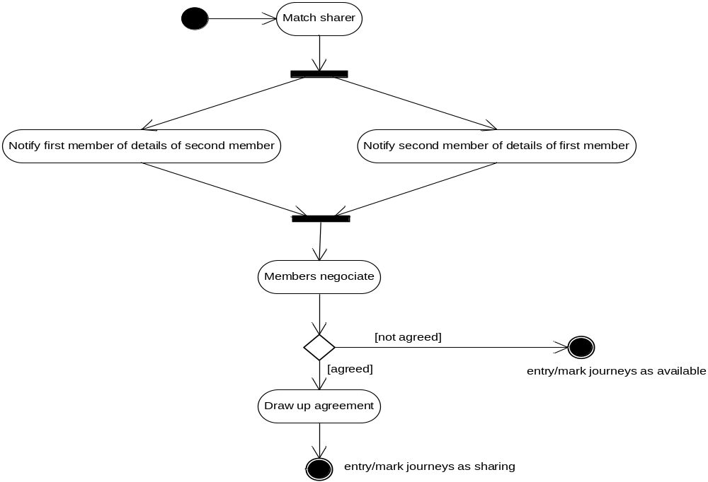
Forks and joins
A transition can be split into multiple paths (a fork) and multiple paths combined (a join) into a single transition by using a synchronization bar
Conceptual Modeling

Slide 13
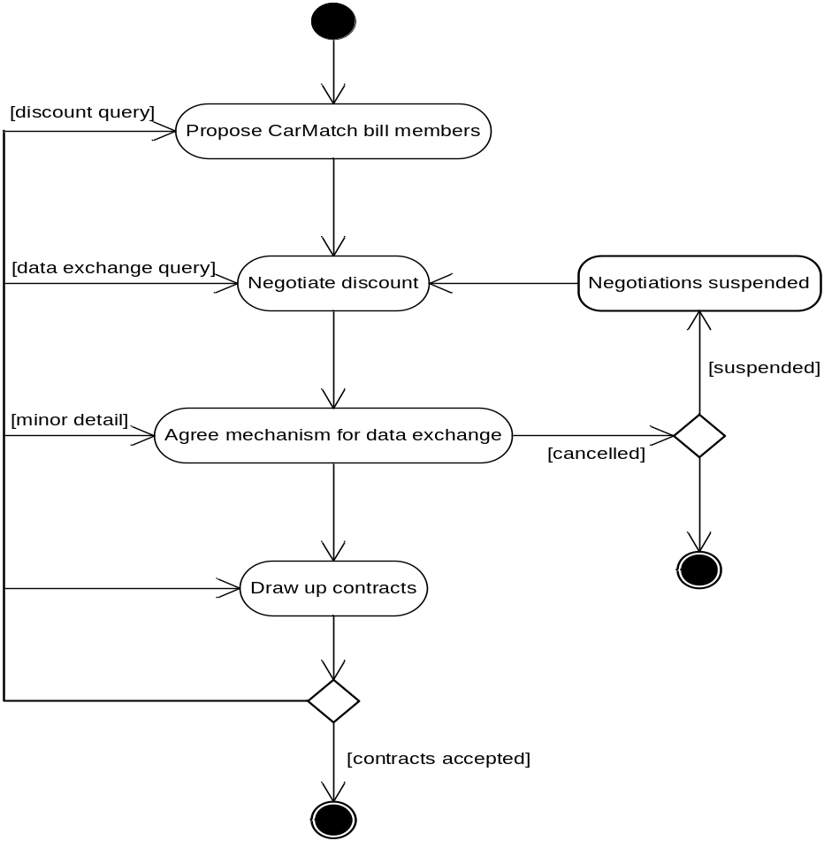
Iteration
Conceptual Modeling

Slide 14
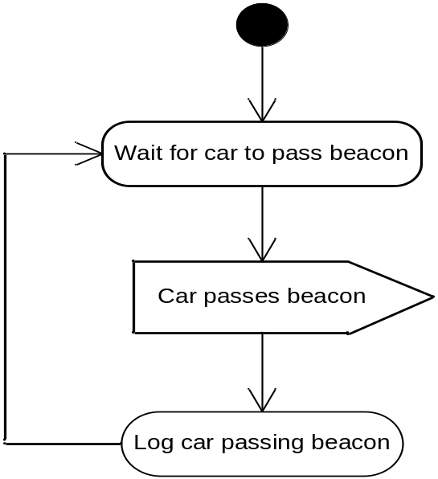
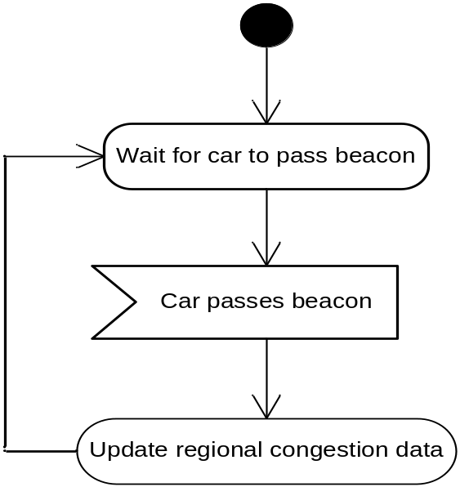
Control icons
Transitions can also trigger events themselves
  Two icons: the sending of a signal (i.e., event) or the receipt of a signal
Conceptual Modeling

Slide 15
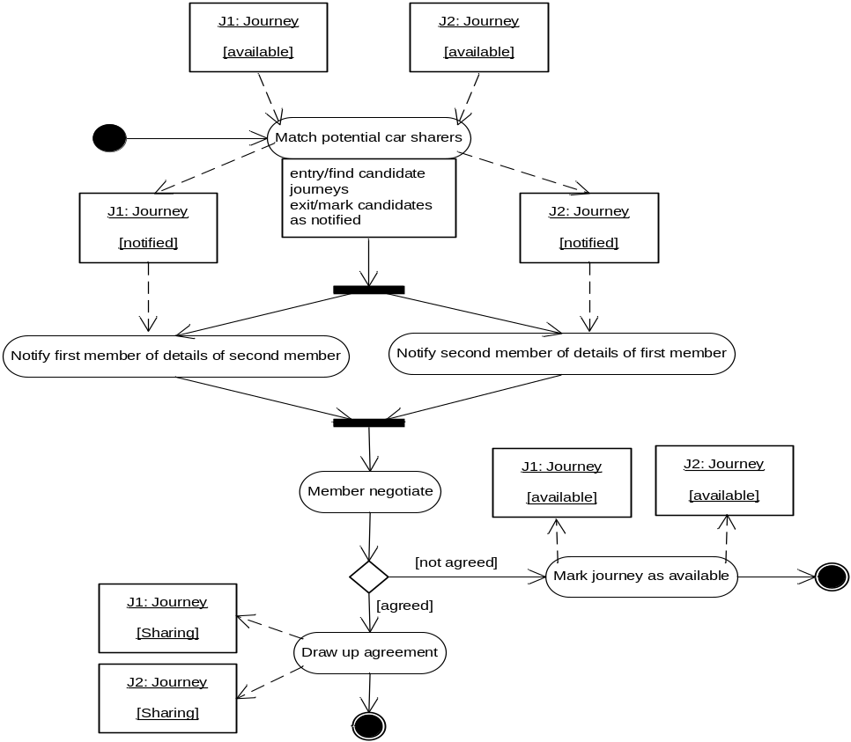
Objects on activity diagrams
All activities need to be carried out by objects in an OO implementation
  it can useful to indicate where a flow affects an object
Conceptual Modeling

Slide 16
How to produce activity diagrams
Identifying key scenarios of system use-cases
Combining the scenarios to produce comprehensive workflows described using activity diagrams
Add objects flows to the diagram where significant object behavior is triggered by a workflow
Use swimlanes to map the activities where worflows cross technology boundaries
Conceptual Modeling

