Slide 1
ECMI-2110: Analyse et Modélisation des Systèmes d’Information
Information System Engineering: Analysis and Design
Chapter 4: Object-Oriented Modeling
Class Diagram
Prof. Stéphane Faulkner
Facultés Univesitaires Notre-Dame de la Paix, 2006-2007

Slide 2
Class Diagram
Class diagram describes the static structure of the classes that make up a system or subsystem
  Static structure includes the classes, their attributes and operations, and the relationships among them
Classes that are shown on a class diagram depend on the phase of development process and the level of detail being considered
  Analysis phase: classes apparent in the problem domain are primary interest
  Design phase: classes and relationships that structure the solution are introduced (e.g., implementation classes, interface classes,…)

Slide 3
Main purpose of producing class diagrams
Class diagrams are used
  To document the classes that constitute a system or subsystem
  To describe the associations, generalization and aggregation relationships among those classes
  To show the attributes and operations of each class
  To show the class structure throughout the development lifecycle
    from the specification of the classes in the problem domain to the implementation model
  To show individual object instances within the class structure
  To show the interfaces supported by a given class

Slide 4
Classes
A class describes a group of objects with similar
  properties (attributes)
  common behaviour (operations)
  common relationships to other objects
  and common meaning (“semantics”)
For example: “employee has a name, a ID and department; an employee is hired, and fired; an employee works in one or more projects”

Slide 5
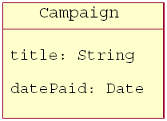
Attributes
Each class can have attributes which represent useful information about instances of a class
Each attribute has a type
For example, Campaign has attributes title and datePaid

Slide 6
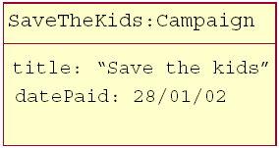
Objects and their attribute values
The instances of a class are called objects
Two different objects may have identical attribute values (like two people with identical name and address)
Each object diagram shows a set of objects and their interrelationships at a point in time used to model a snapshot of the application

Slide 7
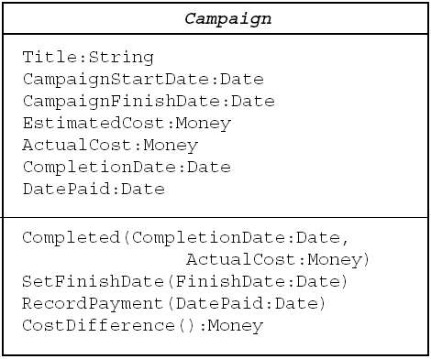
Operations
Operations describe what can be done with the instances of a class
  Often derived from action verbs in use case descriptions
Some operations will carry out processes to change or do calculations with the attributes of an object
Each operation has a signature which specifies the types of its parameters and the type of the value it returns (if any)
For example, we might want to know the difference between the estimated cost and the actual cost of a campaign
→ Campaign would need an operation CostDifference()

Slide 8
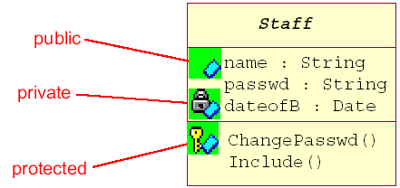
Visibility
As with Java, attributes and operations can be declared with different visibility modes:
  + public: any class can use the feature (attribute or operation)
  # protected: any descendant of the class can use the feature
  - private: only the class itself can use the feature

Slide 9
Relationships
Classes and objects do not exist in isolation from one another
A relationship represents a connection among things
In UML, there are different types of relationships:
  Generalization
  Association:
    - Aggregation
    - Composition
  …more…

Slide 10
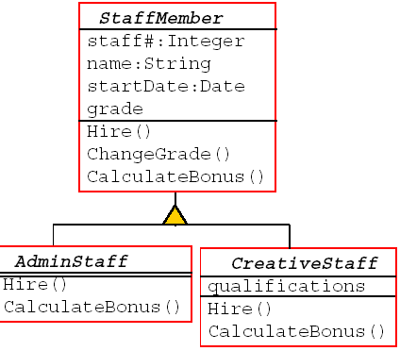
Generalization relationship
Generalization relates two classes when the concept represented by one class is more general than that represented by the other
  The more general class participating in a generalization relationship is also called the superclass or parent, while the more specialized class is called subclass or child
The child always inherits the structure and behavior of the parent. However, the child may also add new structure and behavior, or may modify the behavior of the parent
← The triangle linking the classes shows inheritance; the connecting line between AdminStaff and CreativeStaff indicates that they are mutually exclusive

Slide 11
Generalization relationship (cont’d)
The operation CalculateBonus() is declared in StaffMember but is overridden in each of its sub-classes
  For AdminStaff : the method uses data from ChangeGrade to find out the salary rate and calculate the bonus
  For CreativeStaff: the method uses data from the campaigns that the member of staff has worked on to calculate the bonus
When the same operation is defined differently in different classes, each class is said to have its own method of defining the operation

Slide 12
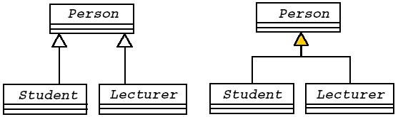
Generlization notation
Possibly overlapping e.g., Maria is both Lecturer and Student
Mutually exclusive I.e., a lecturer can’t be and Student and vice versa

Slide 13
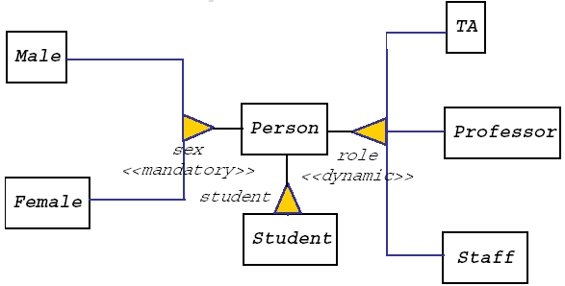
Dynamic classification
Classification refers to the relationship between an object and the classes it is an instance of
Traditional object models (e.g., Smalltalk, C++,…) assume that classification is single and static (i.e., an object is an instance of a single class (and its superclasses) and this instance relationship can’t change during the object’s lifetime)
Dynamic classification allows an object to change its type during its lifetime
→ Mandatory means that every instance of Person must be an instance of Male or Female
→ Dynamic means that an object can cease to be a TA and may become a Professor

Slide 14
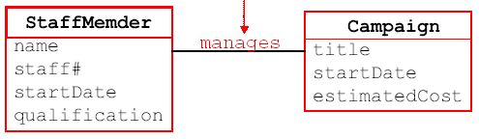
Association relationship
An association is a structural relationship which represents a binary relationship between objects
  For example: a car is owned by a person or a staff member manages a campaign
An association has a name and may be specified along with zero, one or two roles
name

Slide 15
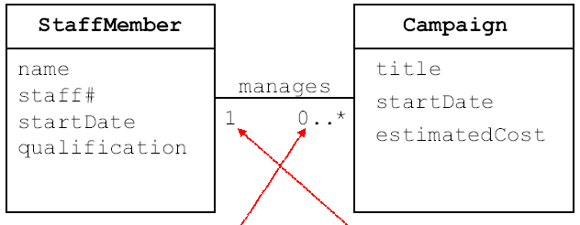
Association with multiplicity
Some examples of specifying multiplicity:
  Optional (0 or 1) = 0..1
  Exactly one 1 = 1..1
  Zero or more 0..* = *
  One or more 1..*
  A range of values 1..6
  A set of ranges 1..3,7..10,15,19..*
“A staff member can manage zero or more campaigns”
“A campaign is managed by exactly one staff member”

Slide 16
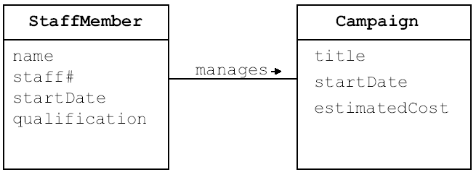
Direction of an association
You can specify explicitly the direction in which an association is to be read

Slide 17
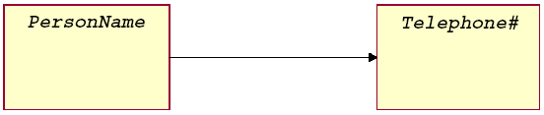
Association navigation
Sometimes we want to model explicitly the fact that an association is uni-directional
For example: given a person’s full name, you can get the person’s telephone number but not the other way around

Slide 18
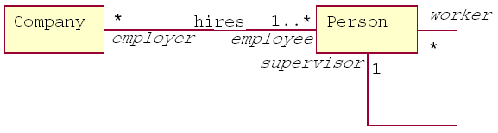
Association and role
We can name explicitly the role a class in an association
The same class can play the same or different roles in other associations

Slide 19
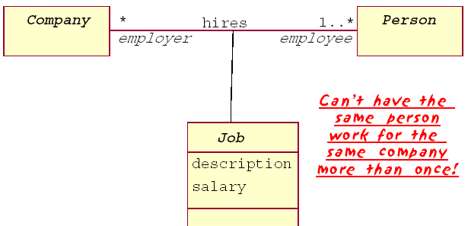
Association class
Sometimes we want to treat an association between two classes as a class in its own right (i.e., with its own attributes and operations)

Slide 20
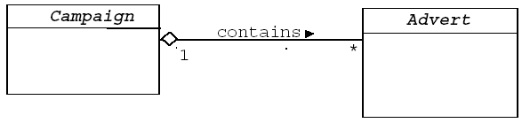
Aggregation relationship
This is the Has-a or Whole/part relationship, where one object is the “whole”, and the other (one of) the “part(s)”

Slide 21
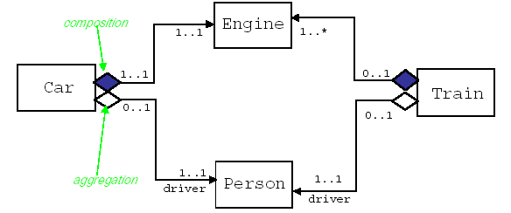
Composition relationship
It is a special case of the aggregation relationship
A composition relationship implies strong ownership of the part by the whole (i.e., implies that if the whole is removed from the model, so is the part)
In a composition relationship, the whole is responsible for the disposition of its parts (i.e. the composite must manage the creation and destruction of its parts)

Slide 22
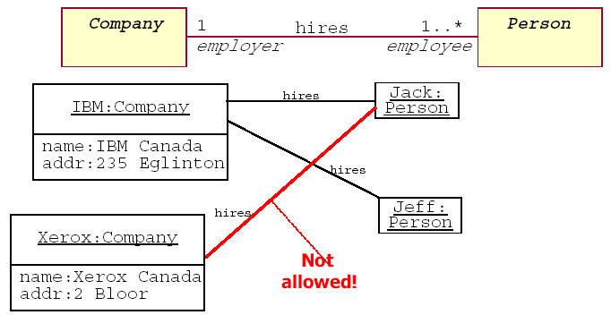
Object diagrams
These are like class diagrams, except now we model objects, i.e., instances of the classes defined in class diagrams

Slide 23
Business rules
Business rules are used to describe the properties of an application, e.g., the fact that an employee cannot earn more than his or her manager.
A business rule can be:
  the description of a concept relevant to the application (also known as a business object)
  an integrity constraint on the data of the application
  a derivation rule, whereby information can be derived from other information within a class diagram

Slide 24
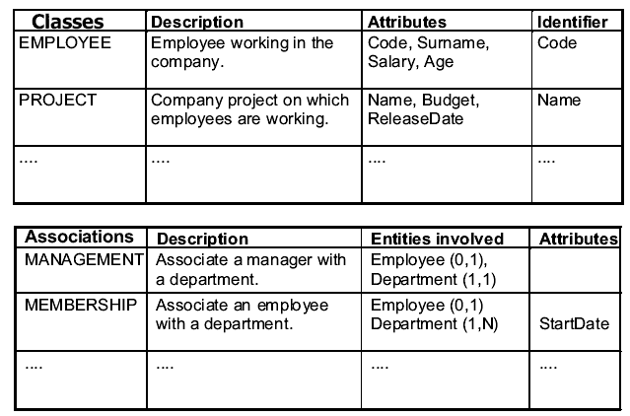
Documentation techniques (1)
Descriptive business rules can be organized into a data dictionary
This is made up of two tables: the first describes the classes of the diagram, the other describes the associations

Slide 25
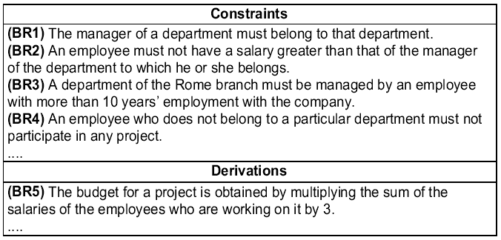
Documentation techniques (2)
Business rules that describe constraints can be expressed in the following form:
<concept> must/must not <expression on concepts>
Business rules that describe derivations can be expressed in the following form:
<concept> is obtained by <operations on concepts>

Slide 26
Comparison of class and ER diagrams
ER diagrams allow N-ary relationships, N≥2; Class diagrams only allow binary relationships
ER diagrams allow multi-valued attributes, class diagrams do not
ER diagrams allow the specification of identifiers (an often-encountered type of constraint), while class diagrams do not
Class diagrams allow dynamic classification, but ER diagrams do not

