Slide 1
ECMI-2110: Analyse et Modélisation des Systèmes d’Information
Information System Engineering: Analysis and Design
Chapter 4: Object-Oriented Modeling
Interaction Diagrams
Prof. Stéphane Faulkner
Facultés Univesitaires Notre-Dame de la Paix, 2005-2006

Slide 2
Interaction diagrams
In OO systems tasks are performed by objects interacting with each other
Interactions among objects are modeled by interaction diagrams
An interaction between two objects A and B involves object A sending a message requesting an action that object B can perform
There are two types of interaction diagrams:
  Sequence diagrams
  Collaboration diagrams
Class diagrams model the static structure of the system <> interaction diagrams model the dynamic aspects of the system

Slide 3
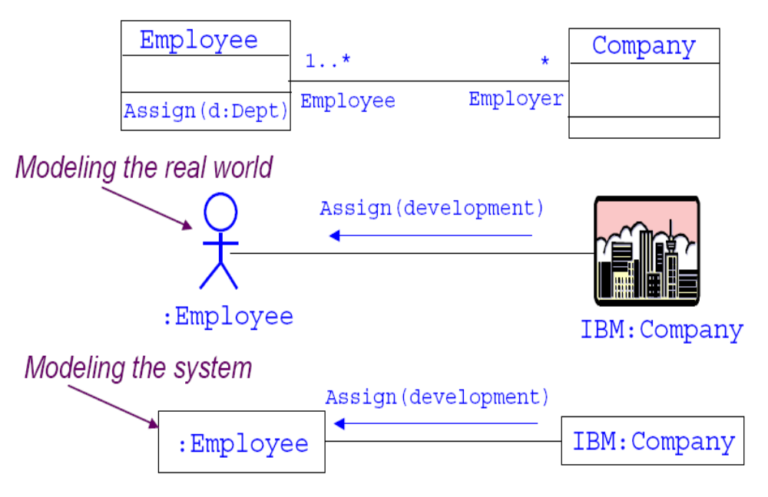
The nature of an interaction

Slide 4
Sequence diagrams
Sequence diagrams describe in detail how actors use use-cases
Interactions consist of one or more messages exchanged between external and system objects.
Interactions may be synchronous (e.g., calling someone on the phone), or asynchronous (e.g., sending someone email)
Sequence diagrams defined during requirements analysis should not:
  include design objects
  specify message signatures in any detail

Slide 5
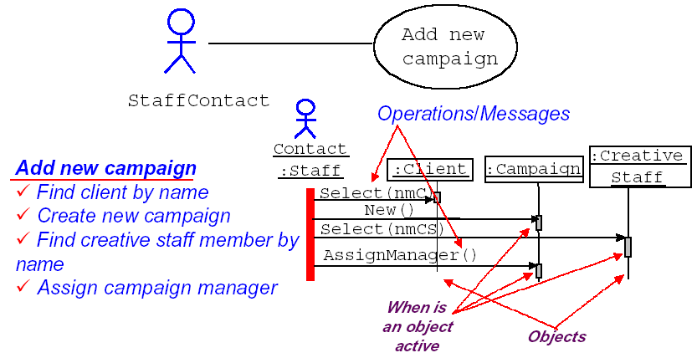
Example: add a new campaign
Getting back to the use case “Add a new campaign”

Slide 6
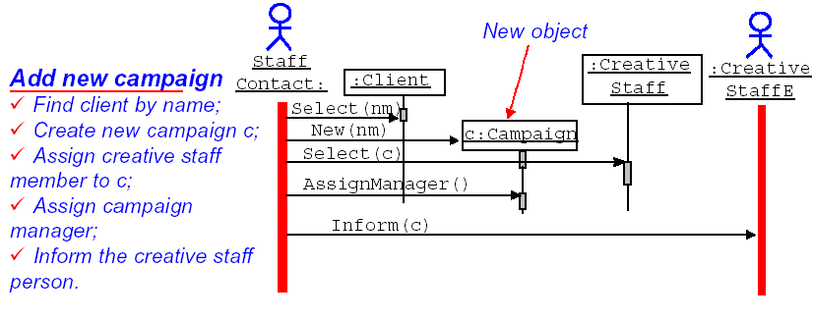
A more realistic example
This describes a business process involving two people and three system objects

Slide 7
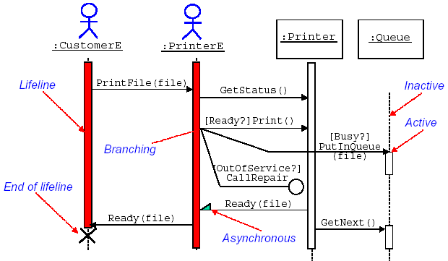
Another example: print shop
Synchronous: a message is sent by one object to another and the first object waits until the resulting action has completed
Asynchronous: a message is sent by one object to another but the first object does not wait until the resulting action has completed to carried out the next action

Slide 8
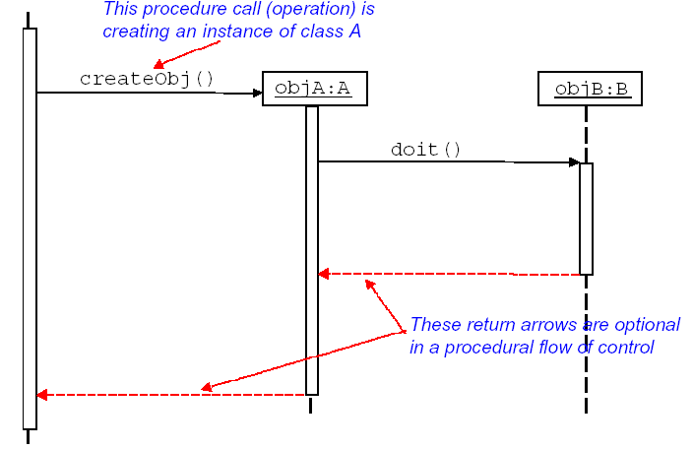
Flow of control
Return: represents the explicit return of control from the object to which the message was sent

Slide 9
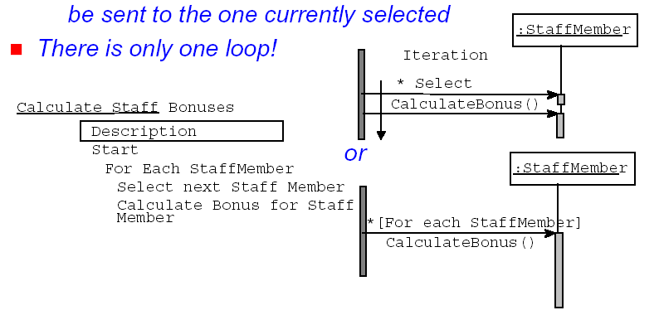
Iteration
Iteration shown with an asterisk:
  Each StaffMember will be selected in turn
  Once selected, the CalculateBonus message will be sent to the one currently selected

Slide 10
How to produce sequence diagrams
For a particular use case, start by identifying which objects and actors might be involved
Imagine that there is a use case called Check Campaign Budget
  Each Campaign has an EstimatedCost attribute and each Advert has an EstimatedCost attribute
The purpose of the use case is to check that the total estimated cost of all the adverts is less than that for the campaign as a whole
...Which objects are involved here?

Slide 11
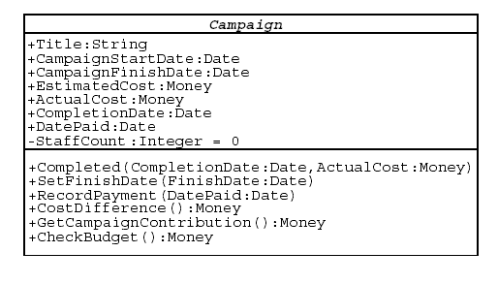
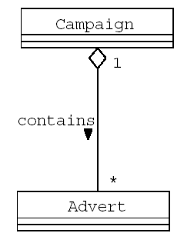
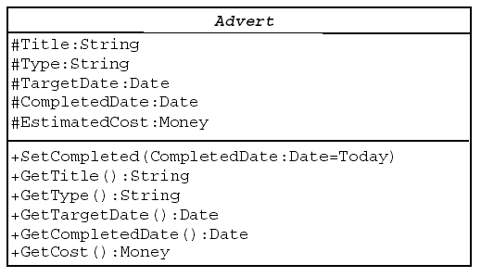
Campaign and advert

Slide 12
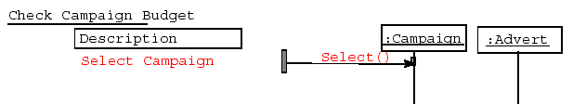
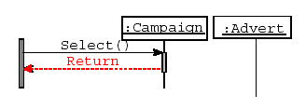
Creating a sequence diagram
We can also add in a Return

Slide 13
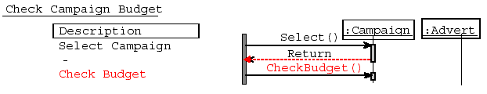
Creating a sequence diagram (Cont’d)
We then need to send a message to the Campaign to check its budget

Slide 14
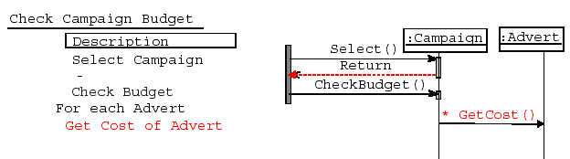
Creating a sequence diagram (Cont’d)
Note the * for iteration
We are assuming here that : Campaign knows about all the Adverts that are associated with it because of the aggregation association shown earlier

Slide 15
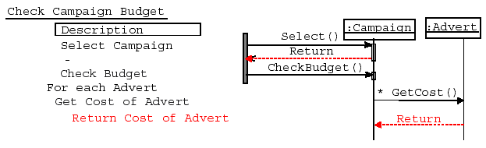
Creating a sequence diagram (Cont’d)
What happens next?
Advert returns its cost, in this case the EstimatedCost of the Advert
Once all the Advert’s costs have been fetched and summed up, the total can be taken away from the EstimatedCost of the Campaign

Slide 16
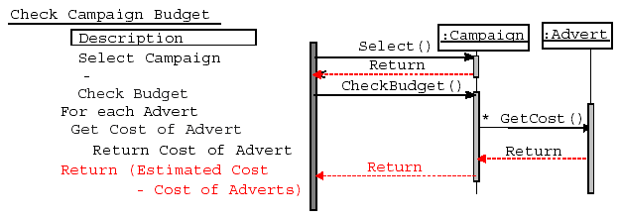
Creating a sequence diagram (Cont’d)
Now Campaign can return the difference between estimated cost and actual cost

Slide 17
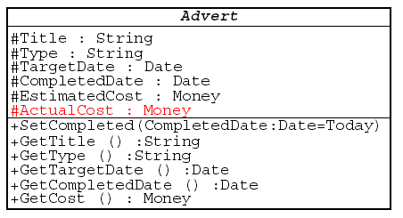
…Back to class diagrams
We could add a new attribute to Advert called ActualCost, set when Advert is completed
Now GetCost() can return the ActualCost if it exists, otherwise it uses EstimatedCost()

Slide 18
Collaboration diagrams
Collaboration diagrams are comparable to sequence diagrams
We can map every sequence diagram to an equivalent collaboration diagram and vice versa…but some information is lost in the conversion:
  Sequence diagrams do not show the links between objects
  Collaboration diagrams show interactions without the time dimension
Like sequence diagrams, collaboration diagrams are intended to model scenaria; each scenario describes a possible sequence of events and actions

Slide 19
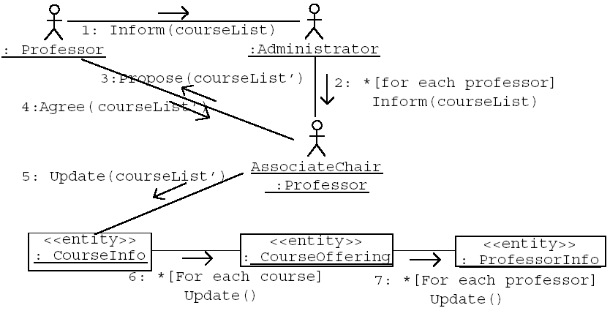
Select courses to teach

Slide 20
Relationship with other diagrams
Sequence or collaboration diagrams can be used to model the realization of either use case or operations of classes
  Each operation being modelled must exist in a class diagram
  The names of messages must be event or be operations of the class receiving the message
  States that are referred to in guard conditions must be valid states of the revelant class and should appear in a statechart diagram

