Slide 1
Analyse et Modélisation des Systèmes d’Information
Information System Engineering: Analysis and Design
Object-Oriented Modeling
Use Case Modelling
Prof. Stéphane Faulkner
Conceptual Modeling

Slide 2
Section overview
What is use-case model
Basic concept for the use-case diagram
  Actor
  Use-case
Relationship between an actor and a use-case
Generalization
Include and extend relationships
How to produce use-cases
Relationships with other diagrams
Conceptual Modeling
Notes:
Azerthhden,b

Slide 3
What is use-case model?
A model that describes the behavior of some entity such as a system or subsystem
  System behavior is how a system acts and reacts
    - It comprises the actions and activities of a system
A model that describe the interactions between the system and (parts of) its environment
  Do not specify the detail of how these interactions are carried out
    - Detail can be provided by interaction diagrams, activity diagram and statechart diagram
Conceptual Modeling

Slide 4

What are the benefits of use-case model?
Communication
Identification
Verification
Use Case
Communication
Verification
Identification
End User
Domain Expert
Users
Conceptual Modeling

Slide 5
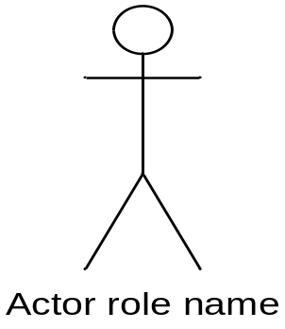
Basic concept for the use-case diagram: an actor
Actors represent roles a user of the system can play
They can represent a human, a machine, or another system
They can actively interchange information with the system
They can be a giver of information
They can be a passive recipient of information
Actors are not part of the system
  Actors are EXTERNAL
Conceptual Modeling

Slide 6
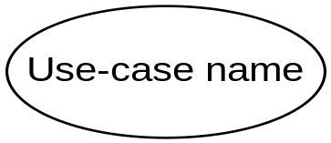
Basic concept for the use-case diagram: a use-case
A use-case describe a sequence of actions a system performs to achieve an observable result of value to an actor
  It may be described informally in text or through a behavior specification represented by a link to an interaction diagram
  The high-level view of the use cases in a system is represented by use case diagram
The term scenarios is often used to refer to the different possible course of action that different instances of the same use case might take
Conceptual Modeling

Slide 7
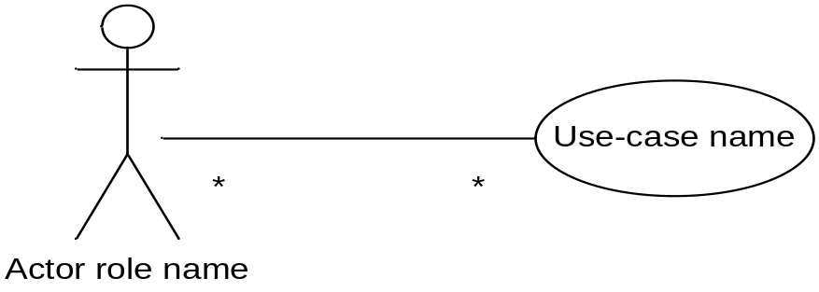
Relationship between an actor and a use case
A use case is initiated by an actor to invoke a certain functionality (behavior) in the system
Actors are connected to the use-cases with which they interact by a communication relationship
  A single actor may be associated with more than one use case, and a single use case may be associated with more than one actor
Conceptual Modeling

Slide 8
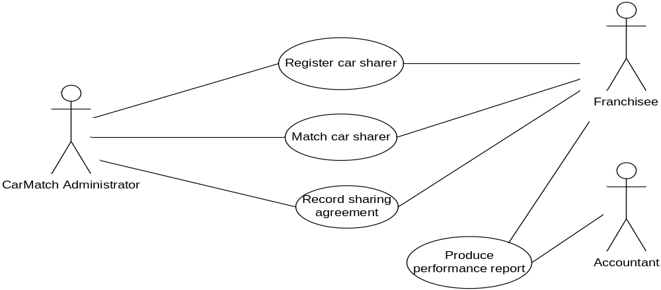
Example of use-case diagram for part of the CarMatch system
Case study: CarMatch is a franchising company that promotes car sharing (for more information see Annex 1)
Conceptual Modeling

Slide 9
Use-case descriptions
There are two common approaches to writing use case description:
  For exemple, the use case Register car sharer
The user will enter the name, address and telephone number of the potential car sharer. For each journey that this person wants to share, the start address, the destination address, the start time and the finish time of the journey are entered.
Simple use-case description
Actor
1 The user enters the name and the address of the car sharer into the system
2 The user enters the telephone number of the car sharer into the system
3 The user enters the start time and start address
4 The user enters the finish time and destination address
System
1 The system confirms that the address can be matched against the geographical DB
2 The system prompts for the details of a journey
3 The system confirms that the start address can be matched against the geographical DB
4 The system confirms that the finish address can be matched against the geographical DB. The system prompts for another journey is to be entered
Use-case description using columns
Conceptual Modeling

Slide 10
Other types of Relationships
There are four other types of relationships that can be shown in a use-case diagram:
  Generalization between use-case
  Generalization between actors
  Include relationship between use-case
  Extend relationship between use-case
Conceptual Modeling

Slide 11
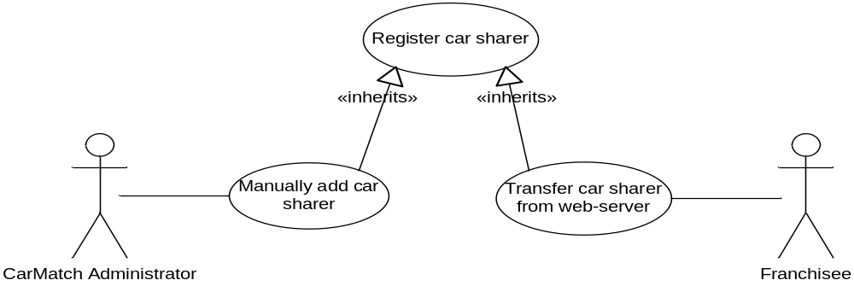
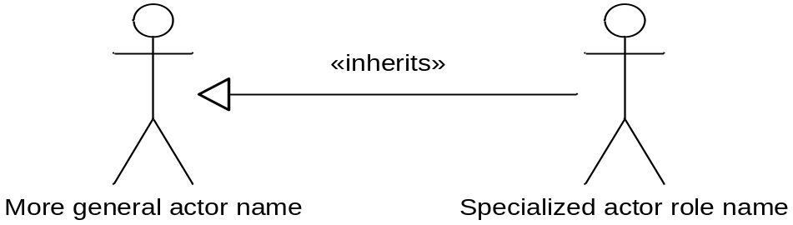
Generalization
Use-case in a generalization relationship
Actor generalization relationship
Conceptual Modeling

Slide 12
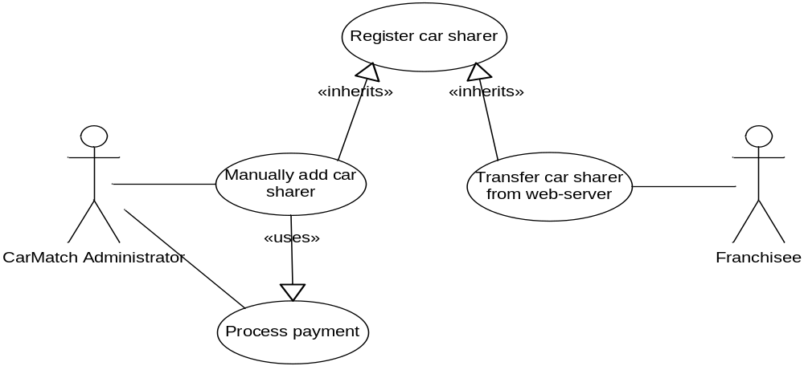
Uses relationship
An include relationship is used when a use-case includes the functionality of another use-case
  For example, Process payments is both a use case on its own and included in the use-case Manually add car sharer
Conceptual Modeling

Slide 13
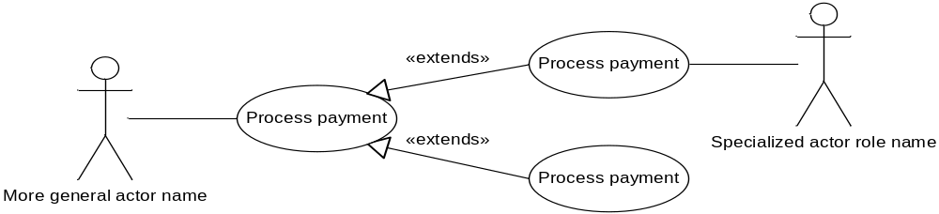
Extend relationship
An extend relationship is used to describe that a use-case may optionally be extended by the functionality of another use-case
  For example, Process payments can be extended by either the use-case Process card payment or the use-case Process direct debit
Conceptual Modeling

Slide 14
How to produce use-cases
Find actors and use-cases
  Who are the people who will use this system to enter information?
  Who are the people who will use this system as recepients of information?
  What are the other systems that this system will interact with?
Prioritize use-cases
  Ensure that the important use-cases are developed in early iterations
Develop each use case (starting with the priority ones)
  Produce use-case descriptions
    - This activity may result in new use-case
Structure the use-case model
  Structure is added to the use-case diagram through the use of generalization, include and extend relationships
Conceptual Modeling

Slide 15
Relationship with other diagrams
The behavior of a use case may be specified using another UML diagram: collaborative diagram, sequence diagram or statechart diagram
An activity diagram in the use-case model can be used to capture the activities and actions performed in a use case
Conceptual Modeling

