Slide 1
Big Data at AT&T
Regional Fall Case Competition
Shouvik Pal
Sanket Panaskar
Anees Mohammed

Slide 2
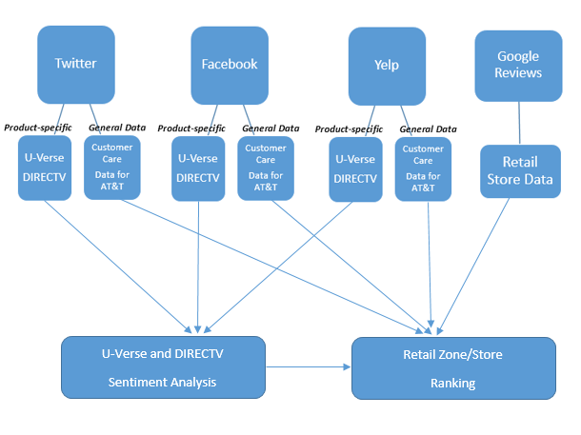
Flow Chart

Slide 3
AT&T Proprietary Information
This is AT&T proprietary information.

