Slide 1
Building Python Programs
Chapter 4: Conditional Execution

Slide 2
The if/else statement

Slide 3
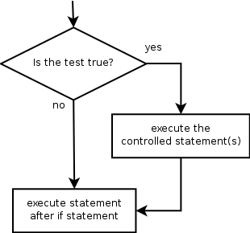
The if statement
Executes a block of statements only if a test is true
if test:
statement
...
statement
Example:
gpa = float(input("gpa? "))
if gpa >= 2.0:
print("Application accepted.")

Slide 4
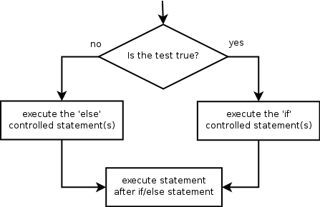
The if/else statement
Executes one block if a test is true, another if false
if test:
statement(s)
else:
statement(s)
Example:
gpa = float(input("gpa? "))
if gpa >= 2.0:
print("Welcome to Mars University!")
else:
print("Application denied.")

Slide 5
Relational expressions
if statements use logical tests.
if i <= 10: ...
These are boolean expressions
Tests use relational operators:
Operator | Meaning | Example | Value
== | equals | 1 + 1 == 2 | True
!= | does not equal | 3.2 != 2.5 | True
< | less than | 10 < 5 | False
> | greater than | 10 > 5 | True
<= | less than or equal to | 126 <= 100 | False
>= | greater than or equal to | 5.0 >= 5.0 | True
Notes:
Note that == tests equality, not = . The = is used for the assignment operator!

Slide 6
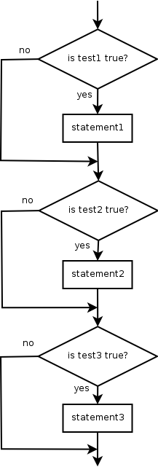
Misuse of if
What's wrong with the following code?
percent = float(input("What percentage did you earn? "))
if percent >= 90:
print("You got an A!")
if percent >= 80:
print("You got a B!")
if percent >= 70:
print("You got a C!")
if percent >= 60:
print("You got a D!")
if percent < 60:
print("You got an F!")
...

Slide 7
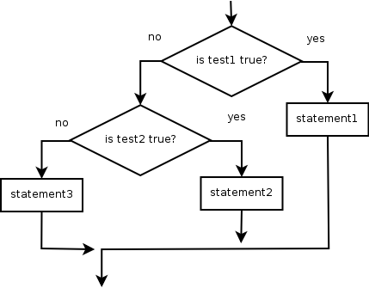
Nested if/else
Chooses between outcomes using many tests
if test:
statement(s)
elif test:
statement(s)
else:
statement(s)
Example:
if x > 0:
print("Positive")
elif x < 0:
print("Negative")
else:
print("Zero")

Slide 8
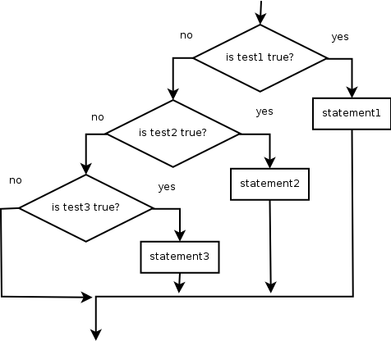
Nested if/elif/elif
If it ends with else, exactly one path must be taken.
If it ends with if, the code might not execute any path.
if test:
statement(s)
elif test:
statement(s)
elif test:
statement(s)
Example:
if place == 1:
print("Gold medal!")
elif place == 2:
print("Silver medal!")
elif place == 3:
print("Bronze medal.")

Slide 9
Nested if structures
exactly 1 path (mutually exclusive) if test: statement(s) elif test: statement(s) else: statement(s) | 0 or 1 path (mutually exclusive) if test: statement(s) elif test: statement(s) elif test: statement(s)
0, 1, or many paths (independent tests; not exclusive) if test: statement(s) if test: statement(s) if test: statement(s)

Slide 10
Which nested if/else?
(1) if/if/if (2) nested if/else (3) nested if/elif/elif
Whether a user is lower, middle, or upper-class based on income.
(2) nested if / elif / else
Whether you made the dean's list (GPA ≥ 3.8) or honor roll (3.5-3.8).
(3) nested if / elif
Whether a number is divisible by 2, 3, and/or 5.
(1) sequential if / if / if
Computing a grade of A, B, C, D, or F based on a percentage.
(2) nested if / elif / elif / elif / else

Slide 11
Nested if/else question
Write a program that produces output like the following:
This program reads data for two
people and computes their basal
metabolic rate and burn rate.
Enter next person's information:
height (in inches)? 73.5
weight (in pounds)? 230
age (in years)? 35
gender (male or female)? male
Enter next person's information:
height (in inches)? 71
weight (in pounds)? 220.5
age (in years)? 20
gender (male or female)? female
Person #1 basal metabolic rate = 2042.3
high resting burn rate
Person #2 basal metabolic rate = 1868.4
moderate resting burn rate
Basal Metabolic Rate Formula:
male BMR = 4.54545 x (weight in lb) + 15.875 x (height in inches) - 5 x (age in years) + 5
female BMR = 4.54545 x (weight in lb) + 15.875 x (height in inches) - 5 x (age in years) - 161
BMR | Burn Level
below 12000 | low
1200 to 2000 | moderate
above 2000 | high
Notes:
// This program computes two people's body mass index (BMI) and
// compares them. The code uses parameters, returns, and Scanner.
import java.util.*; // so that I can use Scanner
public class BMI {
public static void main(String[] args) {
System.out.println("This program reads in data for two people and");
System.out.println("computes their body mass index (BMI)");
System.out.println();
// finish me!
}
}

Slide 12
Nested if/else answer
# This program finds the basal metabolic rate (BMR) for two
# individuals. This variation includes several functions
# other than main.
# introduces the program to the user
def give_intro():
print("This program reads data for two")
print("people and computes their basal")
print("metabolic rate and burn rate.")
print()
# prompts for one person's statistics, returning the BMI
def get_bmr(person):
print("Enter person", person, "information:")
height = float(input("height (in inches)? "))
weight = float(input("weight (in pounds)? "))
age = float(input("age (in years)? "))
gender = input("gender (male or female)? ")
bmr = bmr_for(height, weight, age, gender)
print()
return bmr
...

Slide 13
Nested if/else, cont'd.
# this function contains the basal metabolic rate formula for
# converting the given height (in inches), weight
# (in pounds), age (in years) and gender (male or female) into a BMR
def bmr_for(height, weight, age, gender):
bmr = 4.54545 * weight + 15.875 * height - 5 * age
if gender.lower() == "male":
bmr += 5
else:
bmr -= 161
return bmr
# reports the overall bmr values and status
def report_results(bmr1, bmr2):
print("Person #1 basal metabolic rate =", round(bmr1, 1))
report_status(bmr1)
print("Person #2 basal metabolic rate =", round(bmr2, 1))
report_status(bmr2)
# reports the burn rate for the given BMR value
def report_status(bmr):
if bmr < 1200:
print("low resting burn rate");
elif bmr <= 2000:
print("moderate resting burn rate")
else: # bmr1 > 2000
print("high resting burn rate")
def main():
give_intro()
bmr1 = get_bmr(1)
bmr2 = get_bmr(2)
print(bmr1, bmr2)
report_results(bmr1, bmr2)
main()
Notes:
How would we round the BMI numbers?

Slide 14
Factoring if/else code
factoring: Extracting common/redundant code.
Can reduce or eliminate redundancy from if/else code.
Example:
if a == 1:
print(a)
x = 3
b = b + x
elif a == 2:
print(a)
x = 6
y = y + 10
b = b + x
else: # a == 3
print(a)
x = 9
b = b + x
print(a)
x = 3 * a
if a == 2:
y = y + 10
b = b + x

Slide 15
Cumulative Algorithms

Slide 16
Adding many numbers
How would you find the sum of all integers from 1-1000?
# This may require a lot of typing
sum = 1 + 2 + 3 + 4 + ...
print("The sum is", sum)
What if we want the sum from 1 - 1,000,000? Or the sum up to any maximum?
How can we generalize the above code?

Slide 17
Cumulative sum loop
sum = 0
for i in range(1, 1001):
sum += i // sum = sum + i
print("The sum is", sum)
cumulative sum: A variable that keeps a sum in progress and is updated repeatedly until summing is finished.
The sum in the above code is an attempt at a cumulative sum.
Cumulative sum variables must be declared outside the loops that update them, so that they will still exist after the loop.

Slide 18
Cumulative product
This cumulative idea can be used with other operators:
product = 1
for i in range(1, 21):
product *= 2 // product = product * 2
print("2 ^ 20 =", product)
How would we make the base and exponent adjustable?

Slide 19
input and cumulative sum
We can do a cumulative sum of user input:
sum = 0
for i in range(1, 101):
next = int(input("Type a number: "))
sum = sum + next // sum += next
print("The sum is", sum)

Slide 20
Cumulative sum question
Modify the receipt program from lecture 2
Prompt for how many people, and each person's dinner cost.
Use functions to structure the solution.
Example log of execution:
How many people ate? 4
Person #1: How much did your dinner cost? 20.00
Person #2: How much did your dinner cost? 15
Person #3: How much did your dinner cost? 30.0
Person #4: How much did your dinner cost? 10.00
Subtotal: $75.0
Tax: $6.0
Tip: $11.25
Total: $92.25

Slide 21
Cumulative sum answer
# This program enhances our Receipt program using a cumulative sum.
def main():
subtotal = meals()
results(subtotal)
# Prompts for number of people and returns total meal subtotal.
def meals():
people = float(input("How many people ate? "))
subtotal = 0.0; # cumulative sum
for i in range(1, people + 1):
person_cost = float(input("Person #" + str(i) +
": How much did your dinner cost? "))
subtotal = subtotal + person_cost # add to sum
return subtotal
...

Slide 22
Cumulative answer, cont'd.
# Calculates total owed, assuming 8% tax and 15% tip
def results(subtotal):
tax = subtotal * .08
tip = subtotal * .15
total = subtotal + tax + tip
print("Subtotal: $" + str(subtotal))
print("Tax: $" + str(tax))
print("Tip: $" + str(tip))
print("Total: $" + str(total))

Slide 23
Strings

Slide 24
Strings
string: a type that stores a sequence of text characters.
name = "text"
name = expression
Examples: name = "Daffy Duck" x = 3 y = 5 point = "(" + str(x) + ", " + str(y) + ")"

Slide 25
Indexes
index | 0 | 1 | 2 | 3 | 4 | 5 | 6 | 7
 | -8 | -7 | -6 | -5 | -4 | -3 | -2 | -1
character | U | l | t | i | m | a | t | e
Characters of a string are numbered with 0-based indexes:
name = "Ultimate"
First character's index : 0
Last character's index : 1 less than the string's length

Slide 26
Accessing characters
You can access a character with string[index]:
name = "Merlin"
print(name[0])
Output: M

Slide 27
Accessing substrings
Syntax:
part = string[start:stop]
Example:
s = "Merlin"
mid = [1:3] # er
If you want to start at the beginning you can leave off start
mid = [:3] # Mer
If you want to start at the end you can leave off the stop
mid = [1:] # erlin

Slide 28
String methods
Method name | Description
find(str) | index where the start of the given string appears in this string (-1 if not found)
substring(index1, index2) or substring(index1) | the characters in this string from index1 (inclusive) to index2 (exclusive); if index2 is omitted, grabs till end of string
lower() | a new string with all lowercase letters
upper() | a new string with all uppercase letters
These methods are called using the dot notation below:
starz = "Biles & Manuel"
print(starz.lower()) # biles & manuel

Slide 29
String method examples
# index 012345678901
s1 = "Allison Obourn"
s2 = "Merlin The Cat"
print(s1.find("o")) # 5
print(s2.lower()) # "merlin the cat"
Given the following string:
# index 012345678901234567890123
book = "Building Python Programs"
How would you extract the word "Python" ?

Slide 30
Modifying strings
String operations and functions like lowercase build and return a new string, rather than modifying the current string.
s = "Aceyalone"
s.upper()
print(s) # Aceyalone
To modify a variable's value, you must reassign it:
s = "Aceyalone"
s = s.upper()
print(s) # ACEYALONE

Slide 31
Other String operations - length
Syntax:
length = len(string)
Example:
s = "Merlin"
count = len(s) # 6

Slide 32
Looping through a string
The for loop through a string using range:
major = "CSc"
for letter in range(0, len(major)):
print(major[letter])
You can also use a for loop to print or examine each character without range.
major = "CSc"
for letter in major:
print(letter)
Output:
C
S
c

Slide 33
String tests
Method | Description
startswith(str) | whether one contains other's characters at start
endswith(str) | whether one contains other's characters at end
name = "Voldermort"
if name.startswith("Vol"):
print("He who must not be named")
The in keyword can be used to test if a string contains another string.
example: "er" in name # true

Slide 34
String question
A Caesar cipher is a simple encryption where a message is encoded by shifting each letter by a given amount.
e.g. with a shift of 3, A → D, H → K, X → A, and Z → C
Write a program that reads a message from the user and performs a Caesar cipher on its letters:
Your secret message: Brad thinks Angelina is cute
Your secret key: 3
The encoded message: eudg wklqnv dqjholqd lv fxwh

Slide 35
Strings and ints
All char values are assigned numbers internally by the computer, called ASCII values.
Examples:
'A' is 65, 'B' is 66, ' ' is 32
'a' is 97, 'b' is 98, '*' is 42
One character long Strings and ints can be converted to each other
ord('a') is 97, chr(103) is 'g'
This is useful because you can do the following:
chr(ord('a' + 2)) is 'c'

