Slide 1
Building Python Programs
Chapter 6: File Processing

Slide 2
File Input/output (I/O)
name = open("filename")
opens the given file for reading, and returns a file object
name.readlines() - file's entire contents as a string
>>> f = open("weather.txt”,’r’)
>>> f.read()
['42', '34', '35', '46', '45', '43', '43', '49']

Slide 3
File Input/output (I/O) - Better Style
The following code will output the same thing as the code on the previous slide and will automatically close the file.
with open("weather.txt") as file:
file.readlines()
Considered better style

Slide 4
File paths
absolute path: specifies a drive or a top "/" folder
C:/Documents/smith/hw6/input/data.csv
Windows can also use backslashes to separate folders.
relative path: does not specify any top-level folder
names.dat
input/kinglear.txt
Assumed to be relative to the current directory:
file = open("data/readme.txt")
If our program is in H:/hw6 , open will look for H:/hw6/data/readme.txt

Slide 5
File input question
16.2
23.5
19.1
7.4
22.8
18.5
-1.8
14.9
We have a file weather.txt:
Write a program that prints the change in temperature between each pair of neighboring days.
16.2 to 23.5, change = 7.3
23.5 to 19.1, change = -4.4
19.1 to 7.4, change = -11.7
7.4 to 22.8, change = 15.4
22.8 to 18.5, change = -4.3
18.5 to -1.8, change = -20.3
-1.8 to 14.9, change = 16.7
Notes:
8 temperatures in the file, but 7 lines of output. It's a fencepost problem in disguise.

Slide 6
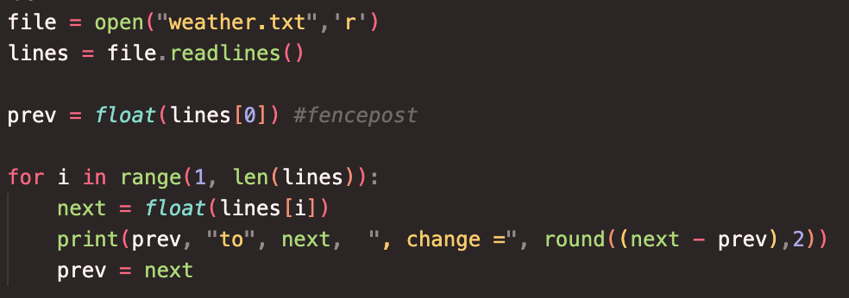
File input answer
# Displays changes in temperature from data in an input file.

Slide 7
Gas prices question
Write a program that reads a file gasprices.txt
Format: Belgium $/gal US $/gal date …
8.20 3.81 3/21/11 8.08 3.84 3/28/11 ...
The program should print the average gas price over all data in the file for both countries:
Belgium average: 8.3
USA average: 3.9
Notes:
I don't usually have time to do this program in lecture. It's just here in case I have extra time, or for students to look at later.

Slide 8
Multiple tokens on one line
You can use read to read the whole file into a string and the split function to break a file apart
str.split() - splits a string on blank space
str.split(other_str) - splits a string on occurrences of the
other string
>>> f = open("hours.txt")
>>> text = f.read()
'1 2\n45 6\n'
>>> f = text.split()
['1', '2', '45', '6']

Slide 9
Looping through a file
The result of split can be used in a for ... in loop
A template for reading files in Python:
with open("filename") as file:
text = file.read()
text = text.split()
for line in text:
statements

Slide 10
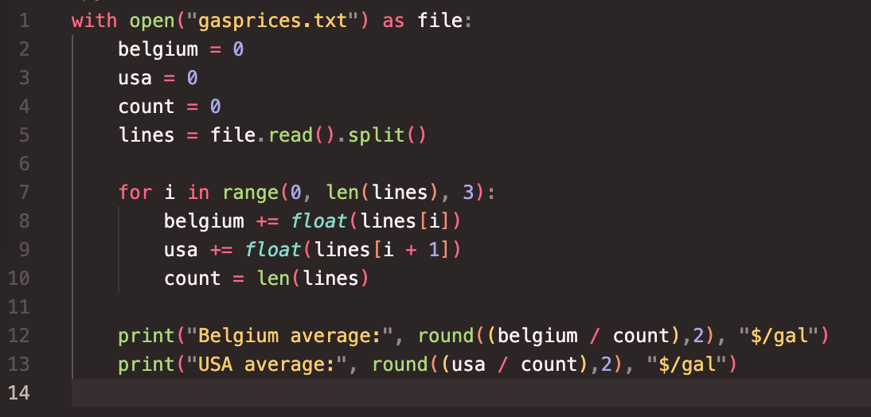
Gas prices solution

Slide 11

Hours question
Given a file hours.txt with the following contents:
123 Clark 12.5 8.1 7.6 3.2
456 Jordan 4.0 11.6 6.5 2.7 12
789 Faiz 8.0 8.0 8.0 8.0 7.5
Consider the task of computing hours worked by each person:
Clark (ID#123) worked 31.4 hours (7.85 hours/day)
Jordan (ID#456) worked 36.8 hours (7.36 hours/day)
Faiz (ID#789) worked 39.5 hours (7.90 hours/day)

Slide 12
Line-based file processing
Instead of using read() use readlines() to read the file
Then use split() on each line
file = open("<filename>")
lines = file.readlines()
For line in lines:
parts = line.split()
<process the parts of the line>

Slide 13
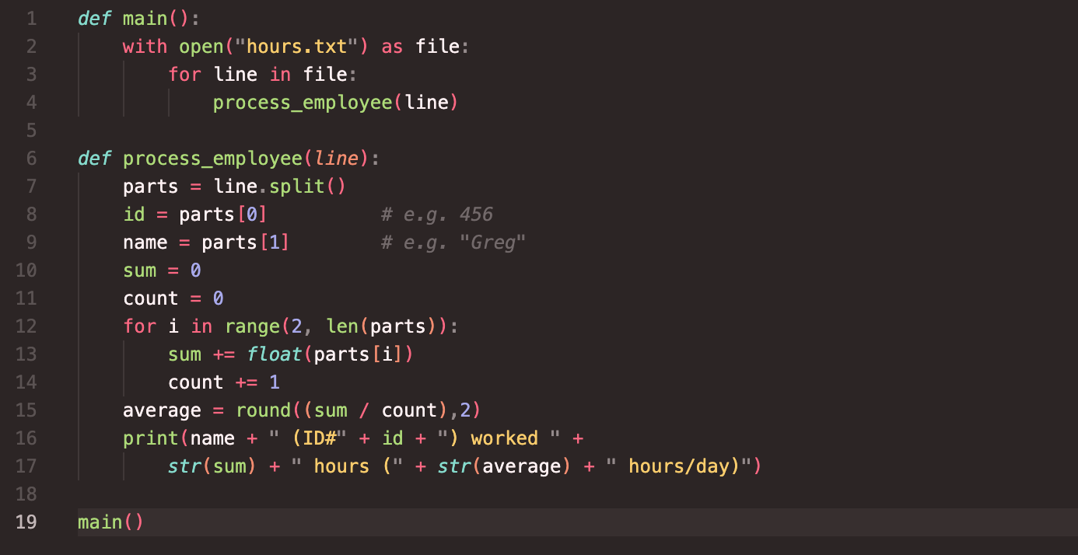
Hours answer
# Processes an employee input file and outputs each employee's hours.

Slide 14
IMDb movies problem
Consider the following Internet Movie Database (IMDb) data:
1 9.1 196376 The Shawshank Redemption (1994)
2 9.0 139085 The Godfather: Part II (1974)
3 8.8 81507 Casablanca (1942)
Write a program that displays any movies containing a phrase:
Search word? part
Rank Votes Rating Title
2 139085 9.0 The Godfather: Part II (1974)
40 129172 8.5 The Departed (2006)
95 20401 8.2 The Apartment (1960)
192 30587 8.0 Spartacus (1960)
4 matches.
Is this a token or line-based problem?

Slide 15
"Chaining"
main should be a concise summary of your program.
It is bad if each function calls the next without ever returning (we call this chaining):
A better structure has main make most of the calls.
Functions must return values to main to be passed on later.
main
functionA
functionB
functionC
functionD
main
functionA
functionB
functionD
functionD

Slide 16
Bad IMDb "chained" code 1
# Displays IMDB's Top 250 movies that match a search string.
def main():
get_word()
# Asks the user for their search word and returns it.
def get_word():
search_word = input("Search word: ")
search_word = search_word.lower()
print()
with open("imdb.txt") as file:
search(file, search_word)
# Breaks apart each line, looking for lines that match the search word.
def search(file, search_word):
matches = 0
for line in file:
line_lower = line.lower() # case-insensitive match
if (search_word in line_lower):
matches += 1
print("Rank\tVotes\tRating\tTitle")
display(line)

Slide 17
Bad IMDb "chained" code 2
# Displays the line in the proper format on the screen.
def display(line):
parts = line.split()
rank = parts[0]
rating = parts[1]
votes = parts[2]
title = ""
for i in range(3, len(parts)):
title += parts[i] + " " # the rest of the line
print(rank + "\t" + votes + "\t" + rating + "\t" + title)

Slide 18
Better IMDb answer 1
# Displays IMDB's Top 250 movies that match a search string.
def main():
word = search_word()
with open("imdb.txt") as file:
lines = file.readlines()
count = 0
for i in range(len(lines)):
if word in lines[i].lower():
# only output the table titles if this is the first
# movie that we have found
if count == 0:
print("Rank\tVotes\tRating\tTitle")
output(lines[i])
count += 1
if count == 1:
print("1 match.")
else:
print(count, "matches.")
...

Slide 19
Better IMDb answer 2
...
# prompts the user for a word or phrase to search for
def search_word():
word = input("Search word? ")
word = word.lower()
return word
# outputs the passed in line in the order of rank, votes, rating, title
# with each separated by a tab.
def output(line):
text = line.split()
print(text[0] + "\t" + text[2] + "\t" + text[1] + "\t", end='')
for i in range(3, len(text)):
print(text[i] + " ", end='')
print()
main()

Slide 20
Output to files
Open a file in write or append mode
'w' - write mode – replaces everything in the file
'a' – append mode – adds to the bottom of the file preserving what is already in it
name = open("filename", "w") # write
name = open("filename", "a") # append

Slide 21
Output to files
name.write(str) - writes the given string to the file
name.close() - closes file once writing is done
Example:
with open("output.txt", "w") as out:
out.write("Hello, world!\n")
out.write("How are you?")
text = open("output.txt").read() # Hello, world!\nHow are you?
Notes:
common PrintStream bug:
- declaring it in a method that gets called many times. This causes the file to be re-opened and wipes the past contents. So only the last line shows up in the file.

