Slide 1
Building Python Programs
Chapter 7: Lists

Slide 2
lists

Slide 3

Can we solve this problem?
Consider the following program (input underlined):
How many days' temperatures? 7
Day 1's high temp: 45
Day 2's high temp: 44
Day 3's high temp: 39
Day 4's high temp: 48
Day 5's high temp: 37
Day 6's high temp: 46
Day 7's high temp: 53
Average temp = 44.6
4 days were above average.

Slide 4
Why the problem is hard
We need each input value twice:
to compute the average (a cumulative sum)
to count how many were above average
We could read each value into a variable... but we:
don't know how many days are needed until the program runs
don't know how many variables to declare
We need a way to declare many variables in one step.

Slide 5
Lists
index | 0 -10 | 1 -9 | 2 -8 | 3 -7 | 4 -6 | 5 -5 | 6 -4 | 7 -3 | 8 -2 | 9 -1
value | 12 | 49 | -2 | 26 | 5 | 17 | -6 | 84 | 72 | 3
element 0
element 4
element 9
list: object that stores many values.
element: One value in a list.
index: A 0-based integer to access an element from an list.

Slide 6
List initialization
index | 0 | 1 | 2 | 3 | 4 | 5 | 6
value | 12 | 49 | -2 | 26 | 5 | 17 | -6
index | 0 | 1 | 2 | 3
value | 0 | 0 | 0 | 0
name = [value, value, … value]
Example:
numbers = [12, 49, -2, 26, 5, 17, -6]
Useful when you know what the list's elements will be
name = [value] * count
Example:
numbers = [0] * 4

Slide 7
Accessing elements
name[index] # access
name[index] = value # modify
Example:
numbers = [0] * 2
numbers[0] = 27
numbers[1] = -6
print(numbers[0])
if (numbers[1] < 0):
print("Element 1 is negative.")
index | 0 | 1
value | 27 | -6

Slide 8
Accessing list elements
x | 3
x
index | 0 | 1 | 2 | 3 | 4 | 5 | 6 | 7
value | 3 | 99 | 6 | 42 | 0 | 0 | 11 | 0
numbers
numbers = [0] * 8
numbers[0] = 3
numbers[1] = 99
numbers[2] = 6
x = numbers[0]
numbers[x] = 42
numbers[numbers[2]] = 11 # use numbers[2] as index

Slide 9
Out-of-bounds
Legal indexes to use []: between – list's length and the list's length - 1.
Reading or writing any index outside this range with [] will cause an IndexError: list assignment index out of range
Example:
data = [0] * 10
print(data[0]) # okay
print(data[9]) # okay
print(data[-20]) # error
print(data[10]) # error
index | 0 | 1 | 2 | 3 | 4 | 5 | 6 | 7 | 8 | 9
value | 0 | 0 | 0 | 0 | 0 | 0 | 0 | 0 | 0 | 0

Slide 10
Lists and for loops
index | 0 | 1 | 2 | 3 | 4 | 5 | 6 | 7
value | 0 | 2 | 4 | 6 | 8 | 10 | 12 | 14
It is common to use for loops to access list elements.
for i in range(0, 8):
print(str(numbers[i]) + " ", end='')
print() # output: 0 4 11 0 44 0 0 2
Sometimes we assign each element a value in a loop.
for i in range(0, 8):
numbers[i] = 2 * i

Slide 11
len()
Use len() to find the number of elements in a list.
for i in range(0, len(numbers)):
print(numbers[i] + " ", end='')
# output: 0 2 4 6 8 10 12 14
What expressions refer to:
The last element of any list?
The middle element?

Slide 12
Lists and for loops
You can also loop directly over lists, just as with strings
list = [1, 3, 6, 23, 43, 12]
for number in list:
print(str(number + " ", end='')
print() # output: 1 3 6 23 43 12

Slide 13
Weather question
Use a list to solve the weather problem:
How many days' temperatures? 7
Day 1's high temp: 45
Day 2's high temp: 44
Day 3's high temp: 39
Day 4's high temp: 48
Day 5's high temp: 37
Day 6's high temp: 46
Day 7's high temp: 53
Average temp = 44.6
4 days were above average.

Slide 14
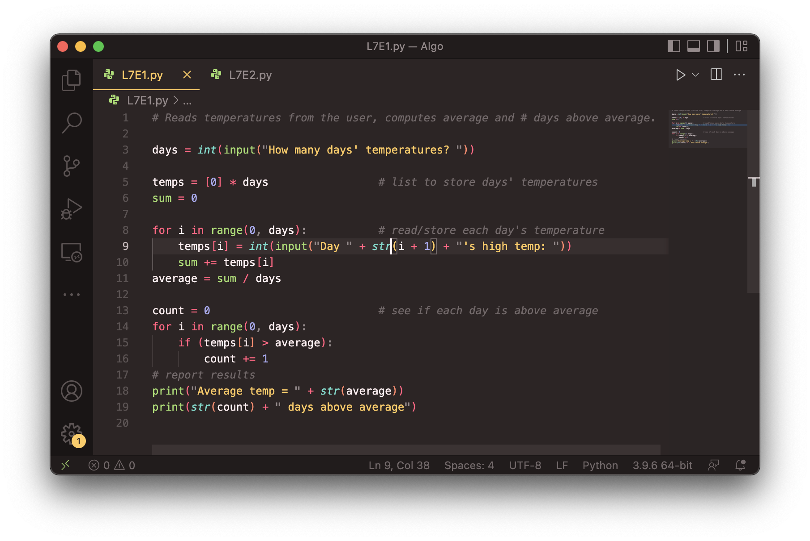
Weather answer

Slide 15
Weather question 2
Modify the weather program to print the following output:
Type in a temperature or "done" to finish
Day 1's high temp: 45
Day 2's high temp: 44
Day 3's high temp: 39
Day 4's high temp: 48
Day 5's high temp: 37
Day 6's high temp: 46
Day 7's high temp: 53
Day 7's high temp: done
Average temp = 44.6
4 days were above average.

Slide 16
List declaration
Creates an empty list
index
value
name = []
Example:
numbers = []

Slide 17
List functions
Function | Description
append(x) | Add an item to the end of the list. Equivalent to a[len(a):] = [x].
extend(L) | Extend the list by appending all the items in the given list. Equivalent to a[len(a):] = L
insert(i, x) | Inserts an item at a given position. i is the index of the element before which to insert, so a.insert(0, x) inserts at the front of the list.
remove(x) | Removes the first item from the list whose value is x. Errs if there is no such item.
pop(i) | Removes the item at the given position in the list, and returns it. a.pop() removes and returns the last item in the list.
clear() | Remove all items from the list.
index(x) | Returns the index in the list of the first item whose value is x. Errs if there is no such item.
count(x) | Returns the number of times x appears in the list.
sort() | Sort the items of the list
reverse() | Reverses the elements of the list
copy() | Return a copy of the list.

Slide 18
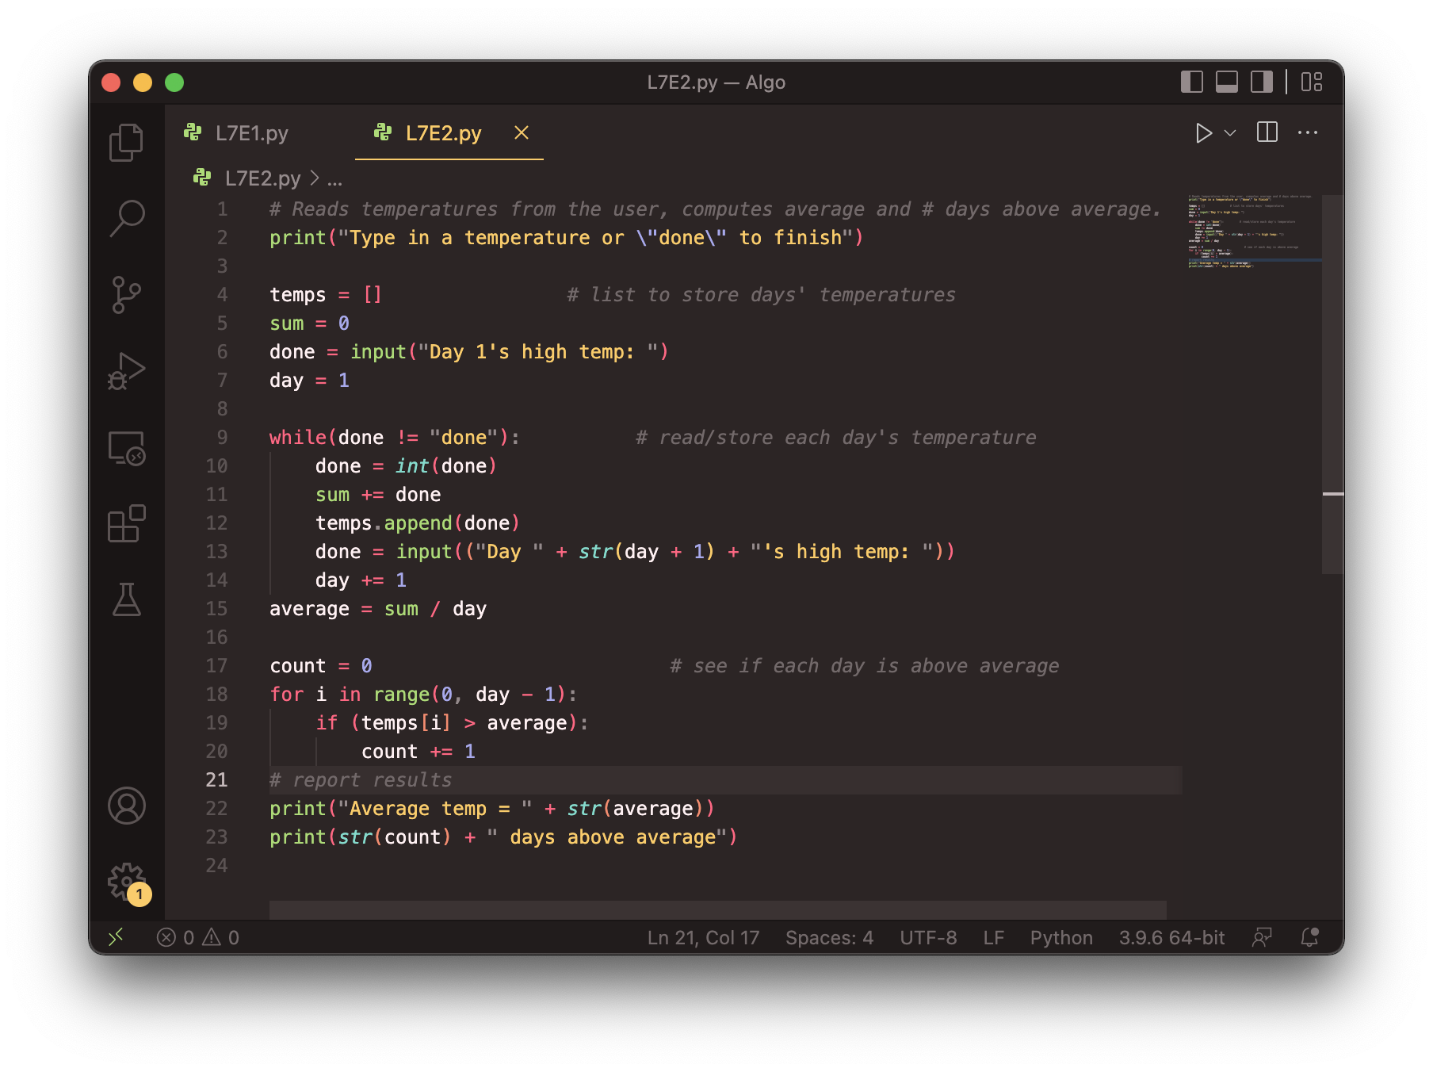
Weather 2 answer

Slide 19
Weather question 3
Modify the weather program to print the following output:
How many days' temperatures? 7
Day 1's high temp: 45
Day 2's high temp: 44
Day 3's high temp: 39
Day 4's high temp: 48
Day 5's high temp: 37
Day 6's high temp: 46
Day 7's high temp: 53
Average temp = 44.6
4 days were above average.
Temperatures: [45, 44, 39, 48, 37, 46, 53]
Two coldest days: 37, 39
Two hottest days: 53, 48

Slide 20
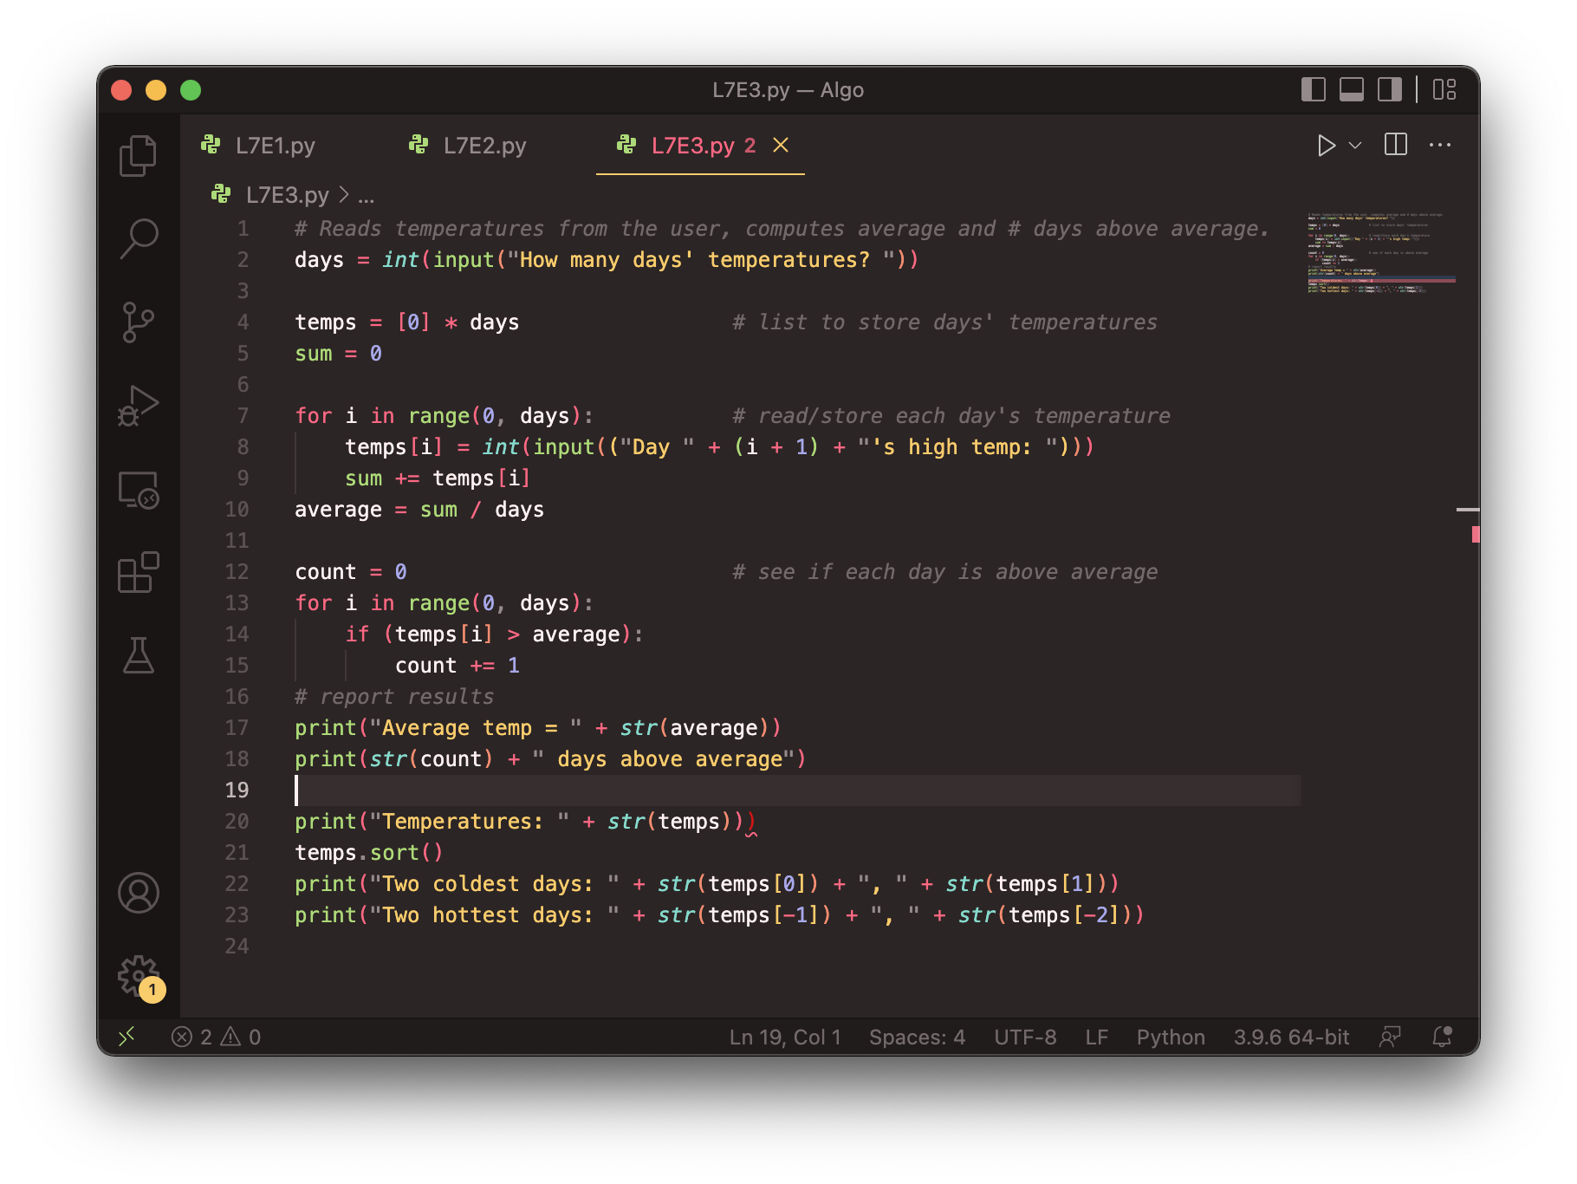
Weather answer 3

Slide 21
"list mystery" problem
traversal: An examination of each element of an list.
What element values are stored in the following list?
a = [1, 7, 5, 6, 4, 14, 11]
for i in range(0, len(a) – 1):
if (a[i] > a[i + 1]):
a[i + 1] = a[i + 1] * 2
index | 0 | 1 | 2 | 3 | 4 | 5 | 6
value
index | 0 | 1 | 2 | 3 | 4 | 5 | 6
value | 1 | 7 | 10 | 12 | 8 | 14 | 22

Slide 22
Lists that change size
Sometimes we don't know how big we want our list to be when our program starts
It can be useful to create an empty list and fill it up.
data = []
data.append("hello")
data.append("world")
print(data) # ['hello', 'world']
How would we insert another word in the middle?

Slide 23
Exercise
Write a function called remove_duplicates that takes a sorted list of numbers and removes any duplicates. For example, if it is called on the following list:
data = [-2, 1, 1, 3, 3, 3, 4, 5, 6, 78, 78, 79]
after the call the list should be
data = [-2, 1, 3, 4, 5, 6, 78, 79]

Slide 24
Looping and removing
When you loop through a list and remove elements you change the length of the list. This means you need to change your upper bound as you are looping.
You must use a while loop when removing items from a list
A for i in range loop won't work as it can't adjust when the length of the list changes
A for num in data loop won't work as it cannot alter the list.

Slide 25
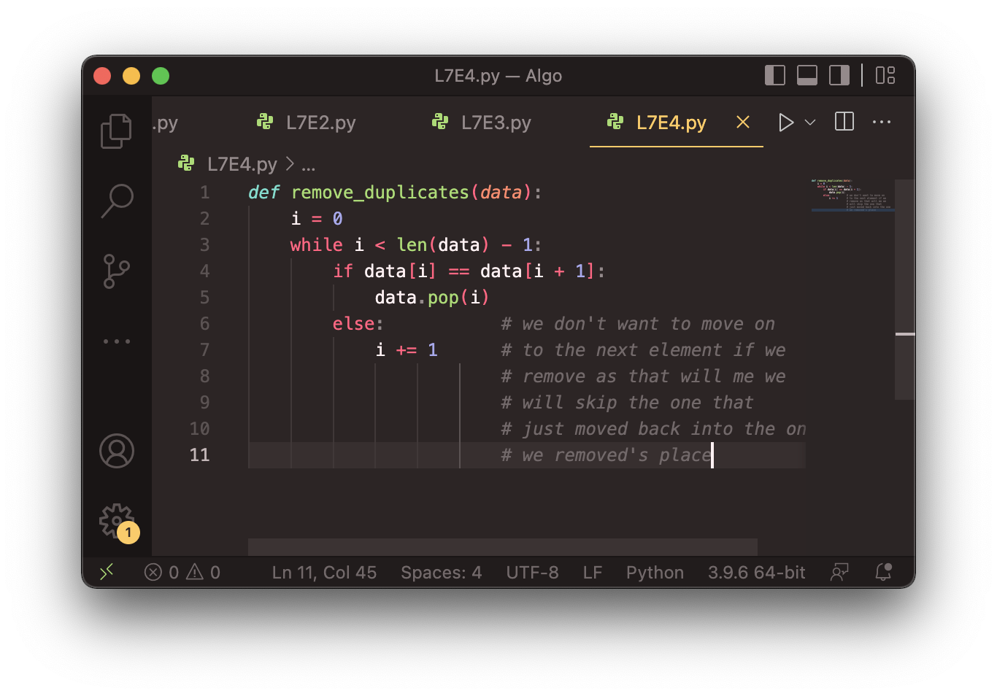
Solution

Slide 26
List reversal question
Write code that reverses the elements of a list.
For example, if the array initially stores:
[11, 42, -5, 27, 0, 89]
Then after your reversal code, it should store:
[89, 0, 27, -5, 42, 11]
The code should work for a list of any size.
Hint: think about swapping various elements...

Slide 27
Algorithm idea
Swap pairs of elements from the edges; work inwards:
index | 0 | 1 | 2 | 3 | 4 | 5
value | 11 | 42 | -5 | 27 | 0 | 89
index | 0 | 1 | 2 | 3 | 4 | 5
value | 89 | 42 | -5 | 27 | 0 | 11
index | 0 | 1 | 2 | 3 | 4 | 5
value | 89 | 0 | -5 | 27 | 42 | 11
index | 0 | 1 | 2 | 3 | 4 | 5
value | 89 | 0 | 27 | -5 | 42 | 11

Slide 28
Swapping values
def main():
a = 7
b = 35
# swap a with b?
a = b
b = a
print(a, b)
What is wrong with this code? What is its output?
The red code should be replaced with:
temp = a
a = b
b = temp

Slide 29
Flawed algorithm
What's wrong with this code?
numbers = [11, 42, -5, 27, 0, 89]
# reverse the list
for i in range(0, len(numbers)):
temp = numbers[i]
numbers[i] = numbers[len(numbers) - 1 - i]
numbers[len(numbers) - 1 - i] = temp
The loop goes too far and un-reverses the array! Fixed version:
for i in range(0, len(numbers) // 2):
temp = numbers[i]
numbers[i] = numbers[len(numbers) - 1 - i]
numbers[len(numbers) - 1 - i] = temp

Slide 30
List reverse question 2
Turn your list reversal code into a reverse function.
Accept the list of integers to reverse as a parameter.
numbers = [11, 42, -5, 27, 0, 89]
reverse(numbers)
How do we write functions that accept lists as parameters?
Will we need to return the new list contents after reversal?
...

Slide 31
A swap function?
Does the following swap function work? Why or why not?
def main():
a = 7
b = 35
# swap a with b?
swap(a, b)
print(a, b)
def swap(a, b):
temp = a
a = b
b = temp
Notes:
It's basically not possible to write a swap method that accepts two ints.
swap can't escape from itself to modify the outside world.
(sort of like the villains in the holodeck on Star Trek; they can wreak havoc in their holo-world, but they can't leave and attack the real Enterprise outside.)

Slide 32
Mutability

Slide 33
Mutability
Mutability: The ability to be changed or mutated
ints, floats, strs and bools are immutable.
lists and objects are mutable

Slide 34
Immutable types
ints, floats, strs and bools are immutable.
Modifying the value of one variable does not affect others.
x = 5
y = x # x = 5, y = 5
y = 17 # x = 5, y = 17
x = 8 # x = 8, y = 17

Slide 35
Mutable types
lists and DrawingPanel are mutable.
Modifying the value of one variable does affect others.
a1 = [4, 15, 8]
a2 = a1 # refer to same list as a1
a2[0] = 7
print(a1) # [7, 15, 8]
index | 0 | 1 | 2
value | 7 | 15 | 8
a1
a2

Slide 36

Mutability and objects
Lists and objects are mutable. Why?
efficiency. Copying large objects slows down a program.
sharing. It's useful to share an object's data among functions.
panel1 = DrawingPanel(80, 50)
panel2 = panel1 # same window
panel2.draw_rect(0, 0, 80, 50, "cyan")
panel1
panel2

Slide 37

Objects as parameters
When a mutable object is passed as a parameter the function can change it.
If the parameter is modified, it will affect the original object.
def main():
window = DrawingPanel(80, 50)
window.draw_rect(0, 0, 80, 50, "yellow")
example(window)
def example(panel):
panel.draw_rect(0, 0, 80, 50, "cyan") ...
window
panel
Notes:
Note: This is also the reason that it works when you pass the Graphics g as a parameter to a method, because it is drawing with the same pen object onto the same window.

Slide 38
Lists as parameters
Lists are mutable too.
Changes made in the function are also seen by the caller.
def main():
iq = [126, 167, 95]
increase(iq)
print(iq)
def increase(a):
for i in range(0, len(a)):
a[i] = a[i] * 2
Output:
[252, 334, 190]
iq
index | 0 | 1 | 2
value | 126 | 167 | 95
index | 0 | 1 | 2
value | 252 | 334 | 190
a

Slide 39
List reverse question 2
Turn your list reversal code into a reverse function.
Accept the list of integers to reverse as a parameter.
numbers = [11, 42, -5, 27, 0, 89]
reverse(numbers)
Solution:
def reverse(numbers):
for i in range(0, len(numbers) // 2):
temp = numbers[i]
numbers[i] = numbers[len(numbers) - 1 - i]
numbers[len(numbers) - 1 - i] = temp

Slide 40
List parameter questions
Write a function swap that accepts a list of integers and two indexes and swaps the elements at those indexes.
a1 = [12, 34, 56]
swap(a1, 1, 2)
print(a1) # [12, 56, 34]
Write a function swap_all that accepts two lists of integers as parameters and swaps their entire contents.
Assume that the two lists are the same length.
a1 = [12, 34, 56]
a2 = [20, 50, 80]
swap_all(a1, a2)
print(a1) # [20, 50, 80]
print(a2) # [12, 34, 56]

Slide 41
List parameter answers
# Swaps the values at the given two indexes.
def swap(a, i, j):
temp = a[i]
a[i] = a[j]
a[j] = temp
# Swaps the entire contents of a1 with those of a2.
def swap_all(a1, a2):
for i in range(0, len(a1)):
temp = a1[i]
a1[i] = a2[i]
a2[i] = temp

Slide 42
List return question
Write a function merge that accepts two lists of integers and returns a new list containing all elements of the first list followed by all elements of the second.
a1 = [12, 34, 56]
a2 = [7, 8, 9, 10]
a3 = merge(a1, a2)
print(a3)
# [12, 34, 56, 7, 8, 9, 10]
Write a function merge3 that merges 3 lists similarly.
a1 = {12, 34, 56]
a2 = {7, 8, 9, 10]
a3 = {444, 222, -1]
a4 = merge3(a1, a2, a3)
print(a4)
# [12, 34, 56, 7, 8, 9, 10, 444, 222, -1]
Notes:
I probably won't reach this in lecture; it's here just in case.

Slide 43
List return answer 1
# Returns a new list containing all elements of a1
# followed by all elements of a2.
def merge(a1, a2):
result = [0] * (len(a1) + len(a2))
for i in range(0, len(a1)):
result[i] = a1[i]
for i in range(0, len(a2)):
result[len(a1) + i] = a2[i]
return result

Slide 44
List return answer 2
# Returns a new list containing all elements of a1,a2,a3.
def merge3(a1, a2, a3):
a4 = [0] * (len(a1) + len(a2) + len(a3)
for i in range(0, len(a1)):
a4[i] = a1[i]
for i in range(0, len(a2)):
a4[len(a1) + i] = a2[i]
for i in range(0, len(a3)):
a4[len(a1) + len(a2) + i] = a3[i]
return a4
# Shorter version that calls merge.
def merge3(a1, a2, a3):
return merge(merge(a1, a2), a3)

Slide 45
Value/Reference Semantics
Variables of type int, float, boolean, store values directly:
Values are copied from one variable to another:
cats = age
Variables of object types store references to memory:
References are copied from one variable to another:
scores = grades
age | 20
cats | 3
age | 20
cats | 20
index | 0 | 1 | 2
value | 89 | 78 | 93
grades
scores

Slide 46
Tallying

Slide 47
A multi-counter problem
Problem: Write a function most_frequent_digit that returns the digit value that occurs most frequently in a number.
Example: The number 669260267 contains: one 0, two 2s, four 6es, one 7, and one 9.
most_frequent_digit(669260267) returns 6.
If there is a tie, return the digit with the lower value.
most_frequent_digit(57135203) returns 3.

Slide 48
A multi-counter problem
index | 0 | 1 | 2 | 3 | 4 | 5 | 6 | 7 | 8 | 9
value | 1 | 0 | 2 | 0 | 0 | 0 | 4 | 1 | 0 | 0
We could declare 10 counter variables ...
counter0, counter1, counter2, counter3, counter4,
counter5, counter6, counter7, counter8, counter9
But a better solution is to use a list of size 10.
The element at index i will store the counter for digit value i.
Example for 669260267:
How do we build such an list? And how does it help?

Slide 49
Creating a list of tallies
index | 0 | 1 | 2 | 3 | 4 | 5 | 6 | 7 | 8 | 9
value | 1 | 0 | 2 | 0 | 0 | 0 | 4 | 1 | 0 | 0
# assume n = 669260267
counts = [0] * 10
while n > 0:
# pluck off a digit and add to proper counter
digit = n % 10
counts[digit] += 1
n = n // 10

Slide 50
Tally solution
# Returns the digit value that occurs most frequently in n.
# Breaks ties by choosing the smaller value.
def most_frequent_digit(n):
counts = [0] * 10
while n > 0:
digit = n % 10 # pluck off a digit and tally it
counts[digit] += 1
n = n // 10
# find the most frequently occurring digit
best_index = 0
for i in range(1, len(counts)):
if counts[i] > counts[best_index]:
best_index = i
return best_index

Slide 51
Section attendance question
Read a file of section attendance (see next slide):
yynyyynayayynyyyayanyyyaynayyayyanayyyanyayna
ayyanyyyyayanaayyanayyyananayayaynyayayynynya
yyayaynyyayyanynnyyyayyanayaynannnyyayyayayny
And produce the following output:
Section 1
Student points: [20, 16, 17, 14, 11]
Student grades: [100.0, 80.0, 85.0, 70.0, 55.0]
Section 2
Student points: [16, 19, 14, 14, 8]
Student grades: [80.0, 95.0, 70.0, 70.0, 40.0]
Section 3
Student points: [16, 15, 16, 18, 14]
Student grades: [80.0, 75.0, 80.0, 90.0, 70.0]
Students earn 3 points for each section attended up to 20.

Slide 52
Section input file
student | 123451234512345123451234512345123451234512345
week | 1 2 3 4 5 6 7 8 9
 | yynyyynayayynyyyayanyyyaynayyayyanayyyanyayna ayyanyyyyayanaayyanayyyananayayaynyayayynynya yyayaynyyayyanynnyyyayyanayaynannnyyayyayayny
section 1 section 2 section 3
Each line represents a section.
A line consists of 9 weeks' worth of data.
Each week has 5 characters because there are 5 students.
Within each week, each character represents one student.
a means the student was absent (+0 points)
n means they attended but didn't do the problems (+1 points)
y means they attended and did the problems (+3 points)

Slide 53
Section attendance answer
def main():
with open("sections.txt") as file:
lines = file.readlines()
section = 1
for line in lines:
points = [0] * 5
for i in range(0, len(line)):
student = i % 5
earned = 0
if (line[i] == 'y'): # c == 'y' or 'n' or 'a'
earned = 3
elif (line[i] == 'n'):
earned = 1
points[student] = min(20, points[student] + earned)
grades = [0] * 5
for i in range(0, len(points)):
grades[i] = 100.0 * points[i] / 20
print("Section " + str(section))
print("Student points: " + str(points))
print("Student grades: " + str(grades))
print()
section += 1

Slide 54
Data transformations
In many problems we transform data between forms.
Example: digits → count of each digit → most frequent digit
Often each transformation is computed/stored as an list.
For structure, a transformation is often put in its own function.
Sometimes we map between data and list indexes.
by position (store the i ^{th} value we read at index i )
tally (if input value is i, store it at array index i )
explicit mapping (count 'J' at index 0, count 'X' at index 1)
Exercise: Modify our Sections program to use functions that use lists as parameters and returns.

Slide 55
List param/return answer
# This program reads a file representing which students attended
# which discussion sections and produces output of the students'
# section attendance and scores.
def main():
with open("sections.txt") as file:
lines = file.readlines()
section = 1
for line in lines:
# process one section
points = count_points(line)
grades = compute_grades(points)
results(section, points, grades)
section += 1
# Produces all output about a particular section.
def results(section, points, grades):
print("Section " + str(section))
print("Student scores: " + str(points))
print("Student grades: " + str(grades))
print()
...

Slide 56
List param/return answer
...
# Computes the points earned for each student for a particular section.
def count_points(line):
points = [0] * 5
for i in range(0, len(line)):
student = i % 5
earned = 0
if line[i] == 'y': # c == 'y' or c == 'n'
earned = 3
elif line[i] == 'n':
earned = 2
points[student] = min(20, points[student] + earned)
return points
# Computes the percentage for each student for a particular section.
def compute_grades(points):
grades = [0] * 5
for i in range(0, len(points)):
grades[i] = 100.0 * points[i] / 20
return grades

Slide 57
Tuples

Slide 58
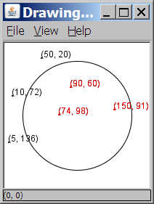
A programming problem
Given a file of cities' names and (x, y) coordinates:
Winslow 50 20
Tucson 90 60
Phoenix 10 72
Bisbee 74 98
Yuma 5 136
Page 150 91
Write a program to draw the cities on a DrawingPanel, then simulates an earthquake that turns all cities red that are within a given radius:
Epicenter x? 100
Epicenter y? 100
Affected radius? 75

Slide 59
A bad solution
lines = open("cities.txt").readlines()
names = [0] * len(lines)
x_coords = [0] * len(lines)
y_coords = [0] * len(lines)
for i in range(0, len(lines)):
parts = lines[i].split()
names[i] = parts[0]
x_coords[i] = parts[1] # read each city
y_coords[i] = parts[2]
...
parallel lists: 2+ lists with related data at same indexes.
Considered poor style.

Slide 60
Observations
The data in this problem is a set of points.
It would be better stored together

Slide 61
Tuples
A sequence similar to a list but it cannot be altered
Good for storing related data
We mainly store the same type of data in a list
We usually store related things in tuples
Creating tuples
name = (data, other_data, … , last_data)
tuple = ("Tucson", 80, 90)

Slide 62
Using tuples
You can access elements using [] notation, just like lists and strings
tuple = ("Tucson", 80, 90)
low = tuple[1]
You cannot update a tuple!
Tuples are immutable
You can loop through tuples
the same as lists
operation | call | result
len() | len((1, 2, 3)) | 3
+ | (1, 2, 3) + (4, 5, 6) | (1, 2, 3, 4, 5, 6)
* | ('Hi!',) * 4 | ('Hi!', 'Hi!', 'Hi!', 'Hi!')
in | 3 in (1, 2, 3) | True
for | for x in (1,2,3): print x, | 1 2 3
min() | min((1, 3)) | 1
max() | max((1, 3)) | 3

Slide 63
Days till
Write a function called days_till that accepts a start month and day and a stop month and day and returns the number of days between them
call return
days_till("december", 1, "december", 10) 9
days_till("novembeR", 15, "december", 10) 25
days_till("OCTober", 6, "december", 17) 72
days_till("october", 6, "ocTober", 1) 360

Slide 64
Days till solution
def days_till(start_month, start_day, stop_month, stop_day):
months = (('january', 31),('february', 28),('march', 31),('april', 30), ('may', 31),('june', 30),
('july', 31), ('august', 31),('september', 30), ('october', 31), ('november', 30), ('december', 31))
if start_month.lower() == stop_month.lower() and stop_day >= start_day:
return stop_day - start_day
days = 0
for i in range(0, len(months)):
month = months[i]
if month[0] == start_month.lower():
days = month[1] - start_day
i += 1
while months[i % 12][0] != stop_month.lower():
days += months[i % 12][1]
i += 1
days += stop_day
return days

Slide 65
Lists of Lists

Slide 66
Exercise
Write a function called flip that takes a list of lists and two columns and swaps their contents. For example if flip(data, 2, 3) were called on the following list
data = [[1, 2, 3], [4, 5, 6], [7, 8, 9]]
data would contain the following afterwards:
data = [[1, 3, 2], [4, 6, 5], [7, 9, 8]]

Slide 67
Exercise
Write a function called create_matrix that takes a width and a height as parameters and returns a list of lists that is width by height and contains the numbers 0 to width - 1 in each row. For example a call to create_matrix(5, 3) would return the following list of lists:
[[0, 1, 2, 3, 4], [0, 1, 2, 3, 4], [0, 1, 2, 3, 4]]

Slide 68
Creating Lists of lists
list = [[0] * 4] * 5 will NOT create a list of lists
This will create a list with 5 spots that all contain the SAME list that is 4 long.
Instead, write the following:
list = []
for i in range(0, 5):
list.append([0] * 4)

Slide 69
Mountain peak
Write a program that reads elevation data from a file, draws it on a DrawingPanel and finds the path from the highest elevation to the edge of the region.
Data:
34 76 87 9 34 8 22 33 33 33 45 65 43 22
5 7 88 0 56 76 76 77 4 45 55 55 4 5
…

