Slide 1
Building Python Programs
Chapter 8: Dictionaries and Sets

Slide 2
Exercise
Write a program that counts the number of unique words in a large text file (say, Moby Dick or the King James Bible).
Store the words in a structure and report the # of unique words.
Once you've created this structure, allow the user to search it to see whether various words appear in the text file.
What structure is appropriate for this problem? List? Tuple?

Slide 3
Sets
set: A collection of unique values (no duplicates allowed) that can perform the following operations efficiently:
add, remove, search (contains)
We don't think of a set as having indexes; we just add things to the set in general and don't worry about order
"the"
"of"
"if"
"to" in set
"to"
"down"
"from"
true
"by"
"she"
"be" in set
"you"
false
"in"
"why"
"him"
set

Slide 4
Creating a Set
An empty set:
a = set()
A set with elements in it:
b = {"the", "hello", "happy"}
a.add(val) | adds element val to a
a.discard(val) | removes val from a if present
a.pop() | removes and returns a random element from a
a - b | returns a new set containing values in a but not in b
a | b | returns a new set containing values in either a or b
a & b | returns a new set containing values in both a and b
a ^ b | returns a new set containing values in a or b but not both
You can also use in, len(), etc.

Slide 5
Looping over a set?
You must use a for element in structure loop
needed because sets have no indexes; can't get element i

Slide 6
Exercise
Write a program to count the number of occurrences of each unique word in a large text file (e.g. Moby Dick ).
Allow the user to type a word and report how many times that word appeared in the book.
Report all words that appeared in the book at least 500 times.
What structure is appropriate for this problem?

Slide 7
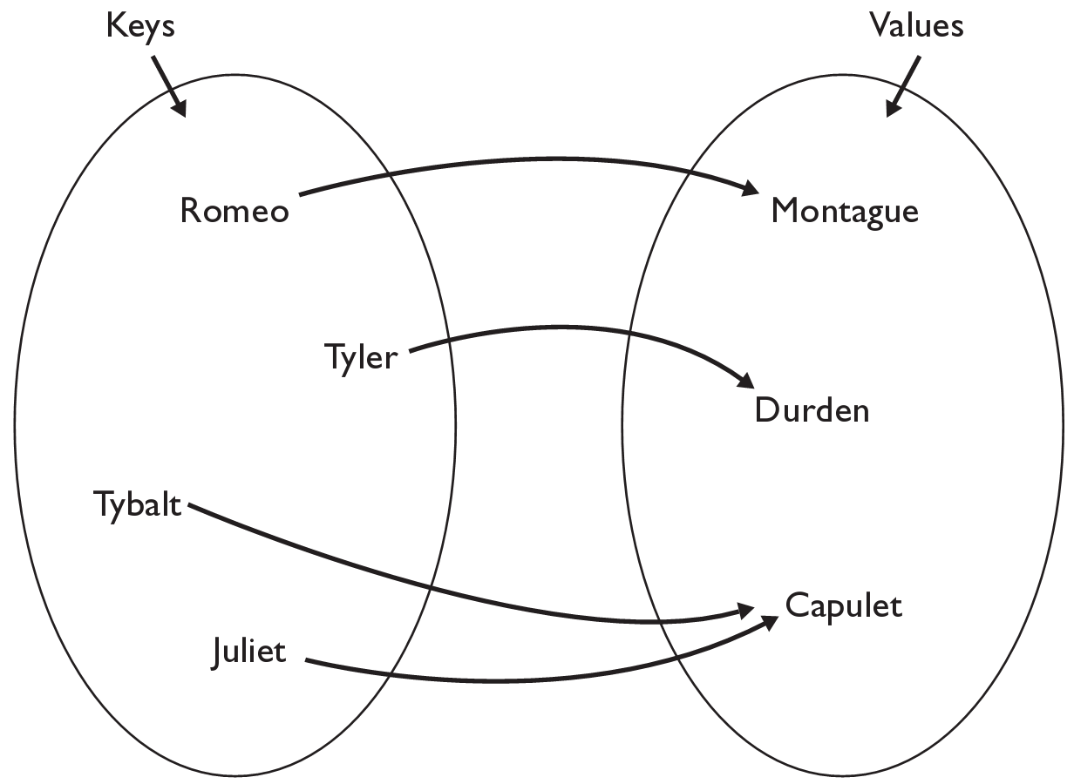
Dictionaries
dictionary: Holds a set of unique keys and a collection of values, where each key is associated with one value.
a.k.a. "map", "associative array", "hash"
basic dictionary operations:
put(key, value ): Adds a mapping from a key to a value.
get(key ): Retrieves the value mapped to the key.
remove(key ): Removes the given key and its mapped value.
my_dict["Juliet"] returns "Capulet"

Slide 8
Creating dictionaries
Creating a dictionary
{key : value, …, key : value}
my_dict = {"Romeo": "Montague",
"Tyler" :"Durden",
"Tybalt" : "Capulet",
"Juliet" :"Capulet" }
my_dict[key] = value
adds a mapping from the given key to the given value; if the key already exists, replaces its value with the given one
Accessing values:
my_dict[key]
returns the value mapped to the given key (error if key not found)
my_dict["Juliet"] produces "Capulet"

Slide 9
Dictionary functions
my_dict[key] = value | adds a mapping from the given key to the given value; if the key already exists, replaces its value with the given one
my_dict[key] | returns the value mapped to the given key (error if key not found)
items() | return a new view of the dictionary’s items ((key, value) pairs)
pop(key) | removes any existing mapping for the given key and returns it (error if key not found)
popitem() | removes and returns an arbitrary (key, value) pair (error if empty)
keys() | returns the dictionary's keys
values() | returns the dictionary's values
You can also use in, len(), etc.

Slide 10
Using dictionaries
A dictionary allows you to get from one half of a pair to the other.
Remembers one piece of information about every index (key).
Later, we can supply only the key and get back the related value:
Allows us to ask: What is Suzy's phone number?
# key value
my_dict["Suzy"] = "206-685-2181"
Dictionary
my_dict["Suzy"]
Dictionary
"206-685-2181"

Slide 11
Dictionaries and tallying
a dictionary can be thought of as generalization of a tallying list
the "index" (key) doesn't have to be an int
count digits: 22092310907
# (T)rump, (C)linton, (I)ndependent
count votes: "TCCCCCCTTTTTCCCCCCTCTTITCTTITCCTIC"
index | 0 | 1 | 2 | 3 | 4 | 5 | 6 | 7 | 8 | 9
value | 3 | 1 | 3 | 0 | 0 | 0 | 0 | 1 | 0 | 2
"T"
15
key | "T" | "C" | "I"
value | 15 | 15 | 3
"C"
3
"I"
15
keys
values

Slide 12
Looping over a set or dictionary?
You must use a for element in structure loop
needed because sets have no indexes; can't get element i
Example:
for item in a:
print(item)
Outputs:
the
happy
hello

Slide 13
items, keys and values
items function returns tuples of each key-value pair
can loop over the keys in a for loop
ages = {}
ages["Merlin"] = 4
ages("Chester"] = 2
ages["Percival"] = 12
for cat, age in ages.items()):
print(name + " -> " + str(age))
values function returns all values in the dictionary
no easy way to get from a value to its associated key(s)
keys function returns all keys in the dictionary

Slide 14
Exercise
Use word counts to figure out if a document is positive or negative
Count all of the positive words and count all of the negative words.
Whichever count is bigger is the sentiment of the document.
How do we know which words are positive and which are negative?

Slide 15
Exercise
Consider the following function:
def mystery(list1, list2):
result = {}
for i in range(0, len(list1)):
result[list1[i]] = list2[i]
result[list2[i]] = list1[i]
return result
What is returned after calls with the following parameters?
list1: [b, l, u, e] list2: [s, p, o, t]
dictionary returned:__________________________________________________________
list1: [k, e, e, p] list2: [s, a, f, e]
dictionary returned:__________________________________________________________
list1: [s, o, b, e, r] list2: [b, o, o, k, s]
dictionary returned:__________________________________________________________

Slide 16
Choosing the Right Structure

Slide 17
What is the right structure?
You want to store a bunch of colors so you can later choose one at random.
Batting order of a baseball team.
Students names and their grades on a project.
Friends names and their phone numbers
Height, width and location of a sports field.
Movies a person has watched.
Items in a shopping cart.
A student's grades.

Slide 18
What is the right structure?
The grades for all students in a class
All books in a store arranged by category
Many recipes each containing many steps
Phone numbers that have been called this month on a phone plan divided by area and country code for billing simplicity

Slide 19
Exercise
We would like to store data for the class so that we can:
Access the entire class list easily
Access a section list easily
What structure is appropriate for this problem?
Sometimes it can be helpful to store a structure inside another structure

Slide 20
2D Structures

Slide 21
Exercise
Consider the following function:
def mystery(alls, letters):
for i in range(len(alls)):
if alls[i] in letters.values():
if alls[i] not in letters.keys():
letters[alls[i]] = i
else:
letters[alls[i]] = i + 1
What is in the dictionary after calls with the following parameters?
all: [b, l, u, e] letters: {s:b, p:t, o:u, t:t}
dictionary:_{'o': 'u', 'p': 't', 'b': 0, 's': 'b', 'u': 2, 't': 't'} __
all: [k, e, e, p] letters: {s:y, a:k, f:e, e:f}
dictionary:_ {'s': 'y', 'a': 'k', 'f': 'e', 'e': 3, 'k': 0} ____
all: [s, o, b, e, r] letters: {b:b, o:o, o:o, k:k, s:s}
dictionary:__ {'o': 2, 'k': 'k', 's': 1, 'b': 3} __

Slide 22
2d Structure Access
Given the following structure:
grades = {'Ali':[10, 16, 20, 13, 3, 17],
'Ken':[9, 16, 8, 19, 20, 20],
'Daniel':[8, 10, 20, 20, 20, 20]}
How can I access Ken's grade on project 3?
How can I find out how many students are in my class / grades?
How can I find out how many projects a student has done?

Slide 23
Exercise
What does the following code produce?
def main():
grades = {'Ali':[10, 16, 20, 13, 3, 17],
'Ken':[9, 16, 8, 19, 20, 20],
'Daniel':[8, 10, 20, 20, 20, 20]}
print(mystery(grades, 2))
def mystery(grades, i):
total = 0
for student in grades:
total += grades[student][i]
return total / len(grades)

Slide 24
Exercise
Write a function to calculate the average grade of all students on all assignments.
How can we get access to each grade?
How can we know how many grades we need to sum?

Slide 25
Exercise
Write a function that returns a list where each element in the list is the average score for that particular assignment number.

Slide 26
Exercise
Write a function that takes a student name as a parameter and returns the project number that the student scored highest on.

Slide 27
Exercise
Write a program that allows a user to ask the distance between two friends.
If person 1 and person 2 are friends then they are distance 0
If person 2 is friends with a friend of person 2 they are distance 1
What structure is appropriate for this problem?

