Slide 1
Building Python Programs
Chapter 9: Recursion

Slide 2
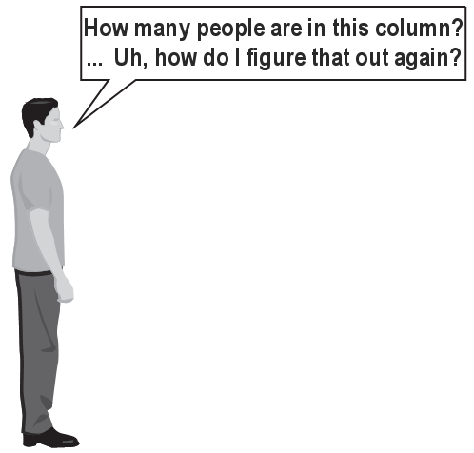
Exercise
(To a student in the front row) How many students total are directly behind you in your "column" of the classroom?
You have poor vision, so you can see only the people right next to you. So you can't just look back and count.
But you are allowed to ask questions of the person next to you.
How can we solve this problem? (recursively )

Slide 3
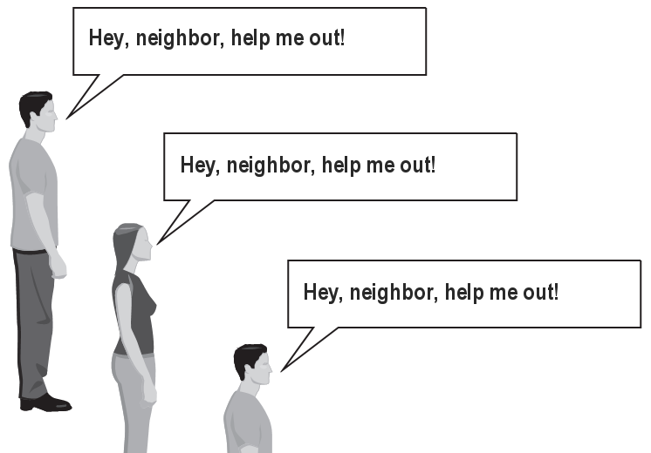
The idea
Recursion is all about breaking a big problem into smaller occurrences of that same problem.
Each person can solve a small part of the problem.
What is a small version of the problem that would be easy to answer?
What information from a neighbor might help me?

Slide 4
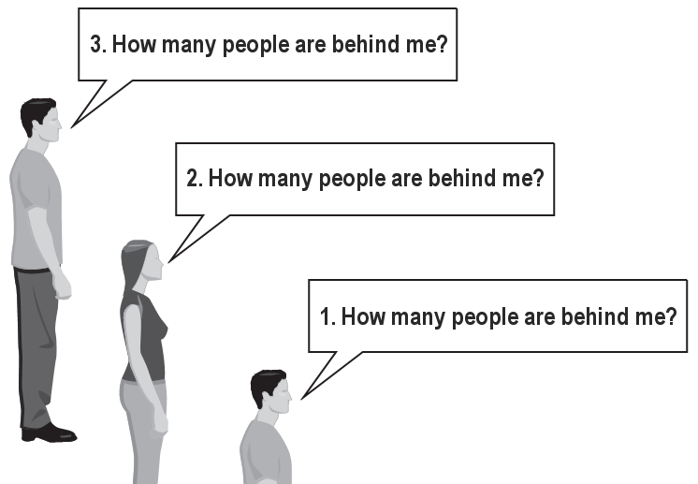
Recursive algorithm
Number of people behind me:
If there is someone behind me, ask him/her how many people are behind him/her.
When they respond with a value N, then I will answer N + 1.
If there is nobody behind me, I will answer 0.

Slide 5
Recursion
recursion: The definition of an operation in terms of itself.
Solving a problem using recursion depends on solving smaller occurrences of the same problem.
recursive programming: Writing functions that call themselves to solve problems recursively.
An equally powerful substitute for iteration (loops)
Particularly well-suited to solving certain types of problems

Slide 6
Why learn recursion?
"Cultural experience" – think differently about problems
Solves some problems more naturally than iteration
Can lead to elegant, simplistic, short code (when used well)
Many programming languages ("functional" languages such as Scheme, ML, and Haskell) use recursion exclusively (no loops)
A key component of many of our assignments in CSE 143

Slide 7
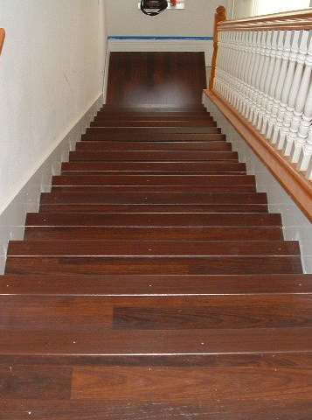
Getting down stairs
Need to know two things:
Getting down one stair
Recognizing the bottom
Most code will look like:
if simplest case:
compute and return solution
else:
divide into similar subproblem(s)
solve each subproblem recursively
assemble the overall solution

Slide 8
Recursion and cases
Every recursive algorithm involves at least 2 cases:
base case: A simple occurrence that can be answered directly.
recursive case: A more complex occurrence of the problem that cannot be directly answered, but can instead be described in terms of smaller occurrences of the same problem.
Some recursive algorithms have more than one base or recursive case, but all have at least one of each.
A crucial part of recursive programming is identifying these cases.

Slide 9
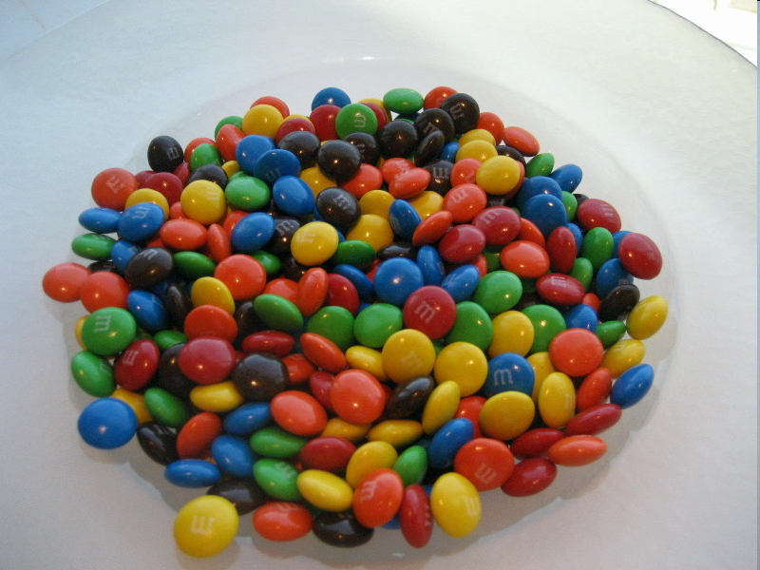
Another recursive task
How can we remove exactly half of the M&M's in a large bowl, without dumping them all out or being able to count them?
What if multiple people help out with solving the problem? Can each person do a small part of the work?
What is a number of M&M's that it is easy to double, even if you can't count?
(What is a "base case"?)

Slide 10
Recursion in Python
Consider the following function to print a line of * characters:
# Prints a line containing the given number of stars.
# Precondition: n >= 0
def print_stars(n):
for i in range(0, n):
print("*", end='')
print() # end the line of output
Write a recursive version of this function (that calls itself).
Solve the problem without using any loops.
Hint: Your solution should print just one star at a time.

Slide 11
A basic case
What are the cases to consider?
What is a very easy number of stars to print without a loop?
def print_stars(n):
if n == 1:
# base case; just print one star
print("*", end='')
else:
...

Slide 12
Handling more cases
Handling additional cases, with no loops (in a bad way):
def print_stars(n):
if n == 1:
# base case; just print one star
print("*", end='')
elif n == 2:
print("*", end='')
print("*", end='')
elif n == 3:
print("*", end='')
print("*", end='')
print("*", end='')
elif n == 4:
print("*", end='')
print("*", end='')
print("*", end='')
print("*", end='')
else: ...

Slide 13
Handling more cases 2
Taking advantage of the repeated pattern (somewhat better):
def print_stars(n):
if n == 1:
# base case; just print one star
print("*")
elif n == 2:
print("*", end='')
print_stars(1) # prints "*"
elif n == 3:
print("*", end='')
print_stars(2) # prints "**"
elif n == 4:
print("*", end='')
print_stars(3) # prints "***"
else: ...

Slide 14
Using recursion properly
Condensing the recursive cases into a single case:
def print_stars(n):
if n == 1:
# base case; just print one star
print("*")
else:
# recursive case; print one more star
print("*", end='')
print_stars(n - 1)

Slide 15
"Recursion Zen"
The real, even simpler, base case is an n of 0, not 1:
def print_stars(n):
if n == 0:
# base case; just end the line of output
print()
else:
# recursive case; print one more star
print("*", end='')
print_stars(n - 1)
Recursion Zen: The art of properly identifying the best set of cases for a recursive algorithm and expressing them elegantly. (Aninformal term)

Slide 16
Recursive tracing
Consider the following recursive function:
def mystery(n):
if n < 10:
return n
else:
a = n // 10
b = n % 10
return mystery(a + b)
What is the result of the following call?
mystery(648)

Slide 17
A recursive trace
mystery(648):
a = 648 // 10 # 64
b = 648 % 10 # 8
return mystery(a + b) # mystery(72)
mystery(72):
a = 72 // 10 # 7
b = 72 % 10 # 2
return mystery(a + b) # mystery(9)
mystery(9):
return 9

Slide 18
Recursive tracing 2
Consider the following recursive function:
def mystery(n):
if n < 10:
return (10 * n) + n
else:
a = mystery(n // 10)
b = mystery(n % 10)
return (100 * a) + b
What is the result of the following call?
mystery(348)

Slide 19
A recursive trace 2
mystery(348)
a = mystery(34)
a = mystery(3)
return (10 * 3) + 3 # 33
b = mystery(4)
return (10 * 4) + 4 # 44
return (100 * 33) + 44 # 3344
b = mystery(8)
return (10 * 8) + 8 # 88
return (100 * 3344) + 88 # 334488
What is this function really doing?

Slide 20
Exercise
Write a recursive function pow accepts an integer base and exponent and returns the base raised to that exponent.
Example: pow(3, 4) returns 81
Solve the problem recursively and without using loops.

Slide 21
An optimization
Notice the following mathematical property:
3¹² = 531441 = 9⁶
= (3²)⁶
531441 = (9²)³
= ((3²)²)³
When does this "trick" work?
How can we incorporate this optimization into our pow function?
What is the benefit of this trick if the function already works?

Slide 22
Exercise
Write a recursive function print_binary that accepts an integer and prints that number's representation in binary (base 2).
Example: print_binary(7) prints 111
Example: print_binary(12) prints 1100
Example: print_binary(42) prints 101010
Write the function recursively and without using any loops.
place | 10 | 1 |  | 32 | 16 | 8 | 4 | 2 | 1
value | 4 | 2 |  | 1 | 0 | 1 | 0 | 1 | 0

Slide 23
Stutter
How did we break the number apart?
def stutter(n):
if n < 10:
return (10 * n) + n
else:
a = mystery(n // 10)
b = mystery(n % 10)
return (100 * a) + b

Slide 24
Case analysis
Recursion is about solving a small piece of a large problem.
What is 69743 in binary?
Do we know anything about its representation in binary?
Case analysis:
What is/are easy numbers to print in binary?
Can we express a larger number in terms of a smaller number(s)?

Slide 25
print_binary solution
# Prints the given integer's binary representation.
# Precondition: n >= 0
def print_binary(n):
if n < 2:
# base case; same as base 10
print(n)
else:
# recursive case; break number apart
print_binary(n // 2)
print_binary(n % 2)
Can we eliminate the precondition and deal with negatives?

Slide 26
Exercise
Write a recursive function is_palindrome accepts a string and returns True if it reads the same forwards as backwards.
is_palindrome("madam") → True
is_palindrome("racecar") → True
is_palindrome("step on no pets") → True
is_palindrome("able was I ere I saw elba") → True
is_palindrome("Java") → False
is_palindrome("rotater") → False
is_palindrome("byebye") → False
is_palindrome("notion") → False

Slide 27
Exercise solution
# Returns True if the given string reads the same
# forwards as backwards.
# Trivially True for empty or 1-letter strings.
def is_palindrome(s):
if len(s) < 2:
return True # base case
else:
first = s[0]
last = s[-1]
if first != last:
return False
# recursive case
middle = s[1 : -1]
return is_palindrome(middle)

Slide 28
Exercise solution 2
# Returns True if the given string reads the same
# forwards as backwards.
# Trivially True for empty or 1-letter strings.
def is_palindrome(s):
if len(s) < 2:
return True; # base case
else:
return s[0] == s[-1] and is_palindrome(s[1 : -1]

Slide 29
Public/private pairs
Often the parameters we need for our recursion do not match those the client will want to pass.
In these cases, we instead write a pair of functions:
1) a non-recursive one with parameters the client wants
2) a recursive one with the parameters we really need

Slide 30
Recursive Backtracking

Slide 31

Exercise: Dice rolls
Write a function dice_roll that accepts an integer parameter representing a number of 6-sided dice to roll, and output all possible arrangements of values that could appear on the dice.
dice_roll(2) dice_roll(3)
[1, 1] [1, 2] [1, 3] [1, 4] [1, 5] [1, 6] [2, 1] [2, 2] [2, 3] [2, 4] [2, 5] [2, 6] | [3, 1] [3, 2] [3, 3] [3, 4] [3, 5] [3, 6] [4, 1] [4, 2] [4, 3] [4, 4] [4, 5] [4, 6] | [5, 1] [5, 2] [5, 3] [5, 4] [5, 5] [5, 6] [6, 1] [6, 2] [6, 3] [6, 4] [6, 5] [6, 6]
[1, 1, 1]
[1, 1, 2]
[1, 1, 3]
[1, 1, 4]
[1, 1, 5]
[1, 1, 6]
[1, 2, 1]
[1, 2, 2]
...
[6, 6, 4]
[6, 6, 5]
[6, 6, 6]
Notes:
interesting variation: Output only the *unique* rearrangements. For example, permute("GOOGLE") has two Os, but swapping them in order produces the same string, which shouldn't appear twice in the output.

Slide 32

Examining the problem
We want to generate all possible sequences of values.
for (each possible first die value):
for (each possible second die value):
for (each possible third die value):
...
print!
This is called a depth-first search
How can we completely explore such a large search space?

Slide 33
A decision tree
chosen | available
- | 4 dice
1 | 3 dice
2 | 3 dice
...
1, 1 | 2 dice
1, 2 | 2 dice
1, 3 | 2 dice
1, 4 | 2 dice
...
...
1, 1, 1 | 1 die
1, 1, 2 | 1 die
1, 1, 3 | 1 die
1, 4, 1 | 1 die
...
...
...
1, 1, 1, 1
1, 1, 1, 2
...
1, 1, 3, 1
1, 1, 3, 2
...

Slide 34
Solving recursively
Pick a value for the first die
Recursively find values for the remaining dice
Repeat with other values for the first die
What is the base case?

Slide 35
Private helpers
Often the function doesn't accept the parameters you want.
So write a helper that accepts more parameters.
Extra params can represent current state, choices made, etc.
def function_name(params):
...
return helper(params, more_params)
def helper(params, more_params):
...
(use more_params to help solve the problem)

Slide 36
Exercise solution
# Prints all possible outcomes of rolling the given
# number of six-sided dice in [#, #, #] format.
def dice_rolls(dice):
chosen = []
dice_rolls(dice, chosen)
# private recursive helper to implement dice_rolls logic
def dice_rolls(dice, chosen):
if dice == 0:
print(chosen) # base case
else:
for i in range(1, 7):
chosen.append(i) # choose
dice_rolls(dice - 1, chosen) # explore
chosen.pop(-1) # un-choose

Slide 37
Exercise: Dice roll sum
Write a function dice_sum similar to dice_roll, but it also accepts a desired sum and prints only arrangements that add up to exactly that sum.
dice_sum(2, 7) dice_sum(3, 7)
[1, 6]
[2, 5]
[3, 4]
[4, 3]
[5, 2]
[6, 1]
[1, 1, 5]
[1, 2, 4]
[1, 3, 3]
[1, 4, 2]
[1, 5, 1]
[2, 1, 4]
[2, 2, 3]
[2, 3, 2]
[2, 4, 1]
[3, 1, 3]
[3, 2, 2]
[3, 3, 1]
[4, 1, 2]
[4, 2, 1]
[5, 1, 1]

Slide 38
Consider all paths?
chosen | available | desired sum
- | 3 dice | 5
1 | 2 dice
2 | 2 dice
3 | 2 dice
4 | 2 dice
5 | 2 dice
6 | 2 dice
1, 1 | 1 die
1, 2 | 1 die
1, 3 | 1 die
1, 4 | 1 die
1, 5 | 1 die
1, 6 | 1 die
1, 1, 1
1, 1, 2
1, 1, 3
1, 1, 4
1, 1, 5
1, 1, 6
1, 6, 1
1, 6, 2
...

Slide 39
Optimizations
We need not visit every branch of the decision tree.
Some branches are clearly not going to lead to success.
We can preemptively stop, or prune, these branches.
Inefficiencies in our dice sum algorithm:
Sometimes the current sum is already too high.
(Even rolling 1 for all remaining dice would exceed the sum.)
Sometimes the current sum is already too low.
(Even rolling 6 for all remaining dice would not reach the sum.)
When finished, the code must compute the sum every time.
(1+1+1 = ..., 1+1+2 = ..., 1+1+3 = ..., 1+1+4 = ..., ...)

Slide 40
New decision tree
chosen | available | desired sum
- | 3 dice | 5
1 | 2 dice
2 | 2 dice
3 | 2 dice
4 | 2 dice
5 | 2 dice
6 | 2 dice
1, 1 | 1 die
1, 2 | 1 die
1, 3 | 1 die
1, 4 | 1 die
1, 5 | 1 die
1, 6 | 1 die
1, 1, 1
1, 1, 2
1, 1, 3
1, 1, 4
1, 1, 5
1, 1, 6
1, 6, 1
1, 6, 2
...

Slide 41
Backtracking
backtracking: Finding solution(s) by trying partial solutions and then abandoning them if they are not suitable.
a "brute force" algorithmic technique (tries all paths)
often implemented recursively
Applications:
producing all permutations of a set of values
parsing languages
games: anagrams, crosswords, word jumbles, 8 queens
combinatorics and logic programming

Slide 42
Backtracking algorithms
A general pseudo-code algorithm for backtracking problems:
Explore(choices):
if there are no more choices to make: stop.
else:
Make a single choice C.
Explore the remaining choices.
Un-make choice C, if necessary. (backtrack!)

Slide 43
Exercise solution, improved
def dice_sum(dice, desired_sum):
chosen = []
dice_sum_help(dice, desired_sum, chosen, 0)
def dice_sum(dice, desired_sum, chosen, sum_so_far):
if dice == 0:
if sum_so_far == desired_sum:
print(chosen)
elif sum_so_far < desired_sum and
sum_so_far + 6 * dice >= desired_sum:
for i in range(1, 7):
chosen.append(i)
dice_sum(dice - 1, desired_sum,
chosen, sum_so_far + i)
chosen.pop(-1)

Slide 44
Backtracking strategies
When solving a backtracking problem, ask these questions:
What are the "choices" in this problem?
What is the "base case"? (How do I know when I'm out of choices?)
How do I "make" a choice?
Do I need to create additional variables to remember my choices?
Do I need to modify the values of existing variables?
How do I explore the rest of the choices?
Do I need to remove the made choice from the list of choices?
Once I'm done exploring, what should I do?
How do I "un-make" a choice?

Slide 45
Exercise: Combinations
Write a function combinations that accepts a string s and an integer k as parameters and outputs all possible k -letter words that can be formed from unique letters in that string. The arrangements may be output in any order.
Example: combinations("GOOGLE", 3) outputs the sequence of lines at right.
To simplify the problem, you may assume that the string s contains at least k unique characters.
EGL EGO ELG ELO EOG EOL GEL GEO GLE GLO GOE GOL | LEG LEO LGE LGO LOE LOG OEG OEL OGE OGL OLE OLG

Slide 46
Initial attempt
def combinations(s, length):
combinations_help(s, "", length)
def combinations_help(s, chosen, length):
if length == 0:
print(chosen) # base case: no choices left
else:
for i in range(len(s)):
ch = s[i]
if ch not in chosen:
rest = s[: i] + s[i + 1 :]
combinations_help(rest, chosen + ch, length - 1)
Problem: Prints same string multiple times.

Slide 47
Exercise solution
def combinations(s, length):
all = set()
combinations(s, "", all, length)
for comb in all:
print(comb)
def combinations(s, chosen, all, length):
if length == 0:
all.add(chosen) # base case: no choices left
else:
for i in range(len(s)):
ch = s[i]
if ch not in chosen:
rest = s[: i] + s[i + 1 :]
combinations(rest, chosen + ch, all, length - 1)

Slide 48
Exercise: Permutations
Write a function permute that accepts a string as a parameter and outputs all possible rearrangements of the letters in that string. The arrangements may be output in any order.
Example: permute("TEAM") outputs the following sequence of lines:
TEAM TEMA TAEM TAME TMEA TMAE ETAM ETMA EATM EAMT EMTA EMAT | ATEM ATME AETM AEMT AMTE AMET MTEA MTAE META MEAT MATE MAET
Notes:
interesting variation: Output only the *unique* rearrangements. For example, permute("GOOGLE") has two Os, but swapping them in order produces the same string, which shouldn't appear twice in the output.

Slide 49
Examining the problem
We want to generate all possible sequences of letters.
for (each possible first letter):
for (each possible second letter):
for (each possible third letter):
...
print!
Each permutation is a set of choices or decisions:
Which character do I want to place first?
Which character do I want to place second?
...
solution space: set of all possible sets of decisions to explore

Slide 50
Decision tree
chosen | available
 | T E A M
T | E A M
E | T A M
...
T E | A M
T A | E M
T M | E A
T E A | M
T E M | A
T A E | M
T A M | E
T M E | A
T M A | E
T E A M
T E M A
T A E M
T A M E
T M E A
T M A E

Slide 51
Exercise solution
# Outputs all permutations of the given string.
def permute(s):
permute_help(s, "")
def permute_help(s, chosen):
if len(s) == 0:
# base case: no choices left to be made
print(chosen)
else:
# recursive case: choose each possible next letter
for i in range(len(s)):
c = s[i] # choose
s = s[: i] + s[i + 1 :]
chosen += c
permute(s, chosen) # explore
s = s[: i] + c + s[i + 1 :]
chosen = chosen[: -1]
# un-choose

Slide 52
The "8 Queens" problem
Consider the problem of trying to place 8 queens on a chess board such that no queen can attack another queen.
What are the "choices"?
How do we "make" or "un-make" a choice?
How do we know when to stop?
Q
 |  |  |  |  | Q
 |  |  |  |  |  |  | Q
 |  | Q
 |  |  |  |  |  | Q
 |  |  | Q
 | Q
 |  |  |  | Q

Slide 53
Naive algorithm
for (each square on board):
Place a queen there.
Try to place the rest of the queens.
Un-place the queen.
How large is the solution space for this algorithm?
64 * 63 * 62 * ...
 | 1 | 2 | 3 | 4 | 5 | 6 | 7 | 8
1 | Q | ... | ... | ... | ... | ... | ... | ...
2 | ... | ... | ... | ... | ... | ... | ... | ...
3 | ...
4
5
6
7
8

Slide 54
Better algorithm idea
Observation: In a working solution, exactly 1 queen must appear in each row and in each column.
Redefine a "choice" to be valid placement of a queen in a particular column.
How large is the solution space now?
8 * 8 * 8 * ...
 | 1 | 2 | 3 | 4 | 5 | 6 | 7 | 8
1 | Q | ... | ...
2 |  | ... | ...
3 |  | Q | ...
4 |  |  | ...
5 |  |  | Q
6
7
8

Slide 55
Exercise
Suppose we have a Board class with these methods:
Write a function solve_queens that accepts a Board as a parameter and tries to place 8 queens on it safely.
Your method should stop exploring if it finds a solution.
Method/Constructor | Description
ChessBoard(size) | construct empty board
safe(row, column) | true if queen can be safely placed here
place(row, column) | place queen here
remove(row, column) | remove queen from here
size() | returns the size of the board

Slide 56
Recall: Backtracking
A general pseudo-code algorithm for backtracking problems:
Explore(choices):
if there are no more choices to make: stop.
else, for each available choice C:
Choose C.
Explore the remaining choices.
Un-choose C, if necessary. (backtrack!)

Slide 57
Exercise solution
# Searches for a solution to the 8 queens problem
# with this board, reporting the first result found.
def solve_queens(board):
if solve_queens(board, 1):
print("One solution is as follows:")
print(board)
else:
print("No solution found.")
...

Slide 58
Exercise solution, cont'd.
# Recursively searches for a solution to 8 queens on this
# board, starting with the given column, returning True if a
# solution is found and storing that solution in the board.
# PRE: queens have been safely placed in columns 1 to (col-1)
def solve_queens_help(board, col):
if col > board.size():
return True # base case: all columns are placed
else:
# recursive case: place a queen in this column
for row in range(1, len(board) + 1):
if board.safe(row, col):
board.place(row, col) # choose
if explore(board, col + 1): # explore
return True # solution found
b.remove(row, col) # un-choose
return False; # no solution found

