Slide 1
Introduction to c programming

Slide 2
Module learning outcomes (MLO)
 | Description
MLO1 | Analyse C program codes to determine the output
MLO2 | Develop C programs involving decision structures and loops
MLO3 | Develop C programs involving functions
MLO4 | Write, compile and debug programs in C language

Slide 3
introduction
The C language facilitates a structured and disciplined approach to computer-program design

Slide 4
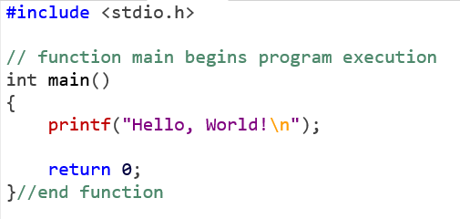
A simple c program
PRINTING A LINE OF TEXT

Slide 5
Comments
Begin with //, indicating that the line is a comment
Comments are inserted to document programs and improve program readability
Comments do not cause the computer to perform any action when the program is run ( ie. Ignored by the C compiler )
/*… */ multi-line comments in which everything from /* on the first line to */ at the end of the last line is a comment

Slide 6
#include Preprocessor Directive
Lines beginning with # are processed by the pre-processor before compilation
Blank lines and white space
Blank lines, spaces characters and tab characters are used to make programs easier to read
Normally ignored by the compiler

Slide 7
The main( ) function
Is part of every C program
Parentheses after main indicates that main is a program building block called a function
Every program in C begins executing at the function main
Functions can return information. The keyword int to the left of the main indicates that the main “returns” an integer value
A left brace. {, begins the body of every function. A corresponding right brace, }, ends each function. The pair of braces and the portion of the program between the braces is called a block.

Slide 8
An Output Statement
printf (“…”) instructs the computer to print on the screen the string of characters marked by the quotation marks
The statement includes the printf function, the argument within the parentheses and the semicolon (;)
Every statement MUST end with a semicolon (also known as the statement terminator)

Slide 9
Escape Sequences
Characters \n were not printed on the screen (backslash \ is called an escape character)
Indicates that printf is supposed to do something out of the ordinary
When encountering a backslash in a string, the compiler looks ahead at the next character and combines it with the backslash to form an escape sequence

Slide 10
Escape Sequence | Description
\n | Newline. Position the cursor at the beginning of the next line
\t | Horizontal tab. Move the cursor to the next tab stop
\a | Alert. Produces a sound or visible alert without changing the current cursor position
\\ | Backslash. Insert a backslash character in a string
\” | Double quote. Insert a double-quote character in a string

Slide 11
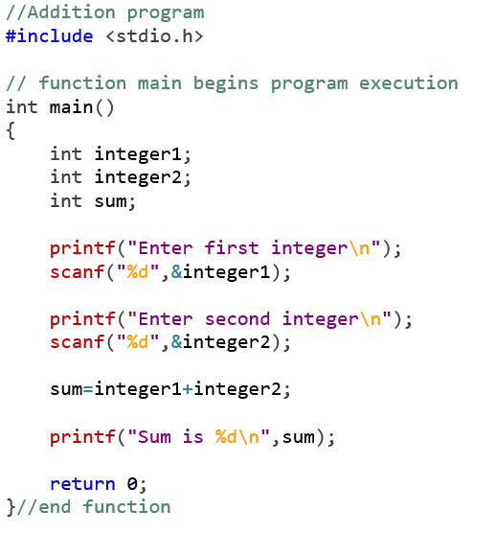
ADDING TWO INTEGERS

Slide 12
Variable and Variable Definitions
The names integer1 and integer2 are the names of variables (locations in memory where values can be stored for use by a program)
The definitions in the code examples specify that the variables are of type int, which means that they’ll hold integer values
All variables must be defined with a name and data type BEFORE they can be used in a program

Slide 13
Variable of same type can be defined in a single line
int integer1, integer2;
A variable name is a series of characters consisting of letters, digits and underscores (_) that does not begin with a digit.
The variable names are case sensitive

Slide 14
The scanf function and formatted inputs
Usually preceded by a prompting message to tell the user to take a specific action
scanf is used to obtain a value from the user
scanf has two arguments, “%d” and &integer1
The first argument indicates the type of data that should be entered by the user (%d indicates an integer should be entered)
The second argument indicates the location(or address) in memory at which the variable integer1 is stored (& is called the address operator)

Slide 15
Printing with a Format Control String
This printf statement has 2 arguments, “Sum is %d\n” and sum
The first argument is the format control string. The conversion specifier %d indicates that an integer is to be printed at that location
The second argument specifies the value to be printed

Slide 16
Memory concepts
Variable names such as integer1, integer2 and sum corresponds to locations in the computer’s memory. Every variable has a name, a type and a value.
Whenever a values is placed in a memory location, the value replaces the previous value in the location and the previous value is lost (this process is said to be destructive).
When a value is read from a memory location, the process is said to be non-destructive.

Slide 17
Arithmetic in C
C operation | Arithmetic operator
Addition | +
Subtraction | -
Multiplication | *
Division | /
Remainder | %

Slide 18
Precedence of arithmetic operators
Operator(s) | Operation(s) | Order of evaluation (precedence)
( ) | Parentheses | Evaluated first. If the parentheses are nested, the expression in the innermost pair is evaluated first. If there are several pairs of parentheses, they are evaluated left to right
* / % | Multiplication Division Remainder | Evaluated second. If there are several, they are evaluated left to right
+ - | Addition Subtraction | Evaluated third. If there are several, they are evaluated left to right
= | Assignment | Evaluated last

Slide 19
Decision making: equality and relational operators
Executable statements either perform actions or make decisions
if statement allows a program to make a decision based on the truth or falsity of a statement of fact called a condition
If the condition is TRUE, the statement in the body of the is statement is executed
If the condition is FALSE, the body statement isn’t executed
After the if statement completes, the execution proceeds with the next statement in sequence

Slide 20
Conditions in if statements are formed using
Equality operators
Relational operators
Algebraic equality or relational operator | C equality or relational operator
Relational Operators > < > < | > < >= <=
Equality Operators = ≠ | == !=

Slide 21
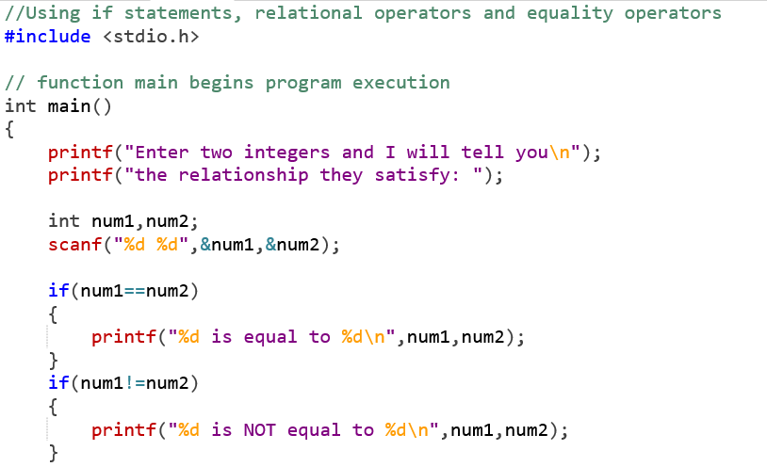

Slide 22
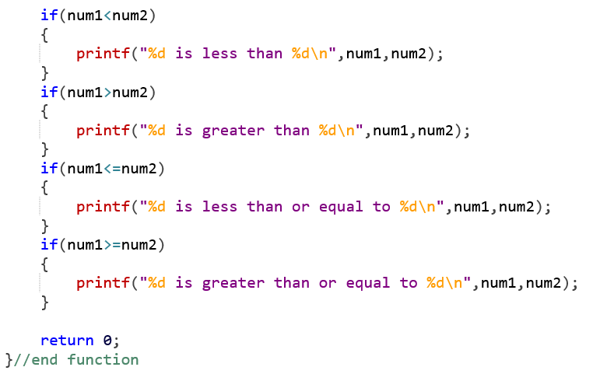

Slide 23
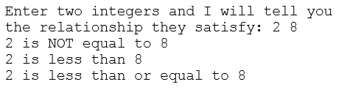
If the two input values were 2 and 8, below will be the output:

Slide 24
Thank you

