Slide 1
C file processing

Slide 2
Creating a sequential access file
The following C program creates a simple sequential-access file that might be used in an accounts receivable system to keep track of the amounts owed by a company’s credit clients. For each client, the program obtains an account number, the client’s name and the client’s balance

Slide 3
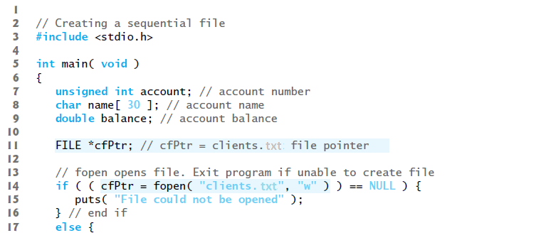

Slide 4
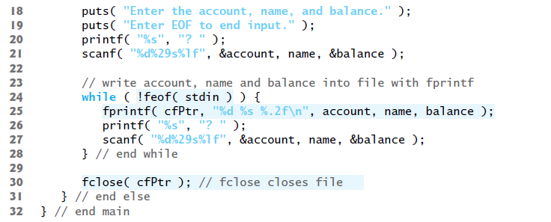
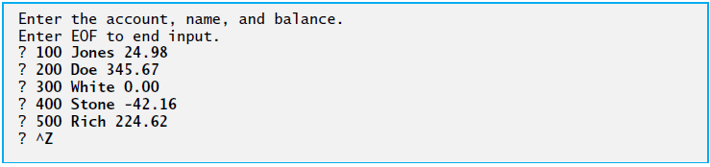

Slide 5
Line 11 states that cfPtr is a pointer to a FILE structure. A C program administers each file with a separate FILE structure.
Each open file must have a separately declared pointer of type FILE that’s used to refer to the file. Line 14 names the file—"clients.txt"—to be used by the program and establishes a “line of communication” with the file.
The file pointer cfPtr is assigned a pointer to the FILE structure for the file opened with fopen. Function fopen takes two arguments: a filename (which can include path information leading to the file’s location) and a file open mode. The file open mode "w" indicates that the file is to be opened for writing.

Slide 6

If a file does not exist and it’s opened for writing, fopen creates the file. If an existing file is opened for writing, the contents of the file are discarded without warning.
In the program, the if statement is used to determine whether the file pointer cfPtr is NULL (i.e., the file is not opened). If it’s NULL, the program prints an error message and terminates. Otherwise, the program processes the input and writes it to the file.
The program prompts the user to enter the various fields for each record or to enter end-of-file when data entry is complete. Figure below lists the key combinations for entering end-of-file for various computer systems.

Slide 7
Line 25 writes data to the file clients.txt. Function fprintf is equivalent to printf except that fprintf also receives as an argument a file pointer for the file to which the data will be written.
After the user enters end-of-file, the program closes the clients.dat file with fclose and terminates. Function fclose also receives the file pointer (rather than the filename) as an argument.
If function fclose is not called explicitly, the operating system normally will close the file when program execution terminates. This is an example of operating system “housekeeping.”

Slide 8
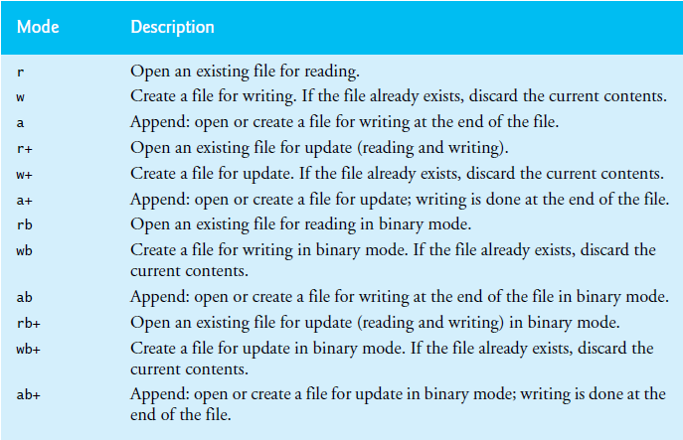
File open modes

Slide 9
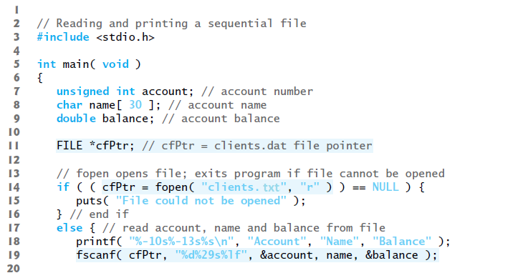
Reading data from a sequential-access file

Slide 10
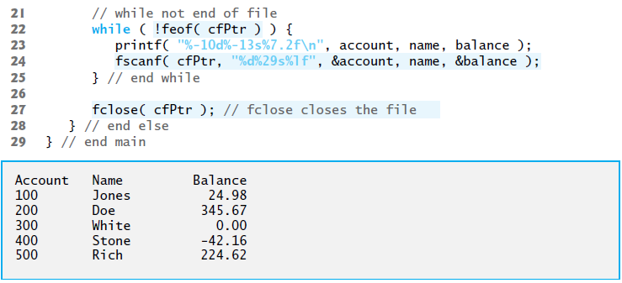

Slide 11
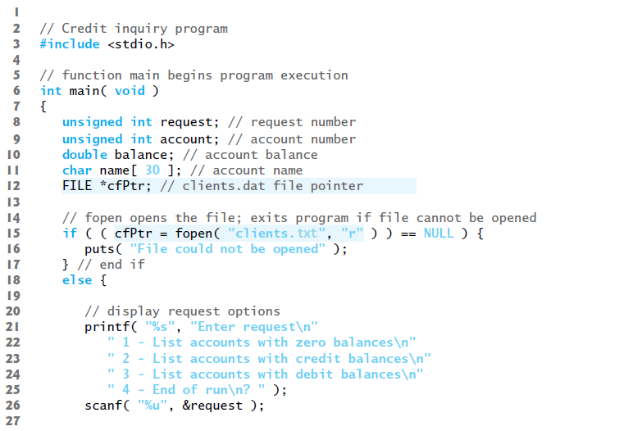
Example of a program that reads from and writes to a file

Slide 12
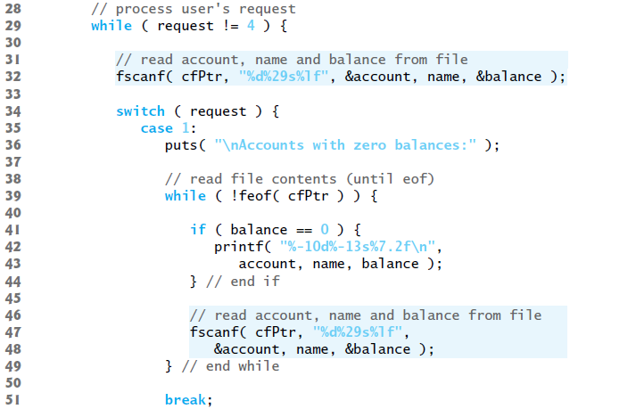

Slide 13
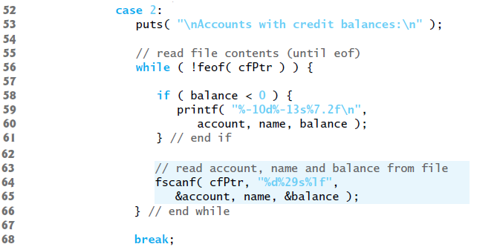

Slide 14
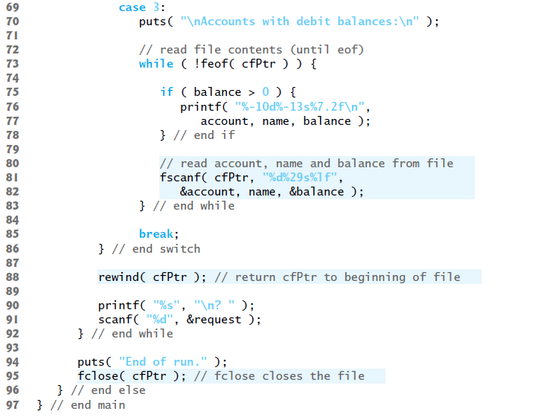

Slide 15
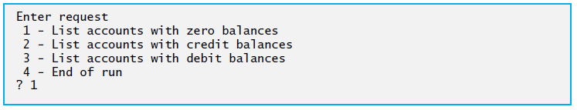
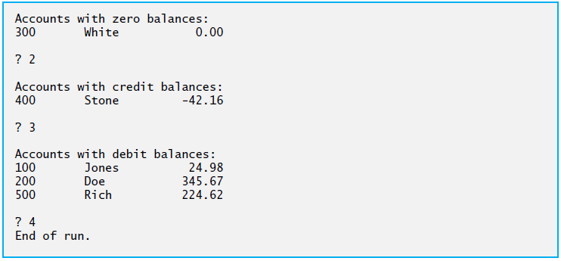

Slide 16
Creating a Random-access files
Function fwrite transfers a specified number of bytes beginning at a specified location in memory to a file. The data is written beginning at the location in the file indicated by the file position pointer.
Function fread transfers a specified number of bytes from the location in the file specified by the file position pointer to an area in memory beginning with a specified address.
fprintf( fPtr, "%d", number ); could print a single digit or as many as 11 digits (10 digits plus a sign, each of which requires 1 byte of storage) for a four-byte integer.
fwrite( &number, sizeof( int ), 1, fPtr ); always writes four bytes on a system with four-byte integers from a variable number to the file represented by fPtr

Slide 17
Although fread and fwrite read and write data, such as integers, in fixed-size rather than variable-size format, the data they handle are processed in computer “raw data” format (i.e., bytes of data) rather than in printf’s and scanf’s human-readable text format.
Because the “raw” representation of data is system dependent, “raw data” may not be readable on other systems, or by programs produced by other compilers or with other compiler options.
The third argument of both fread and fwrite is the number of elements in the array that should be read from or written to disk.
The preceding fwrite function call writes a single integer to disk, so the third argument is 1 (as if one element of an array is being written).
File-processing programs rarely write a single field to a file. Normally, they write one struct at a time.

Slide 18
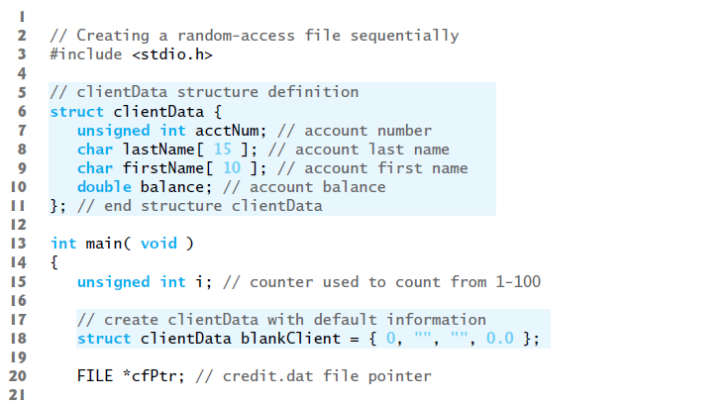

Slide 19
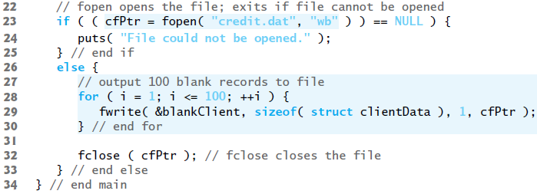

Slide 20
Writing data randomly to a random-access file
Function fseek sets the file position pointer to a specific position in the file, then fwrite writes the data.
offset is the number of bytes to seek from whence in the file pointed to by stream—a positive offset seeks forward and a negative one seeks backward.
Argument whence is one of the values SEEK_SET, SEEK_CUR or SEEK_END (all defined in <stdio.h>), which indicate the location from which the seek begins.
SEEK_SET indicates that the seek starts at the beginning of the file; SEEK_CUR indicates that the seek starts at the current location in the file; and SEEK_END indicates that the seek starts at the end of the file.

Slide 21
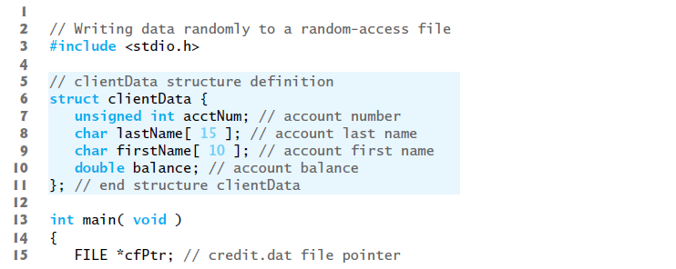

Slide 22
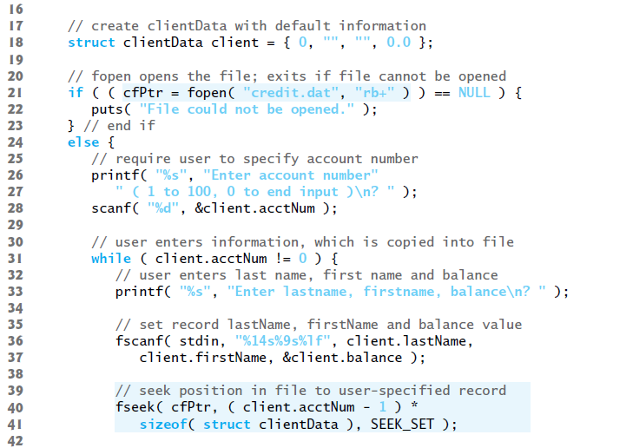

Slide 23
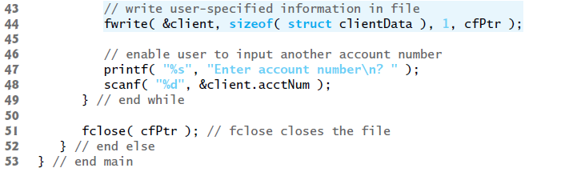

Slide 24
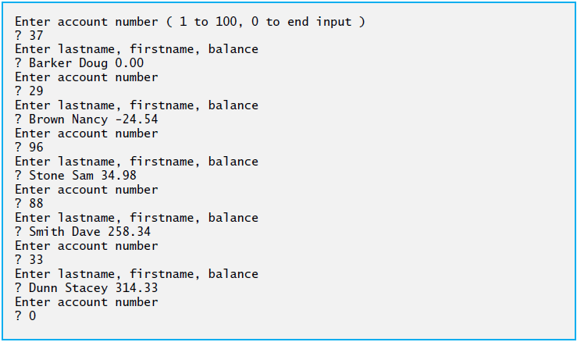

Slide 25
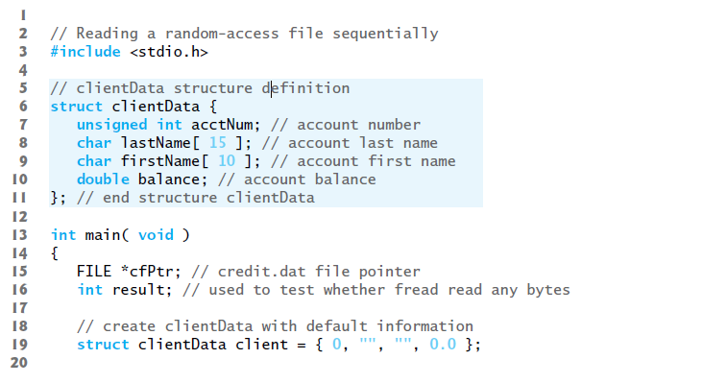
Reading data from a random-access file

Slide 26
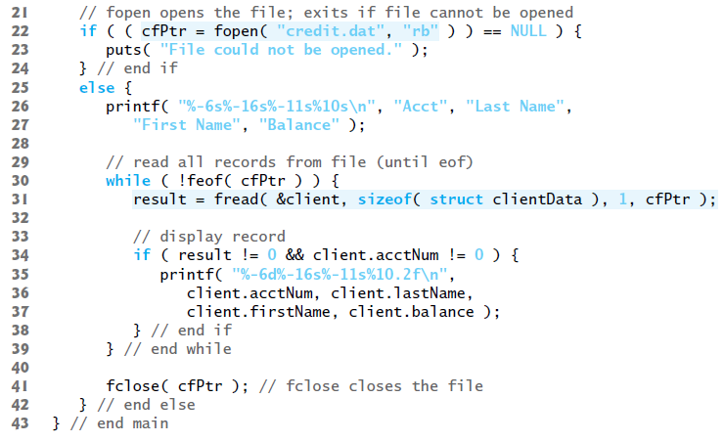

Slide 27
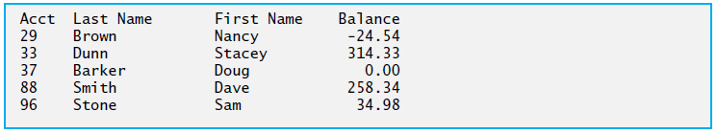

Slide 28
Thank you

