Slide 1
Structured program development in c

Slide 2
Module learning outcomes (MLO)
 | Description
MLO1 | Analyse C program codes to determine the output
MLO2 | Develop C programs involving decision structures and loops
MLO3 | Develop C programs involving functions
MLO4 | Write, compile and debug programs in C language

Slide 3
algorithms
The solution to any computing problem involves executing a series of actions in a specific order.
A procedure for solving a problem in terms of actions to be executed and the order in which these actions are to be executed is called an algorithm.
Specifying the order in which statements are to be executed in a computer program is called program controlled.

Slide 4
pseudocode
Pseudocode is an artificial and informal language that helps you develop algorithms
Similar to everyday English.
Not an actual computer programming language.
Pseudocode programs are NOT executed on computers
Used to help “think out” a program.
Consists only of action and decision statements
Not definitions (i.e. int x;)

Slide 5
Control structures
It has been demonstrated that all programs could be written in terms of only 3 controls structures:
Sequence structure
Selection structure
Iteration structure

Slide 6
FLOWCHARTS
A graphical representation of an algorithm or of a portion of an algorithm.
Drawn using certain special purpose symbols such as:
Rectangles (action symbol)
Diamonds (decision symbol)
Rounded rectangles (Used as the first and last symbol of a complete algorithm. Contains the word “Begin” or “End”)
Small circles (connector symbol. Used when drawing a portion of an algorithm)
These symbols are connected by arrows called flowlines.
Used for developing and representing algorithms, like pseudocode.

Slide 7
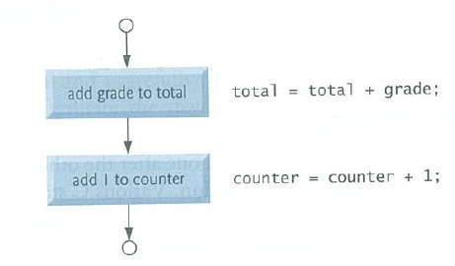
SEQUENCE STRUCTURE
Unless directed otherwise, the computer executes C statements one after the other in the order in which they are written.

Slide 8
SELECTION STURCTURE
if selection statement either selects/performs an action if a condition is TRUE or skips the action if the condition is FALSE. (single-selection statement)
if…else selection statement performs an action if a condition is TRUE and performs a different action if the condition is FALSE. (double-selection statement)
switch statement performs one of many different actions, depending on the value of an expression. (multiple-selection statement)

Slide 9
ITERATION STRUCTURE
C provides 3 types of iteration structure in the form of statements:
while
do…while
for

Slide 10


The if selection statement
Selection statements are used to choose among alternative courses of actions
Pseudocode:
C Program:

Slide 11
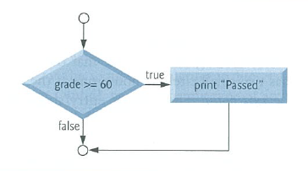
Flowchart:

Slide 12
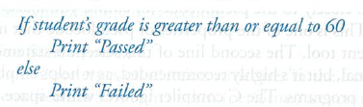
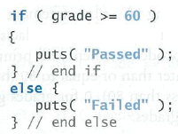
The if…else selection statement
The statement allows the you to specify that different actions are to be performed when the condition is true and when it’s false.
Pseudocode:
C program:

Slide 13
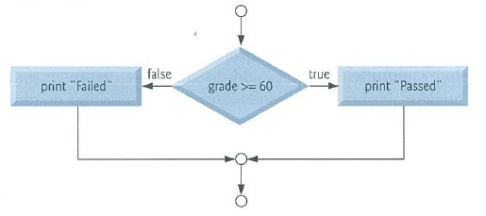
Flowchart:

Slide 14
C also provides conditional operator (?:), which is closely related to the if…else statement.
It takes 3 operands
First operand is a condition
Second operand is the value for the entire conditional expression if the condition is true
Third operand is the value for the entire conditional expression if the condition is false
C Program:

Slide 15
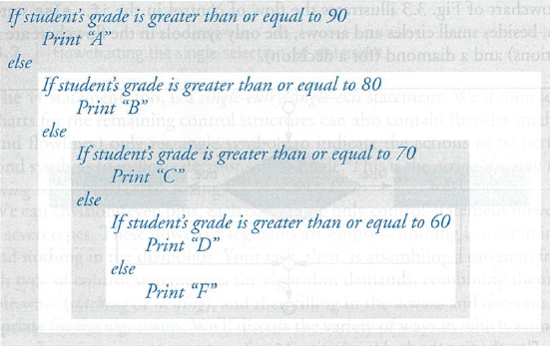
Nested if…else statements:
Placing if…else statements inside if…else statements
Pseudocode:

Slide 16
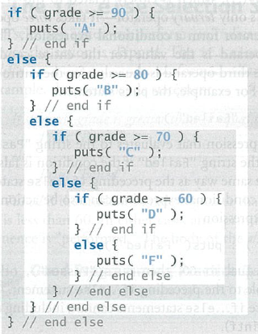
C Program:

Slide 17

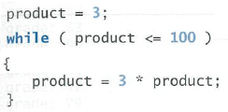
The while iteration statement
An iteration statement / repetition statement / loop allows you to specify that an action is to be repeated while some condition remains true.
Pseudocode:
C Program:

Slide 18
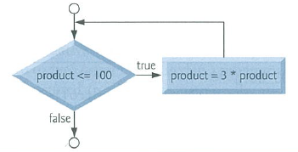
Flowchart:

Slide 19
Example 1
A class of ten students took a quiz. The grades (integers in the range of 0 to 100) for this quiz are available to you. Determine the class average on the quiz.

Slide 20
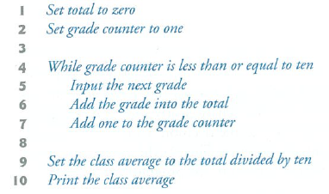
Pseudocode:

Slide 21
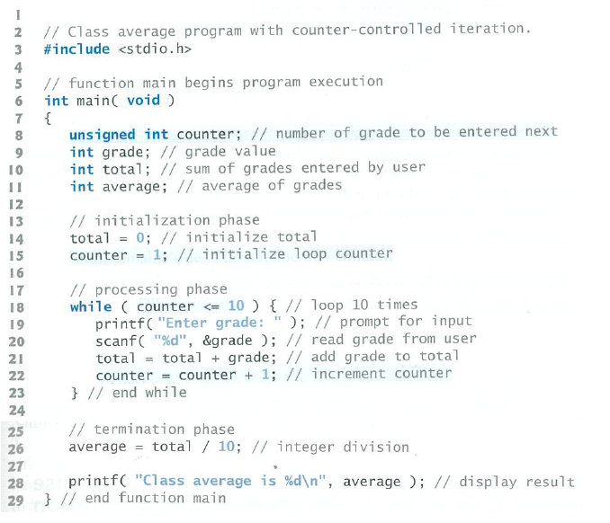
C Program:

Slide 22
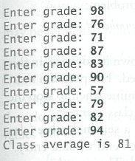
Output

Slide 23
Example 2
Develop a class-averaging program that will process an arbitrary number of grades each time the program is run

Slide 24
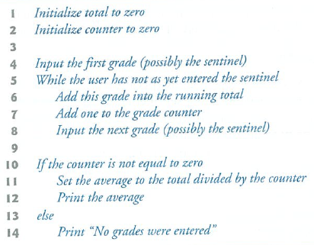
Pseudocode:

Slide 25
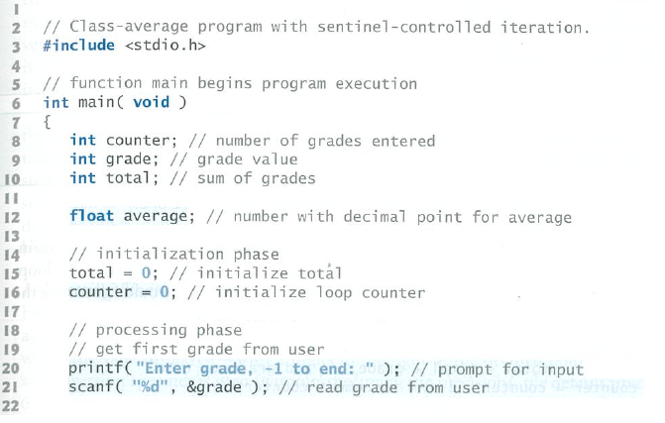
C Program:

Slide 26
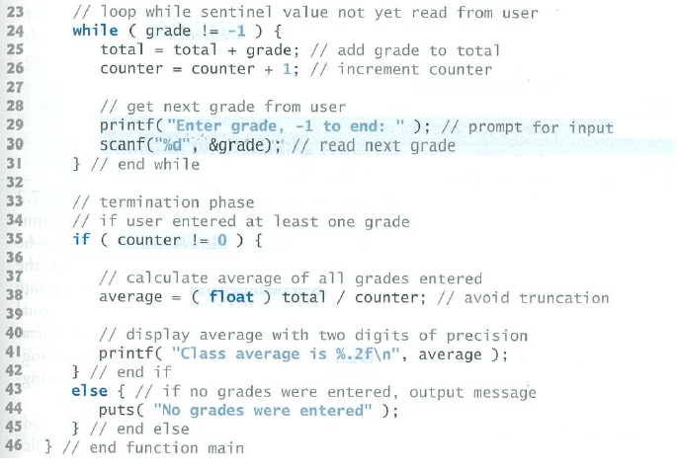

Slide 27
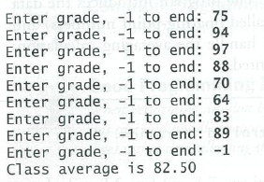

Output 1:
Output 2:

Slide 28

Converting between types explicitly and implicitly
Dividing two integers results in integer division in which any fractional part of the calculation is truncated (i.e. lost)
To produce a floating-point calculation with integer values, we must create temporary values that are floating-point numbers.
C provides unary cast operators to accomplish this task.

Slide 29
The cast operator creates a temporary floating-point copy of its operand (i.e. total)
The value stored in total is still an integer
Using the cast operator in this manner is called explicit conversion.
C evaluates arithmetic expressions only in which the data types of the operands are identical.
To ensure that the operands are of the same type, the compiler performs an operation called implicit conversion on selected operands
For an expression containing the data type int and float, copies of int operands are made and converted to float.

Slide 30

Formatting floating-point numbers
The f specifies that a floating point value is to be printed.
.2 is the precision with which the value will be displayed – with 2 digits to the right of the decimal point.
Without specifying the precision, the default precision of 6 is used (i.e. %.6f)
The printed value is rounded to the indicated number of decimal positions.

Slide 31
Assignment operators
C provides several assignment operators for abbreviating assignment expressions.
C=C+3; can be abbreviated with the addition assignment operator += as C+=3;
The += adds the value of the expression on the right of the operator to the value of the variable on the left of the operator and stores the result in the variable on the left of the operator.

Slide 32
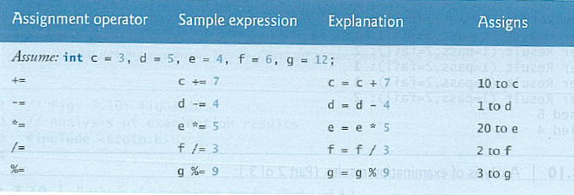

Slide 33
Increment and decrement operators
C also provides the unary increment operator (++) and the unary decrement operator (--)
If the increment/decrement operators are placed before a variable (i.e. prefixed), the variable will be incremented/decremented by 1, then its new value is used in the expression in which it appears.
If the increment/decrement operators are placed after a variable (i.e. postfixed), the current value of the variable will be used in the expression in which it appears, then the variable value is incremented/decremented by 1.

Slide 34
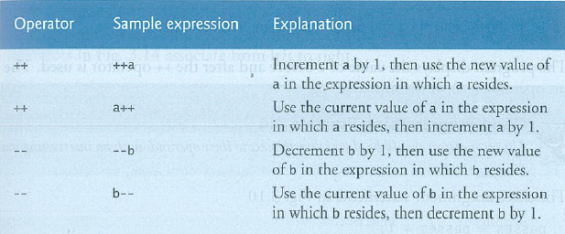

Slide 35
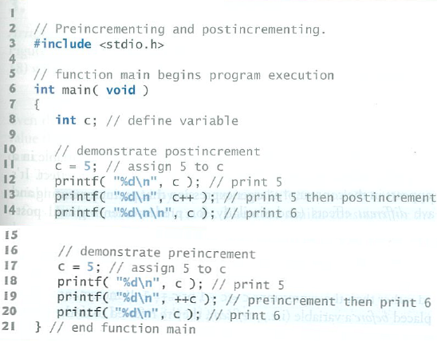
C Program:

Slide 36
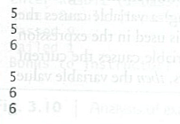
Output:

Slide 37
Thank you

