Slide 1
C program control

Slide 2
Module learning outcomes (MLO)
 | Description
MLO1 | Analyse C program codes to determine the output
MLO2 | Develop C programs involving decision structures and loops
MLO3 | Develop C programs involving functions
MLO4 | Write, compile and debug programs in C language

Slide 3
Iteration essentials
Most programs involve iteration, or looping. It consists of a group of instructions that the computer executes repeatedly while some loop-continuation condition remains true
Counter-controlled iteration.
Sentinel-controlled iteration.

Slide 4
Counter-controlled iteration
Sometimes called definite iteration.
Know in advance exactly how many times the loop will be executed.
A control variable is used to count the number of iterations.
The control variable is incremented (usually by 1) each time the group of instructions is performed.
The loop terminates when the value of the control variable indicates that the correct number of iterations has been performed.

Slide 5
Sentinel-controlled iteration
Sometimes called indefinite iteration.
Not known in advance how many times the loop will be executed.
The loop includes statements that obtain data each time the loop is performed.
The sentinel value indicates “end of the data”.
Sentinels must be distinct from regular data items.

Slide 6
Counter-controlled iteration
Counter-controlled iteration requires:
The name of a control variable (or loop counter).
The initial value of the control variable.
The increment (or decrement) by which the control variable is modified each time through the loop.
The condition that tests for the final value of the control variable (i.e. whether looping should continue).

Slide 7
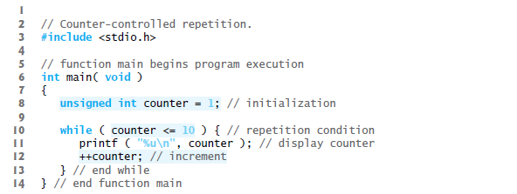
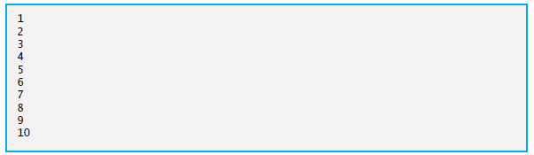
C Program:
Output:

Slide 8

for iteration statement
The for iteration statement handles all the details of counter-controlled iteration.
The general format of the for statement is:
Expression 1 initializes the loop-control variable.
Expression 2 is the loop continuation condition.
Expression 3 increments the control variable

Slide 9
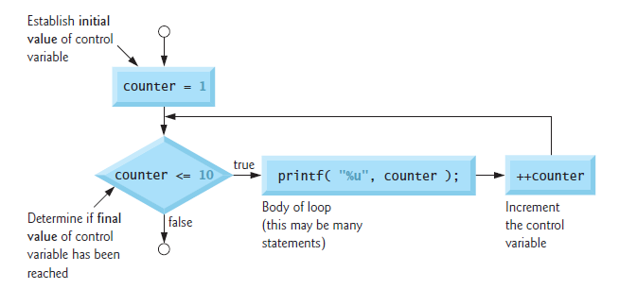
Flowchart:

Slide 10
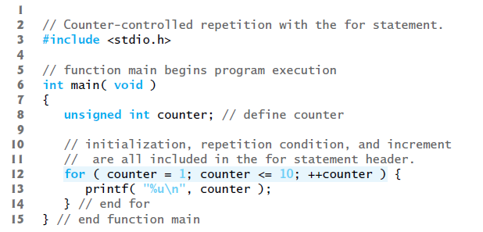
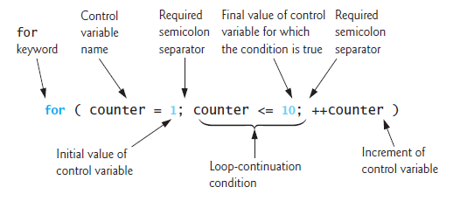
C Program:

Slide 11

Increment expression acts like a standalone statement.
The expressions above are all equivalent in the increment part of the for statement.

Slide 12
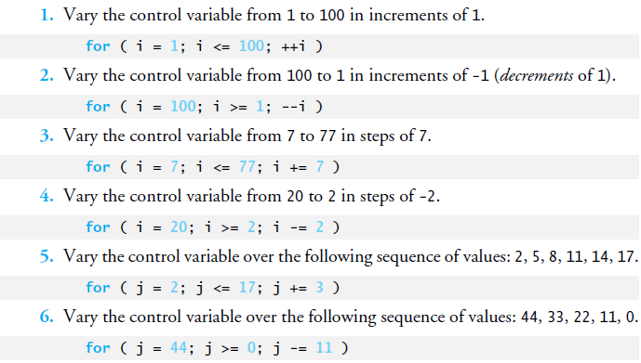
Examples using the for statement:

Slide 13
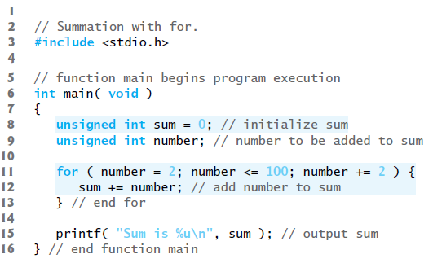
Example 1:
Sum up all the even integers from 2 to 100.
Solution:

Slide 14
switch multiple-selection statement
Occasionally, an algorithm will contain a series of decisions in which a variable or expression is tested separately for each of the constant integral values it may assume, and different actions are taken – multiple selection.
switch multiple-selection statement is used to handle such decision making.
Consists of a series of case labels, an optional default case and statements to execute for each case.

Slide 15
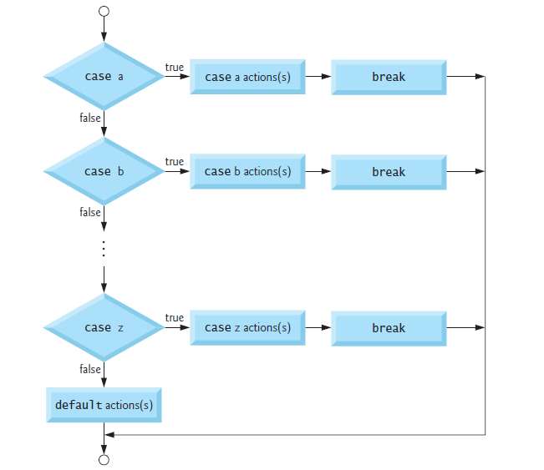
Flowchart:

Slide 16
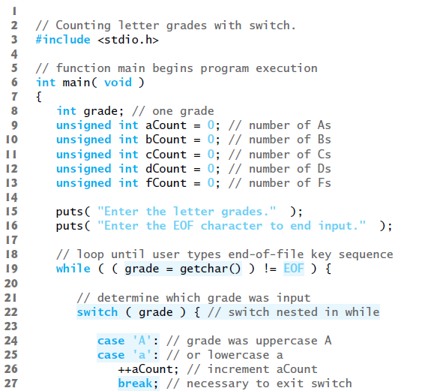
C Program:

Slide 17
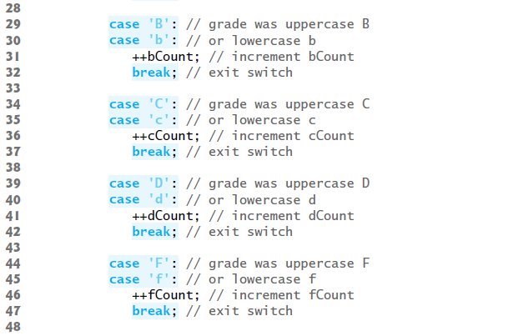

Slide 18
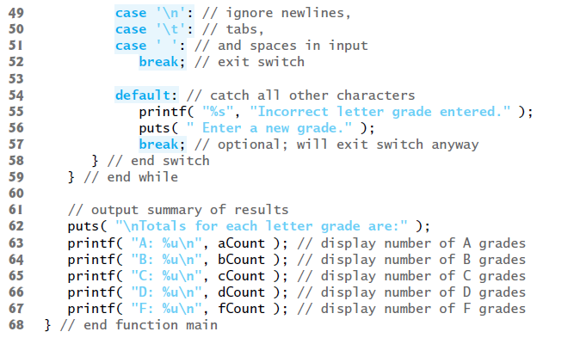

Slide 19
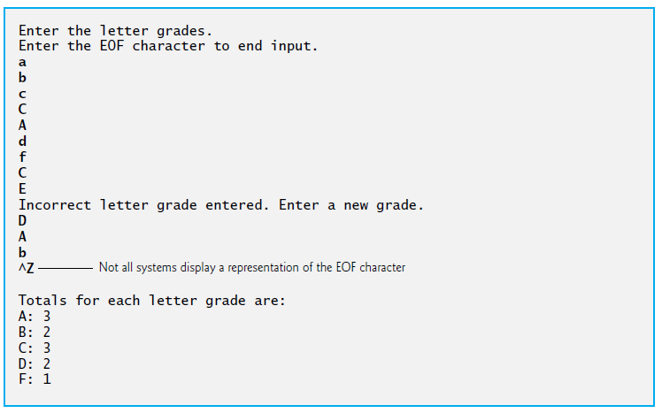
Output:

Slide 20
do…while iteration statement
Similar to the while statement.
For while statement, the loop-continuation condition is tested at the beginning of the loop before the body of the loop is performed.
For do…while statement, the loop-continuation condition is tested after the loop body is performed.
Loop will always execute at least once.

Slide 21
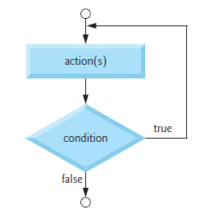
Flowchart:

Slide 22
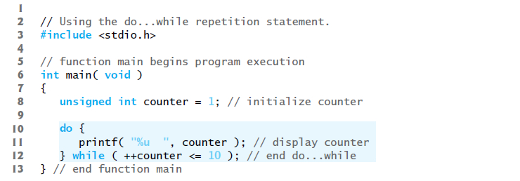
C Program:
Output:

Slide 23
break and continue statements
Used to alter the flow of control.
The break statement, when executed in a while, for, do…while or switch statement causes an immediate exit from that statement.
Used to escape early from a loop or to skip the remainder of a switch.

Slide 24
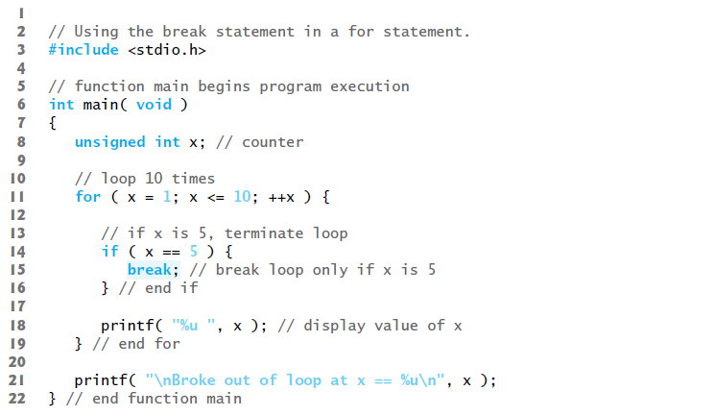

C Program:
Output:

Slide 25
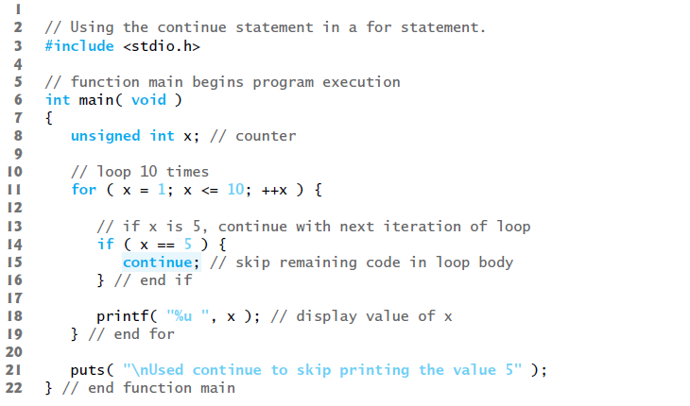
The continue statement, when executed in a while, for or do…while statement, skips the remaining statements in that control statement’s body and performs the next iteration of the loop.
C Program:

Slide 26

Output:

Slide 27
Logical operators
Used to test multiple conditions in the process of making a decision.
Combine simple conditions to form more complex conditions.
The logical operators are:
&& (logical AND)
|| (logical OR)
! (logical NOT, also called logical negation)

Slide 28
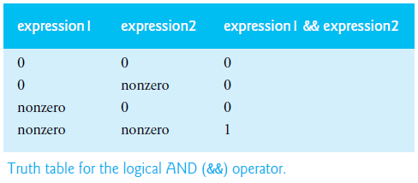
Logical AND (&&) Operator
The seniorFemales value will increment by 1 when both gender has the value of 1 and age is more than or equal to 65.

Slide 29
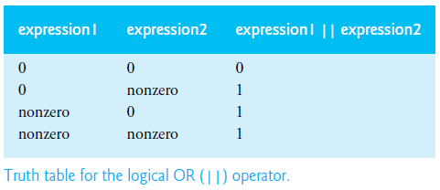
Logical OR (||) Operator
The statement Student grade is A will be printed when the value of semesterAverage is more than or equal to 90 or when the value of finalExam is more than or equal to 90.

Slide 30
Short-Circuit Evaluation
An expression containing && or || operators is evaluated only until the truth or falsehood is known.
The evaluation of the condition gender ==1 && age >=65 will stop if gender is not equal to 1 (i.e. the entire expression is guaranteed to be false), and continue if gender is equal to 1 (i.e. the entire expression could still be true if age >=65).
Can help reduce a program’s execution time.

Slide 31
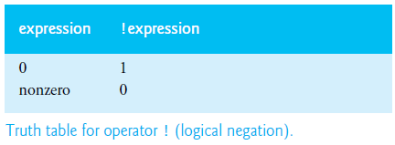
Logical Negation (!) Operator
The statement The next grade is … will only be printed out if the grade value is not the same as the sentinelValue.

Slide 32
Thank you

