Slide 1
C functions

Slide 2
Module learning outcomes (MLO)
 | Description
MLO1 | Analyse C program codes to determine the output
MLO2 | Develop C programs involving decision structures and loops
MLO3 | Develop C programs involving functions
MLO4 | Write, compile and debug programs in C language

Slide 3
Modularizing programs in C
Most computer programs that solve real-world problems are large.
Best way to develop and maintain a large program is to construct smaller pieces.
Functions are used to modularize programs.
Programs are typically written by combining new functions you write with pre-packaged functions available in the C standard library.
Functions are invoked by a function call, which specifies the function name and provides information (as arguments) that the function needs to perform its designated task.

Slide 4
Math library functions
Math library functions allow you to perform certain common mathematical calculations.
Functions are normally used in a program by writing the name of the function followed by a left parenthesis followed by the argument (or a comma-separated list of arguments) of the function followed by a right parenthesis. For example, to calculate and print the square root of 900.0, you might write

Slide 5
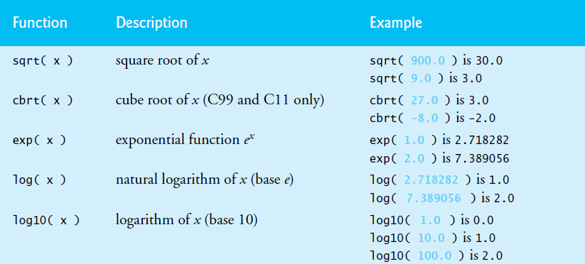
All functions in the math library that return floating-point values return the data type double.
double values, like float values, can be output using the %f conversion specifier.
Commonly used math library functions:

Slide 6
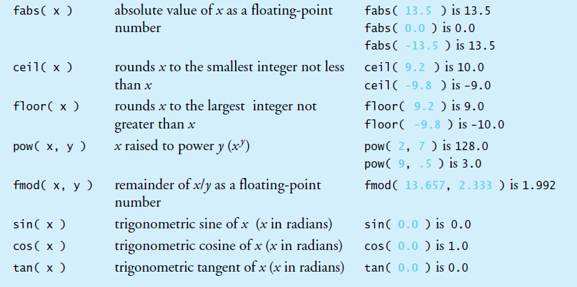

Slide 7
functions
Functions allow you to modularize a program.
All variables defined in function definitions are local variables
The variables can be accessed only in the function in which they are defined.
Motivations for using functions in a program are:
The divide-and-conquer approach makes program development more manageable.
Software reusability – using existing functions as building blocks to create new programs.
Avoid repeating code in a program.

Slide 8
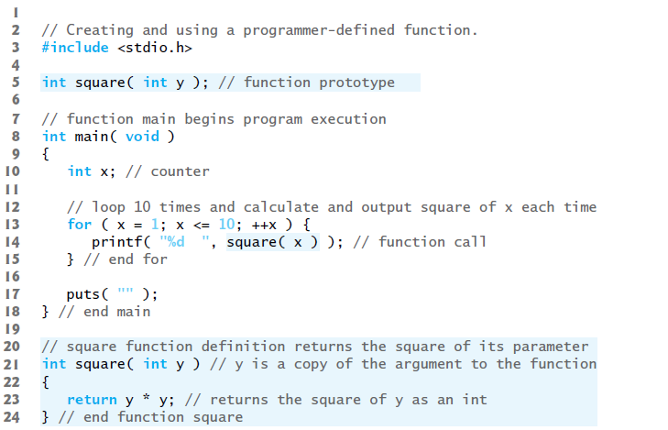
Example of a square function

Slide 9
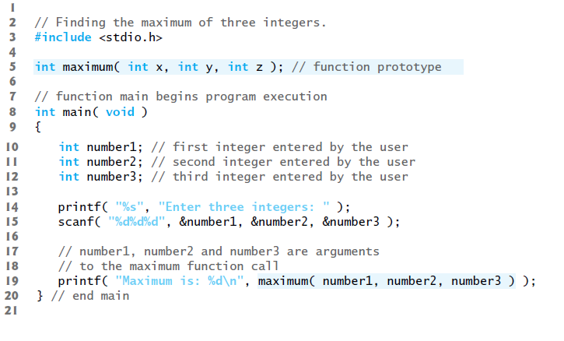
Example of a maximum function

Slide 10
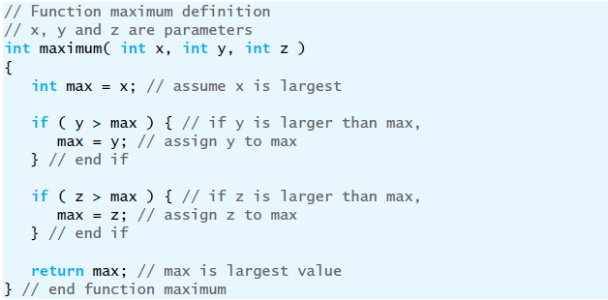
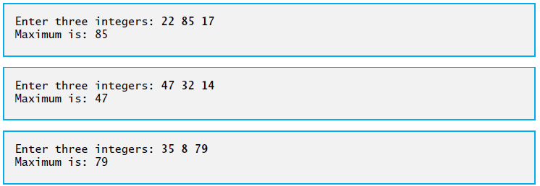

Slide 11
Function prototypes: a deeper look
The compiler uses function prototypes to validate function calls.
A function call that does not match the function prototype is a compilation error.

Slide 12
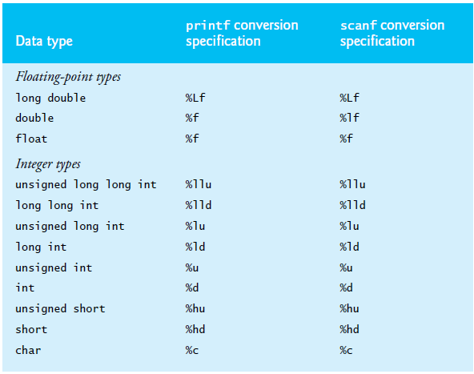

Slide 13
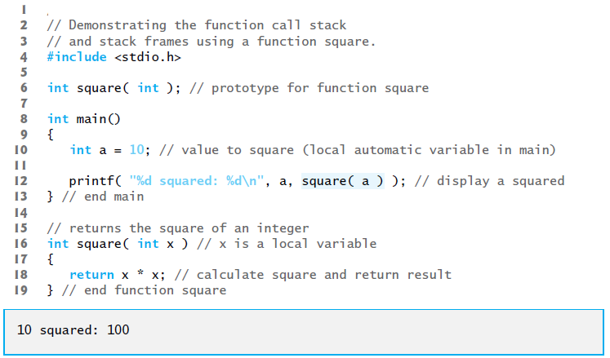

Slide 14
headers
Each standard library has a corresponding header containing the function prototypes for all the functions in that library and definitions of various data types and constants needed by those functions.
You can also create custom headers.
Should use the .h filename extension.
#include “square.h”
Programmer defined headers are enclosed in quotes (“ “) rather than angle brackets (<>)

Slide 15
Scope rules
The scope of an identifier is the portion of the program in which the identifier can be referenced.
Global variable
Local variable
Static local variable

Slide 16
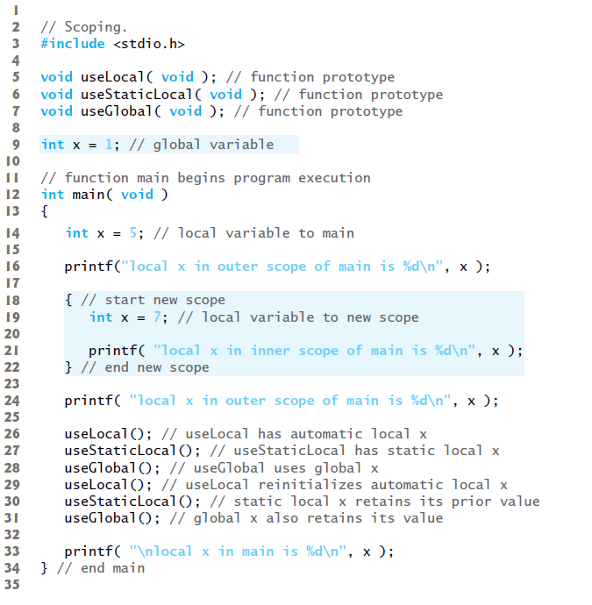

Slide 17
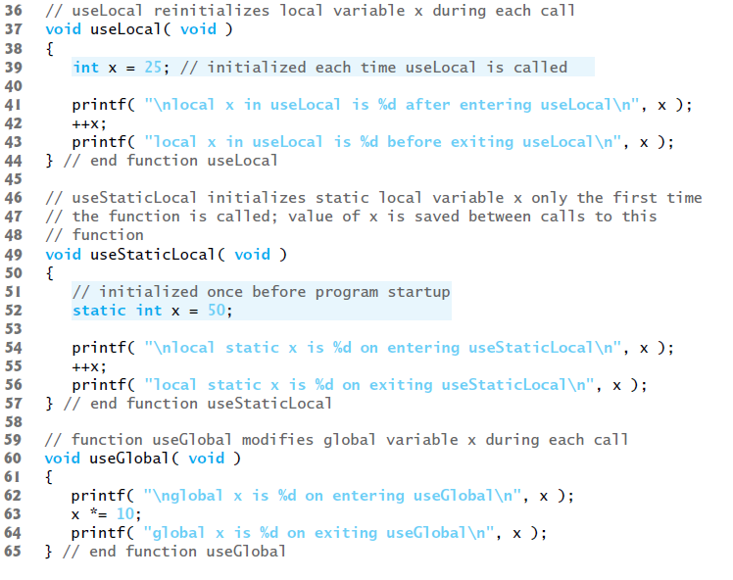

Slide 18
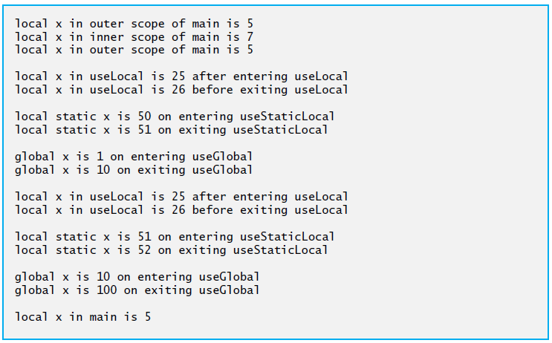

Slide 19
Thank you

