Slide 1
C arrays

Slide 2
Module learning outcomes (MLO)
 | Description
MLO1 | Analyse C program codes to determine the output
MLO2 | Develop C programs involving decision structures and loops
MLO3 | Develop C programs involving functions
MLO4 | Write, compile and debug programs in C language

Slide 3
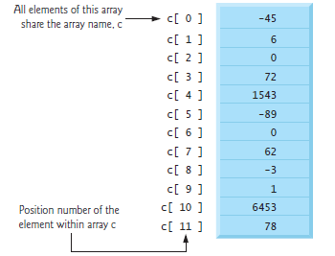
arrays
Arrays are data structures consisting of related data items of the same type.
To refer to a particular location or element in the array, we specify the array’s name and the position number of the particular element in the array.

Slide 4
The figure shows an integer array called c, containing 12 elements.
Any one of these elements may be referred to by giving the array’s name followed by the position number of particular element in square brackets ([ ]).
The first element in every array is the zeroth element (i.e. the one with position number 0).
The position number in square brackets is called the element’s index or subscript.
Index must be an integer.

Slide 5
Defining arrays
Arrays occupy space in memory. You specify the type of each element and the number of elements each array requires so that the computer may reserve the appropriate amount of memory
int b[100] , x[27];
Reserves 100 elements for integer array b and 27 elements for integer array x.
These arrays have indices of 0-99 and 0-26 respectively.
Array may contain other data types.

Slide 6
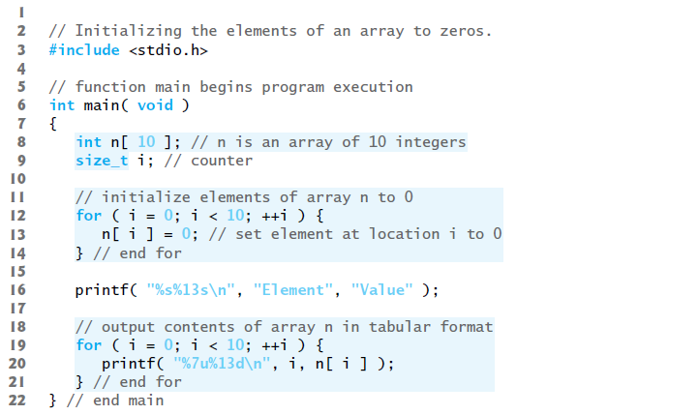
Array examples
Defining an array and using a loop to set the array’s element values

Slide 7
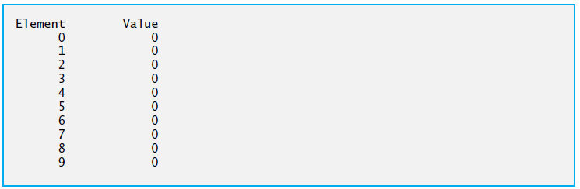

Slide 8
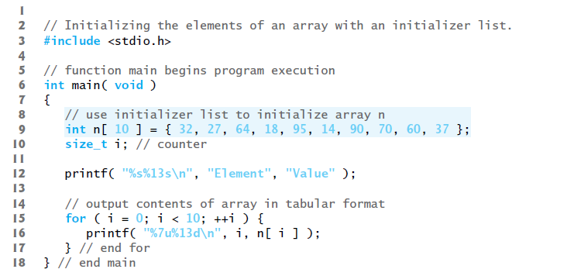
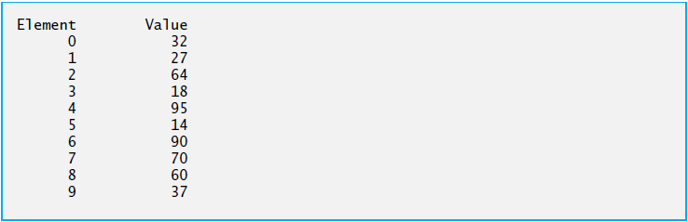
Initializing an array in a definition with an initializer list

Slide 9
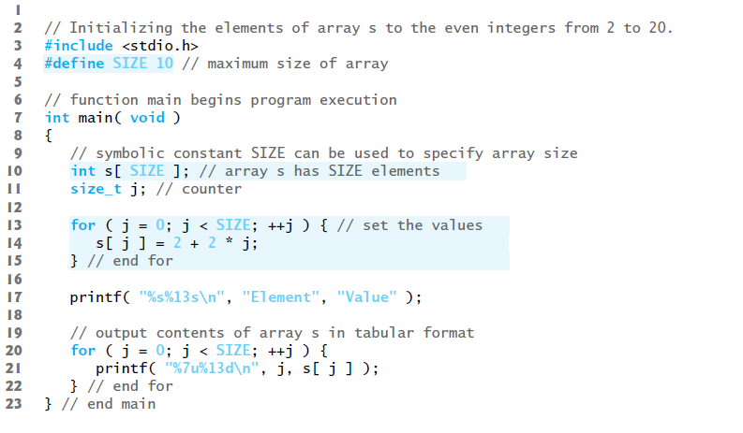
Specifying an array’s size with a symbolic constant and initializing array elements with calculations

Slide 10
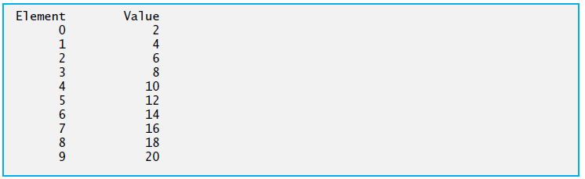

Slide 11
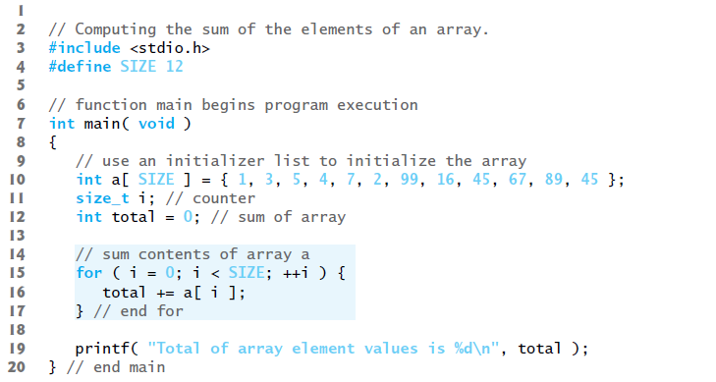
Summing the elements of an array

Slide 12
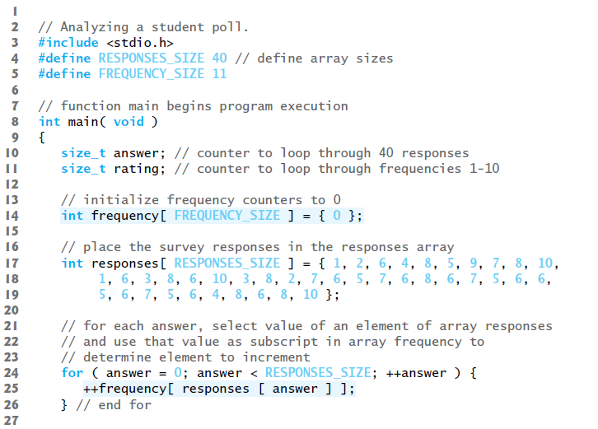
Using arrays to summarize survey results

Slide 13
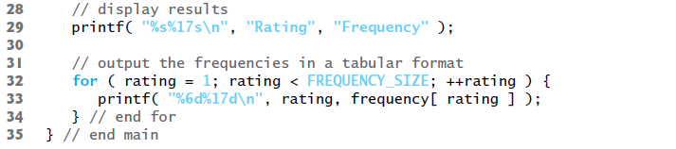
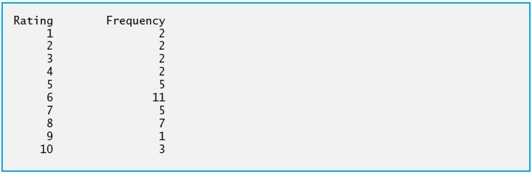

Slide 14
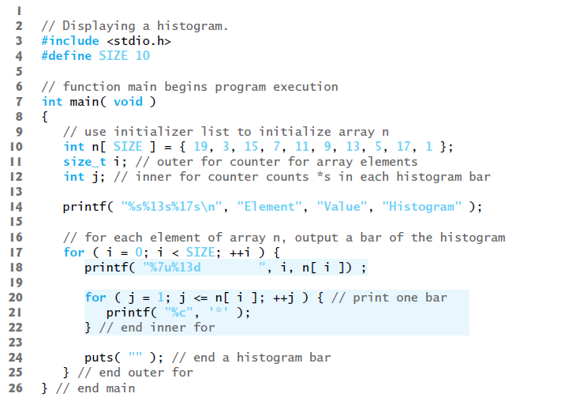
Graphing array elements with histograms

Slide 15
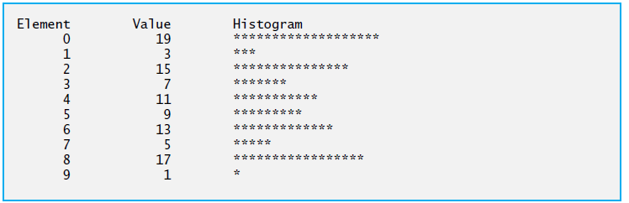

Slide 16
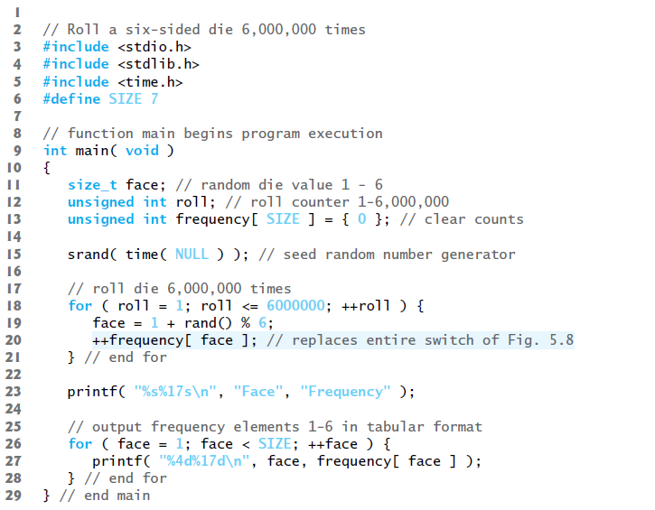
Rolling a die 6,000,000 times and summarizing the results in an array

Slide 17
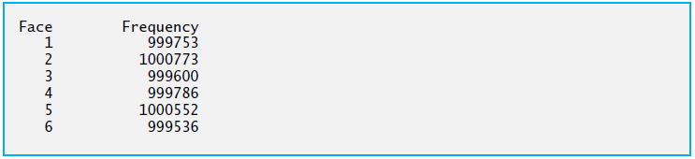

Slide 18
Using character arrays to store and manipulate strings
Initializing a character array with a string
char string1[ ] = “first”;
The string contains 5 characters and a special string-termination character (null character). Thus, string1 actually contains six elements.
The escape sequence representing the null character is ‘\0’. All strings in C end with this character.
A character array representing a string should always be defined large enough to hold the number of characters in the string and the terminating null character.

Slide 19
Initializing a character array with an initializer list of characters
char string1[ ] = { ‘f’, ‘i‘, ‘r’, ‘s’, ‘t’, ‘\0’ };
Character arrays can also be initialized with individual character constants in an initializer list but this can be tedious.
Accessing the characters in a string
Because a string is really an array of characters, we can access individual characters in a string directly using array index notation.
For example, string1[0] is the character ‘f’ and string1[3] is the character ‘s’.
Inputting into a character array
We can also input a string directly into a character array from the keyboard using scanf and the conversion specifier %s

Slide 20
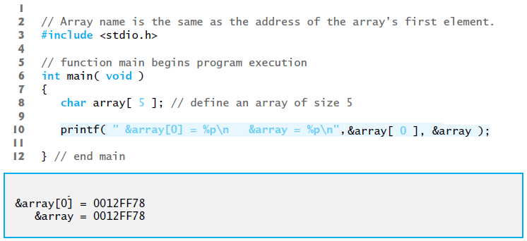
char string2[ 20 ]; creates a character array capable of storing a string of at most 19 characters and a terminating null character.
scanf(“%19s” , string2); reads a string from the keyboard into string2.
The name of the array is passed to scanf without the preceding & used with nonstring variables. This is because the value of an array name is the address of the start of the array, therefore the & is not necessary.

Slide 21
Function scanf will read characters until a space, tab, newline or end-of-file indicator is encountered.
The string string2 should be no longer than 19 characters to leave room for the terminating null character.
If the user types in 20 or more characters, your program may crash or create a security vulnerability called buffer overflow.
For this reason, we used the conversion specifier %19s so that scanf reads a maximum of 19 characters and does not write characters into memory beyond the end of the array string2.

Slide 22
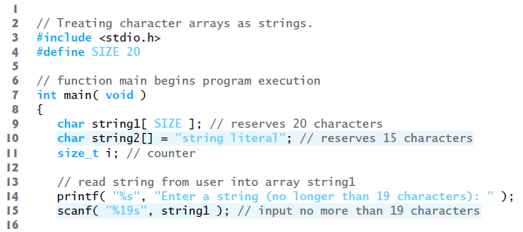
Outputting a character array that represents a string
printf (“%s \n”,string2);
Demonstrating character arrays

Slide 23
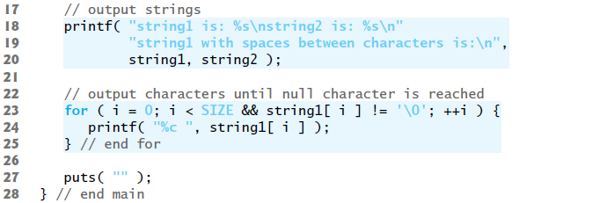
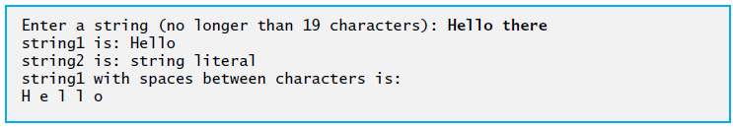

Slide 24
Static local arrays and automatic local arrays
We can apply static to a local array definition so that the array is not created and initialized each time the function is called and the array is not destroyed each time the function is exited in the program.
This reduces program execution time, particularly for programs with frequently called functions that contain large arrays.
Arrays that are static are initialized once at program startup.

Slide 25
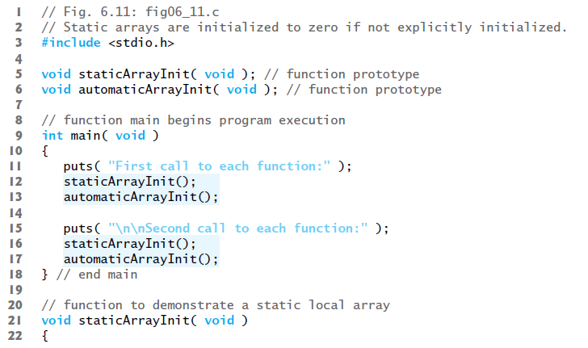

Slide 26
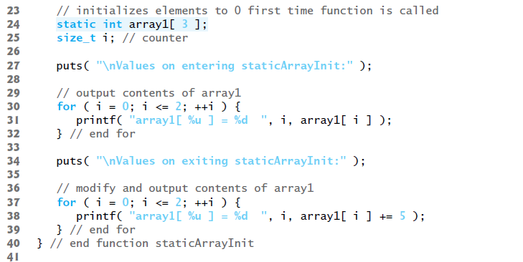

Slide 27
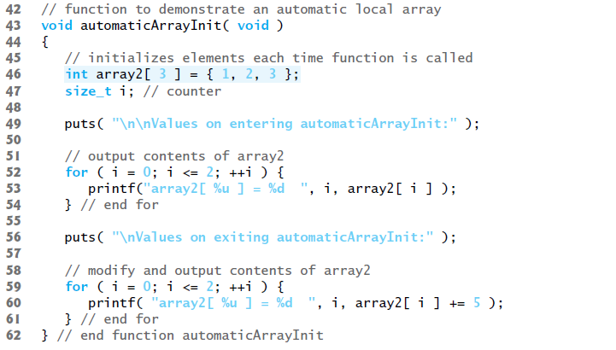

Slide 28
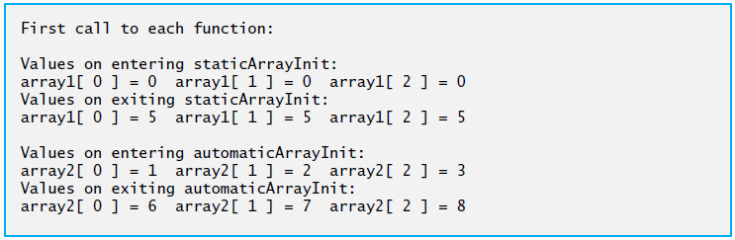
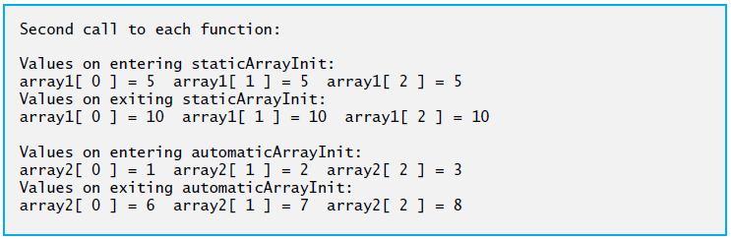

Slide 29
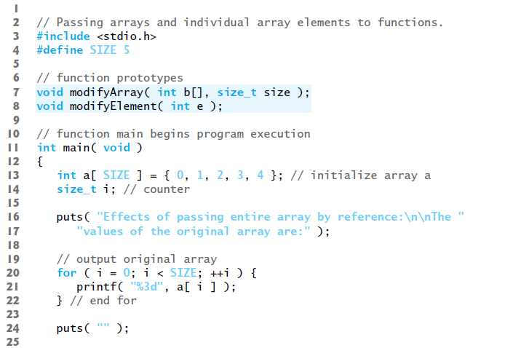
Passing arrays to functions

Slide 30
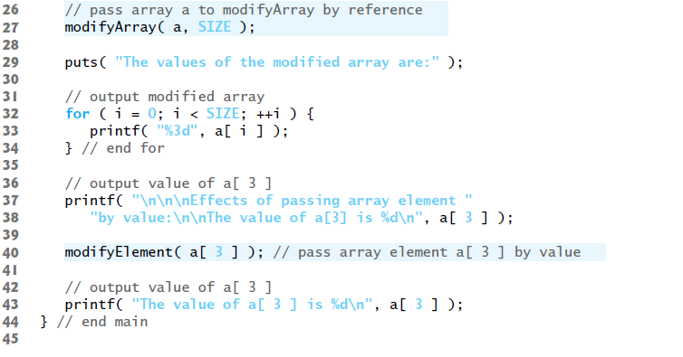

Slide 31
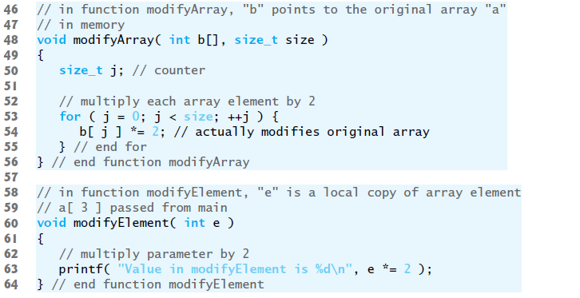

Slide 32
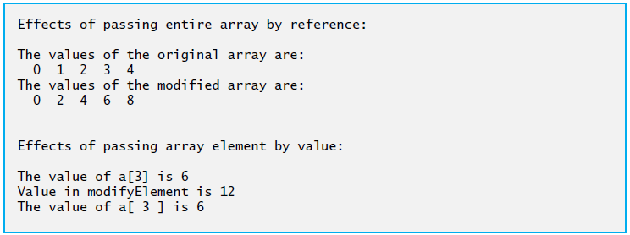

Slide 33
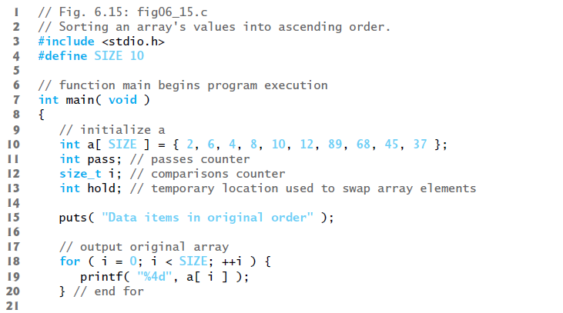
Sorting arrays

Slide 34
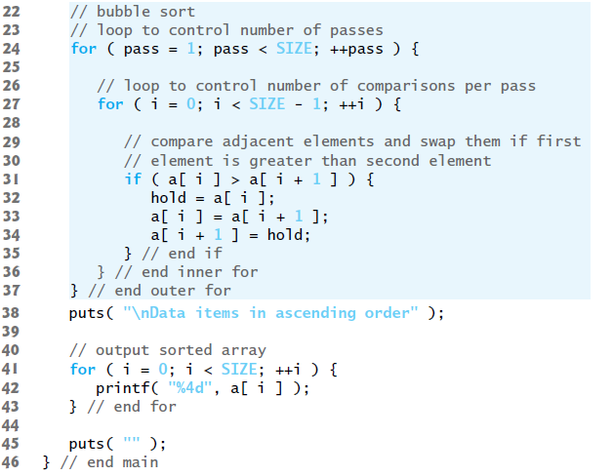
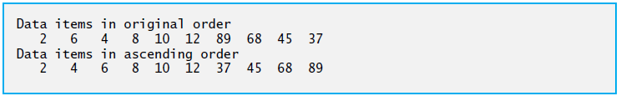

Slide 35
Multidimensional arrays
A common use of multidimensional arrays is to represent tables of values consisting of information arranged in rows and columns.
To identify a particular table element, we must specify two indices: The first (by convention) identifies the element’s row and the second (by convention) identifies the element’s column.
Tables or arrays that require two indices to identify a particular element are called two-dimensional arrays.
Multidimensional arrays can have more than two indices.

Slide 36
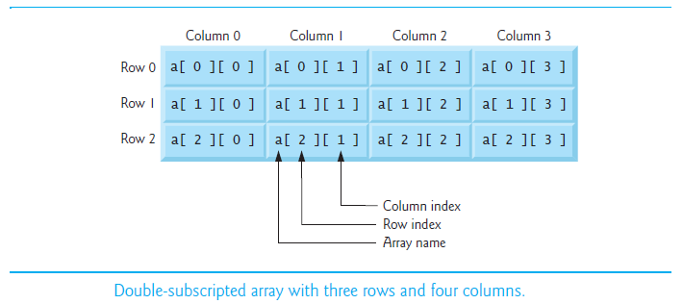

Slide 37
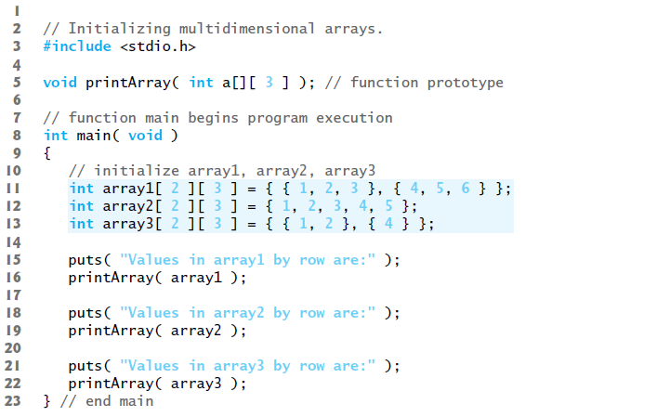

Slide 38
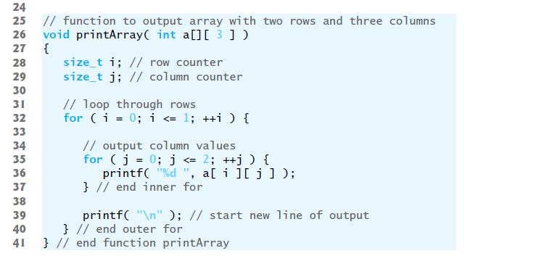
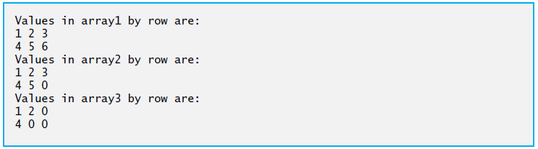

Slide 39
Thank you

