Slide 1
C pointers

Slide 2
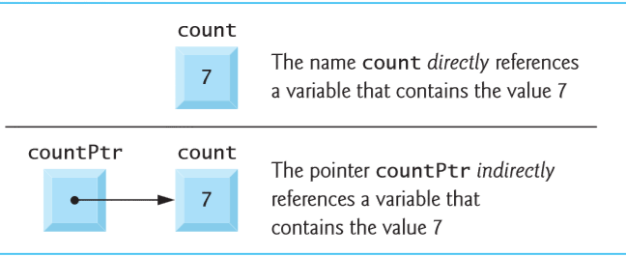
Pointer variable definitions and initialization
Pointers are variables whose values are memory addresses.
Normally, a variable directly contains a specific value.
A pointer contains an address of a variable that contains a specific value.
In this sense, a variable name directly references a value and a pointer indirectly references a value.

Slide 3
Declaring Pointers
int *countPtr, count;
The above line of code specifies that variable countPtr is of type int * (i.e., a pointer to an integer) and is read (right to left), “countPtr is a pointer to int” or “countPtr points to an object of type int.”
Variable count is defined to be an int, not a pointer.
When * is used in this manner in a definition, it indicates tat the variable being defined is a pointer.
Pointers can be defined to point to objects of any type.

Slide 4


Pointers operators
The Address (&) Operator
The &, or address operator, is an operator that returns the address of its operand.
The statement yPtr = &y assigns the address of the variable y to pointer variable yPtr.
Variable yPtr is then said to “point to” y.

Slide 5

Pointer Representation in Memory
The Dereferencing (*) Operator
The * operator, commonly referred to as the dereferencing operator or indirection operator, returns the value of the object to which its operand (i.e., a pointer) points.
printf ( “%d”, *yPtr);
The code above prints the value of the variable y (which is 5).
Using * in this manner is called dereferencing a pointer.

Slide 6
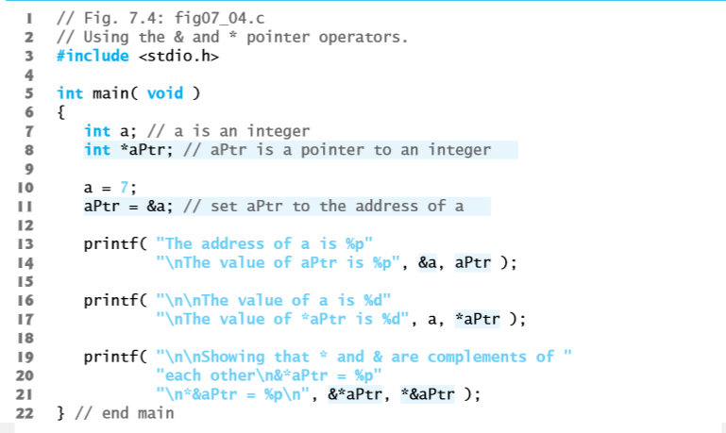
Demonstrating the & and * Operators

Slide 7
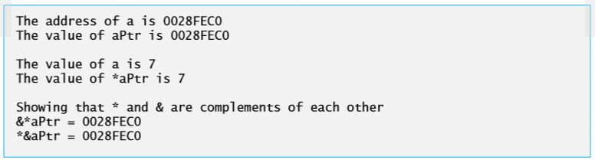

Slide 8
Passing arguments to functions by reference
There are two ways to pass arguments to a function:
Pass-by-value
Pass-by-reference

Slide 9
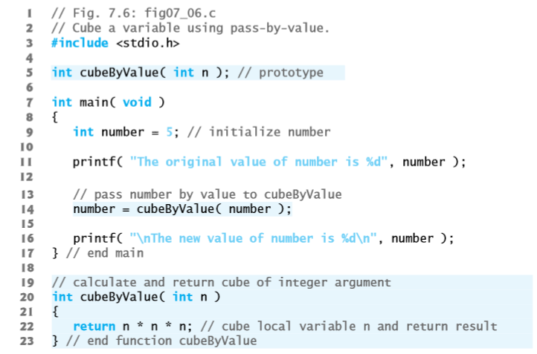

Pass-By-Value

Slide 10
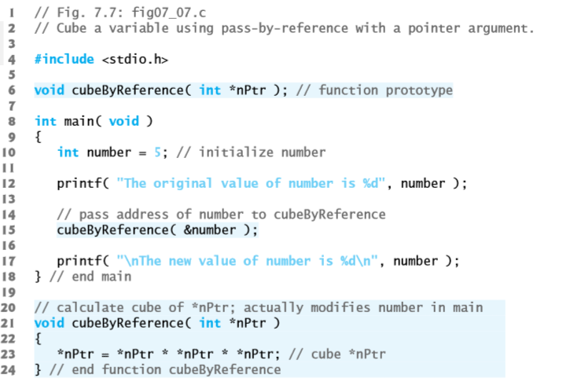

Pass-By-Reference

Slide 11
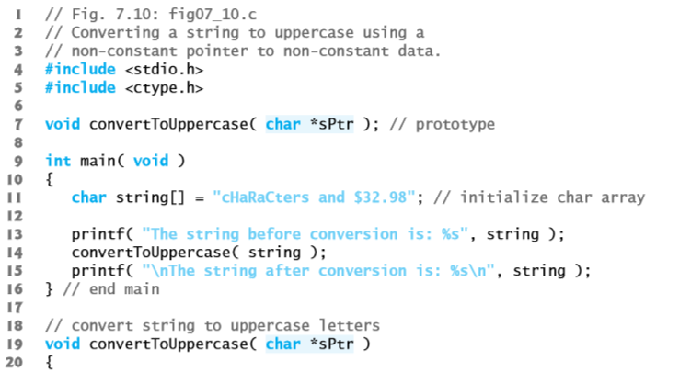
examples

Slide 12
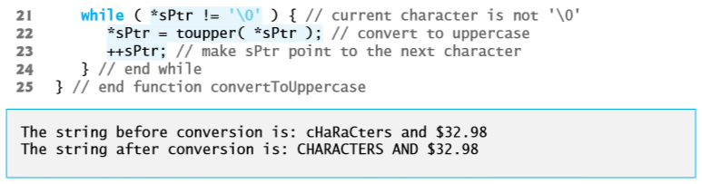

Slide 13

Pointer expressions and pointer arithmetic
Limited arithmetic operations may be performed on pointers.
Assume that array int v[5] has been defined and its first element is at location 3000 in memory. Assume pointer vPtr has been initialized to point to v[0]—i.e., the value of vPtr is 3000. Variable vPtr can be initialized to point to array v with either of the statements:

Slide 14
vPtr += 2 would cause pointer vPtr to now point to v[2].
If vPtr now points to v[4], the vPtr -= 4 would set vPtr back to 3000, the beginning of the array.
++vPtr, vPtr++, --vPtr, vPtr– can also be used to increment/decrement the pointer

Slide 15
Thank you

