Slide 1
C characters and strings

Slide 2
Fundamentals of Strings and Characters
Characters are the fundamental building blocks of source programs. Every program is composed of a sequence of characters that—when grouped together meaningfully—is interpreted by the computer as a series of instructions used to accomplish a task.
A program may contain character constants.
A character constant is an int value represented as a character in single quotes.
For example, 'z' represents the integer value of z, and '\n' the integer value of newline (122 and 10 in ASCII, respectively).

Slide 3
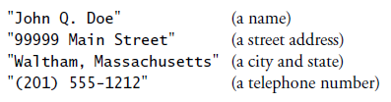
A string is a series of characters treated as a single unit. A string may include letters, digits and various special characters such as +, -, *, / and $.
String literals, or string constants, in C are written in double quotation marks as follows:

Slide 4
A string in C is an array of characters ending in the null character ('\0’).
A string is accessed via a pointer to the first character in the string.
The value of a string is the address of its first character.
Thus, in C, it’s appropriate to say that a string is a pointer—in fact, a pointer to the string’s first character.
In this sense, strings are like arrays, because an array is also a pointer to its first element.

Slide 5

A character array or a variable of type char * can be initialized with a string in a definition.
Each initialize a variable to the string "blue". The first definition creates a 5-element array color containing the characters 'b', 'l', 'u', 'e' and '\0'. The second definition creates pointer variable colorPtr that points to the string "blue" somewhere in memory.

Slide 6
The preceding array definition could also have been written
When defining a character array to contain a string, the array must be large enough to store the string and its terminating null character.
The preceding definition automatically determines the size of the array based on the number of initializers in the initializer list.

Slide 7
A string can be stored in an array using scanf. For example, the following statement stores a string in character array word[20]:
The string entered by the user is stored in word.
Variable word is an array, which is, of course, a pointer, so the & is not needed with argument word.

Slide 8
Recall that function scanf will read characters until a space, tab, newline or end-of-file indicator is encountered.
So, it’s possible that, without the field width 19 in the conversion specifier %19s, the user input could exceed 19 characters and that your program might crash!

Slide 9
Character-Handling Library
The character-handling library (<ctype.h>) includes several functions that perform useful tests and manipulations of character data.
Each function receives an unsigned char (represented as an int) or EOF as an argument.
EOF normally has the value –1.

Slide 10
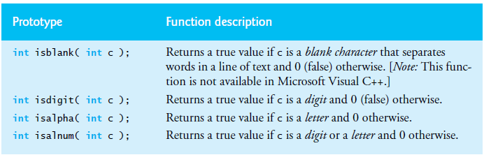

Slide 11
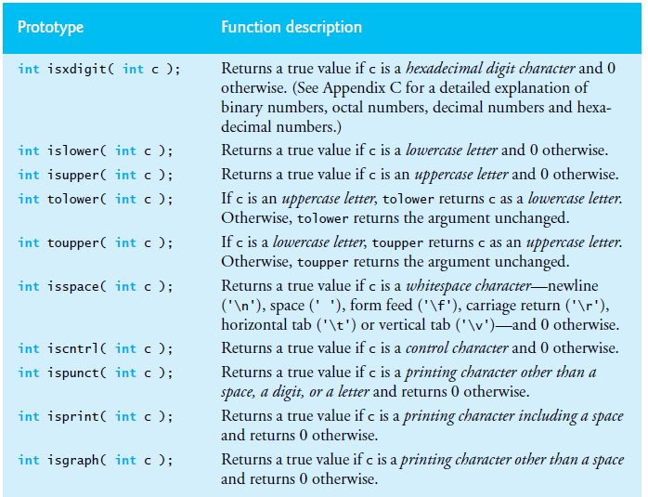

Slide 12
Standard Input/Output Library Functions
This section presents several functions from the standard input/output library (<stdio.h>) specifically for manipulating character and string data.

Slide 13
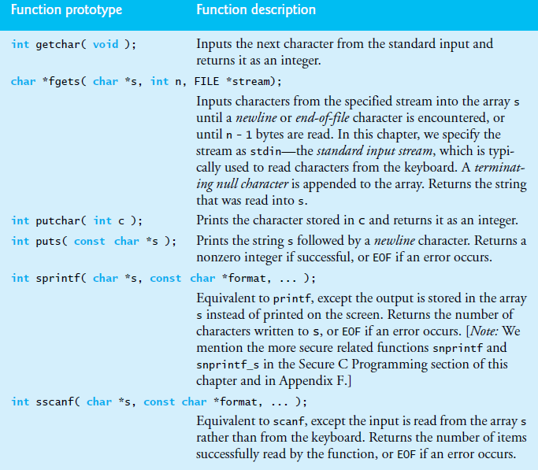

Slide 14
Functions fgets and putchar
Functions fgets and putchar can be used to read a line of text from the standard input (keyboard) and output the characters of the line.

Slide 15
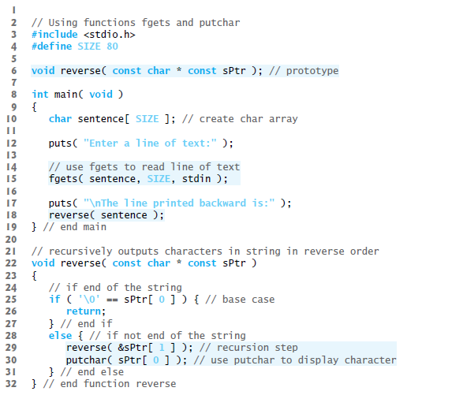

Slide 16

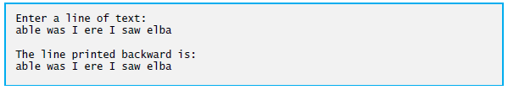

Slide 17
Function getchar
Functions getchar and puts can be used to read characters from the standard input into character array sentence and display the characters as a string.

Slide 18
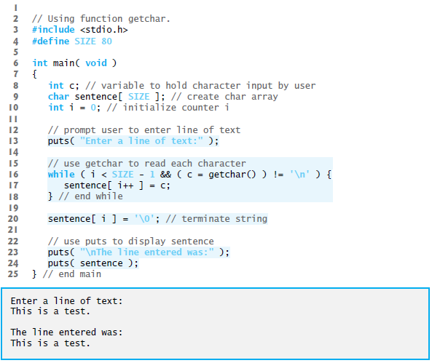

Slide 19
String-Manipulation Functions of the String- Handling Library
The string-handling library (<string.h>) provides many useful functions for manipulating string data (copying strings and concatenating strings), comparing strings, searching strings for characters and other strings, tokenizing strings (separating strings into logical pieces) and determining the length of strings.

Slide 20
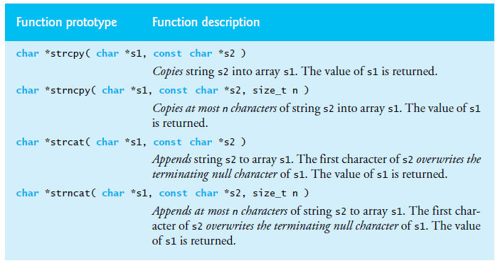

Slide 21
Functions strcpy and strncpy
strcpy can be used to copy the entire string in one array into another array while strncpy can be used to copy the first X number of characters of an array into another array.
A null character ('\0') is appended to array z, because the call to strncpy in the program does not write a terminating null character (the third argument is less than the string length of the second argument).

Slide 22
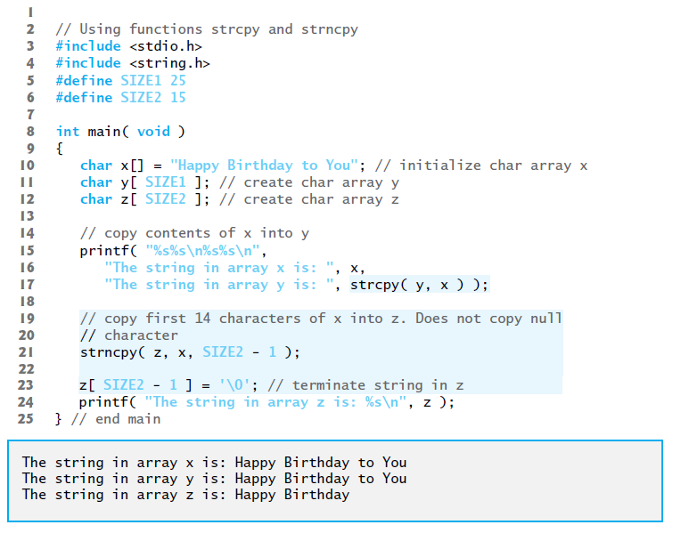

Slide 23
Functions strcat and strncat
Function strcat appends its second argument (a string) to its first argument (a character array containing a string).
The first character of the second argument replaces the null ('\0’) that terminates the string in the first argument.
You must ensure that the array used to store the first string is large enough to store the first string, the second string and the terminating null character copied from the second string.
Function strncat appends a specified number of characters from the second string to the first string. A terminating null character is automatically appended to the result.

Slide 24
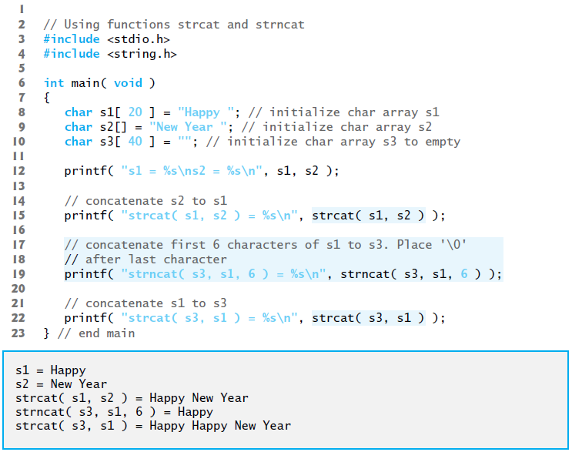

Slide 25
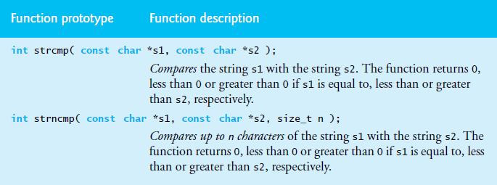
Comparison Functions of the String-Handling Library
This section presents the string-handling library’s string-comparison functions, strcmp and strncmp.

Slide 26
Function strcmp compares its first string argument with its second string argument, character by character.
The function returns 0 if the strings are equal, a negative value if the first string is less than the second string and a positive value if the first string is greater than the second string.
Function strncmp is equivalent to strcmp, except that strncmp compares up to a specified number of characters.
Function strncmp does not compare characters following a null character in a string.

Slide 27
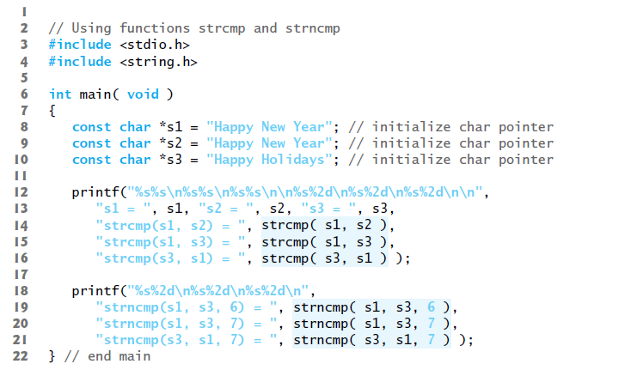
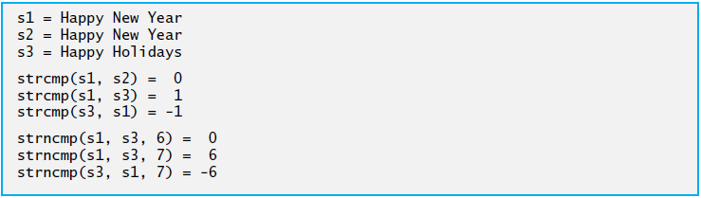

Slide 28
To understand just what it means for one string to be “greater than” or “less than” another, consider the process of alphabetizing a series of last names.
The reader would, no doubt, place “Jones” before “Smith,” because the first letter of “Jones” comes before the first letter of “Smith” in the alphabet.
But the alphabet is more than just a list of 26 letters—it’s an ordered list of characters. Each letter occurs in a specific position within the list.
“Z” is more than merely a letter of the alphabet; “Z” is specifically the 26th letter of the alphabet.

Slide 29
How do the string comparison functions know that one particular letter comes before another?
All characters are represented inside the computer as numeric codes in character sets such as ASCII and Unicode; when the computer compares two strings, it actually compares the numeric codes of the characters in the strings.

Slide 30
Thank you

