Slide 1
C formatted input/output

Slide 2
streams
All input and output is performed with streams, which are sequences of bytes.
In input operations, the bytes flow from a device to main memory
Keyboard, hard disk, a network connection.
In output operations, bytes flow from main memory to a device
Display screen, printer, hard disk, a network connection

Slide 3
When program execution begins, three streams are connected to the program automatically.
Normally, the standard input stream is connected to the keyboard and the standard output stream is connected to the screen.
A third stream, the standard error stream, is also connected to the screen.

Slide 4
Formatting output with printf
Every printf call contains a format control string that describes the output format.
The format control string consists of conversion specifiers, flags, field widths, precisions and literal characters.
Together the percent sign (%), these form conversion specifications.

Slide 5
Function printf can perform the following formatting capabilities, each of which is discussed in this chapter:
Rounding floating-point values to an indicated number of decimal places.
Aligning a column of numbers with decimal points appearing one above the other.
Right justification and left justification of outputs.
Inserting literal characters at precise locations in a line of output.
Representing floating point numbers in exponential format.
Representing unsigned integers in octal and hexadecimal format.
Displaying all types of data with fixed-size field widths and precisions.

Slide 6
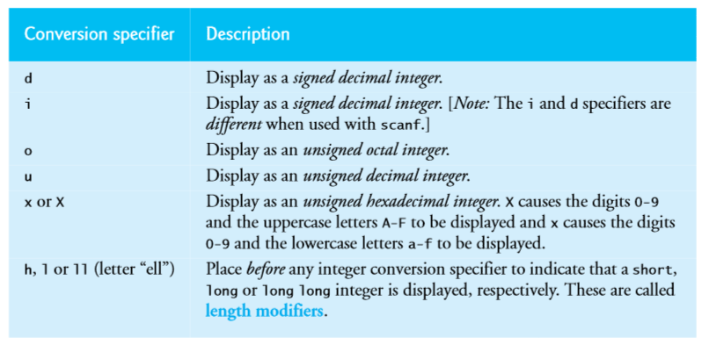
Printing integers
Integers are whole numbers, such as 776, 0 or -52.

Slide 7
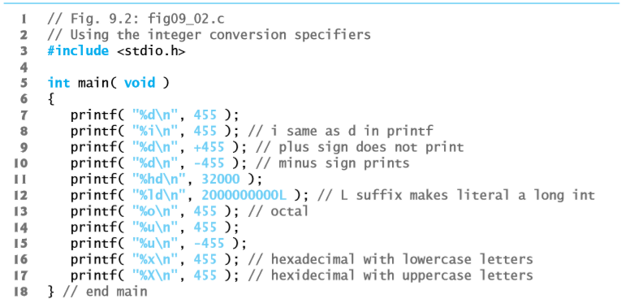

Slide 8
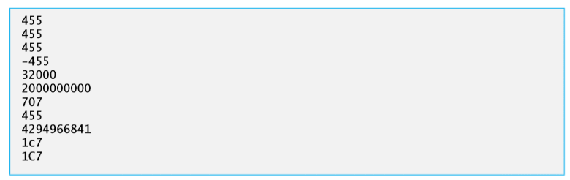

Slide 9
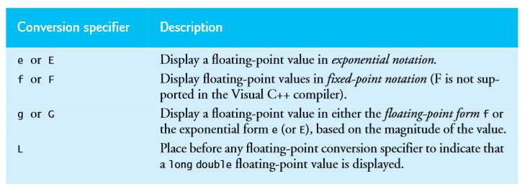
Printing floating-point numbers
A floating point value contains a decimal point as in 33.5, 0.0 or -657.983.
Floating point values are displayed in one of several formats

Slide 10
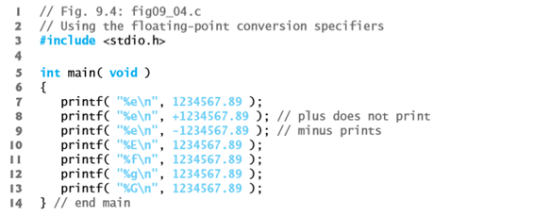
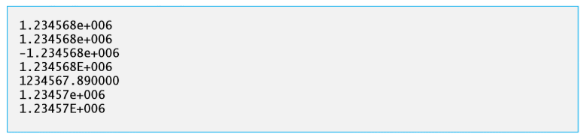

Slide 11
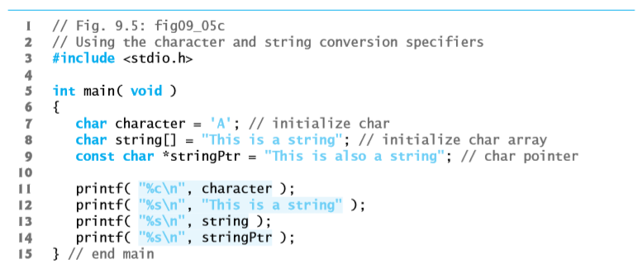
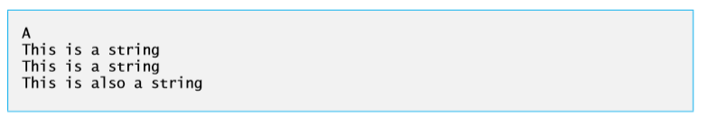
Printing strings and characters

Slide 12
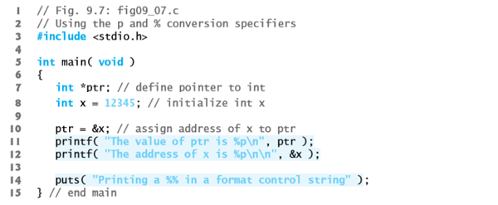
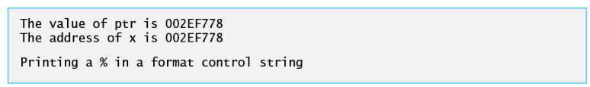
Other conversion specifiers

Slide 13
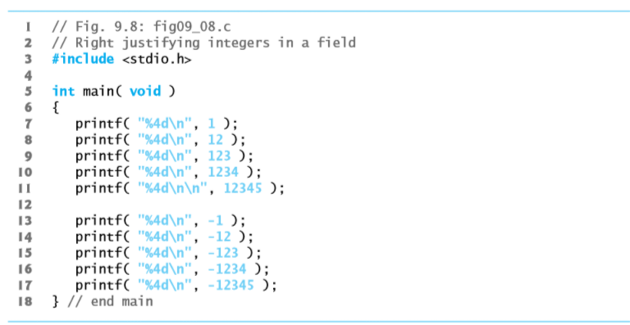
Printing with field widths and precision

Slide 14
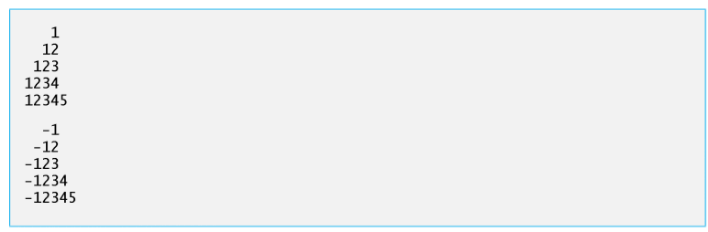

Slide 15
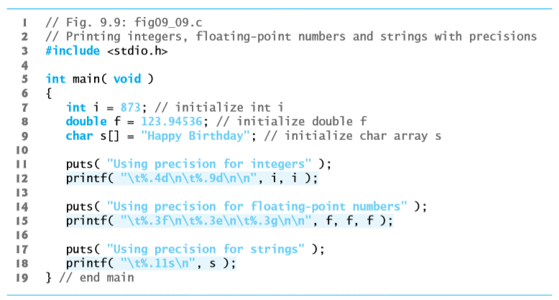

Slide 16
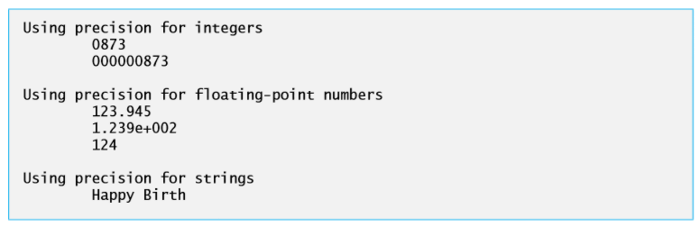

Slide 17
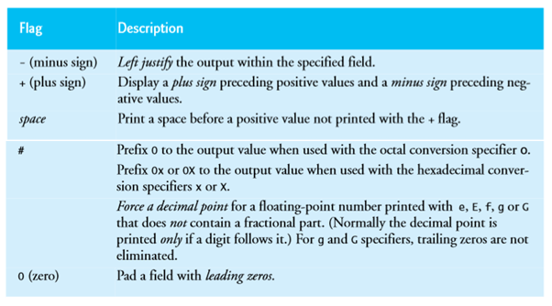
Using flags in the printf format control string

Slide 18
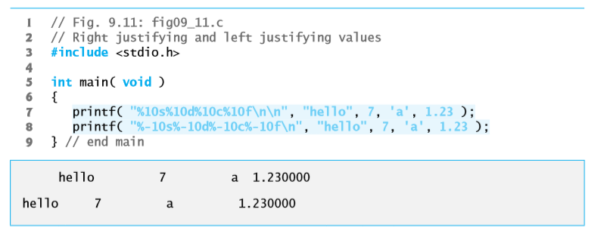
Right and left justification

Slide 19
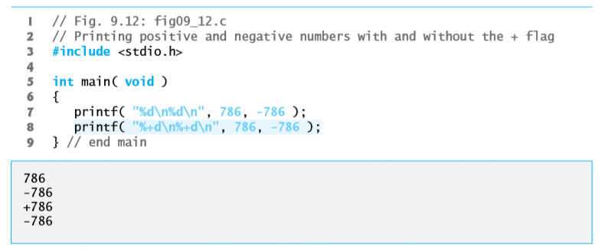
Printing positive and negative numbers with and without the + flag

Slide 20
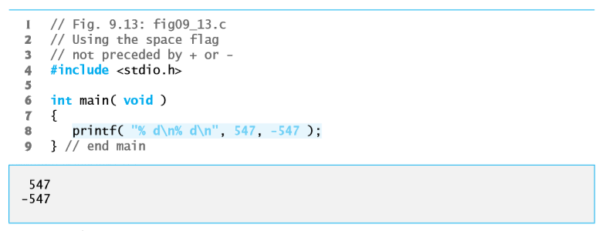
Using the space flag

Slide 21
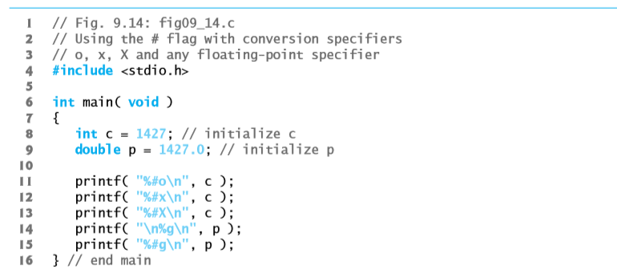
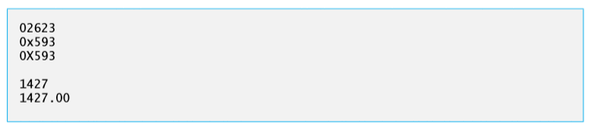
Using the # flag

Slide 22
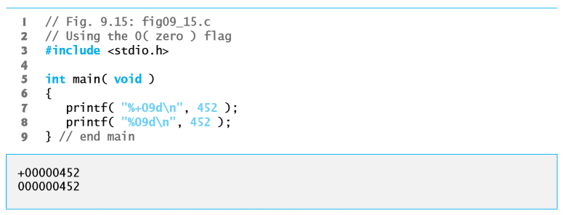
Using the 0 flag

Slide 23
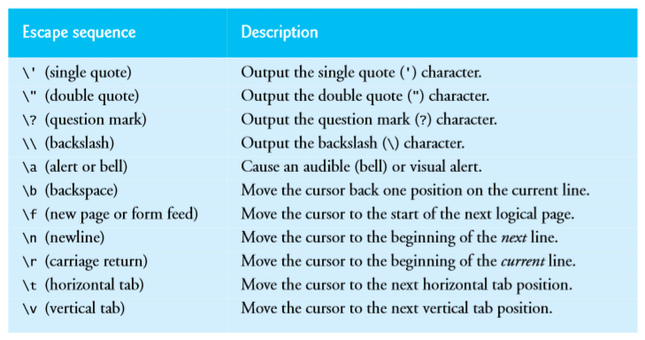
Printing literals and escape sequences

Slide 24
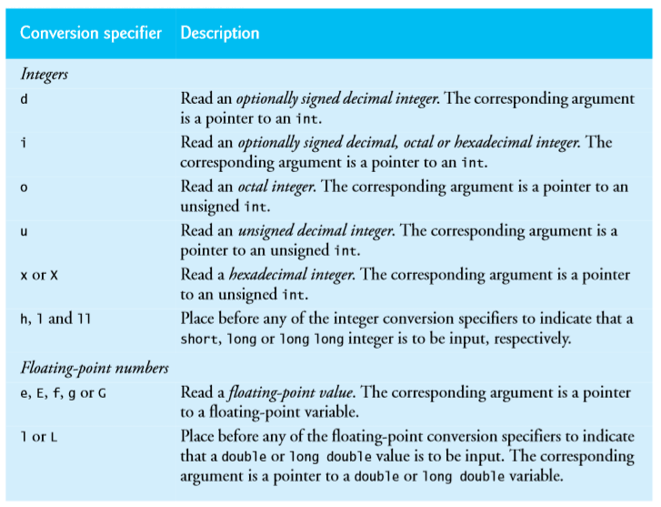
scanf conversion specifiers

Slide 25
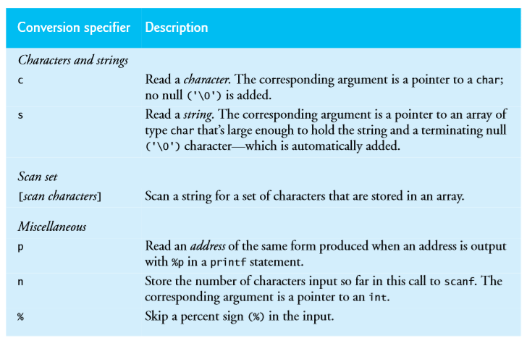

Slide 26
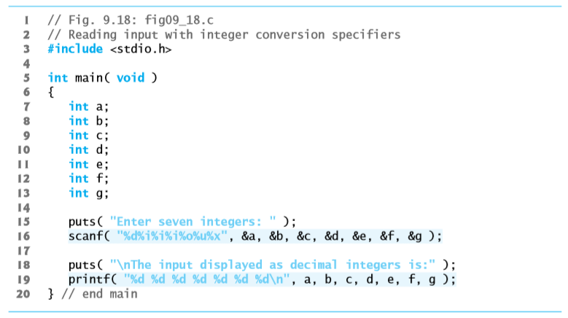
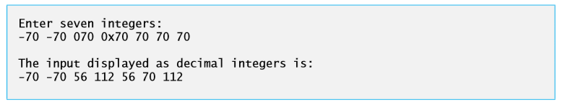
Reading integers with scanf

Slide 27
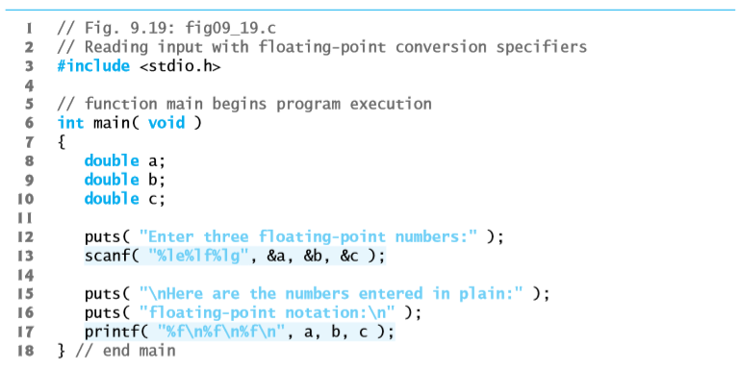
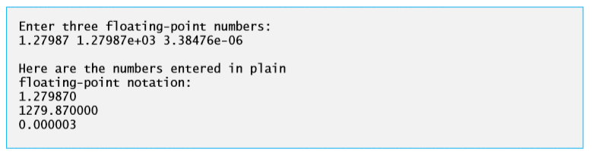
Reading floating-point numbers with scanf

Slide 28
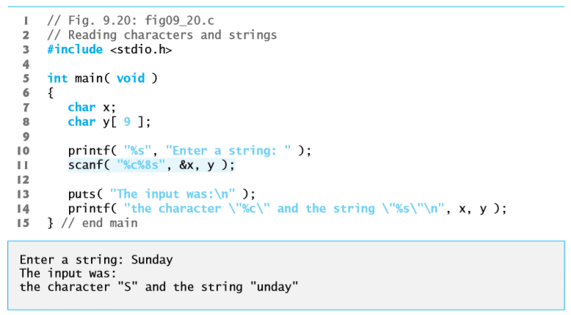
Reading characters and strings with scanf

Slide 29
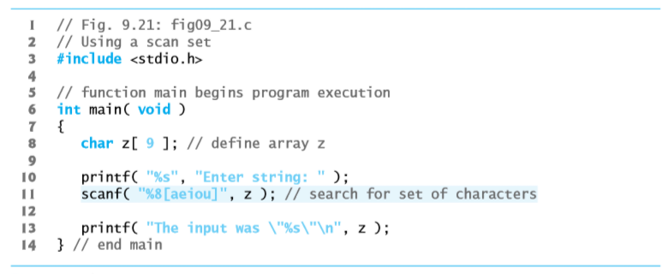

Using scan sets with scanf

Slide 30
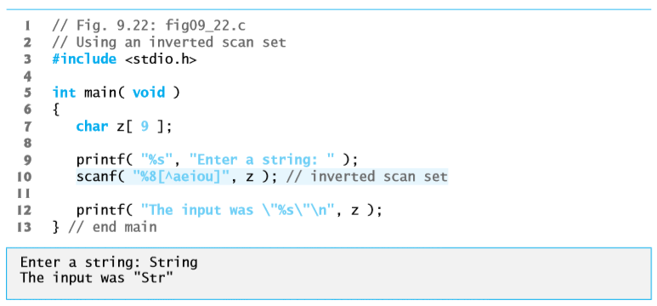

Slide 31
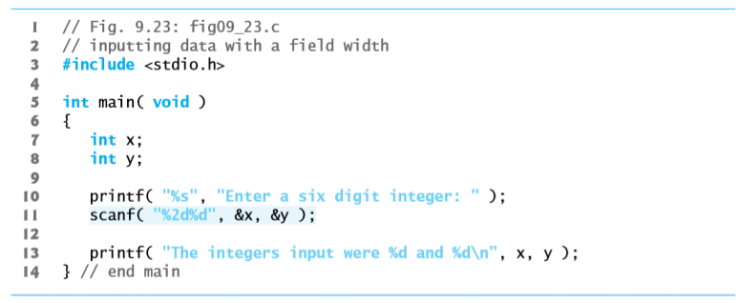

Using field widths with scanf

Slide 32
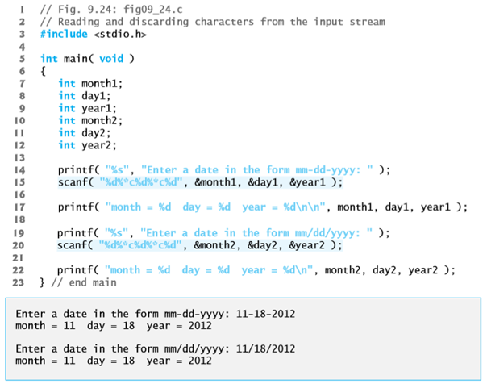
Skipping characters in an input stream

Slide 33
Thank you

