Slide 1
C structures

Slide 2
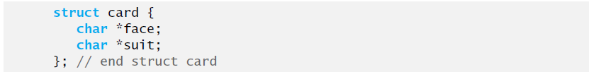
Structure definitions
Structures are collections of related variables under one name.
May contain variables of many different data types.
Different from arrays which contain only elements of the same data type.
Structures are derived data types and are constructed using objects of other types

Slide 3
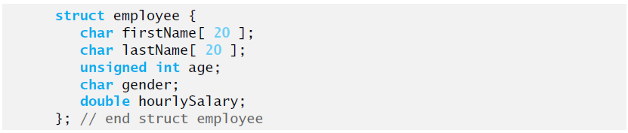
Keyword struct introduces a structure definition.
The identifier card is the structure tag, which names the structure definition and is used with struct to declare variables of the structure type.
Variables declared within the braces of the structure definition are the structure’s members.
Members of the same structure type must have unique names but two different structure types may contain members of the same name without conflict.
Each structure definition must end with a semicolon.

Slide 4
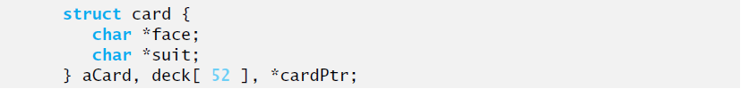
Defining variables of structure types
Structure variables are defined like variables of other types.
Variables of a given structure type may also be declared by placing a comma-separated list of variable names between the closing brace of the structure definition and the semicolon that ends the structure definition.

Slide 5
Initializing structures
Structure can be initialized using initializer lists as with arrays. To initialize a structure, follow the variable name in the definition with an equal sign and a brace-enclosed, comma-separated list of initializers.
The declaration above creates variable aCard to be of type struct card, as defined in Slide 2, and initializes member face to “Three” and member suit to “Hearts”.
If there are fewer initializers in the list than members, the remaining members are automatically initialized to 0 (or NULL if the member is a pointer).

Slide 6
Accessing structure members with . And ->
Two operators are used to access member of structures
The structure member operator (.) – also called the dot operator.
The structure pointer operator (->) – also called the arrow operator.
the expression cardPtr->suit is equivalent to (*cardPtr).suit, which dereferences the pointer and access the member suit using the structure member operator.

Slide 7
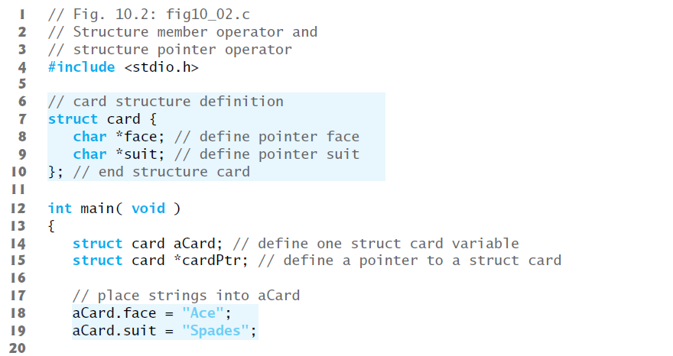

Slide 8
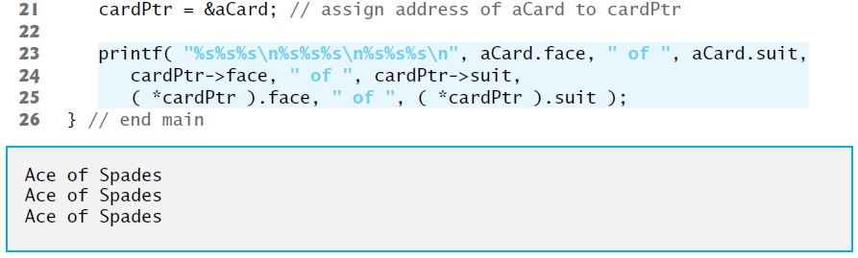

Slide 9
Using structures with functions
Structures may be passed to functions by passing individual structure members, by passing an entire structure or by passing a pointer to a structure.
When structures or individual structure members are passed to a function, they’re passed by value.
the members of a caller’s structure cannot be modified by the called function.
To pass a structure by reference, pass the address of the structure variable.
Arrays of structures - like all other arrays - are automatically passed by reference.

Slide 10
typedef
The keyword typedef provides a mechanism for creating synonyms (or aliases) for previously defined data types.
Names for structure types are often defined with typedef to create shorter type names.
The statement above defines the new type name Card as a synonym for type struct card. C programmers often use typedef to define a structure type, so a structure tag is not required.

Slide 11
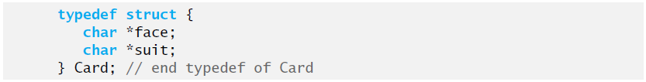
The definition above creates the structure type Card without the need for a separate typedef statement.
Card can now be used to declare variables of type struct card. The declaration above declares an array of 52 Card structures (i.e., variables of type struct card).

Slide 12
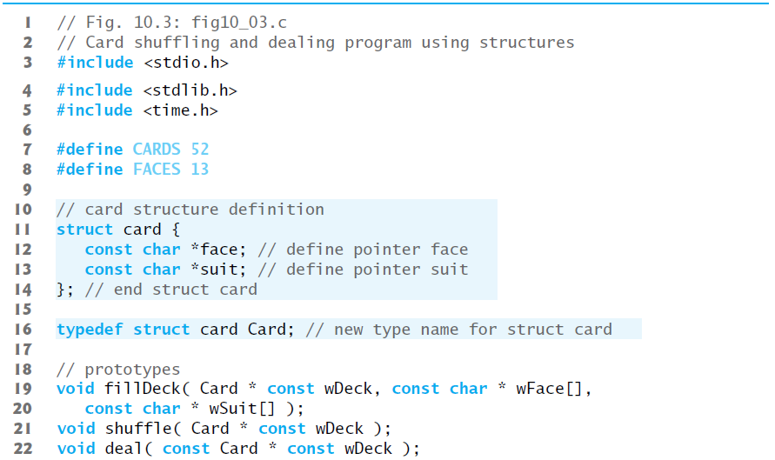
Example: High-Performance Card Shuffling and Dealing Simulation

Slide 13
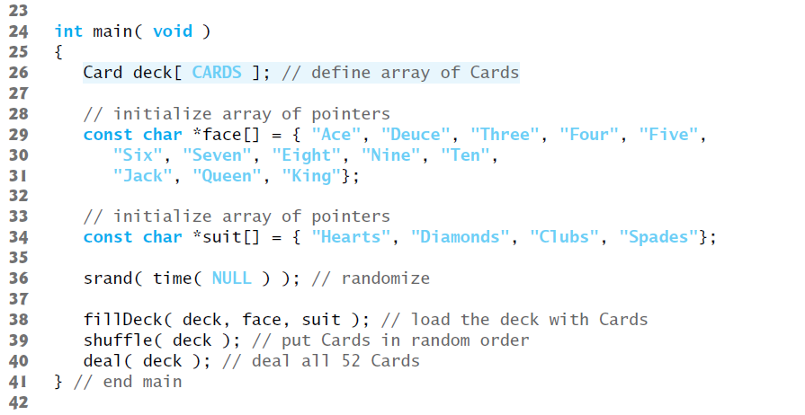

Slide 14
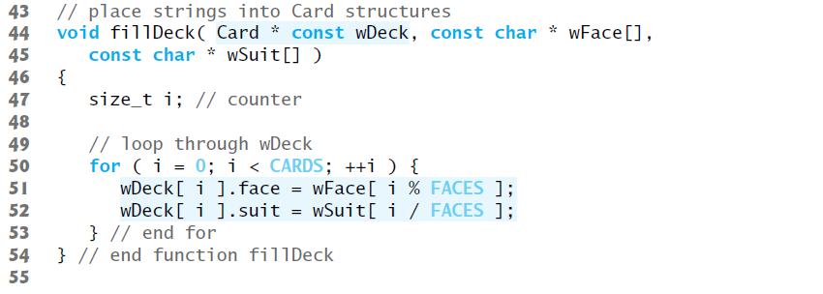

Slide 15
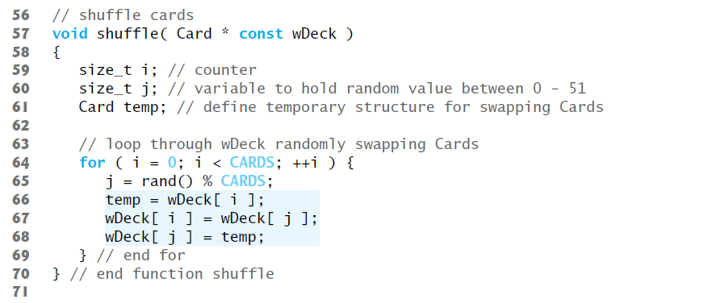

Slide 16
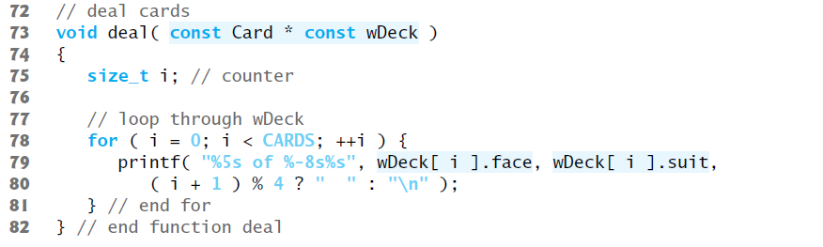

Slide 17
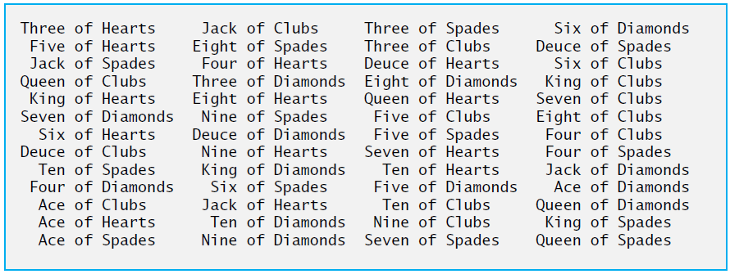

Slide 18
Thank you

