Slide 1
Project Title: Heartbeat measurement using ECG signal processing
M.K.S.S.S’s Cummins College of Engineering for Women
Department of Electronics & Telecommunication Engineering
Course: Digital Signal Processing (EC-3201)
A.Y. 2019-2020 SEM. II
PROJECT BASED LEARNING
Presented by:
GROUP No._11___
Project Group Members
Roll number: 3180 Name: Saloni Wamburkar(TL)
Roll number: 3105 Name: Nikita Awalkar
Roll number: 3109 Name: Siddhi Chikode
Roll number: 3114 Name: Rutuja Deshmukh
Roll number: 3148 Name: Shweta Padamwar
T.Y.(E&TC) Div. A
Guided by:
Dr. Ashwini Deshpande
E&TC Department, CCEW, Pune

Slide 2
Contents
Work Plan
Task list and distribution
Objectives
Literature Survey
System Block Diagram
Methodology
DSP Technique or Method used
Detail Design
Algorithm
Software used
Program
Simulation
Simulation results
System Analysis
Applications
References
PHASE- I
PHASE- II
PHASE- III

Slide 3
PHASE- I EVALUATION MARCH- WEEK 1
COURSE: DSP (PROJECT BASED LEARNING)

Slide 4
Contents
Work Plan
Task list and distribution
Objectives
Literature Survey
System Block Diagram

Slide 5
Work plan
Insert Chart, Table (for 6 Weeks duration)
Phase | Week | Work to be done
1 | 02/03/20 - 06/03/20 | Research & brainstorming. Completion of phase 1
2 | 09/03/20 - 13/03/20 | Division of project into 2 parts: a)Obtaining ECG signal, b)Processing the obtained signal
 | 16/03/20 - 20/03/20 | Working on part a), Filter specifications and filter design
 | 23/03/20 - 27/03/20 | Working on part b), DSP techniques and algorithms. Completion of phase 2
3 | 30/03/20 - 03/04/20 | Debugging and running simulations
 | 06/04/20 - 10/04/20 | Completion of phase 3 and final submission

Slide 6
Task List and Distribution
Obtaining ECG waveform : Saloni Wamburkar, Shweta Padamwar, Siddhi Chikode
Filter Specification/choice and filter design: Nikita Awalkar, Rutuja Deshmukh, Shweta Padamwar
DSP technique/algorithm application: Saloni Wamburkar, Siddhi Chikode, Nikita Awalkar
Matlab coding : Rutuja Deshmukh, Shweta Padamwar, Saloni Wamburkar, Siddhi Chikode, Nikita Awalkar
Debugging, Simulation: Saloni Wamburkar, Nikita Awalkar, Siddhi Chikode, Rutuja Deshmukh, Shweta Padamwar
Preparation of presentations: Saloni Wamburkar, Shweta Padamwar, Siddhi Chikode

Slide 7
Objectives:
Underlying objective of this project is to calculate Heart rate by doing signal processing of an ECG signal.
Detection of R peaks from the QRS complex of each period of the ECG signal.
Finding out the average R-R interval of the specific ECG sample used.
Calculating the Heartbeat or heart rate using the R-R interval.

Slide 8
Literature Survey
References | Summary
Dr.M.Anto Bennet,Bhavani.B , Hema Priya.C.A Professor of Electronics and Communication Engineering, Vel Tech,Chennai,India ,UG Scholar,Department of Electronics and Communication Engineering,Vel Tech,Chennai,India International Journal of Pure and Applied Mathematics:Volume 119 No. 15 2018, 99-110 | DSP Block Diagram
https://www.eetimes.com/techniques-for-accurate-ecg-signal-processing/# | ECG acquisition and filtering: Removal of common mode noise. Removal of baseline wander Removal of high frequency noise Removal of power-line noise
/

Slide 9
Literature Survey
Reference | Summary
Study and Analysis of ECG Signal Using MATLAB & LABVIEW as Effective Tools M.K. Islam, N.M.M Hague, G. Tangim, T.Ahammad and M.R.H Khondokar, Member,IACSIT,IJCEE,Vol 4, No,June 2012 | Deals with study and analysis of ECG signal processing by means of MATLAB tool effectively.
Stuchilin V. V, Rumyantseva V. A, Svirin I. S. The use of Digital Signal Processing Algorithms for Electrophysiological Diagnostics of Cardiovascular Diseases. Biomed Pharmacol J 2017;10(1). | DSP Techniques: Discrete Fourier Transform, Fast Fourier Transform
https://www.mathworks.com/help/dsp/examples/real-time-ecg-qrs-detection.html | Real-Time ECG QRS Detection

Slide 10
Block Diagram
ECG
Signal
Frequency Analysis
Noise Filter
Peak detection:
R peak detection
Digital display
Heart rate

Slide 11
PHASE- II EVALUATION MARCH- WEEK 4
COURSE: DSP (PROJECT BASED LEARNING)

Slide 12
Phase-II Work
Methodology
DSP Technique or Method used
Detail Design
Algorithm

Slide 13
Methodology
DSP Techniques used:
1.Fast Fourier Transform (FFT): FFT is a mathematical method for transforming a function of time into a function of frequency. It is used to transform signals from the time domain to the frequency domain and is useful for the analysis of time-dependent phenomena. In our case, we’ve chosen this method to remove the low frequency components, mainly in the ‘R’ peak detection of the QRS segment of the ECG signal.
2. Inverse Fast Fourier Transform (IFFT): Is used to transform signals from the frequency domain, back to the time domain.
Filters used:
1.FIR (Finite Impulse Response) - Windowing method and thresholding.

Slide 14
Standard values for ECG signal:
Normal values for segments and their duration:
Sr No. | Waves | Intervals(Duration)
1. | RR interval | 0.6 - 1.2 seconds
2. | P wave | 80 ms
3. | PR interval | 120 - 200 ms
4. | PR segment | 50 - 120 ms
5. | QRS complex | 80 - 100 ms
6.. | ST segment | 80 - 120 ms
7. | T wave | 160 ms
8. | ST interval | 320 ms
9. | QT interval | 420 ms or less if heart rate is 60 beats per minute(bpm)
10. | PQ interval | 0.15 seconds

Slide 15
Standard values for ECG signals:
Different signals and their heart-rate values in the form of Normal and Abnormal conditions:
Sr No. | Signals | RR interval(Sec) | Heart rate(bpm) | QRS duration(sec) | Conditions
1. | Normal Signal | 0.791 | 75.84 | 0.094 | STANDARD
2. | Signal A | 0.877 | 68.41 | 0.093 | NORMAL
3. | Signal B | 0.911 | 65.83 | 0.088 | NORMAL
4. | Signal C | 1.059 | 56.65 | 0.238 | ABNORMAL
5. | Signal D | 0.80 | 75.00 | 0.080 | NORMAL
6. | Signal E | 0.516 | 116.07 | 0.197 | ABNORMAL
7. | Signal F | 0.78 | 76.90 | 0.083 | NORMAL
8. | Signal G | 0.45 | 133.33 | 0.162 | ABNORMAL

Slide 16
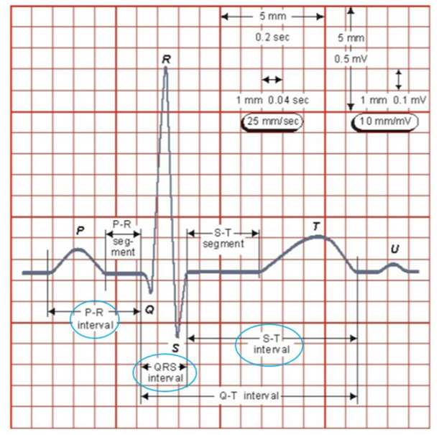
A normal ECG waveform

Slide 17
Detailed Design
1.Fast Fourier Transform(FFT):- FFT is an algorithm for computing the DFT of a sequence. It is particularly useful in areas like signal and image processing, where its uses range from filtering, convolution and frequency analysis to power spectrum estimation.
To remove the low frequency components, we make use of the fft function in MATLAB.
FFT function is applied to the original ecg signal and this value is stored in a variable freq_domain_res.
freq_domain_res(1: round(length(freq_domain_res)*5/sampling_rate))=0; // Making the low frequency components(first few samples) zero.
freq_domain_res(end - round(length(freq_domain_res)*5/sampling_rate) : end)=0; //Making the low frequency components(last few samples) zero.
Rectified=real(ifft(freq_domain_res)); // Transforming the real valued part of freq_domain_res back into the time domain using ifft function in MATLAB.

Slide 18
Detailed Design
Window size for windowing method:
The window size represents a number of samples and a duration. It is the main parameter of the analysis. The window size depends on the fundamental frequency, intensity and changes of the signal.
The window size for R point detection is defined by the average duration of the QRS complex, which is from 70 to 100 ms, taking only the approximate width of the R peak and fs equal to the frequency with which the signal was sampled, the number of samples of the half of the window will be equal to: 0.30*fs.
The distance between two R peaks is calculated using a function for position. Distance= position of a peak - position of preceding peak.
Window size = sampling rate*(571/1000)
We calculate the optimized filter window size as:
window size = 2* Distance - QR_Distance.
QR_Distance is obtained by using floor function on (Sampling rate*0.04) and is incremented if remainder of (QR_Distance/2) is zero. The time scale factor is 0.04. (0.04 secs spanned across 1mm when the ECG signal is graphed).

Slide 19
Detailed Design
Thresholding operation:
To determine peaks upto a threshold value of amplitude
If f(x)=0 for x<4;
=1 for x>=4
(If value of peak<4 : It is not considered as a peak and gets the value 0
value of peak>=4 : then it is considered as a peak and gets the value 1)
Here the thresholding is normalized to a value of 7.

Slide 20
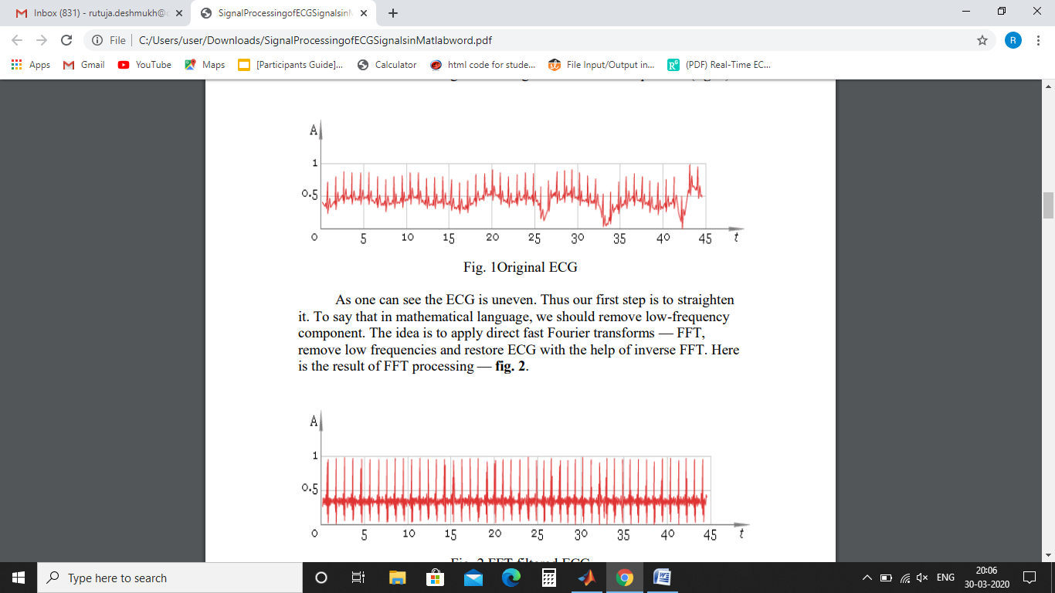
Algorithm
The basic task of electrocardiogram (ECG) processing is R-peaks detection. There are some difficulties one can encounter in processing ECG:
Irregular distance between peaks,
irregular peak form,
presence of low- frequency component in ECG due to patient breathing etc.
To solve the task the processing pipeline should contain particular stages to reduce influence of those factors.
STEPS:
1. Load a digital ECG signal - that is, input data (fig. 1):

Slide 21
Algorithm
2. The ECG is uneven. Thus, the low-frequency components should be removed. Then we apply direct fast Fourier transforms - FFT, remove low frequencies and restore ECG with the help of inverse FFT.
The result of FFT processing :
3. Finding local maxima. Using windowing that “sees” only maximum in this window and ignores all other values.
As result we get fig. 3.

Slide 22
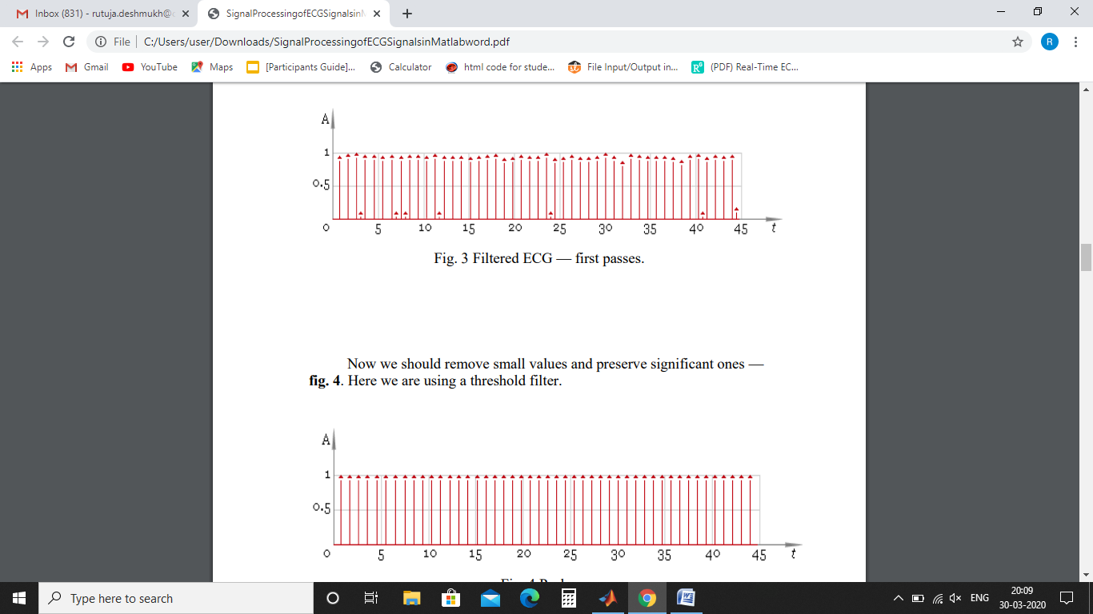
Algorithm
Fig3. Filtered ECG- First pass:
4. Using a thresholding operation to remove small values and preserve the significant values.

Slide 23
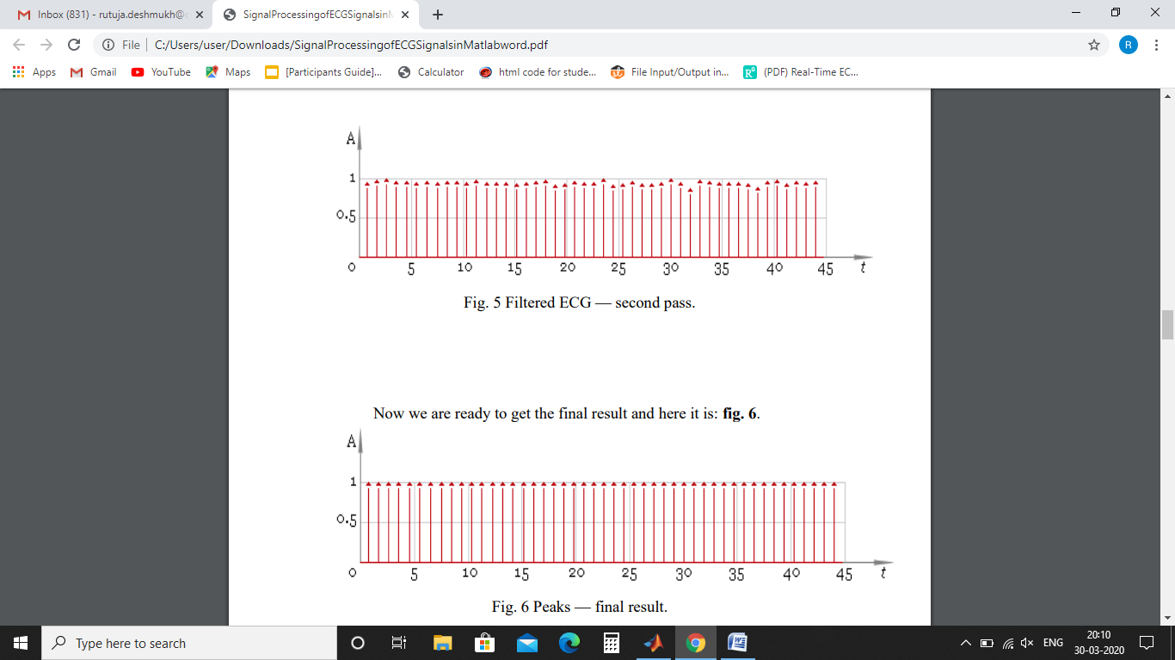
Algorithm
5. To ensure better filtering quality, we need to adjust the window size and repeat filtering -fig. 5. Comparing the result with fig. 3 – We have a better filtered signal and prominent peaks.
Fig 5. Filtered ECG- second pass:
6. The final result is:
fig 6.final peaks

Slide 24
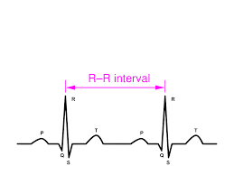
Algorithm
7. Calculation of heart beats from the ecg signal:
Rate= 60*sampling rate/(R-R interval) in beats/min.
Comparing distance between two corresponding peaks and
getting minimum distance as R-R interval.

Slide 25
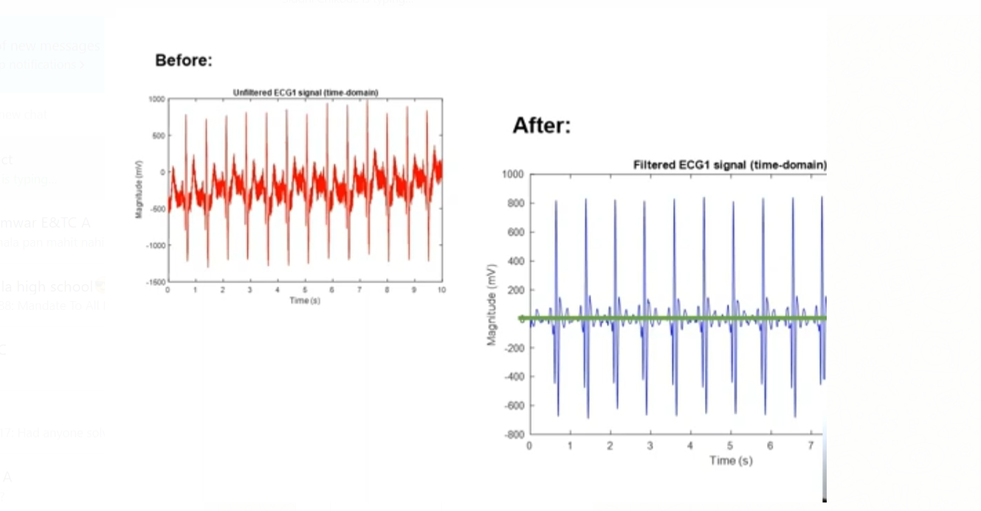
ECG signal in time domain

Slide 26
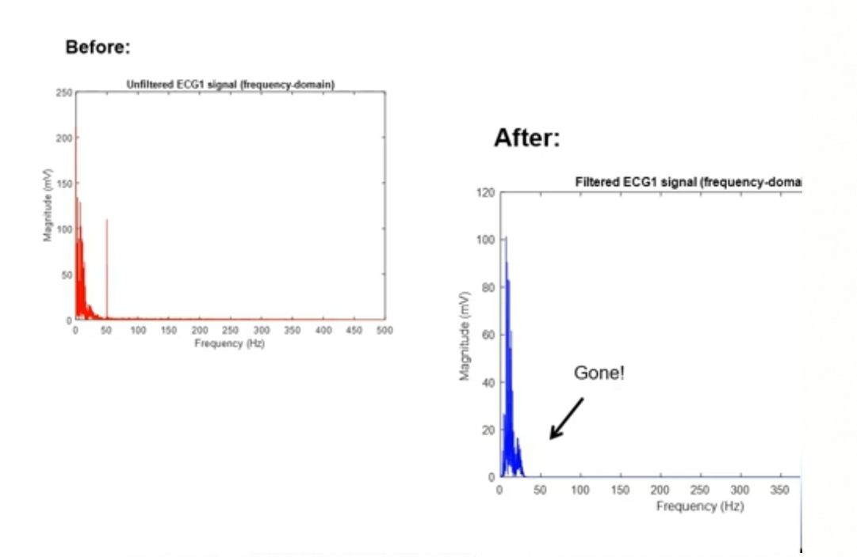
ECG signal in spectral domain

Slide 27
PHASE- III EVALUATION APRIL- WEEK 2
COURSE: DSP (PROJECT BASED LEARNING)

Slide 28
Phase III- Work
Software used
Program
Simulation
Simulation results
Applications
References

Slide 29
Software used:
MATLAB

Slide 30
Program/ Code
ecg_main file:
for demo = 1:2:3
% Clear the variables
clear ecg samplingrate rectified filter1 R_peak1 filter2 R_peak2 freq_domain_res
% Load data sample
switch(demo)
case 1,
plotname = 'Sample 1';
load ecgdemodata1;
case 3,
plotname = 'Sample 2';
load ecgdemodata2;
end
% Remove lower frequencies

Slide 31
freq_domain_res=fft(ecg);
freq_domain_res(1 : round(length(freq_domain_res)*5/samplingrate))=0;
freq_domain_res(end - round(length(freq_domain_res)*5/samplingrate) : end)=0;
Rectified=real(ifft(freq_domain_res));
% Filter - first pass
filter_winfunsz = floor(samplingrate * 571 / 1000);
if rem(filter_winfunsz,2)==0
filter_winfunsz = filter_winfunsz+1;
end
filter1=ecg_func(Rectified, filter_winfunsz);
% Scale ecg
R_peak1=filter1/(max(filter1)/7);
% Filter by threshold filter
for data = 1:1:length(R_peak1)
if R_peak1(data) < 4
R_peak1(data) = 0;
else

Slide 32
R_peak1(data)=1;
end
end
posn=find(R_peak1);
dist=posn(2)-posn(1);
for data=1:1:length(posn)-1
if posn(data+1)-posn(data)<dist
dist=posn(data+1)-posn(data);
end
end
% Optimize filter window size
QR_dist=floor(0.04*samplingrate);
if rem(QR_dist,2)==0
QR_dist=QR_dist+1;
end
filter_winfunsz=2*dist-QR_dist;
% Filter - second pass

Slide 33
filter2=ecg_func(Rectified, filter_winfunsz);
R_peak2=filter2;
for data=1:1:length(R_peak2)
if R_peak2(data)<4
R_peak2(data)=0;
else
R_peak2(data)=1;
end
end
% Heart Rate measurement
posn2=find(R_peak2);
dist_firstandlastpeak=posn2(length(posn2))-posn2(1);
avgdist_peaks=dist_firstandlastpeak/length(posn2);
avgHeartRate=60*samplingrate/avgdist_peaks;
disp('Average distance between the first and last peak in milliseconds= ');
disp(avgdist_peaks);
disp('Average Heart Rate in beats per minute (bpm)= ');
disp(avgHeartRate);

Slide 34
% Create figure - stages of processing
figure(demo); set(demo, 'Name', strcat(plotname, ' - Processing Stages'));
% Original input ECG data
subplot(3, 2, 1); plot((ecg-min(ecg))/(max(ecg)-min(ecg)));
title('\bf1. Original ECG'); ylim([-0.2 1.2]);
% ECG with removed low-frequency component
subplot(3, 2, 2); plot((Rectified-min(Rectified))/(max(Rectified)-min(Rectified)));
title('\bf2. FFT Filtered ECG'); ylim([-0.2 1.2]);
% Filtered ECG (1^st pass) - filter has default window size
subplot(3, 2, 3); stem((filter1-min(filter1))/(max(filter1)-min(filter1)));
title('\bf3. Filtered ECG - 1^{st} Pass'); ylim([0 1.4]);
% Detected peaks in filtered ECG
subplot(3, 2, 4); stem(R_peak1);
title('\bf4. Detected Peaks'); ylim([0 1.4]);
% Filtered ECG (2-d pass) - now filter has optimized window size
subplot(3, 2, 5); stem((filter2-min(filter2))/(max(filter2)-min(filter2)));
title('\bf5. Filtered ECG - 2^d Pass'); ylim([0 1.4]);

Slide 35
% Detected peaks - final result
subplot(3, 2, 6); stem(R_peak2);
title('\bf6. Detected Peaks - Finally'); ylim([0 1.4]);
% Create figure - result
figure(demo+1); set(demo+1, 'Name', strcat(plotname, ' - Result'));
% Plotting ECG in green
plot((ecg-min(ecg))/(max(ecg)-min(ecg)), '-g'); title('\bf Comparative ECG R-Peak Detection Plot');
% Show peaks in the same picture
hold on
% Stemming peaks in dashed black
stem(R_peak2'.*((ecg-min(ecg))/(max(ecg)-min(ecg)))', ':k');
% Hold off the figure
hold off
end

Slide 36
ecg_func file:
function Windowing=ecg_func(Original_ecg, filter_winfunsz)
filter_winhalfsz = floor(filter_winfunsz/2);
filter_winhalfsz_inc = filter_winhalfsz+1;
filter_winfunsz_dec = filter_winfunsz-1;
Inc_fnt= 1;
filter_winfunpos = filter_winhalfsz;
filter_winposmax = filter_winhalfsz;
filter_winfunmax = Original_ecg(1);
Inc_op = 0;
for len_cnt = 0:1:filter_winhalfsz-1
if Original_ecg(Inc_fnt+1) > filter_winfunmax
filter_winfunmax = Original_ecg(Inc_fnt+1);
filter_winposmax = filter_winhalfsz_inc + len_cnt;
end
Inc_fnt=Inc_fnt+1;

Slide 37
end
if filter_winposmax == filter_winhalfsz
Windowing(Inc_op+1)=filter_winfunmax;
else
Windowing(Inc_op+1)=0;
end
Inc_op = Inc_op+1;
for len_cnt = 0:1:filter_winhalfsz-1
if Original_ecg(Inc_fnt+1)>filter_winfunmax
filter_winfunmax=Original_ecg(Inc_fnt+1);
filter_winposmax=filter_winfunsz_dec;
else
filter_winposmax=filter_winposmax-1;
end
if filter_winposmax == filter_winhalfsz
Windowing(Inc_op+1)=filter_winfunmax;
else

Slide 38
Windowing(Inc_op+1)=0;
end
Inc_fnt = Inc_fnt+1;
Inc_op = Inc_op+1;
end
for Inc_fnt=Inc_fnt:1:length(Original_ecg)-1
if Original_ecg(Inc_fnt+1)>filter_winfunmax
filter_winfunmax=Original_ecg(Inc_fnt+1);
filter_winposmax=filter_winfunsz_dec;
else
filter_winposmax=filter_winposmax-1;
if filter_winposmax < 0
Inc_win = Inc_fnt-filter_winfunsz_dec;
filter_winfunmax = Original_ecg(Inc_win+1);
filter_winposmax = 0;
filter_winfunpos=0;
for Inc_win = Inc_win:1:Inc_fnt

Slide 39
if Original_ecg(Inc_win+1)>filter_winfunmax
filter_winfunmax = Original_ecg(Inc_win+1);
filter_winposmax = filter_winfunpos;
end
filter_winfunpos=filter_winfunpos+1;
end
end
end
if filter_winposmax==filter_winhalfsz
Windowing(Inc_op+1)=filter_winfunmax;
else
Windowing(Inc_op+1)=0;
end
Inc_op=Inc_op+1;
end
Inc_win = Inc_win-1;
filter_winposmax = filter_winposmax-1;

Slide 40
for len_cnt=1:1:filter_winhalfsz_inc-1
if filter_winposmax<0
Inc_win=length(Original_ecg)-filter_winfunsz+len_cnt;
filter_winfunmax=Original_ecg(Inc_win+1);
filter_winposmax=0;
filter_winfunpos=1;
for Inc_win=Inc_win+1:1:length(Original_ecg)-1
if Original_ecg(Inc_win+1)>filter_winfunmax
filter_winfunmax=Original_ecg(Inc_win+1);
filter_winposmax=filter_winfunpos;
end
filter_winfunpos=filter_winfunpos+1;
end
end
if filter_winposmax==filter_winhalfsz
Windowing(Inc_op+1)=filter_winfunmax;
else

Slide 41
Windowing(Inc_op+1)=0;
end
Inc_fnt=Inc_fnt-1;
filter_winposmax=filter_winposmax-1;
Inc_op=Inc_op+1;
end

Slide 42
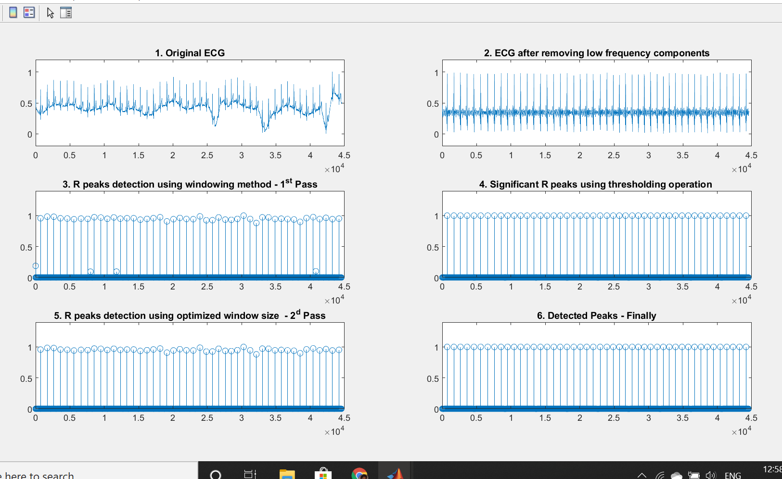
Simulation
Results: Sample 1: Processing stages

Slide 43
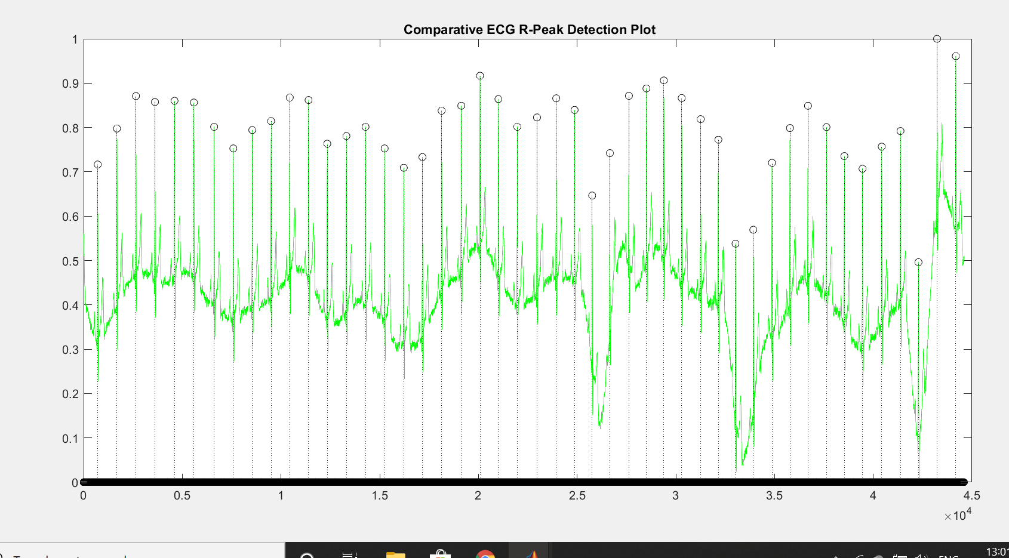
Sample 1: R peak plot on original ECG signal

Slide 44
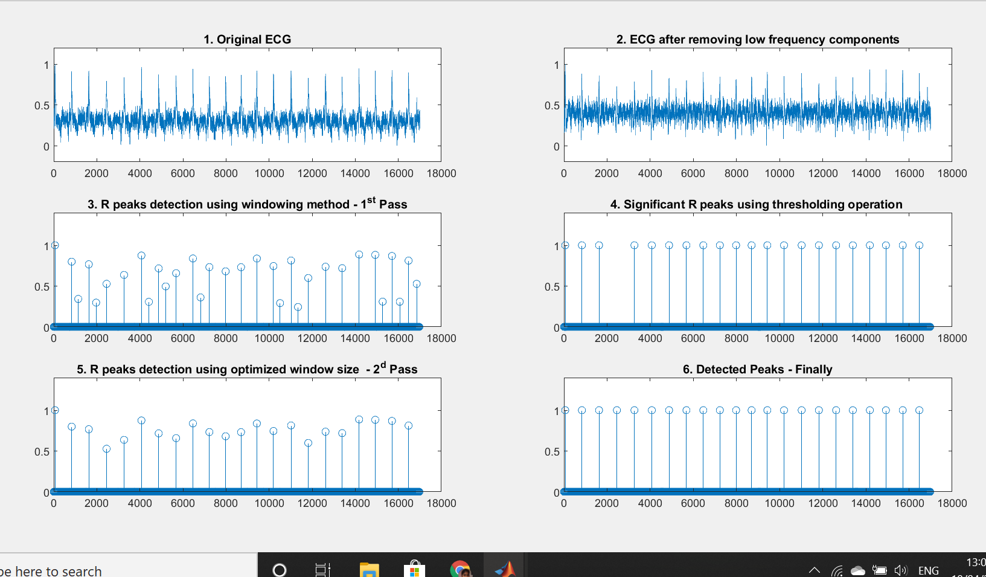
Sample 2: Processing stages

Slide 45
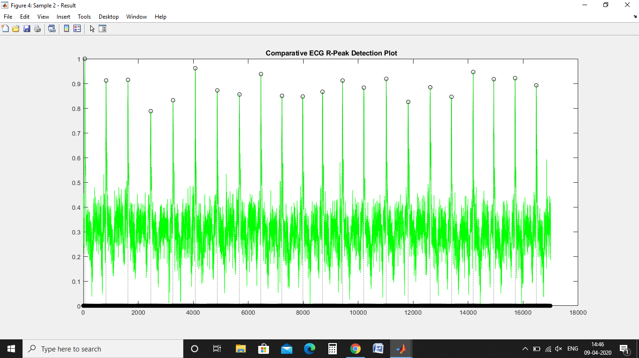
Sample 2: R peak plot on original ECG signal

Slide 46
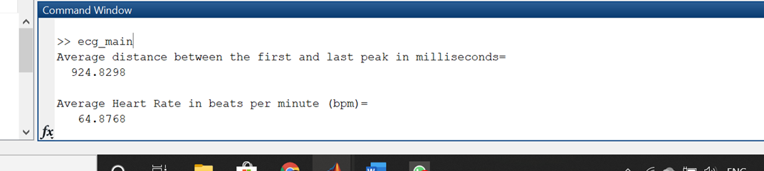
Output from command window
Sample 1:

Slide 47
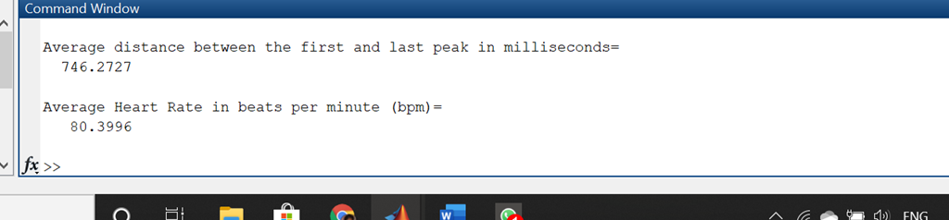
Output from command window
Sample 2:

Slide 48
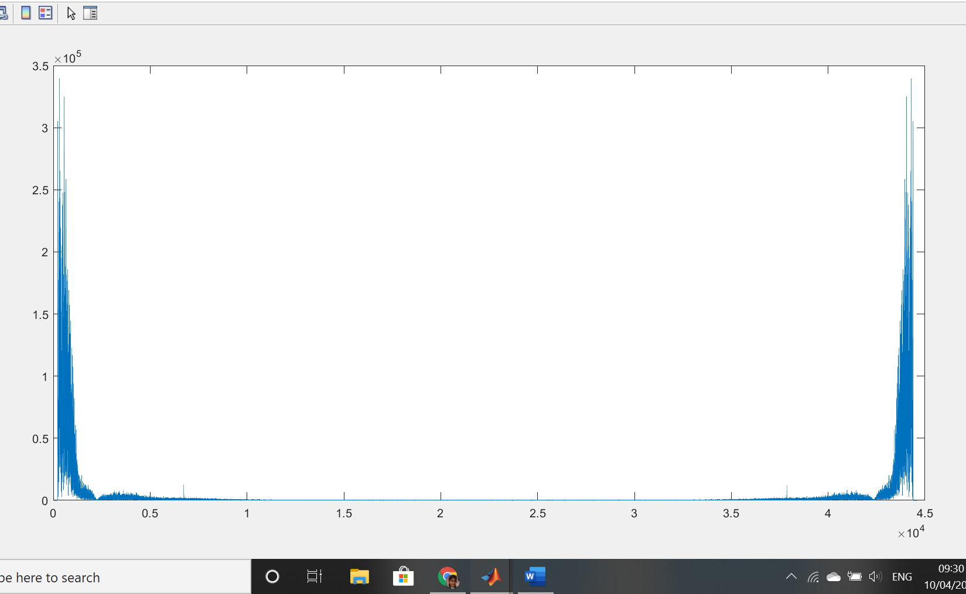
System Analysis
Frequency response of original ecg input signal from sample 1:

Slide 49
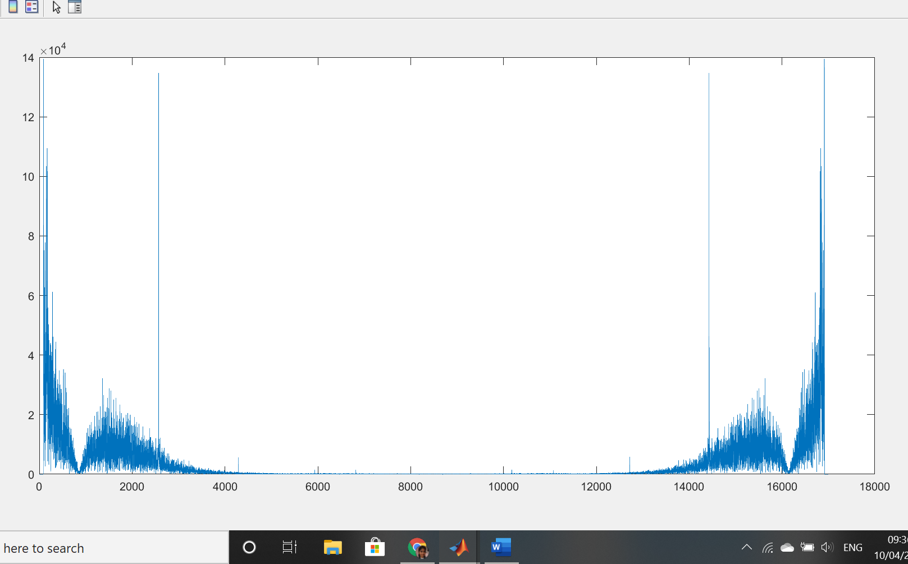
System Analysis
F Frequency response of original ecg input signal from sample 2:

Slide 50
R-R Interval and Heart-Rate Calculation
The average distance measured in time frame, between the first and the last peak for the duration of the signal for Sample 1 is 924.82 ms.
Comparing it with the standard reference for the R-R interval which is (0.6-1.2 seconds), our value of 0.92 seconds is in the range for the R-R interval of ECG signal for a normal person. This yields a heart rate of 64.87 bpm.
Similarly, we obtained the time duration of 746.27 ms for our second sample data. This too lies in the normal R-R interval for the ECG signal. This results in a heartbeat of 80.39 bpm.
Theoretically, the ECG waveform of a person suffering from Tachycardia, a condition where the heart rate is abnormally fast, the R-R interval is a low 0.45 seconds with a heart rate of 133.33 bpm. The heart rate is abnormal even when the R-R interval is higher than 1.2 seconds, which leads to a slow heart rate, less than 50 bpm- the condition being called Bradycardia.

Slide 51
Applications:
ECG (Electrocardiogram) records the electrical activity of the heart at rest.ECG signal processing can provide information about the heart rate and rhythm and can help diagnose an array of illnesses such as arrhythmias, heart defects, heat inflammation, cardiac arrest, poor blood supply, coronary artery disease or heart attack and many more.
ECG test is used to check enlargement of heart due to high blood pressure (hypertension) or evidence of a previous heart attack (myocardial infarction).
ECG monitoring is important in order to understand the functioning of the heart. The QRS complex is the most significant part in the ECG since it determines the heart rate of a person, and thus various cardiac abnormalities can be detected and treated using continuous ECG monitoring.
The heart rate measurement is crucial in diagnosing heart disorders like Tachycardia and Bradycardia. Using various methods to measure one’s resting and active heart rates, a lot of information regarding the person’s health can be gathered.

Slide 52
Conclusion:
We determined the heart rate from ecg signal by detecting the R-peaks. We transformed the ECG signal from time domain to frequency domain using FFT in order to eliminate the low frequency components and converted it back to time domain using ifft.
We see exact mapping of R peaks on original ECG signal using the ‘find’ function from MATLAB to detect the position of the R peaks.
The actual distance in time frame, between the R-R peaks is displayed and compared with the standard lookup table. Thus the practical values fall within the range of normal theoretical results.
The R-R interval for two consecutive peaks is fairly constant throughout the signal sample and varies by about 14 ms.
The R-R interval determines the heartbeat. The abnormalities in the functioning of the heart can be determined by studying this interval and thus obtaining the heart rate of a person, to find out the underlying disease.

Slide 53
References:
Dr.M.Anto Bennet,Bhavani.B , Hema Priya.C.A Professor of Electronics and Communication Engineering, Vel Tech,Chennai,India ,UG Scholar,Department of Electronics and Communication Engineering,Vel Tech,Chennai,India
International Journal of Pure and Applied Mathematics:Volume 119 No. 15 2018, 99-110\
https://www.eetimes.com/techniques-for-accurate-ecg-signal-processing/#
Study and Analysis of ECG Signal Using MATLAB & LABVIEW as Effective Tools
M.K. Islam, N.M.M Hague, G. Tangim, T.Ahammad and M.R.H Khondokar, member,IACSIT,IJCEE,Vol 4, No,June 2012
Stuchilin V. V, Rumyantseva V. A, Svirin I. S. The use of Digital Signal Processing Algorithms for Electrophysiological Diagnostics of Cardiovascular Diseases. Biomed Pharmacol J 2017;10(1).
Some sample RR intervals and the consequent heart rates : https://www.researchgate.net/figure/Values-of-QRS-complex-duration-RR-intervals-and-heart-rates-of-test-and-normal-ECG_tbl1_299405889
Normal values for segments and their duration :
https://emedicine.medscape.com/article/2172196-overview
ECG database: https://physionet.org/

