Slide 1

Named Entity Recognition and Disambiguation
in Tweets
S.R.Patra
Supervisors : dr. Mykola Pechenizkiy
Erik Tromp MSc
August 29, 2014

Slide 2
Outline
Introduction
  NER & NED in tweets: motivation & challenges
Approach
  Unsupervised NER, contextual NED
Experiments
  Benchmarking against the state-of-the-art
Case Study
  Filtering relevant tweets with NER & NED
Conclusion
Department of Mathematics and Computer Science
PAGE <number>

Slide 3
Introduction

Slide 4
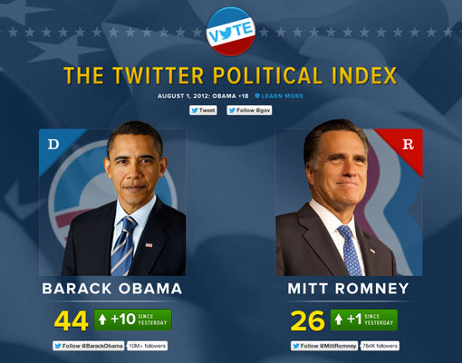

Motivation
Political predictions
Sentiment analysis
Department of Mathematics and Computer Science
PAGE <number>
Notes:
Social media growing tremendously
More that 500 million tweets everyday
Topics : sports, politics, movies and many more

Slide 5

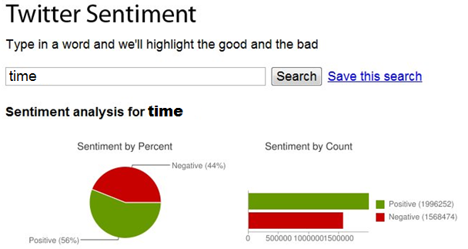
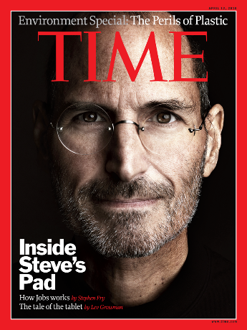
Motivation for NER
Sentiment analysis
or
Department of Mathematics and Computer Science
PAGE <number>

Slide 6
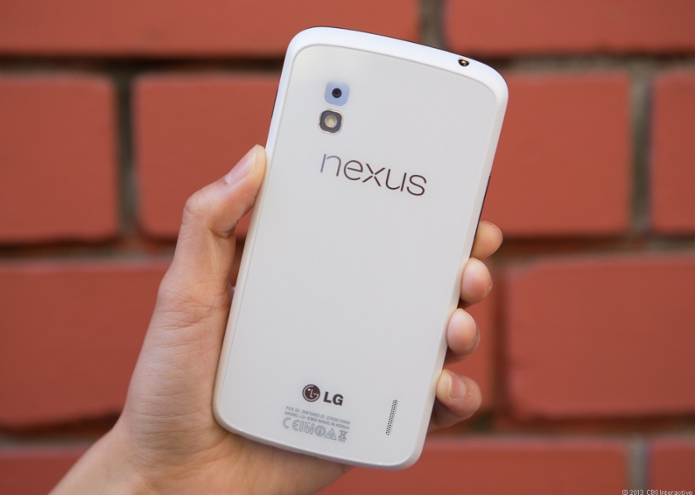
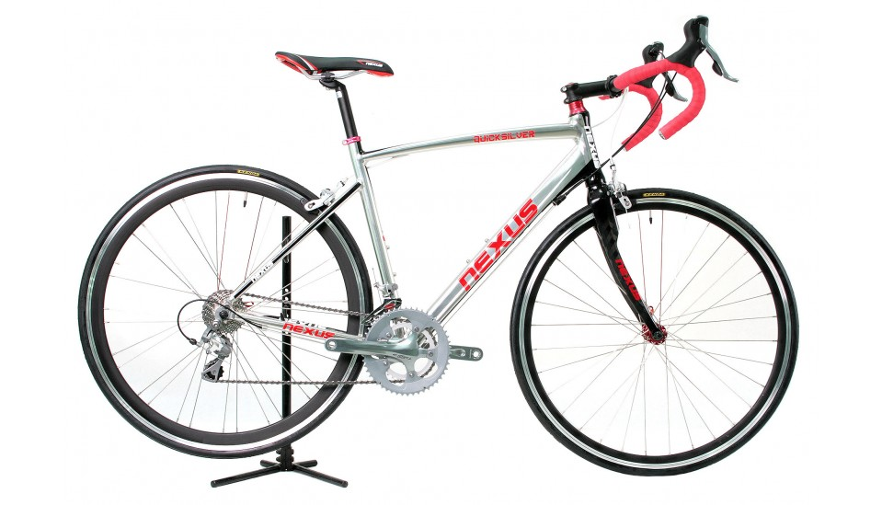
Motivation for NED
Ambiguity problem
Nexus phone
Nexus bike
Department of Mathematics and Computer Science
PAGE <number>

Slide 7
Problem Formulation
Problem :
  NER: does a tweet contain a NE? like “Bill”
  NED: If it does (“Bill” is NE) - which semantic entity it is referring to ?
Focus :
  Consider only English tweets
  No assumption on the presence of NE inside a tweet
Department of Mathematics and Computer Science
PAGE <number>

Slide 8
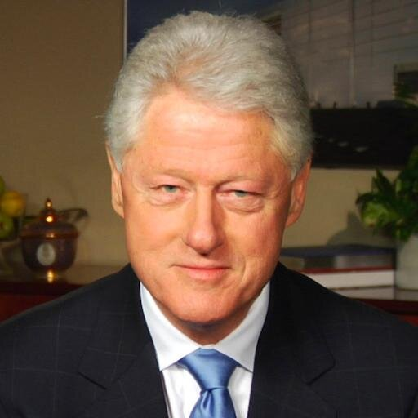
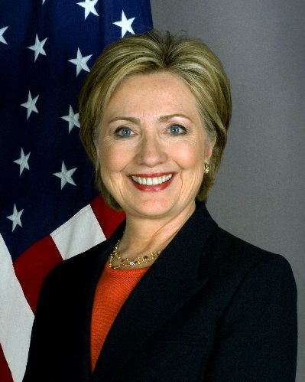
Problem Formulation
Example :
  Do u hv a 2 dollar bill?
  I feel bad for bill and hilary.
Example :
  Do u hv a 2 dollar bill?
  I feel bad for bill and hilary.
No
Yes
http://en.wikipedia.org/wiki/Bill_Clinton
http://en.wikipedia.org/wiki/Hillary_Rodham_Clinton
Department of Mathematics and Computer Science
PAGE <number>

Slide 9
Challenges
Examples of “bad behavior” in tweets:
No. | Challenge | Example Tweet
1 | missing capitalization | george #Clooney did a great job in gravity
2 | unreliable capitalization | #JLO WAITIN TO SEE JENNIFER’S NEW CAR
3 | abbreviation | HIMYM starts in 10 mins
4 | shortened texts | @rk89 pls dnt 4get to brng ma ifun
5 | spelling mistakes | sry bt you r wrng this time mr ptersan
Department of Mathematics and Computer Science
PAGE <number>

Slide 10
Challenges
Other challenges making current approaches fail more often:
  Unreliable POS tag features
  Lack of labelled training data
  Insufficient context due to 140 character limit
Department of Mathematics and Computer Science
PAGE <number>

Slide 11
Approach

Slide 12
5-Step Pipeline
Preprocessing (non-core)
Tokenization
POS tagging
Normalization
Tweet
Disambiguation
Mention
Extraction
Disambiguated
Tweet
Core components
Department of Mathematics and Computer Science
PAGE <number>

Slide 13
Current state-of-the-art for NER & NED
Supervised
  require lots of labeled data
Make strong assumptions about data quality
  Capitalization
  No spelling errors
  No grammatical mistakes
Only able to classify specific categories of NEs
  Person, Location, Organization
Department of Mathematics and Computer Science
PAGE <number>

Slide 14
Tokenization & POS Tagging
Owoputi et al. Tokenizer & Tagger :
  State-of-the-art performance on tweets
  Twitter specific tags (#, @, emoticons, URL)
  Tokenizer :
    Regular expression matching
  Tagger :
    Does not rely on capitalization
    Unsupervised Brown clusters as features
Department of Mathematics and Computer Science
PAGE <number>

Slide 15
Tokenization & POS Tagging
Example :
  Input :
    #Deni, lets watch ‘Harry Potter’ today.
  Output :
    #Deni/# ,/, lets/V watch/V ‘/, Harry/^ Potter/^ ’ /, today/A ./,
Department of Mathematics and Computer Science
PAGE <number>

Slide 16
Normalization
Problem :
  Locate the Out Of Vocabulary (OOV) words
  Transform them to their correct forms
  OOV Examples :
    Abbreviations (2mrw tomorrow)
    Spelling errors (Microzoft Microsoft)
Department of Mathematics and Computer Science
PAGE <number>

Slide 17
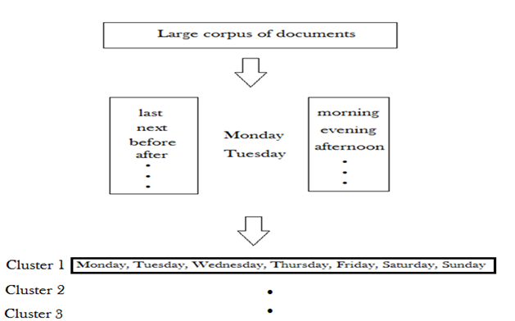
Normalization
My approach for handling OOV, misspelling and abbreviations:
  Brown clustering:
    Intuition : Similar words occur in similar contexts i.e. similar words have similar distributions of words to their left and right
Department of Mathematics and Computer Science
PAGE <number>

Slide 18
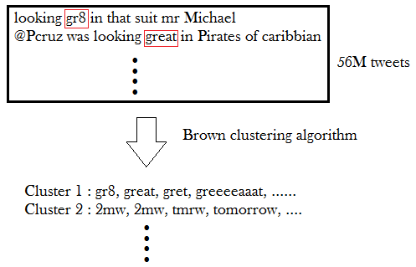
Normalization
My approach for handling OOV, misspelling and abbreviations:
Department of Mathematics and Computer Science
PAGE <number>

Slide 19
Normalization
My approach for further refinement for terms not appearing in any of the clusters:
  Language Model :
    Probability(“I am going home”) > Probability(“I am going house”)
  Character edit distance :
    Levenshtein (goin , going) = 1
  Phonetic edit distance :
    Metaphone (tomorrow, 2morow) = 0
Department of Mathematics and Computer Science
PAGE <number>

Slide 20
Normalization
    The expndibles is a gr8 movie
    expndibles
    gr8
Check Word clusters
OOV check
    Cluster :greeeaat, terrific, grt, superb, fantastic, great, ….
    expndibles
    gr8
(Levenshtein <= 2 or Metaphone <=1)
And
In Vocabulary
    great
Department of Mathematics and Computer Science
PAGE <number>

Slide 21
Normalization
    expndibles
Check Word clusters
    No
Dictionary suggestions
    expendable, vendibles, expendables, extendibles, ….
Language Model
    great
    expendables
Department of Mathematics and Computer Science
PAGE <number>

Slide 22
Normalization
My approach :
  Input : “The expndibles is a gr8 movie”
  Output : “The expendables is a great movie”
Department of Mathematics and Computer Science
PAGE <number>

Slide 23
Mention Extraction
Problem :
  Extract NEs from the tweet
  Example :
    Tweet : “going to watch argo in texas”
    Output : “argo”, “texas”
Department of Mathematics and Computer Science
PAGE <number>

Slide 24
Mention Extraction
Related Work :
  Traditional approaches:
    Supervised task with annotated training data
    Trained on features
      Capitalization
      Current word POS tag
      Surrounding word POS tag
annotated training
Too much manual effort
Unreliable
Unreliable
Unreliable
Department of Mathematics and Computer Science
PAGE <number>

Slide 25
Mention Extraction
My approach :
  No annotated training data needed
  Unsupervised : Does not depend on unreliable features
  Extract any type of entities
    Not specific categories like Person, Location etc
Department of Mathematics and Computer Science
PAGE <number>

Slide 26
Mention Extraction
    Joe @Jray robert downey jr is the best ☺ and JLO too
    Joe robert downey jr is the best and JLO too
Segmentation
Generate ngrams
Robert downey jr is
downey jr is the
jr is the best
Match Freebase
No match
Department of Mathematics and Computer Science
PAGE <number>

Slide 27
Mention Extraction
    Joe @Jray robert downey jr is the best ☺ and JLO too
    Joe robert downey jr is the best and JLO too
Segmentation
Generate ngrams
robert downey jr
Match Freebase
robert downey jr
Department of Mathematics and Computer Science
PAGE <number>

Slide 28
Mention Extraction
    Joe @Jray robert downey jr is the best ☺ and JLO too
    Joe robert downey jr is the best and JLO too
Segmentation
Generate ngrams
is the best
is the
the best
best
Match Freebase
robert downey jr
Department of Mathematics and Computer Science
PAGE <number>

Slide 29
Mention Extraction
    Joe @Jray robert downey jr is the best ☺ and JLO too
    Joe robert downey jr is the best and JLO too
Segmentation
Generate ngrams
and JLO too
and JLO
JLO too
JLO
Match Freebase
robert downey jr, JLO
Department of Mathematics and Computer Science
PAGE <number>

Slide 30
Mention Extraction
    Joe @Jray robert downey jr is the best ☺ and JLO too
    Joe robert downey jr is the best and JLO too
Segmentation
Match Freebase
No match
Proper noun check
Yes
Joe, robert downey jr, JLO
Department of Mathematics and Computer Science
PAGE <number>

Slide 31
Mention Extraction
My approach :
  Input : “Joe @Jray robert downey jr is the best ☺ and JLO too”
  Mentions : “Joe”, “robert downey jr”, “JLO”
Department of Mathematics and Computer Science
PAGE <number>

Slide 32
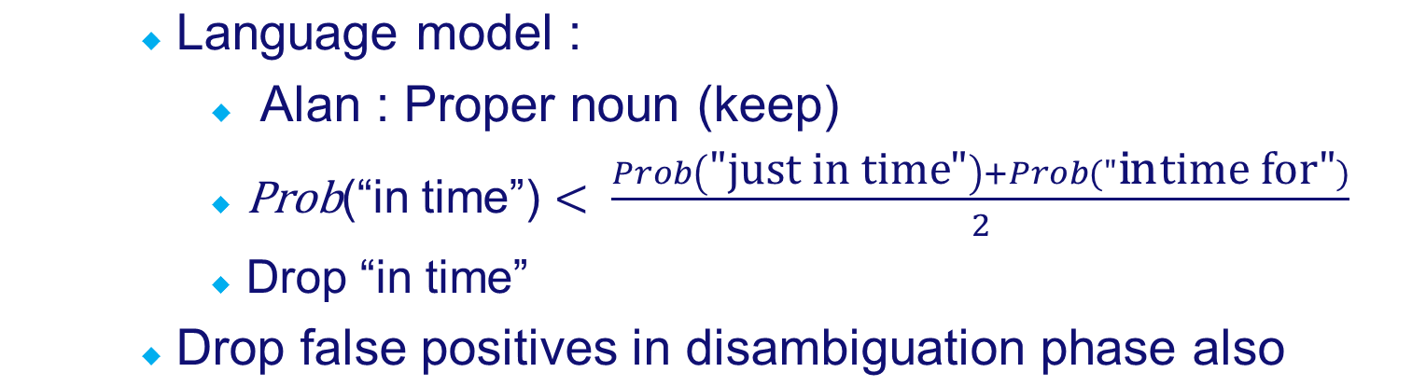
Mention Extraction
My approach :
  Trade off :
    More computation time
    More false positives
    Example :
      just in time for lunch, Alan.
      NE : in time (movie), Alan
Department of Mathematics and Computer Science
PAGE <number>

Slide 33
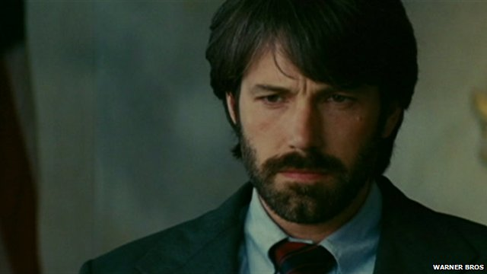

Disambiguation
Problem :
  Assign correct reference link to entities
  Example :
    Tweet : “Ben did a good job in Argo”
Output : Ben : Ben Affleck, Argo : Movie (2012)
http://en.wikipedia.org/wiki/Ben_Affleck
http://en.wikipedia.org/wiki/Argo_(2012_film)
Department of Mathematics and Computer Science
PAGE <number>

Slide 34
Disambiguation
My approach :
  Relationship among NEs inside a tweet
    similarity(Argo, Ben Affleck) > similarity(Argo, Ben and Jerry's)
  Similarity measured from entity vector model generated from Freebase
Department of Mathematics and Computer Science
PAGE <number>

Slide 35
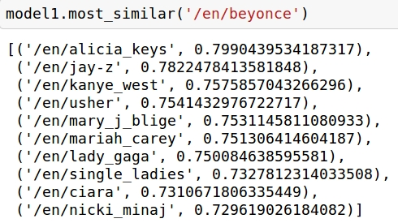
Disambiguation
My approach : Unsupervised
  Word2vec : Mikolov et al.(2013)
Corpus with 100 billion words
continuous bag-of-words
continuous skip-gram
1.4 million Freebase entity vectors
+
Cosine similarity between entities
Department of Mathematics and Computer Science
PAGE <number>

Slide 36
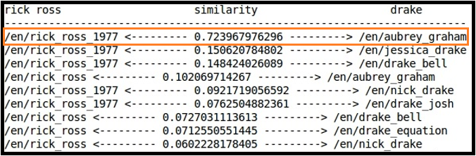
Disambiguation : Example
  Ran into Rick ross and drake 2day
Extracted NEs
  Rick ross drake
http://www.freebase.com/en/rick_ross_1977
http://www.freebase.com/en/aubrey_graham
Department of Mathematics and Computer Science
PAGE <number>

Slide 37
Disambiguation
Drop false positives through disambiguation:
  Example : “South Bend Tribune : First black woman said to have graduated from Notre Dame dies”
    Extracted mentions : “South Bend Tribune”, “black woman”, “Notre Dame”
    Similarity(“South Bend Tribune”, “Notre Dame”) = 0.56
    Similarity(“South Bend Tribune”, “black woman”) = 0.07
    Similarity(“Notre Dame”, “black woman”) = 0.12
    Drop “black woman”
    Final : “South Bend Tribune”, “Notre Dame”
Department of Mathematics and Computer Science
PAGE <number>

Slide 38
Experiments

Slide 39
Goals
Goal 1 :
  Compare the approach for NER & NED against state-of-the-art
Goal 2 :
  Quantify the importance of pre- and post-processing steps
Department of Mathematics and Computer Science
PAGE <number>

Slide 40
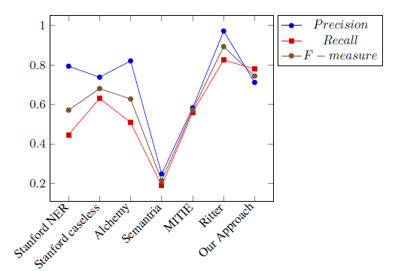
Goal 1 : NER Benchmarking
  Ritter et al.(2011) dataset :
 | Ritter et al. dataset
Tweets | 1000
NEs | 682
NE per tweet | 0.68
Department of Mathematics and Computer Science
PAGE <number>

Slide 41
NER : Weaknesses of Existing Techs
Stanford:
  Capitalization errors :
    Yipee, reached london finally!!! => Yipee
  Limited categories :
    just watched The Walking Dead on ABC => ABC
Department of Mathematics and Computer Science
PAGE <number>

Slide 42
NER : On Fairness of Comparison
My approach errors :
  PETA .. Animal rescue or BIG BUSINESS
    My output : PETA, BIG BUSINESS
  @sjsimson is at home-going now
    My output : home-going
Department of Mathematics and Computer Science
PAGE <number>

Slide 43
NER : On Fairness of Comparison
Ritter et al. : supervised learning:
  Too much manual effort for labelled data
  Can extract limited categories of entities
    Current approach 10 categories in test dataset
    Example :
      Tweet : “Have you read the book unearthly by cynthia hand”
      Ritter et al. output : “cynthia hand”
Department of Mathematics and Computer Science
PAGE <number>

Slide 44
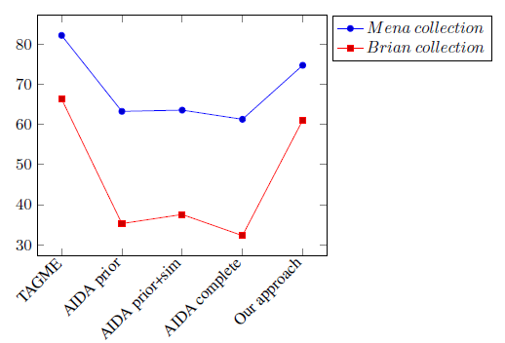
Goal 1 : NED Benchmarking
Habib and van Keulen(2013) dataset
 | Mena coll. | Brian coll.
Tweets | 162 | 1603
NEs | 483 | 1233
NEs per tweet | 2.98 | 0.77
Department of Mathematics and Computer Science
PAGE <number>

Slide 45
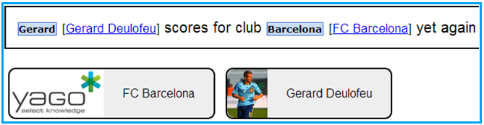
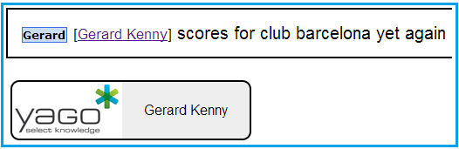
NED : Weaknesses of Existing Techs
AIDA :
  Capitalization errors
Department of Mathematics and Computer Science
PAGE <number>

Slide 46

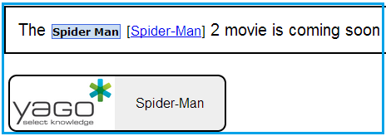
NED : Weaknesses of Existing Techs
AIDA :
  Grammatical mistakes
Department of Mathematics and Computer Science
PAGE <number>

Slide 47
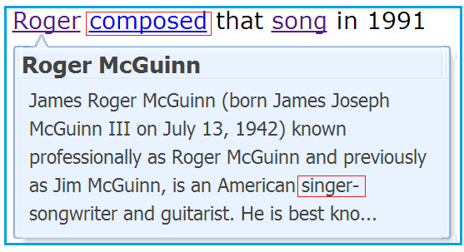
NED : New state-of-the art Approach
TAGME :
Department of Mathematics and Computer Science
PAGE <number>

Slide 48
NER : w/wo pre- & post-processing
Individual steps evaluation :
  Remove the step from the pipeline
  Benchmark against the complete process
  Dataset : Ritter et al.(2011) test set
Department of Mathematics and Computer Science
PAGE <number>

Slide 49
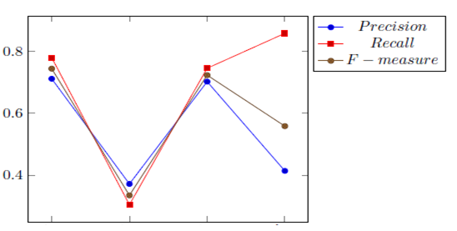
Goal 2 : Individual Steps Evaluation
  Results :
Without POS
Complete process
Without Normalization
Without Disambiguation
Department of Mathematics and Computer Science
PAGE <number>

Slide 50
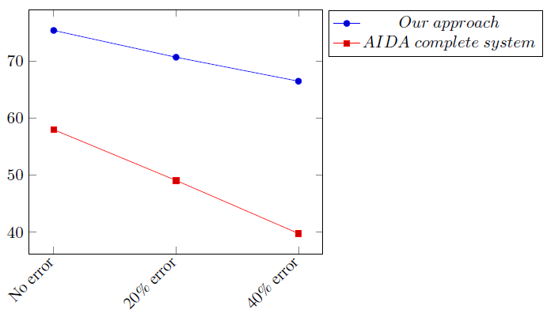
Goal 2 : Individual Steps Evaluation
  Normalization evaluation by introducing manual errors :
Department of Mathematics and Computer Science
PAGE <number>

Slide 51
Case Study

Slide 52
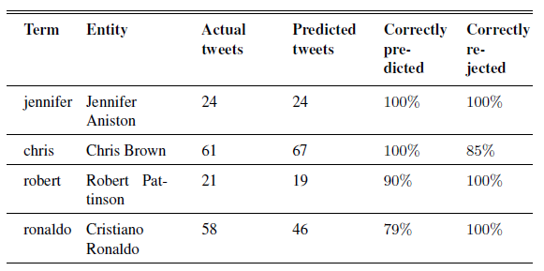
Case Study
Filtering targeted tweets with disambiguation
Department of Mathematics and Computer Science
PAGE <number>

Slide 53
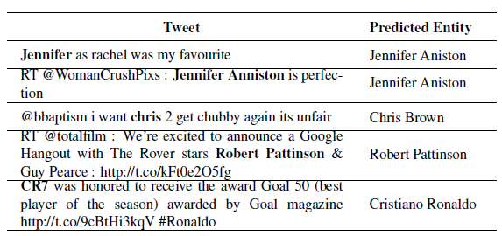
Case Study
Filtering targeted tweets with disambiguation
  Representative examples :
Department of Mathematics and Computer Science
PAGE <number>

Slide 54
Conclusions

Slide 55
Main Contributions
Proposed new solutions for NER and NED in tweets
Novelties:
  Brown clustering for normalization
  LM & NED for reducing FPs of NER
  Entity vector model for NED
Competitive :
  Unsupervised, Reduction of FPs works
Several directions to improve :
  Other sources like Facebook, other languages than English
Available as a GitHub project
Department of Mathematics and Computer Science
PAGE <number>

Slide 56
Future Work
Improve disambiguation results
  By including a topic detection model
  By exploring other tweets shared by user
  By exploring the tweet url link contents
Department of Mathematics and Computer Science
PAGE <number>

Slide 57
Thank You

Slide 58
Back up slides

Slide 59
Introduction : Definition
Philips hired 500 employees this quarter in Eindhoven.
Philips hired 500 employees this quarter in Eindhoven.
Department of Mathematics and Computer Science
PAGE <number>

Slide 60

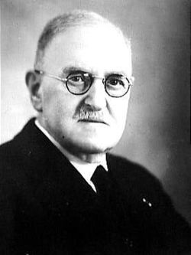

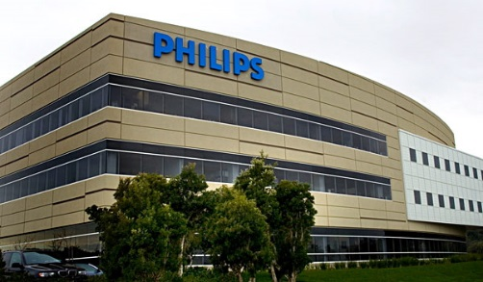
Introduction : Definition
Philips
Philips company
Philips TV
Gerard Philips
Department of Mathematics and Computer Science
PAGE <number>

Slide 61
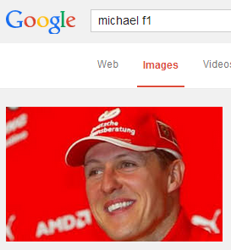
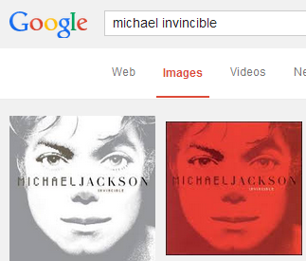
Introduction : Applications
IR systems
Department of Mathematics and Computer Science
PAGE <number>

Slide 62
Introduction : Applications
Question answering
Semantic knowledge extraction
Department of Mathematics and Computer Science
PAGE <number>

Slide 63
Experiments
NER evaluation :
  Evaluation metrics:
    True Positive (tp) : System extracts an entity and entity is in ground truth
    False Positive (fp) : System extracts an entity and entity is not in ground truth
    False Negative (fn) : System can not extract an entity which is in ground truth
Department of Mathematics and Computer Science
PAGE <number>

Slide 64
Experiments
NER evaluation :
  Evaluation metrics :
    Example :
      Tweet (ground truth) : RT @new Parishotels : RT @espn : [[Alabama]] PA announcer fired for songs directed at [[Auburn]]’s [[Cam Newton]]
      System output : RT @new Parishotels : RT @espn : [[Alabama]] [[PA]] announcer fired for songs directed at Auburn’s Cam [[Newton]]
  True positive : “Alabama”, “Newton” (partial matching)
  False positive : “PA”
  False negative : “Auburn”
Department of Mathematics and Computer Science
PAGE <number>

Slide 65
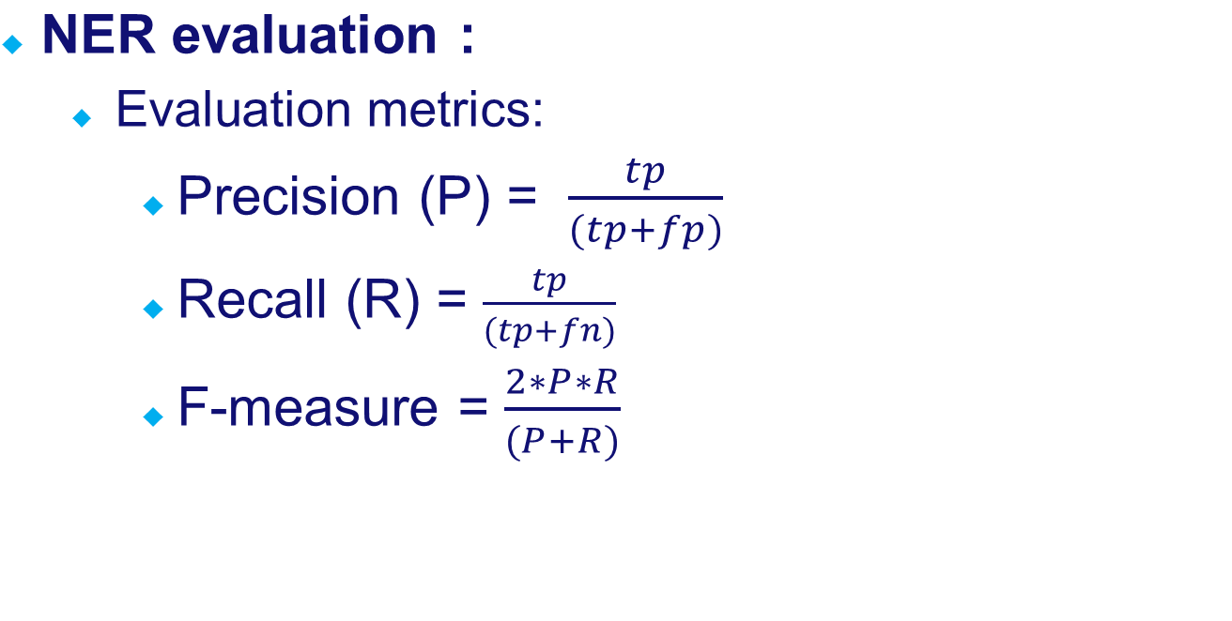
Experiments
Department of Mathematics and Computer Science
PAGE <number>

Slide 66
Experiments
NED evaluation :
  Evaluation metrics:
    accuracy of finding the correct Wikipedia link for extracted mentions
    100 entities, 80 correctly assigned links => Accuracy 80%
Department of Mathematics and Computer Science
PAGE <number>

Slide 67
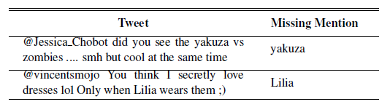
Experiments : Goal 2
Individual steps evaluation :
  Errors after removing POS tagging
Department of Mathematics and Computer Science
PAGE <number>

