Slide 1

Mobile Phone Analysis
Project: Web scraping with EDA
Domain: Electronics
Title: Best mobile phones under the price 30,000
By: Prathima Koppula
Batch:175

Slide 2

Steps involved in the Project
Introduction
Problem statements
Data scraping
Data cleaning
EDA (Exploratory data analysis)
Conclusion

Slide 3
Libraries used in this project
Pandas
pandas is easy to use data analysis and manipulation tool, built on top of the Python programming language.
Numpy
NumPy is a Python library that provides a multidimensional array object, mathematical and basic statistical operations.
Seaborn
Seaborn is a visualization library based on matplotlib. It provides a high-level interface for drawing and informative statistical graphics.
Matplotlib
Matplotlib is a comprehensive library for creating static, animated, and interactive visualizations in Python.
Beautiful Soup
Beautiful Soup is a Python package for parsing HTML and XLM documentation.
Request
The requests module allows you to send HTTP requests using Python.

Slide 4
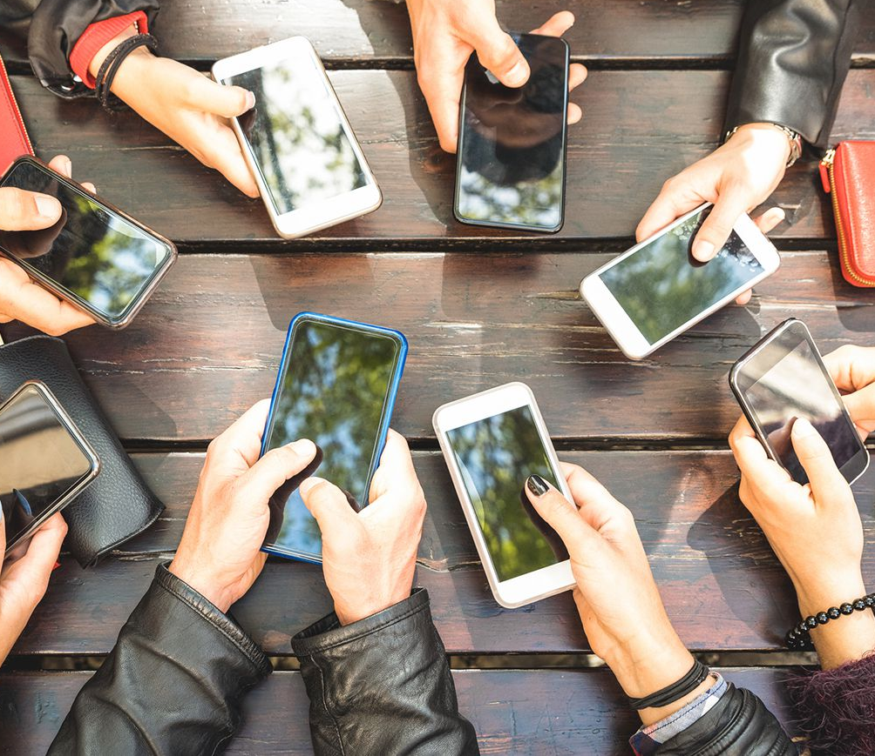
Step:1 Introduction

Slide 5
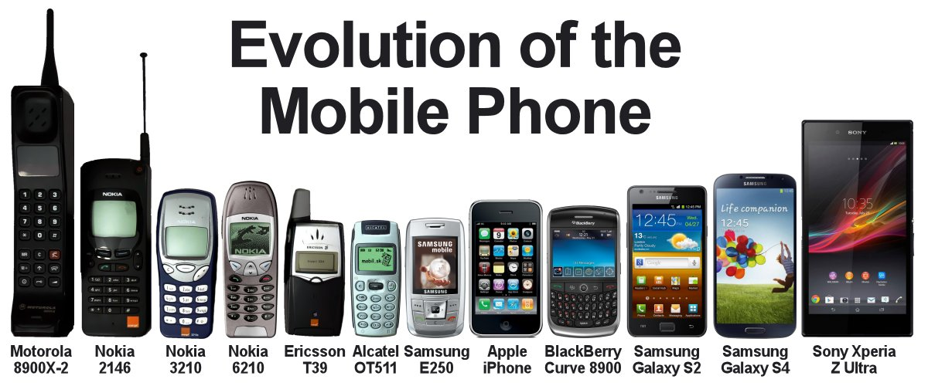
Mobile phones are used for a variety of purposes, such as keeping in touch with family members, for conducting business, and in order to have access to a telephone in the event of an emergency.
India is the second largest smartphone market in the world, and it is still growing at almost 30% annually. Today, you can get smartphones at price points ranging from Rs.5,000 all the way up to Rs. 90,000. The sheer number of choices can often leave you confused. Hence, making a decision then becomes an exercise involving spending hours on the internet, researching various features and offers.

Slide 6

All about this project
In this project first I used BeautifulSoup library to scrape data
For this project I used Filpkart website as our source URL to scrap data
I scrape all the relevant data and convert it into a Data frame
Once data frame is created, I saved it into a CSV file. This is Raw data we have.
From this CSV file we read the data to work on it .
As this data is raw data, we need to clean the data by handling the null values and duplicate values. This can be done using Numpy, Panda libraries.
Filtered the data according to my requirement.
We now have the clean and filtered data to use for visualization.
For visualization I used EDA(Exploratory data analysis)

Slide 7
Step:2 Problem Statements

Slide 8

Problem Statements
Here my aim is, by using Web scraping with Python to find out
The best mobile company available in market to provide products in given price range.
Company with most satisfied customers with good ratings
Factors like 'RAM' and 'Display' effecting the prices
Price range in which most of the mobile phones available
Correlation between all the factors to consider before buying a mobile phone

Slide 9
Step:3 Data scraping

Slide 10
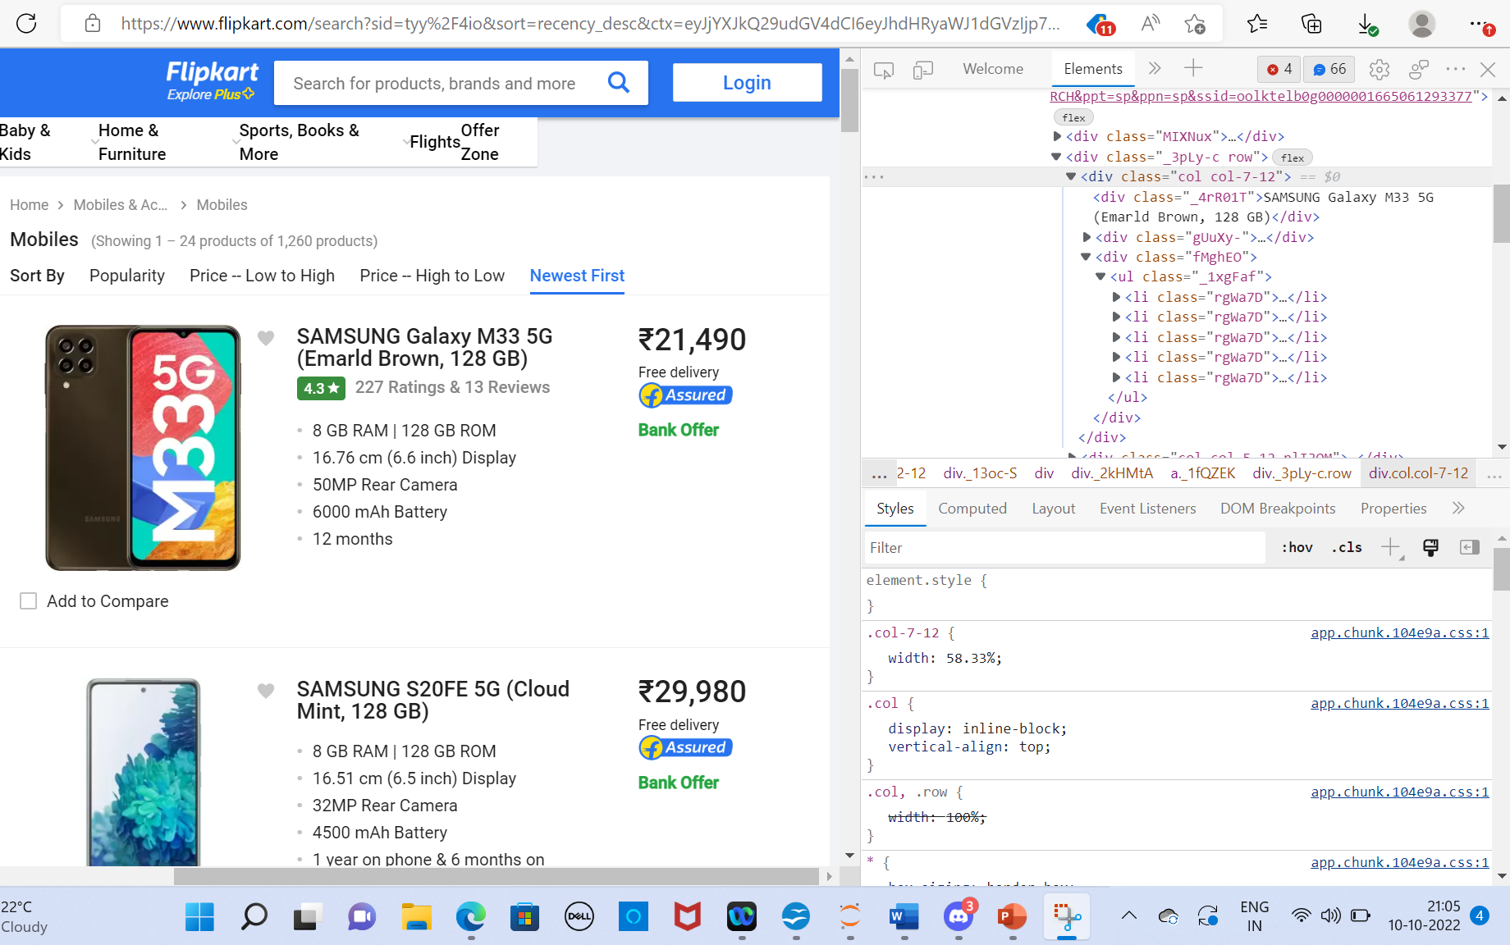
Data Extraction

Slide 11
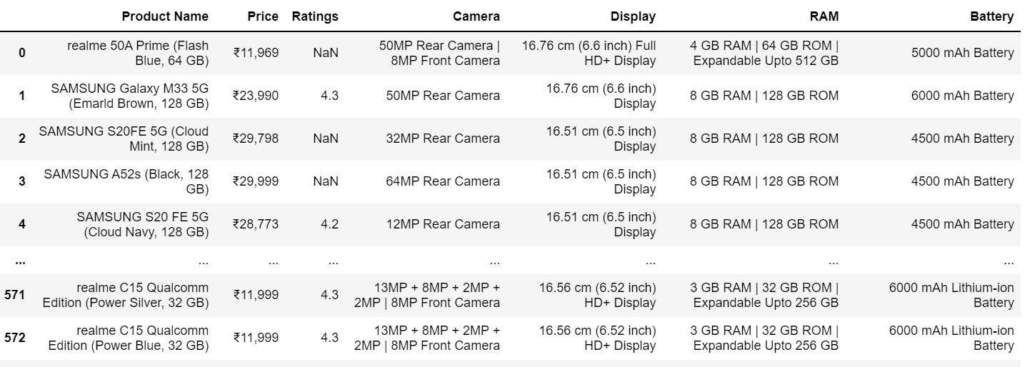
Scraped Raw Data

Slide 12
Step:4 Data cleaning

Slide 13
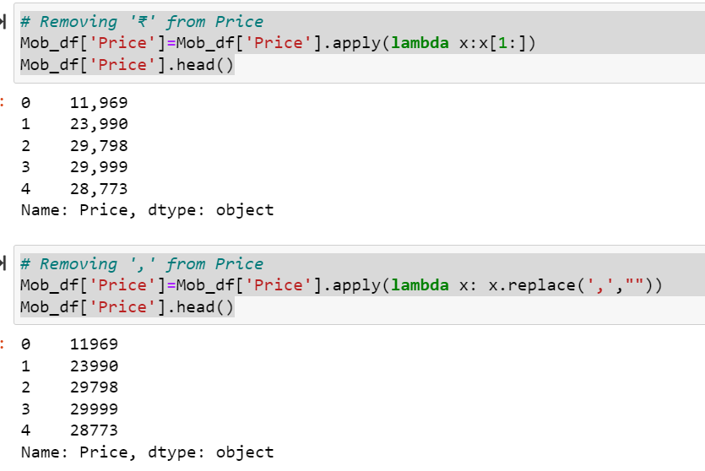
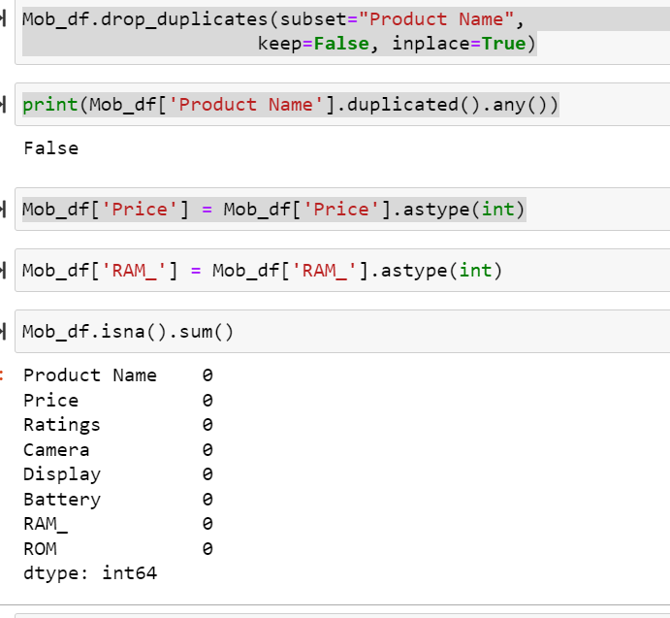
Data cleaning

Slide 14
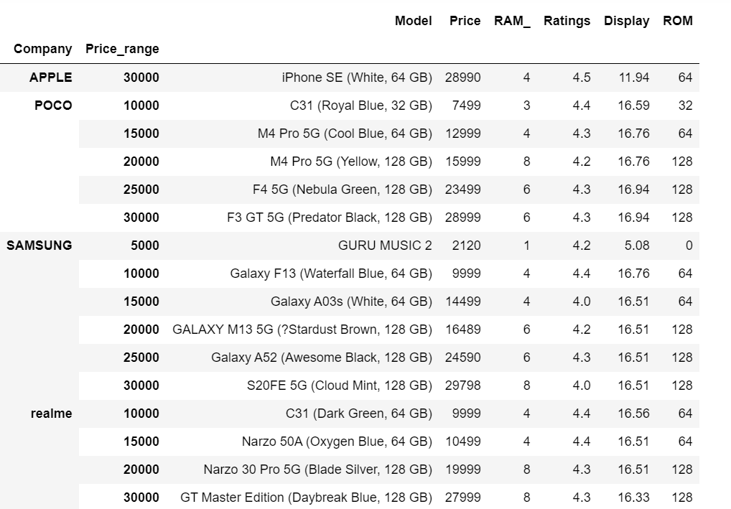
Clean Data

Slide 15
Raw Data
Clean Data

Slide 16
Step:5 EDA {Exploratory Data Analysis}

Slide 17
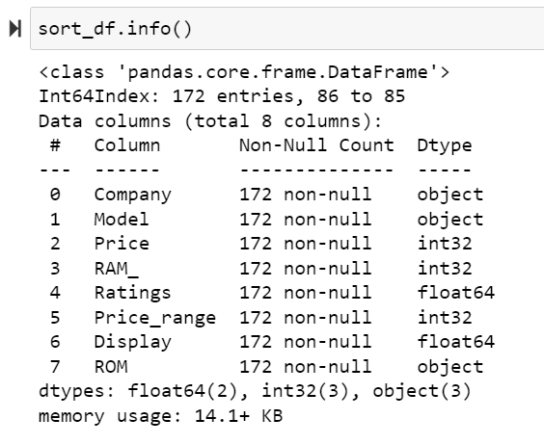
Insights
Here we can see :
Price, RAM and Price range are of type Int
Ratings and Display are of type Float
Rest of the columns are of type object
So we have two columns of float type, three columns of int type and 4 columns of object type

Slide 18
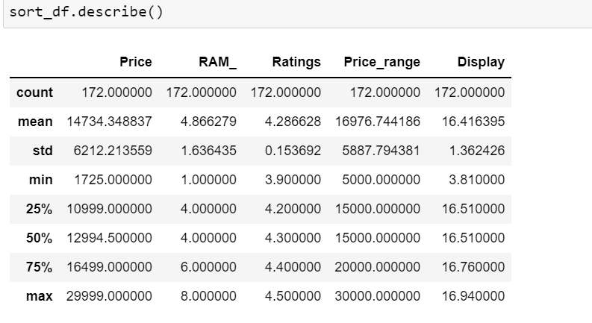
Insights
Here we can see:
For Price the max price is 29,999 and min price is 1725
Max RAM provided is 8GB
Max ratings are not more than 4.5 and min ratings are 3.9
Max Display is 16.94 and min is 3.81

Slide 19
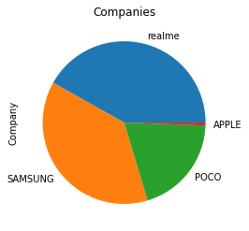
Top companies that provide mobile phones in given range
Here we can see the most popular companies that provide the mobile phones in the given price range.
We can see that Samsung and realme are major providers

Slide 20
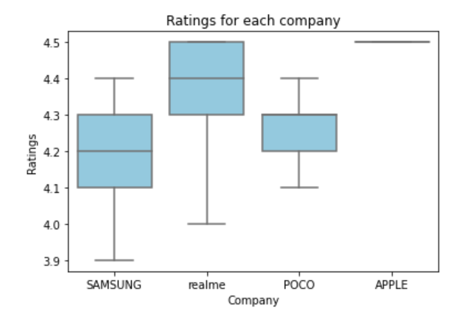
Company with most satisfied customers with ratings
Here we can see the most each company’s ratings given by customers.
We can see that realme products are most liked

Slide 21
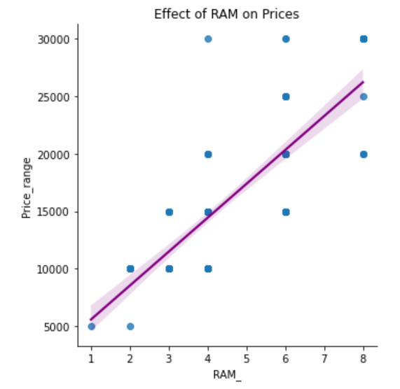
Factors like RAM size effecting the prices
Here we can see the most each products RAM size effecting the price of the product
We can see that as the RAM size increases, product price also increases

Slide 22
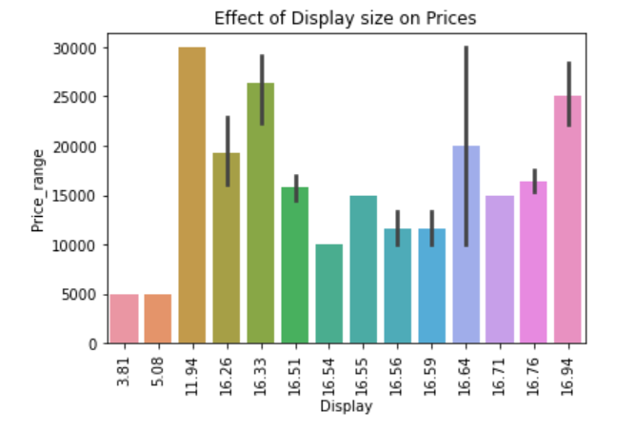
Factors like Display size effecting the prices
Here we can see that each products Display size effecting the price of the product
We can see that as the display size increases, product price also increases in some places
The Black line is the Error bar
Error bars are graphical representations of the variability of data and used on graphs to indicate the error or uncertainty in a reported measurement.

Slide 23
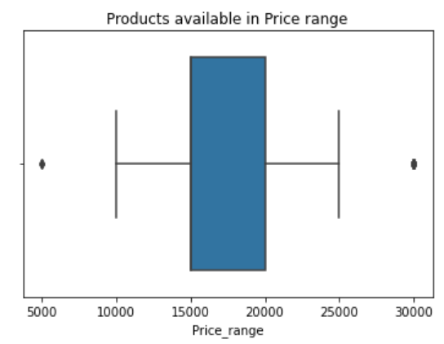
Price range in which most of the phones are available
Here we can see the most product prices are between 15000 and 20000
We can see some outlier at 5000 and 30000
An outlier is an observation that is numerically distant from the rest of the data.
outlier
outlier

Slide 24
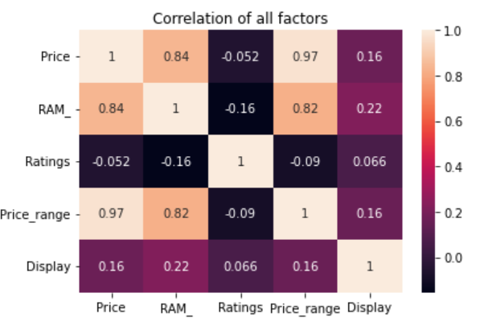
Corelation between all the factors to consider before buying a mobile phone
Correlation Heat map is a two dimensional plot of the amount of correlation (measure of dependence) between variables represented by colors. The varying intensity of color represents the measure of correlation. An outlier is an observation that is numerically distant from the rest of the data.
In the given map we can see that RAM is directly proportional to Price
Display is proportional to Ratings

Slide 25
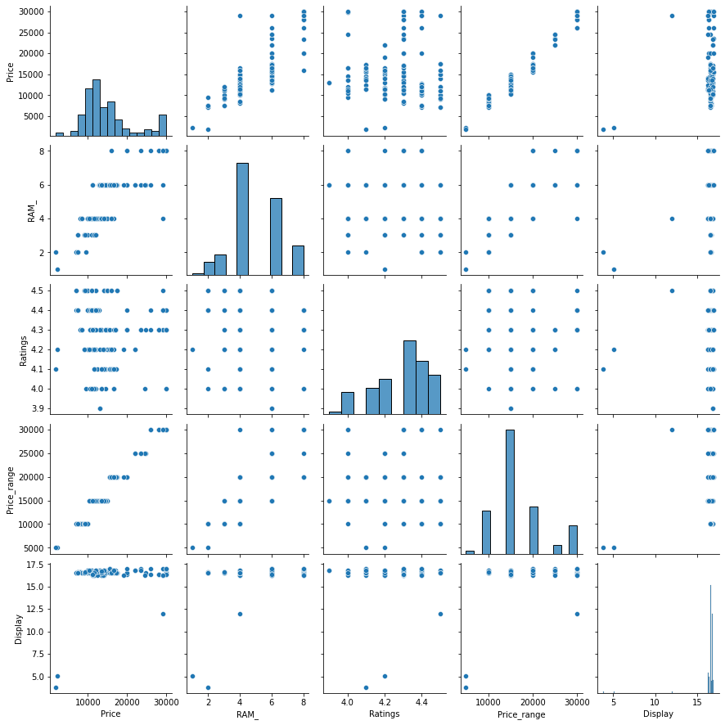
Pair plots

Slide 26

Conclusion
From the above visualization, my analysis is to provide customers with some valuable information about best products available with good ratings and with Price constraint of below 30,000.
Here we found out bout the following
The best mobile companies available in market to provide products in given price range are Realme and Samsung
Company with most satisfied customers with ratings is Realme
Factors like 'RAM’ effecting the prices- as RAM size increase, prices also increase
Factors like 'Display' effecting the prices- as display increase so does price and ratings
Price range in which most of the mobile phones available are 15,000 to 22,000
Correlation between all the factors to consider before buying a mobile phone can be observed.
Above is the information which customers can consider before buying a mobile phone in his budget range
This Photo by Unknown Author is licensed under CC BY-SA

Slide 27


