Slide 1
The Home Depot Product Search relevance from
BY:
Farah mohsin
Mohamad El-Rifai
Nitish Bahadur
Satishraju Rajendran

Slide 2
Business Case Importance
E-commerce is the future for big retailers
Lower the operating costs
Personalize the customer shopping experience
New shopping experiences, like BOPUS
Bigger catalogs that can be maintained online
Increase the margin of competitive prices due to low operating costs.

Slide 3

Business Problem – The Home Depot
Too many stores (2,200 stores )
High operating costs
Almost 1 million item in HD catalogs
Threat of loosing online profits ($3.76 billion yearly) due to weak product search capabilities online
Unsatisfied users with HD online product search

Slide 4

How to solve the problem?
Develop a model that can accurately predict the relevance of search results.
Goal of this Project :
Speed
Accuracy
Increase Sales
Enhance customer shopping experience

Slide 5
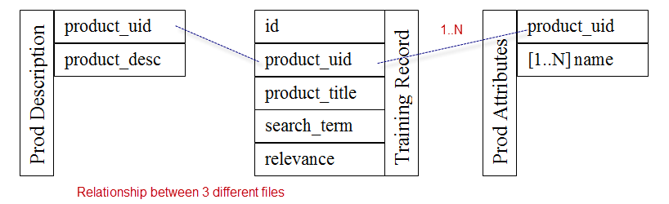
Data Collection – HD DataSet
Train.csv [74067 records]
Product_uid , Product_title, Search_term, Relevence
Test.csv [166694 records]
Product_uid, Product_title, Search_term
Attributes.csv [1048486 records]
Product_uid, Name, value
Product_description.csv [124429 records]
Product_uid, Product_description

Slide 6
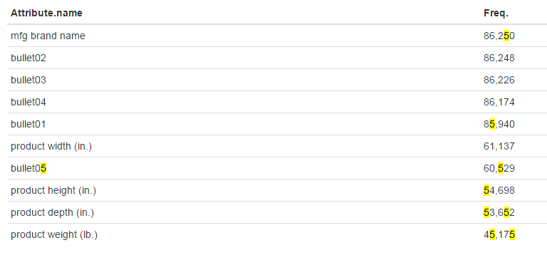
Data Issues
Examples of Typos:
words concatenated together, for example, sidewalks100%, surfaceActual, environmentsCertified ….
Examples of Misspelling:
Mowe, sprkinler, keorsene, lanterun ….
Example of inconsistent data:
In the attributes.csv file there are 5343 different categories and majority of the items don’t share the same set of attributes

Slide 7

Data Processing – Fixing Misspellings
Callenges:
Search terms misspellings need to be fixed in home improvement, gardening, construction and do-it-yourself context
Regular English dictionary failed to fix the misspelled terms in the HD context
For example, “mowe” get corrected as “more” and the intention was “mower”
Solution:
Built a custom dictionary using the set of words from product descriptions fixed majority of misspelled words in the HD context.

Slide 8

Data Processing – Cleaning Data
Challenges:
Redundant words made the computation of relevance rating more complex and slower
Composite words that were separated by special characters, which a regular tokenizer failed to parse correctly
Solution:
Remove stop words using Python stop words list.
Remove alpha numeric terms that were not contributing to the model
Use regular expressions to segregate composite words

Slide 9
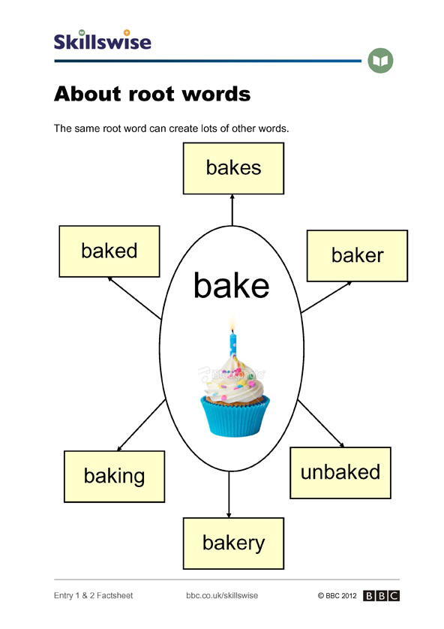
Data Processing – Stemming words
Challenges:
Mismatching between the search term and the words in the title, description and attributes due to English suffixes
Solution:
Using Python stem functionality to unify the words and remove suffixes, so that we avoid mismatches,
For example, “write” != “writing”, but stem(“write”) = “stem(“writing” ) = “write”

Slide 10
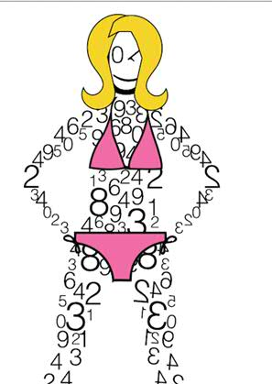
Models and Features - Word Count Approach
Given the search term, we find the number of occurrences of its words in the product title, description and attributes.
Generating three new features that we used in order to predict the relevancy of the search term to a given item.

Slide 11
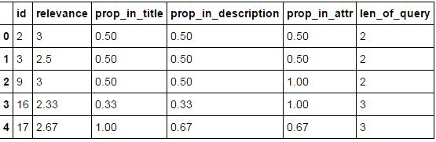
Models and Features Word Proportion Approach
We find the proportion of the search term across product title, product description and attributes.
Generating three new features that we used in order to predict the relevancy of the search term to a given item.

Slide 12
Linear and Bagging Models
Linear Regression Model
Model | Pre-processing | Training Obs | Test Obs. | CV | RMSE
BR | Spelling and typo corrections using product description dictionary | 55550 | 18516 | No | 0.48
Bagging Regression Model
Model | Pre-processing | Training Obs | Test Obs. | CV | RMSE
LR | Spelling and typo corrections using product description dictionary | 55550 | 18516 | No | 0.49

Slide 13
Random Forest Regressed model
Parameters:
rfr_n_estimators: 25
rfr_max_depth: 6
Large depth makes the decision trees less readable
Model | Pre-processing | Training Obs | Test Obs. | CV | RMSE
RFR | No spelling correction | 55550 | 18516 | Yes | 0.49
RFR | Spelling and typo corrections using product description dictionary | 55550 | 18516 | Yes | 0.47

Slide 14

Conclusion
Pre-processing with custom tokenizers help build better search
Preliminary experiments are extremely promising and the use of data science techniques such as random forest regression.
We feel our RMSE of 0.47 is good given the short time window and the complexity of the problem
We believe RMSE can be further improved by exploring more feature extracting and data processing techniques in the future

Slide 15

Questions

