Slide 1

Analyzing Data from MovieLens
By Farah Mohsin, Mohamad El-Rifai, Nitish Bahadur, Satish Rajendran

Slide 2


Is it big industry?
It is expected, that the sector as a whole will have generated 564 billion U.S. dollars in revenue by the end of 2014.
Forecasts predict that the entertainment industry will grow to over 679 billion US dollars in value over the next four years.

Slide 3
Well, How big some Data then?
MovieLens DataSets:
100K - Stable benchmark dataset. 100,000 ratings from 1000 users on 1700 movies. Released 4/1998.
1 Million - Stable benchmark dataset. 1 million ratings from 6000 users on 4000 movies. Released 2/2003.
10 Million - 10 million ratings and 100,000 tag applications applied to 10,000 movies by 72,000 users. Released 1/2009.
20 Million - Stable benchmark dataset. 20 million ratings and 465,000 tag applications applied to 27,000 movies by 138,000 users. Released 4/2015.
MovieLens Latest Datasets - These datasets will change over time, and are not appropriate for reporting research results

Slide 4
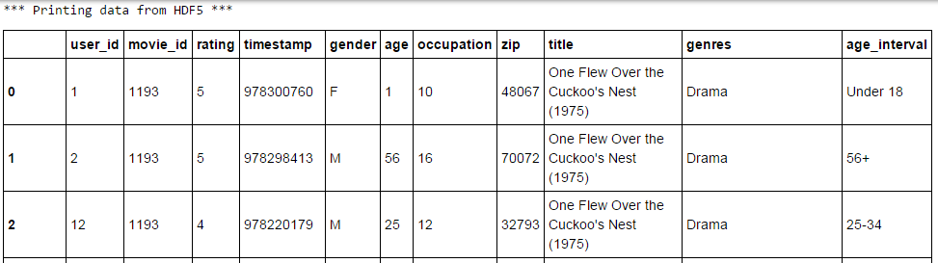
Merging MovieLens 1 million DataSet
Merging users.dat, ratings.dat and movies.dat in one DataFrame

Slide 5


Some Stats from DataSet
TOTAL MOVIES WITH MEAN RATING OVER 4.5 : 29
TOTAL MOVIES WITH MEAN RATING OVER 4.5 AMONG MEN: 29
TOTAL MOVIES WITH MEAN RATING OVER 4.5 AMONG WOMEN: 70
TOTAL MOVIES WITH MEDIAN RATING OVER 4.5 : 92
TOTAL MOVIES WITH MEDIAN RATING OVER 4.5 AMONG MEN 30+ yrs: 105
TOTAL MOVIES WITH MEDIAN RATING OVER 4.5 AMONG WOMEN 30+ yrs: 187

Slide 6
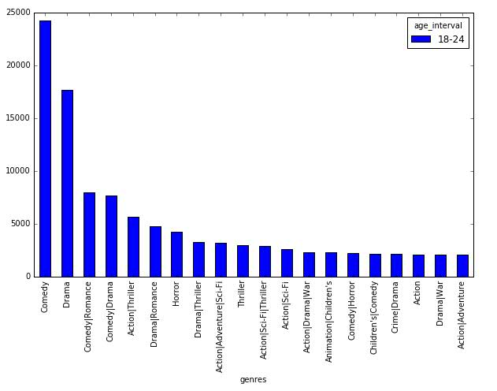
Which group to please?

Slide 7
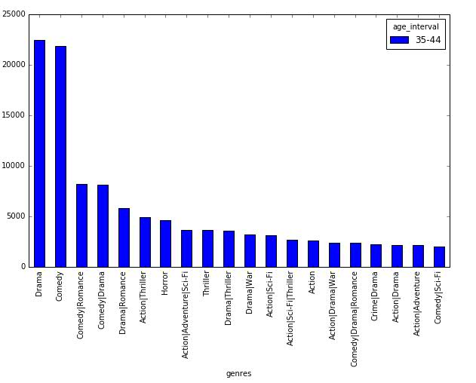
Which group to please?

Slide 8
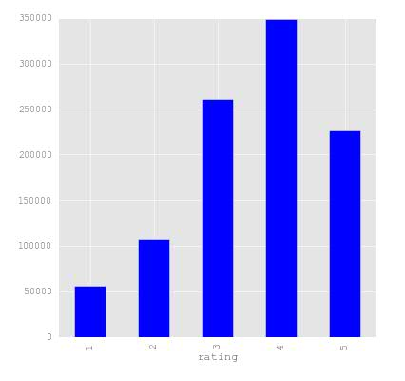
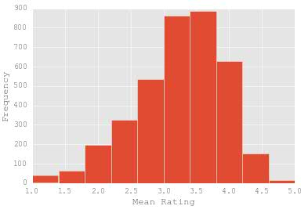
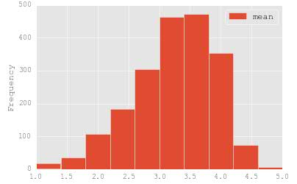
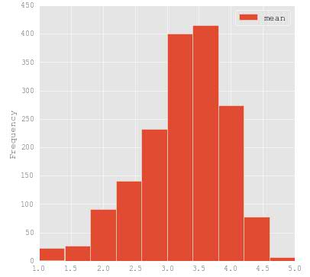
Histograms from Q2
Ratings of all Movies
Rated < 100
Rated >= 100
Ratings each movie recieved

Slide 9
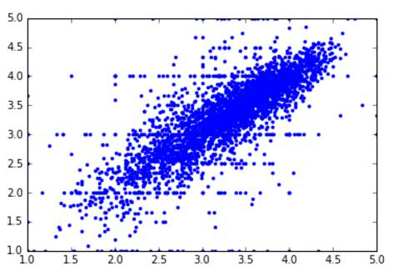
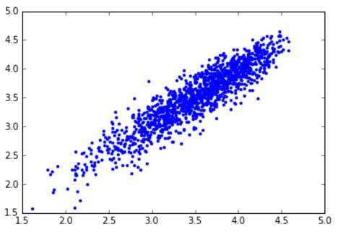
Men vs Women Ratings Linear!!
All Ratings
Movies Rated > 200 times

Slide 10
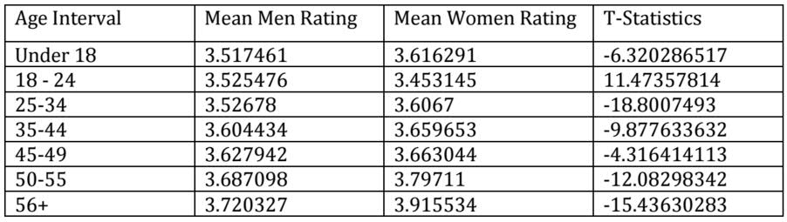
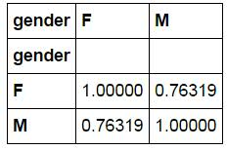
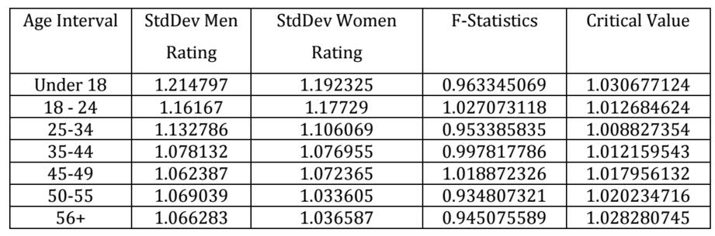
Math behind Linearity

Slide 11
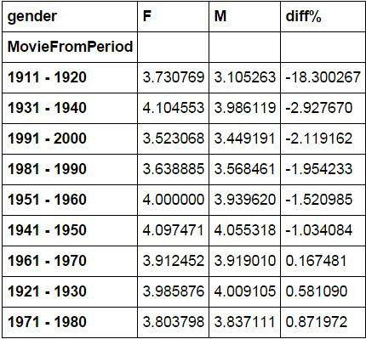
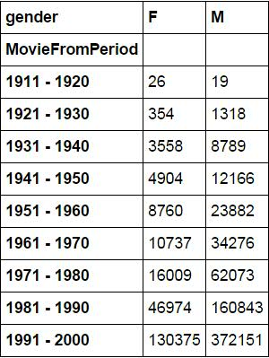
Similar taste across movies periods
Mean Ratings across periods per gender
Number of Ratings across periods per gender

Slide 12
Bussines Intellegence (Our Story)
Study how the median movie ratings move within first 90, 180, 365, and finally greater than 365 days
For this experiment we use 22MM movie ratings from movie lens
For each of the 33043 movies we download additional movie attributes such as release date, production companies, director, revenue, budget, etc.

Slide 13
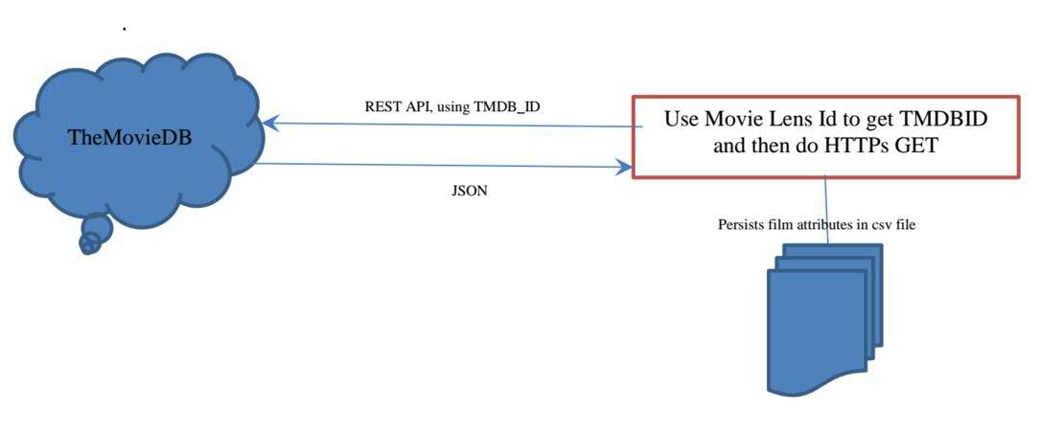
Data Gathering

Slide 14
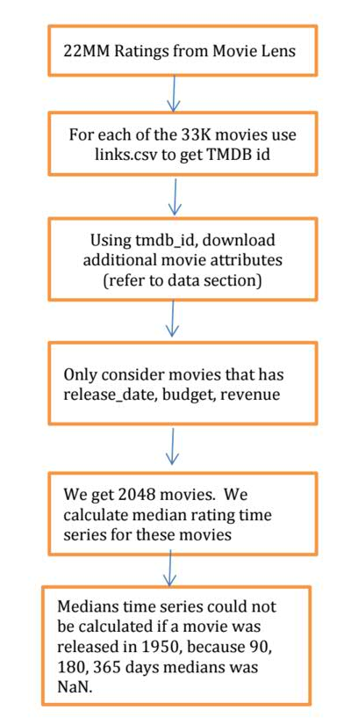
Data Processing Model
Data quality has been extremely challenging.
For some movies the budget was $1,and for some revenue was $100.
To provide consistency we only consider movies that have a budget of $100,000.

Slide 15
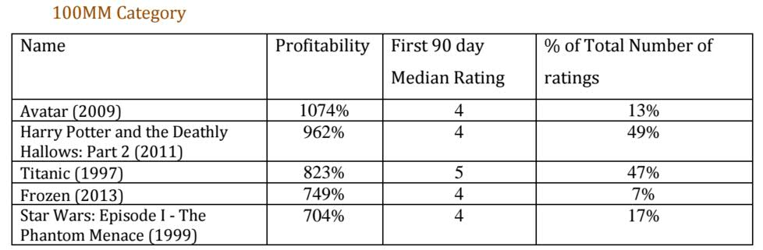
Data Analysis
Out of 1569 movies, 81% were profitable and 19% lost money.
Profitability is defined as (revenue – budget) / budget.
After considering a budget floor of $100,000 we segregate the movies into 3 categories: Budget of more than 100MM; 10-100MM;1-10MM and less than 1MM.

Slide 16
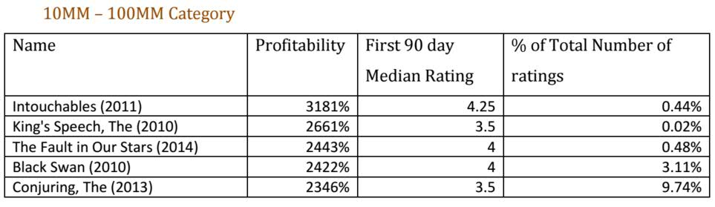
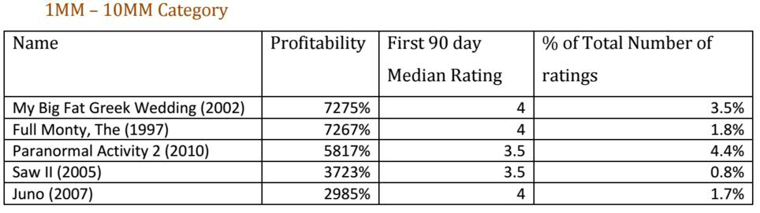
Data Analysis

Slide 17
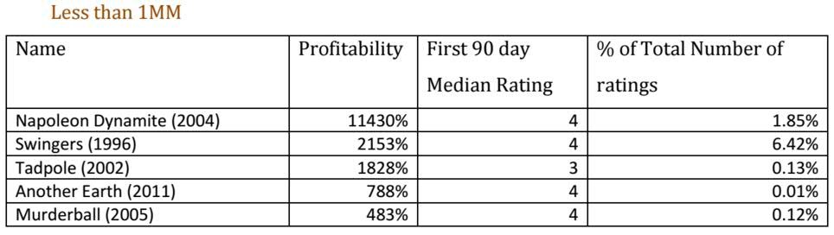
Data Analysis
Because of the data quality, we find no loss making movie in the less than 1MM category. We believe this is akin to survivorship bias; why report about a small budget loss making movie?

Slide 18
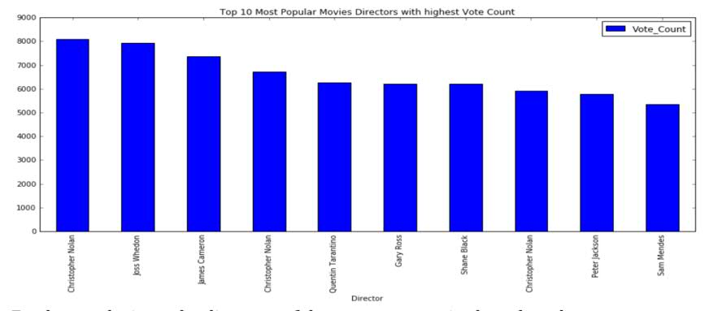
Anaylsis on Directors
To determine the most profitable Director we leveraged the TMDB database

Slide 19
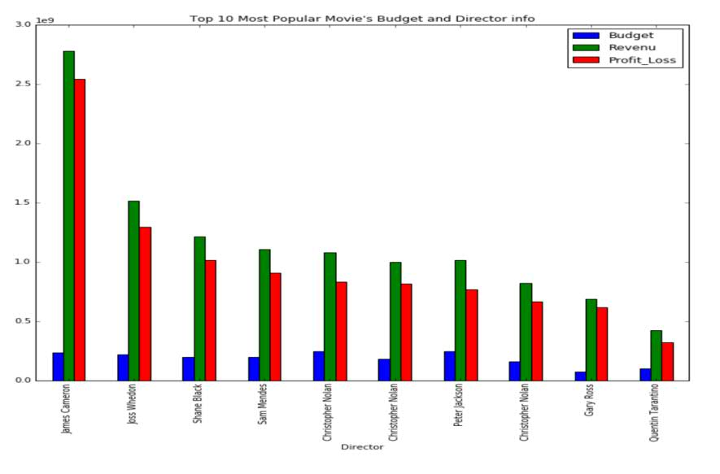
Anaylsis on Directors

Slide 20
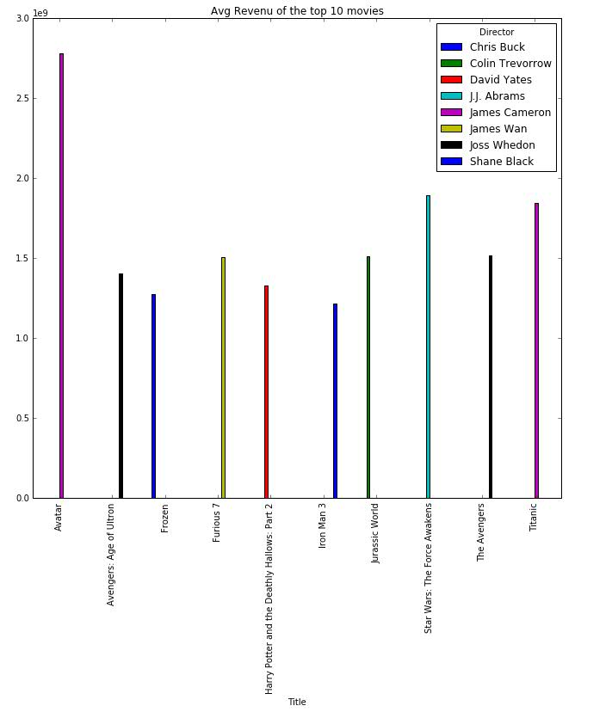
Anaylsis on Directors

Slide 21
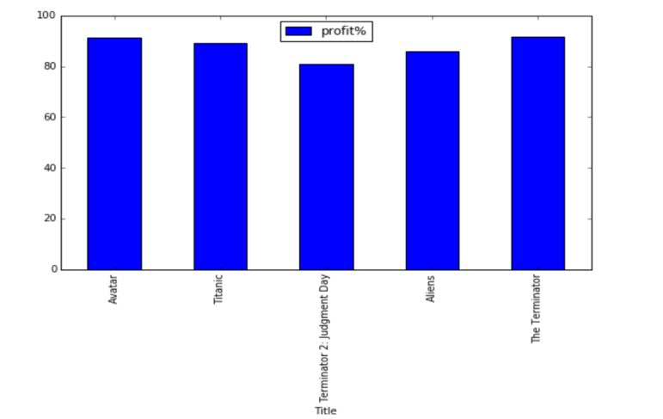
Anaylsis on Directors

Slide 22


