Slide 1
Case- Study-3 Textual analysis of movie reviews
By
Farah Mohsin, Satishraju Rajendran, Mohmad El-Rifai, Nitish Bahadur

Slide 2
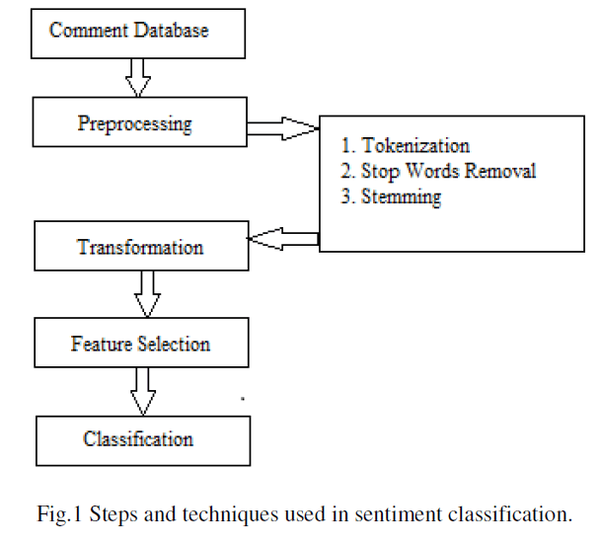
Study of movie reviews from the v2.0 polarity dataset
Exploratory analysis
Text classification, using different classifiers
Exploration of different visualization techniques
Exploring Supervised Learning, & Unsupervised Learning

Slide 3
Overview of Problem-1: Sentiment Analysis on Movie Review
Output
Data Exploration
Preprocessing
Loading
Tests vs. Training Set
Experiment
Analysis

Slide 4
The Experiment
Tfidf Vectorizer: min_df = 0.35, max_df = 0.75
LinearSVC classifier
vect_ngram_range: both (1,1) and (1,2) were experimented with.
n_jobs: values was set to -1 and 1, depending on the environment
GridSearchCV.fit: used for fitting the model to the training data set
GridSearchCV.predict: used for predicting model output using test data set
Confusion Matrix: plotted using sklearn.metrics.confusion_matrix
Movies Reviews | Pos. Reviews | Neg.Reviews
Total | 1000 | 1000
Training VS Testing Data | Training Data | Testing Data
Total | 75% | 25%
Findings:
After training the model, we predicted the model output on test data set and calculated prediction accuracy and plotted the confusion matrix.

Slide 5
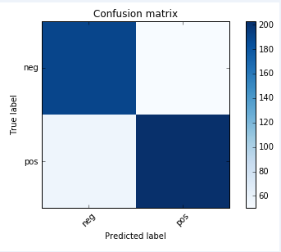
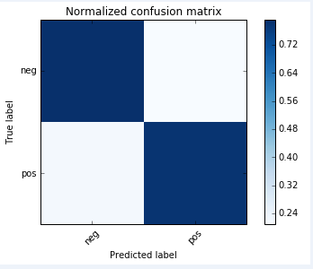
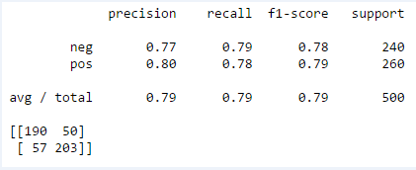
Highlights of Analysis and output
Overview of the Experiment:
n_job parameter should be set carefully, especially on a machine with single processor | we should not set the value to -1. | Use of n_grams increases features space and consequently increasing model training time.

Slide 6
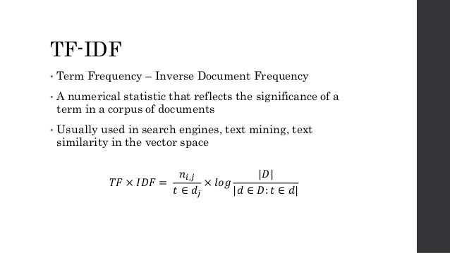
Problem 2: Explore TdidfVectorizer
2.1 What is TF-IDF
Term Frequency (TF) is defined as the number of occurrences of each word in a document divided by the total number of words in the document. Because larger documenting has higher average count than smaller documents, term frequency normalizes the word count. Further, words that are present in large number of documents are less informative.
Inverse Document Frequency (IDF) is a refinement where we downscale weights of words to neutralize the ubiquity factor. Holistically, this process of vectorizing words in a collection of documents is called Term Frequency times Inverse Document Frequency or td-idf in short.

Slide 7
Exploring TdidfVectorizer and other characteristics of DF and IDF
2.2 Running TdidfVectorizer | 2.3 min_df vs. max_df min_df VS max df1 | 2.4 n_gram_range n_gram range
Running defined TdidfVectorizer class on the docs_train was straightforward | When using a float in the range [0.0, 1.0] they refer to the document frequency. That is the percentage of documents that contain the term. When using an integer it refers to absolute number of documents that hold this term. For example, when you have 1000 text files (or documents), if you set max_df = 0.6 then that would translate to 0.6*1000=600 documents containing the term. If you set max_df = 100 then that would simply translate to 100 documents containing the term. | n-gram is a contiguous sequence of n items from a given sequence of text or speech. An n-gram of size 1 is referred to as a "unigram"; size 2 is a "bigram" (or, less commonly, a "diagram") Size 3 is a "trigram". Larger sizes are sometimes referred to by the value of n, e.g., "four-gram", "five-gram", and so on.

Slide 8
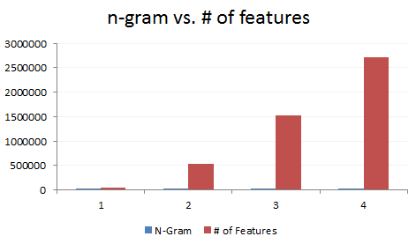
n_gram_range
The n_gram_range, parameter in TdidfVectorizer is used to parameterize the lower and upper boundary of the range of n-values for different n-grams to be extracted.
All values of n such that min_n <= n <= max_n is used.

Slide 9
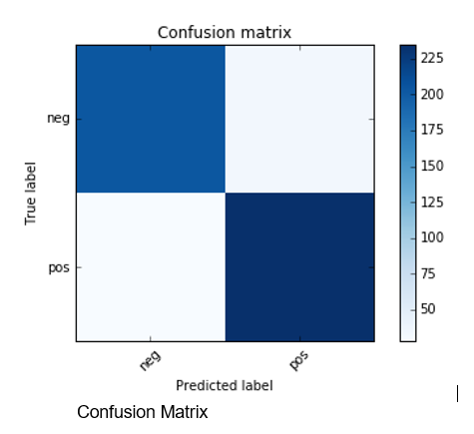
Problem-3: Machine Learning Algorithm
3.1 TfidfVectorizer, Xtrain and Xtest | 3.2 LinearSVC
In order to find Xtrain and Xtest we had to transform our train data set to a matrix of TF-IDF features using TfidVectorizer. We optimized the TfidVectorizer with set of parameters (sublinear_tf=True, max_df=0.5, analyzer='word', stop_words='english') in order to achieve the best subset of features. Xtrain: n_samples=1500, n_features=35000 Xtest: n_samples=500, nfeatures=35000 | For LinearSVC we tried multiple combinations of parameters and we accomplished our best performance from using the following set of parameter for the TfidVectorizer (sublinear_tf=True, max_df=0.5, analyzer='word') and for LinearSVC we used C=1
Accuracy 87.8%
Confusion Matrix:
[204 33]
[28 235]

Slide 10
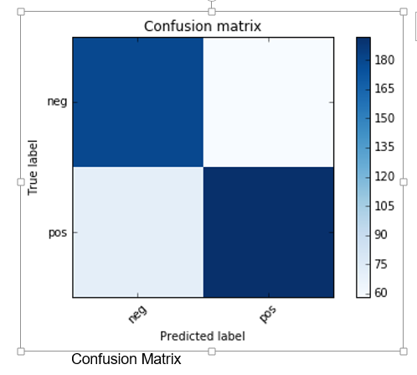
3.3 KNN
For KNN we made a model with the following parameters for for the TfidVectorizer (min_df=5, max_df = 0.8, sublinear_tf=True, use_idf=True) and for KNN we used the following parameters (leaf_size=30, metric='minkowski', metric_params=None, n_jobs=1, n_neighbors=5, p=2, weights='uniform')
Accuracy 72.4%
[148 89]
[ 49 214]

Slide 11
KNN multi runs
K value | precision | recall | f1-score | support | Accuracy | Error_rate
n_neighbors : 2 | 0.69 | 0.68 | 0.67 | 400 | 67% | 0.322
n_neighbors : 3 | 0.72 | 0.72 | 0.72 | 400 | 72% | 0.28
n_neighbors : 4 | 0.73 | 0.72 | 0.72 | 400 | 72% | 0.27
n_neighbors : 5 | 0.73 | 0.73 | 0.73 | 400 | 73% | 0.27
n_neighbors : 6 | 0.74 | 0.74 | 0.74 | 400 | 74% | 0.26
n_neighbors : 7 | 0.74 | 0.73 | 0.73 | 400 | 73.5% | 0.26
n_neighbors : 8 | 0.72 | 0.72 | 0.72 | 400 | 72% | 0.28
n_neighbors : 9 | 0.72 | 0.72 | 0.72 | 400 | 72% | 0.28

Slide 12
3.4 Classifier & Parameters Highlights
For LinearSVC and KNN we can see clearly that LinearSVC is outperforming KNN and getting higher accuracy. The reasons we think SVM outperform KNN are:
KNN tends to perform very well with a lot of data points and since our dataset is 2000 points
KNN is very sensitive to bad features, so feature selection is very important to achieve good results in KNN
KNN is sensitive to outliers and not removing them will impact the accuracy of the model
KNN tends to perform very well with a lot of data points and since our dataset is 2000 points
SVM needs to be tuned, the cost "C" and the use of a kernel and its parameters are critical hyper-parameters to the algorithm.
On the other side SVM has advantages with our dataset:
Because we have limited set of points in multidimensional space SVM tends to be very good because it should be able to find the linear separation easily.
SVM is good with outliers as it will only use the most relevant points to find a linear separation

Slide 13
3.5 Misclassification in KNN
For a particular choice of parameters and classifier, look at 2 examples where the prediction was incorrect. Can you conjecture on why the classifier made a mistake for this prediction? First example of KNN misclassification will be file \neg\cv206_15893.txt which is misclassified as a positive review. The key word in this file is “moses” which exists 8 times in the file and also exists 1 time in a positive review and 18 times in a 3 different negative reviews since, the word “moses” is common between these files they will tend to be neighbors in the space, and since we are using n_neighbors=5 following the majority vote for KNN it will be 3 votes toward positive which will make the algorithm to misclassify the review as positive review. Second example of KNN misclassification will be \pos\cv138_12721.txt which is misclassified as negative review. The key word in this review is “jackal” which exists 8 times in the review and also exists 35 times in 8 negative reviews and 8 time in 2 positive reviews since, the word “jackal” is common between these files they will tend to be neighbors in the space, and since we are using n_neighbors=5 following the majority vote for KNN it will be 5 votes toward negative which will make the algorithm to misclassify the review as negative review.
Examples and Details of the Model
Model Details: | KNN model with n_neighbors=5 and weights='distance' parameters and using TfidVectorizer with the following (sublinear_tf=True, max_df=0.5, analyzer='word')
example -1 of KNN misclassification | Direcoty/File Name | Word “moses” Count
 | \neg\cv230_7913.txt | 1
 | \pos\cv151_15771.txt | 3
 | \pos\cv468_15228.txt | 8
 | \pos\cv796_15782.txt | 7
Example-2 of KNN misclassification | Direcoty/File Name | Word “jackal” Count
 | \neg\cv131_11568.txt | 15
 | \neg\cv278_14533.txt | 1
 | \neg\cv286_26156.txt | 1
 | \neg\cv392_12238.txt | 1
 | \neg\cv393_29234.txt | 1
 | \neg\cv753_11812.txt | 1
 | \neg\cv906_12332.txt | 13
 | \neg\cv951_11816.txt | 1
 | \pos\cv267_14952.txt | 1
 | \pos\cv909_9960.txt | 7

Slide 14
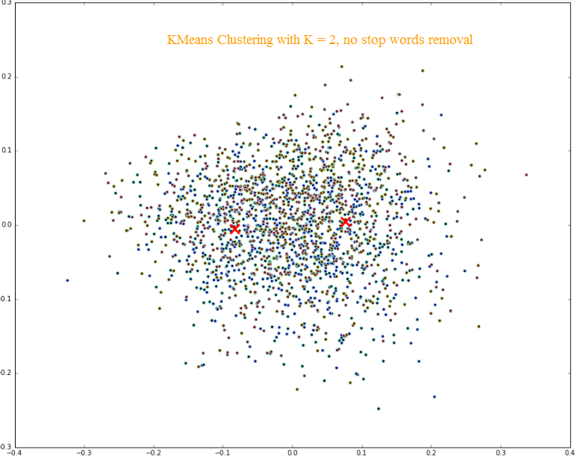
Problem 4: Finding the right plot :
For the given 2 positive and negative movie reviews:
Using the unsupervised technique, the movie cluster reviews were divided into 2 clusters
While the KMeans gave us 2 centroids, marked in red below, the scatter plot of blue, negative reviews, and green, positive reviews, failed to segregate the movie reviews.
KMeans with K = 2 Without stop words removal
we have used K = 2, as the number of clusters.
In the quest to find a 2D plot, in which the positive and negative reviews are separated

Slide 15
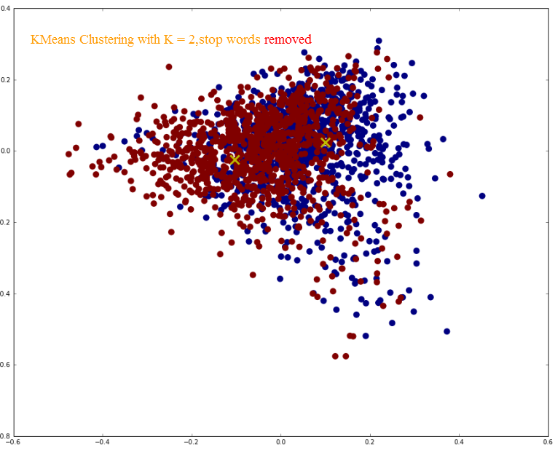
Problem 4: Finding the right plot :
KMeans with K = 2 w/stop words removal
As the scatter plot indicates, we got better clustering for negative reviews, the brown dots, but unfortunately, the positive reviews, the blue dots, were sprinkled all over and in 2D the negative reviews overlaid the positive reviews.
Because the scatter plot did not give us clear clusters, and we knew that we have 2 clusters (positive and negative movie reviews) we wanted to remove the stop words and see if we got better clustering.

Slide 16
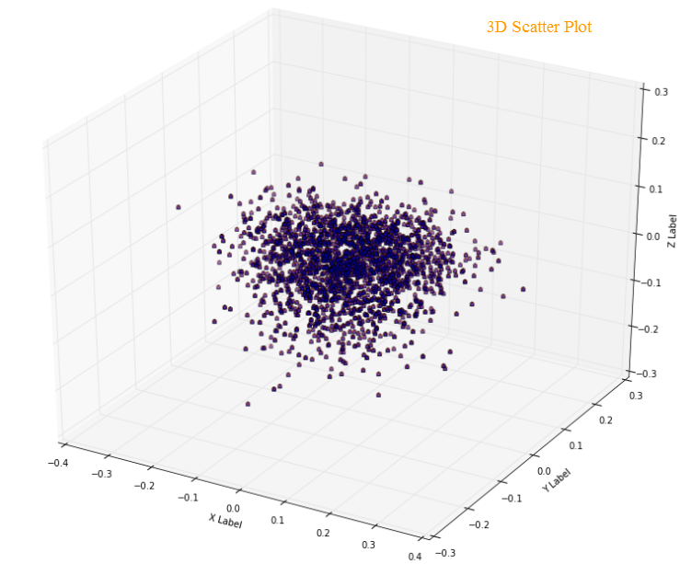
Problem 4: Finding the right plot :
D - Scatter Plots
As the scatter plot indicates, we got better clustering for negative reviews, the brown dots, but unfortunately, the positive reviews, the blue dots, were sprinkled all over and in 2D the negative reviews overlaid the positive reviews.
Based on the scatter plot above, we decided to plot the text clusters in 3D, hoping to see a better view. Unfortunately, using PCA to reduce the vector to 3 components did not help either.

Slide 17
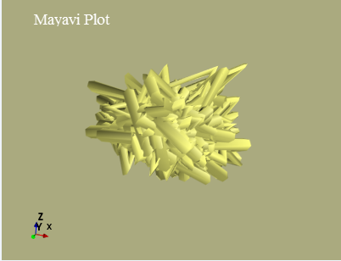
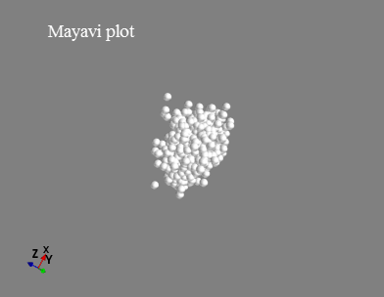
Problem 4: Finding the right plot :
4.4 Mayavi – Add Interactivity
Inspired by the cool visualization and interactivity of Mayavi, Rotating the 3D scatter plot was considered. We tried a few alternatives, but were not convinced that we had a plot that was a clear winner

Slide 18
Questions
Questions
Suggestions
Suggestions
Comments
Comments

