Slide 1
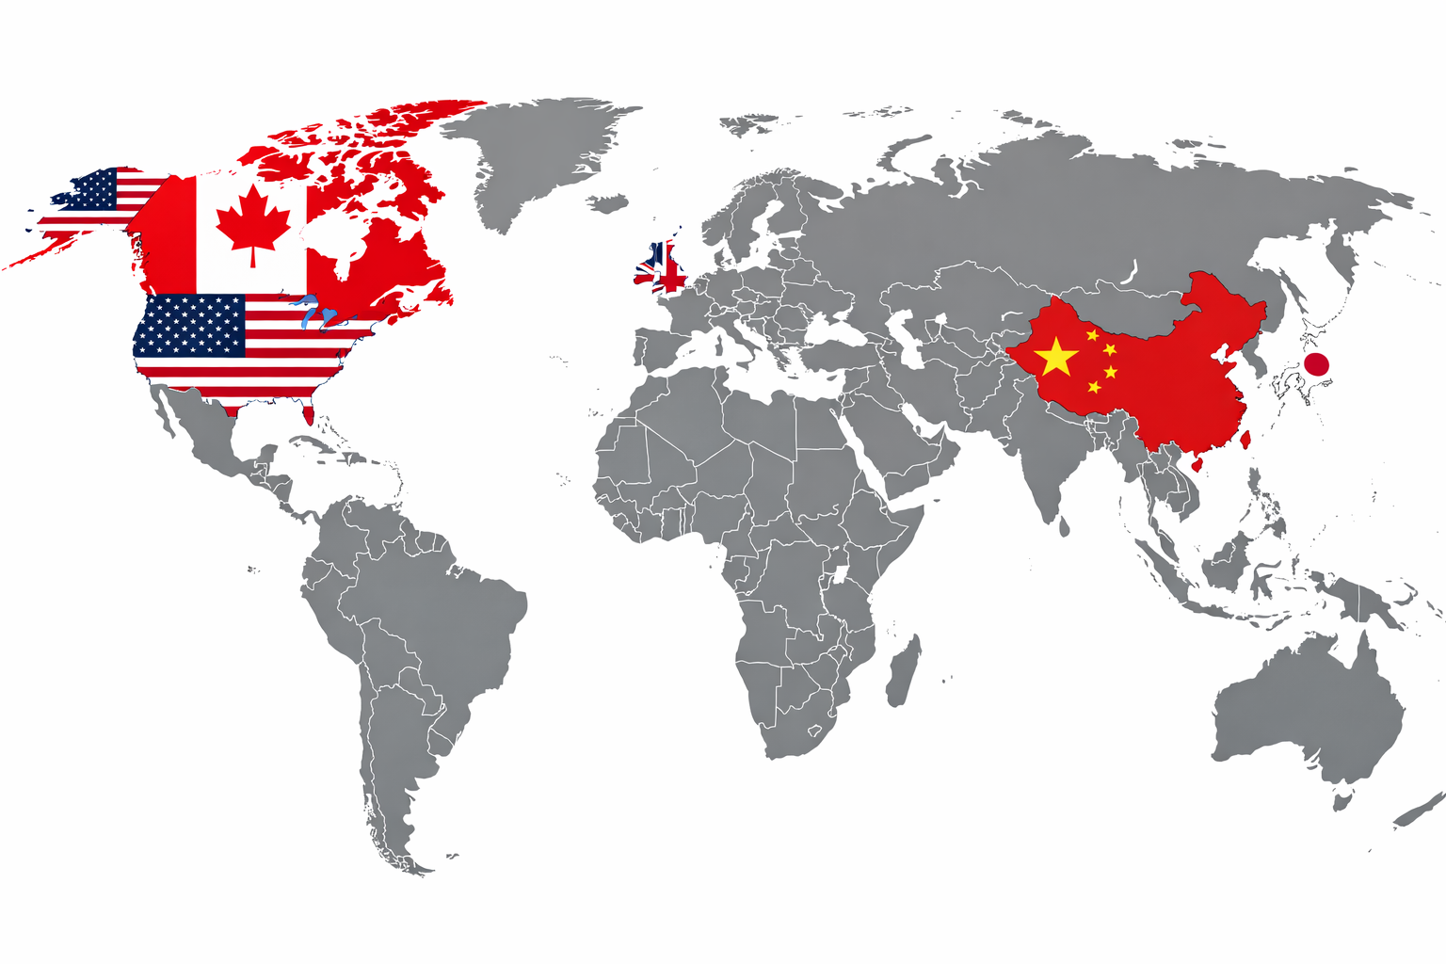
COMPARING CONSUMER OUT-OF-POCKET HEALTHCARE EXPENDITURES A Cross-National Dataset (2015–2022)
DSCI-511
Ari Voluck, Khushi Patel, Sharon Robinson & Thanh Huynh
Notes:
Our project is titled Comparing Consumer Out-of-Pocket Healthcare Expenditures: A Cross-National Dataset from 2015 to 2022.
In this project, we constructed a reproducible dataset that compares how much individuals pay out-of-pocket for healthcare in five countries: the United States, Canada, the United Kingdom, Japan, and China.
Rather than looking at total national healthcare spending, we focused specifically on household financial burden — what consumers directly pay themselves.

Slide 2
01
Team & Contributions
02
Introduction & Purpose of Dataset
03
Data Sources
04
Data Acquisition Approach
05
Data Preprocessing Approach
CONTENTS
06
Constructed Dataset
07
Distribution Approach
08
Discussion of Access Rights
09
Issues & Limitations
10
Potential Users & Applications
11
Conclusions

Slide 3
TEAM & CONTRIBUTIONS
ARI VOLUCK
KHUSHI PATEL
SHARON ROBINSON
THANH HUYNH
?
?
?
B.S. in Integrative Science
CURRENT PROGRAM
CURRENT PROGRAM
CURRENT PROGRAM
CURRENT PROGRAM
MS in AI & Machine Learning
MS in AI & Machine Learning
MS in Data Science
MS in Data Science
WORK EXPERIENCE
WORK EXPERIENCE
WORK EXPERIENCE
WORK EXPERIENCE
Quality & Compliance (URL Pharma)
LMS Associate (Sun Pharma)
LMS Administrator (GSK) Documentation Specialist (GSK)
Project Manager (Merck)
CURRENT SKILLS
CURRENT SKILLS
CURRENT SKILLS
CURRENT SKILLS
Python, Java, MS Office, financial services, business analysis, and project support
Python, Java, SQL, C, HTML/CSS, FastAPI, MS Office, LaTeX, MongoDB (database)
Beginner Python developer; EPIC EHR data analysis and auditing via system queries/slicing and Excel
Python, MS Office, project management, documentation/technical writing
CONTRIBUTIONS
CONTRIBUTIONS
CONTRIBUTIONS
CONTRIBUTIONS
Data verification
Visualization and interpretation
Presentation preparation
Data verification
Visualization and interpretation
Presentation preparation
Documentation write-up (README)
Presentation preparation
API implementation (WHO + OECD)
Data cleaning and harmonization
Dataset merging and validation
Presentation slide design
Presentation preparation

Slide 4





INTRODUCTION & PURPOSE of DATASET
i
Build a harmonized dataset of OOP spending per capita (PPP-adjusted)
Healthcare costs directly impact household finances and access to care. While public discussions often focus on government spending, individuals still bear significant costs through out-of-pocket payments. This project constructs a standardized cross-national dataset comparing consumer healthcare expenditures across the United States, Canada, the United Kingdom, Japan, and China to enable meaningful comparison of household financial burden.
Compare trends across five countries
Evaluate consistency between OECD and WHO reporting systems
Notes:
Healthcare spending is often discussed in terms of total national expenditure, but individuals experience costs through out-of-pocket payments.
Our project isolates this specific component to better understand household financial burden across different healthcare systems.
We had three main goals:
Build a harmonized dataset of out-of-pocket spending per capita, adjusted for purchasing power parity.
Compare trends across five countries from 2015 to 2022.
Evaluate consistency between OECD and WHO reporting systems.
Both datasets follow the SHA 2011 framework, which is an internationally standardized system for reporting health expenditures developed by the OECD, WHO, and Eurostat. Using this shared framework allows meaningful cross-country comparison.

Slide 5

DATA SOURCES
Indicator Used: Out-of-pocket expenditure per capita (PPP-adjusted, current international $)
WHO Global Health Expenditure Database (GHED)
(accessed via World Bank World Development Indicators API)
OECD Health Statistics
(System of Health Accounts 2011 — HF3: Household OOP)
Notes:
Our data came from two primary sources:
First, the WHO Global Health Expenditure Database, accessed programmatically through the World Bank API using indicator code SH.XPD.OOPC.PP.CD.
Second, OECD Health Statistics, accessed via the OECD SDMX API under SHA 2011 category HF3, which represents household out-of-pocket spending.
The key indicator we used was out-of-pocket expenditure per capita, adjusted for purchasing power parity in current international dollars.
Since both sources follow the same accounting framework, this enables systematic comparison.

Slide 6
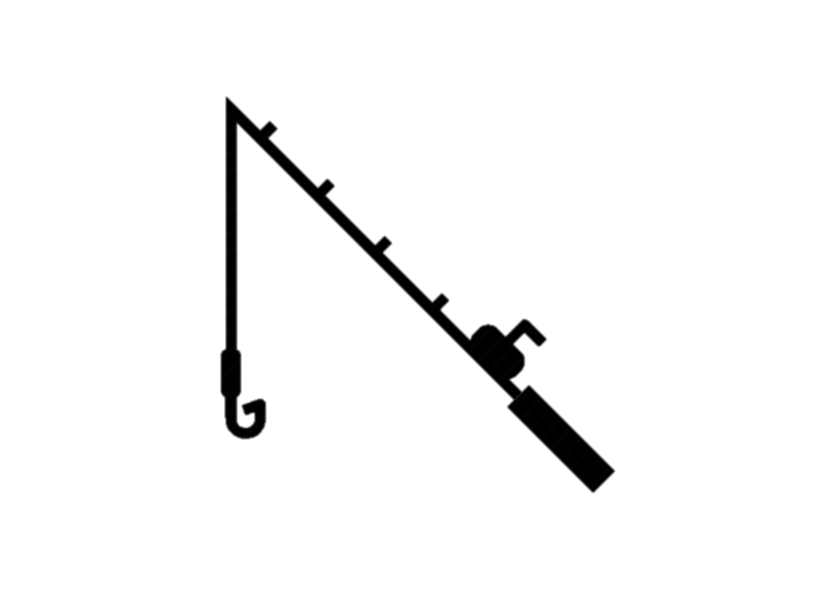







DATA ACQUISITION APPROACH
RETRIEVAL METHOD
PROCESSING ENVIRONMENT
Python
pandas
Jupyter Notebook
Automated API requests using Python
KEY FEATURES
Fully reproducible
No manual downloads
Structured programmatic workflow
CSV retrieval and parsing for OECD SDMX data
JSON parsing for WHO/World Bank data
Notes:
Data were collected using publicly available APIs in Python. Out-of-pocket health spending per capita (PPP-adjusted) was retrieved from the WHO Global Health Expenditure Database through the World Bank API. OECD data were collected using the OECD SDMX API under the SHA 2011 framework (HF3 category).
The data were cleaned and reshaped using pandas. We filtered the dataset to include only years 2015–2022 and standardized country codes to merge the datasets. We then calculated differences between OECD and WHO values to assess consistency.
Using APIs ensures the data collection process is transparent and reproducible.

Slide 7











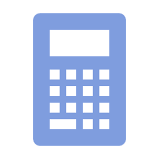
DATA PREPROCESSING APPROACH
Converted JSON and CSV responses to pandas DataFrames
Removed missing values
Standardized column names
Reshaped data (pivot/melt)
Converted country names to ISO alpha-3 codes
Merged datasets on country and year
ISO
Calculated:
Absolute differences
Percentage differences
Filtered years: 2015–2022
Note: All steps performed programmatically for reproducibility.
Notes:
After retrieving the data, we performed several preprocessing steps:
We converted JSON and CSV responses into pandas DataFrames. We standardized column names and country codes. We filtered the years to 2015 through 2022. We removed missing values and reshaped the data where necessary using pivot and melt functions.
Finally, we merged the datasets on country and year and calculated:
Absolute differences
Percentage differences
All of these steps were performed programmatically to ensure transparency and reproducibility.

Slide 8
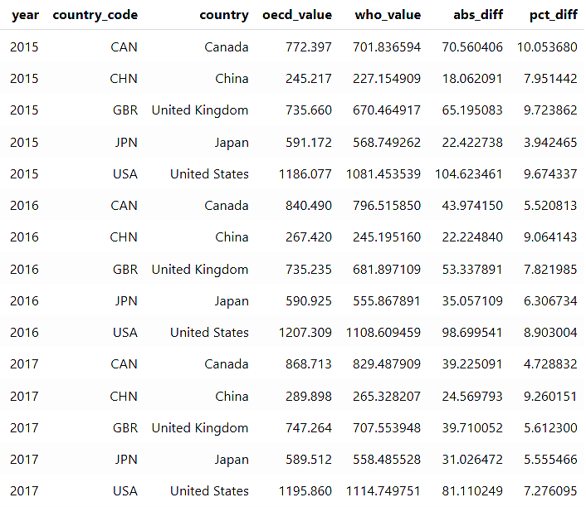
CONSTRUCTED DATASET
Structure of the Final Dataset
The cleaned master dataset contains:
Column | Description
country | Country name
country_code | ISO alpha-3 country code
year | Calendar year (2015–2022)
oecd_value | OECD reported OOP per capita (PPP)
who_value | WHO/World Bank reported OOP per capita (PPP)
abs_diff | Absolute difference between OECD and WHO
pct_diff | Percentage difference between OECD and WHO
Each row represents:
One country in one specific year.
Total observations:
5 countries × 8 years = 40 rows
Sample of the Final Dataset
Notes:
This slide summarizes the structure of our final constructed dataset.
The cleaned master dataset contains seven key columns.
First, we have the country name and the ISO alpha-3 country code, which standardizes country identification across both data sources.
Next, we include the calendar year, covering 2015 through 2022.
The core variables are the OECD-reported out-of-pocket expenditure per capita and the WHO/World Bank-reported value for the same indicator. Both are PPP-adjusted and expressed in current international dollars, which allows meaningful cross-country comparison.
To evaluate consistency between the two reporting systems, we calculated two additional variables:
The absolute difference between OECD and WHO values
The percentage difference between the two sources
Each row in the dataset represents one country in one specific year.
Since we analyze five countries across eight years, the total dataset contains 40 observations.
On the right side of the slide, you can see a sample of the final dataset. This preview illustrates how the values are structured and how the comparison metrics—absolute and percentage differences—allow us to directly assess cross-source consistency.
Overall, the dataset is fully harmonized, reproducible, and structured to support cross-national affordability analysis.

Slide 9




DISTRIBUTION APPROACH
Final outputs
Cleaned master dataset (CSV format)
Jupyter notebook with full workflow
All API calls scripted
Dataset easily extendable to additional countries or years
No manual intervention required
OECD vs WHO comparison dataset
Reproducibility
Notes:
The final outputs include:
A cleaned master dataset in CSV format
A comparison dataset showing OECD versus WHO values
A Jupyter notebook containing the full workflow
Because the API calls and preprocessing steps are fully scripted, anyone can rerun or extend this analysis.
The dataset is easily expandable to include additional countries or additional years.

Slide 10












DISCUSSION OF ACCESS RIGHTS
All data are publicly available
WHO GHED: Open global database
OECD Health Statistics: Public API access
Aggregated national statistics only
No personal or restricted data used
Notes:
All data used in this project are publicly available.
The WHO Global Health Expenditure Database is open access. OECD Health Statistics also provides public API access.
The data consist only of aggregated national statistics, meaning no individual-level or restricted data were used.
Therefore, there are no privacy or ethical concerns related to this dataset.

Slide 11


ISSUES & LIMITATIONS
Minor discrepancies between OECD and WHO values due to:
Revision timing
Update cycles
PPP adjustments may vary slightly across reporting systems
COVID-19 may distort short-term comparability
OOP excludes insurance premiums
Notes:
Although both OECD and WHO follow the SHA 2011 framework, we observed minor discrepancies between reported values.
These differences likely arise from:
Revision timing
Update cycles
Slight differences in PPP adjustment calculations
Additionally, the COVID-19 pandemic may distort short-term comparability across countries.
Finally, out-of-pocket spending does not include insurance premiums, meaning it may understate total consumer financial exposure in some systems.
Despite these limitations, the dataset provides a standardized and reproducible foundation for cross-national comparison.

Slide 12







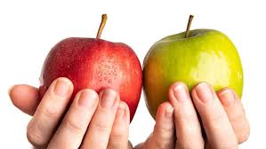

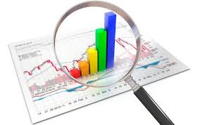
POTENTIAL USERS & APPLICATIONS
RESEARCHERS
Affordability studies
POLICY ANALYSTS
Policy comparison
STUDENTS
Economic research
JOURNALISTS
Public Health Analysis
Notes:
This dataset can support multiple types of users.
Researchers can use it for affordability studies. Policy analysts can compare healthcare systems across countries. Students can apply it in economic or public health research. Journalists and advocates can use it to communicate cost differences clearly.
Because the dataset is standardized and reproducible, it can easily be extended to other countries or future years.

Slide 13
CONCLUSIONS
The United States Has the Highest Out-of-Pocket Spending
Even after PPP adjustment, U.S. households bear a larger direct financial burden. This aligns with the U.S. healthcare system’s heavier reliance on private insurance and cost-sharing.
01
02
The UK and Japan Have the Lowest Household Burden
Both countries have strong public coverage systems. OOP spending represents a smaller portion of overall health financing.
03
Canada and China Sit in the Middle (But for Different Reasons)
Canada: Moderate OOP levels — universal coverage, but some services (e.g., dental, prescriptions outside hospital) require private payment. China: Rising OOP trend across years, reflecting healthcare reforms and system transition dynamics.
04
WHO and OECD Values Are Very Close
Both sources follow the SHA 2011 framework. Differences likely reflect: Update timing, Revision cycles, Rounding differences, PPP recalculations
The ranking order across years likely looks like:
USA > China ≈ Canada > UK ≈ Japan
COVID-19 Years (2020–2021) Show Irregular Patterns
Slower growth or slight distortions during 2020–2021. This likely reflects: Deferred care, Government interventions, Temporary cost-sharing changes
05
The Data Confirms Structural System Differences
This pattern reflects structural differences in: Insurance design, Cost-sharing policies, Public vs private financing balance
06
Notes:
Now I’ll briefly summarize what we can conclude from our constructed dataset.
First, across all years from 2015 to 2022, the United States consistently has the highest out-of-pocket healthcare spending per capita among the five countries we examined. Even after adjusting for purchasing power parity, U.S. households face a significantly higher direct financial burden compared to Canada, the United Kingdom, Japan, and China.
Second, the United Kingdom and Japan consistently show the lowest levels of out-of-pocket spending per capita. This reflects the structure of their healthcare systems, which rely more heavily on public financing and provide stronger financial protection for households.
Canada and China fall in the middle range, though for different structural reasons. Canada has universal coverage but still requires out-of-pocket spending for certain services like dental and outpatient prescriptions. China shows a noticeable upward trend over time, reflecting ongoing healthcare system reforms and changes in financing structure.
Another important finding is the strong alignment between OECD and WHO data. The absolute and percentage differences between the two sources are generally small. This suggests that both reporting systems, which follow the SHA 2011 framework, are highly consistent. Any small discrepancies are likely due to differences in update cycles, revision timing, or PPP recalculations rather than conceptual differences.
We also observe some irregularities during 2020 and 2021, likely related to the COVID-19 pandemic. Temporary reductions in elective care, government interventions, and shifts in utilization patterns may have affected short-term spending trends.
Overall, our dataset confirms substantial structural differences in how healthcare systems distribute financial responsibility to households. It demonstrates that even among high-income countries, the degree of direct financial burden varies significantly.
Most importantly, because our dataset is fully reproducible and harmonized, it provides a reliable foundation for future affordability analysis, policy comparison, and further research into household healthcare costs.

