Slide 1
Generative Adversarial Network
GAN is one of the most hottest topics in Deep learning now because of their highly useful and practical applications in real time and the power they have to almost learn anything.
It uses the 2 class of machine learning Models
Generative Models
Discriminative Models

Slide 2
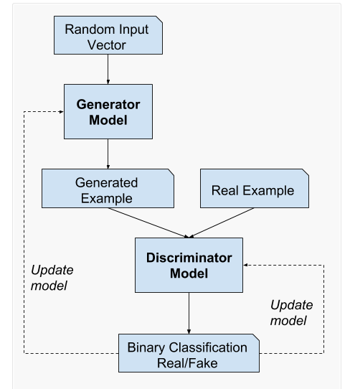
Generative Adversarial Network Model Architecture

Slide 3
How to train a Generative Model
To train a Generative Model we first collect lots of data of any domain(images , audio ,videos etc) and then feed the data to the model to generate data like it.

Slide 4
Steps
For example — we used a new-initialized network to generate 500 images, each time starting with a different random code.
The question is that: how should we adjust the network’s parameters to encourage it to produce slightly more believable(real looking) samples in the future?
One thing to take care is that we are actually doing unsupervised training on Generative Model,hence we don’t actually have the targets(outputs) corresponding to those 500 images , we merely want them to look real like training images.

Slide 5
Steps
One clever approach to use here is using GAN(Generative Adversarial Network) , i.e introducing another Discriminator Model which discriminates or classifies the images that we feed it to Real or Fake images. For a instance lets consider we can feed the Discriminator the Real image dataset and another set of Images generated from the Generator and use it as a standard classifier to discriminate or differentiate amongst the 2 types of images Real and Fake(generated images), and here’s the magic— we can also backpropagate through both the discriminator and the generator to find how we should change the generator’s parameters to make its 500 image samples slightly more confusing for the discriminator. And what actually happens by backpropogation is that the Generator and the Discriminator both are indulged in a battle of defeating each other in what they both are good at i.e The generator is trying to generate images and fool and confuse the Discriminator into believing that they are Real , and the discriminator tries distinguish the Real images from the Fake ones generated by the Generator.

Slide 6
Generative Adversarial Networks - The training process is a fight between two Models: a Generator Model and a second discriminator Model that tries to classify samples as either coming from the true distribution p(x) or the model distribution P(X) using conditional probabilities. Every time the discriminator notices a difference between the two distributions the generator adjusts its parameters slightly to make it go away and make the images much better and real looking , until at the end the generator exactly reproduces the true data distribution and the discriminator is guessing at random, unable to find a difference.

Slide 7
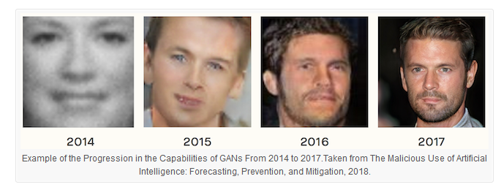

Slide 8
Links
https://towardsdatascience.com/generative-models-and-gans-fe7efc20020b
https://machinelearningmastery.com/generative_adversarial_networks/

