Slide 1
Principal Component Analysis (PCA)

Slide 2
Introduction
Principal component analysis (PCA) is a standard tool in modern data analysis - in diverse fields from neuroscience to computer graphics.
It is very useful method for extracting relevant information from confusing data sets.

Slide 3
Definition
Principal component analysis (PCA) is a statistical procedure that uses an orthogonal transformation to convert a set of observations of possibly correlated variables into a set of values of linearly uncorrelated variables called principal components.
The number of principal components is less than or equal to the number of original variables.

Slide 4
Goals
The main goal of a PCA analysis is to identify patterns in data
PCA aims to detect the correlation between variables.
It attempts to reduce the dimensionality.

Slide 5
Dimensionality Reduction
It reduces the dimensions of a d-dimensional dataset by projecting it onto a (k)-dimensional subspace (where k<d) in order to increase the computational efficiency while retaining most of the information.

Slide 6
Transformation
This transformation is defined in such a way that the first principal component has the largest possible variance and each succeeding component in turn has the next highest possible variance.

Slide 7
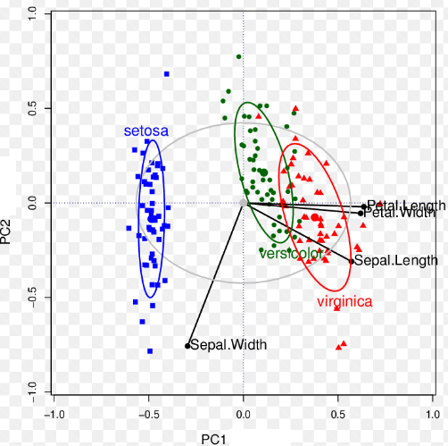
PCA Example

Slide 8
PCA Approach
Standardize the data.
Compute the Eigenvectors and Eigenvalues.
Sort eigenvalues in descending order and choose the k- eigenvectors
Construct the projection matrix from the selected k- eigenvectors.
Transform the original dataset via projection matrix to obtain a k-dimensional feature subspace.

Slide 9
Limitation of PCA
The results of PCA depend on the scaling of the variables.
A scale-invariant form of PCA has been developed.

Slide 10
Linear Discriminant Analysis (LDA)

Slide 11
Introduction
Linear Discriminant Analysis (LDA) is used to solve dimensionality reduction for data with higher attributes
Pre-processing step for pattern-classification and machine learning applications.
Used for feature extraction.
Linear transformation that maximize the separation between multiple classes.
“Supervised” - Prediction agent

Slide 12
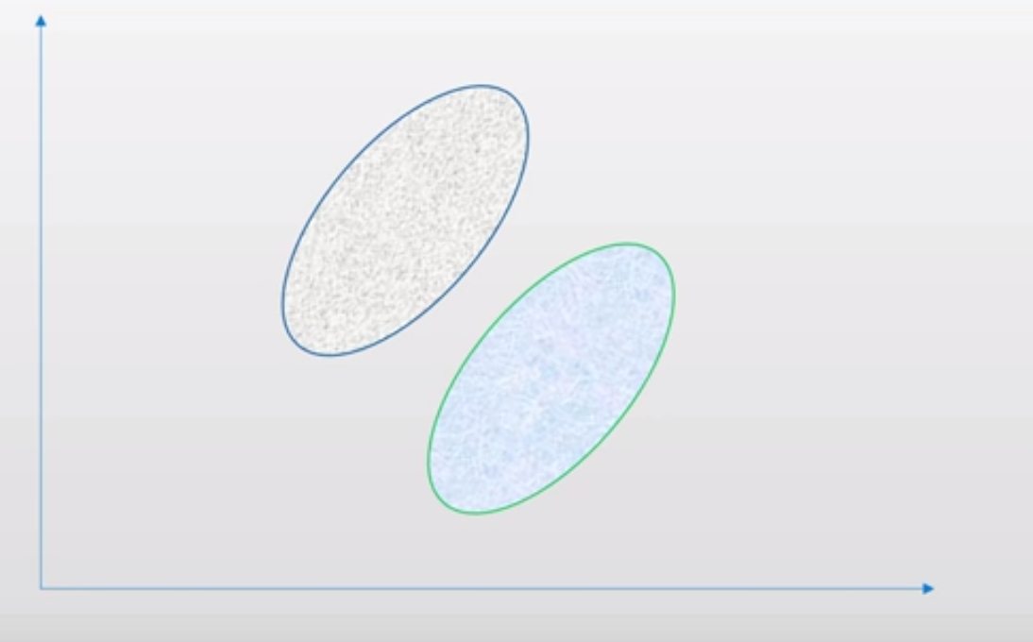

Slide 13
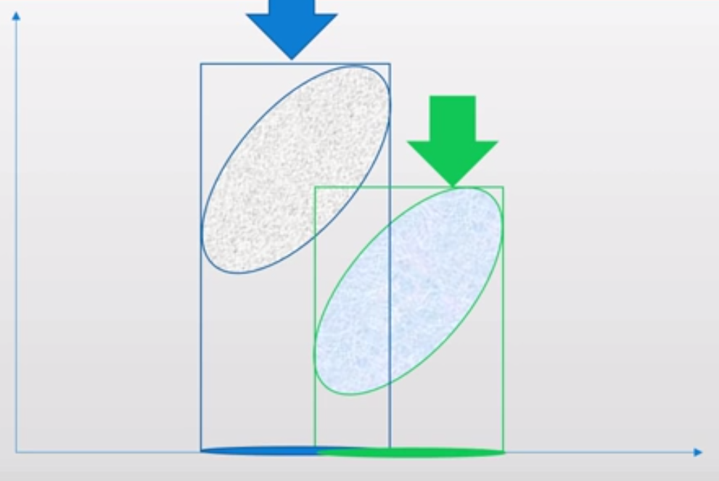

Slide 14
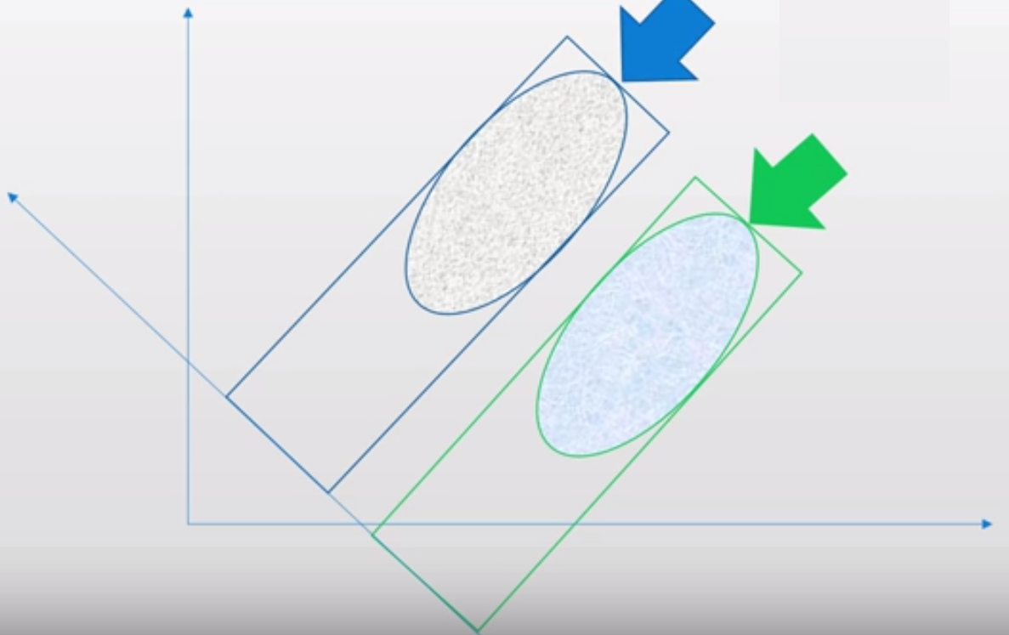

Slide 15
LDA steps:
Compute the d-dimensional mean vectors.
Compute the scatter matrices
Compute the eigenvectors and corresponding eigenvalues for the scatter matrices.
Sort the eigenvalues and choose those with the largest eigenvalues to form a d×k dimensional matrix
Transform the samples onto the new subspace.

Slide 16
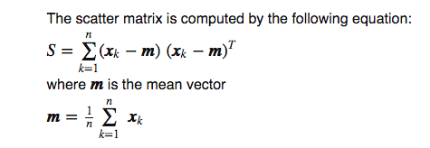
Scatter Matrix:

Slide 17
Feature Subspace :
To reduce the dimensions of a d-dimensional data set by projecting it onto a (k)-dimensional subspace
(where k < d)
Feature space data is well represented?
Compute eigen vectors from dataset
Collect them in scatter matrix
Generate k-dimensional data from d-dimensional dataset.

