Slide 1
Clustering

Slide 2
What is Clustering?
Attach label to each observation or data points in a set
Can be called as unsupervised classification
We want to assign same label to the data points that are “close” to each other
After clustering, the elements in a single cluster should be similar and elements in different clusters should differ in their behavior.
Maximize inter cluster distance
Minimize intra cluster distance
Clustering algorithms rely on a distance metric between data points

Slide 3
Applications -Examples
Grouping the shirt sizes to small , medium and large
Segment customers according to their interests
Given a set of text documents , we can group them based on their content similarities, to produce a topic hierarchy
News item clustering by google
Application in medicine, psychology, botony, sociology, archeology, marketing, insurance etc.

Slide 4
Types of clustering:
Hierarchical algorithms: these find successive clusters
using previously established clusters.
1. Agglomerative ("bottom-up"): Agglomerative algorithms begin with each element as a separate cluster and merge them into successively larger clusters.
2. Divisive ("top-down"): Divisive algorithms begin with the whole set and proceed to divide it into successively smaller clusters.
2. Partitional clustering: Partitional algorithms determine all clusters at once. They include:
K-means and derivatives
Fuzzy c-means clustering
QT clustering algorithm

Slide 5
K-means Overview
An unsupervised clustering algorithm
“K” stands for number of clusters - It is typically a user input to the algorithm; some criteria can be used to automatically estimate K
K-means algorithm is iterative in nature
It converges after many steps.
Works only for numerical data
Easy to implement

Slide 6
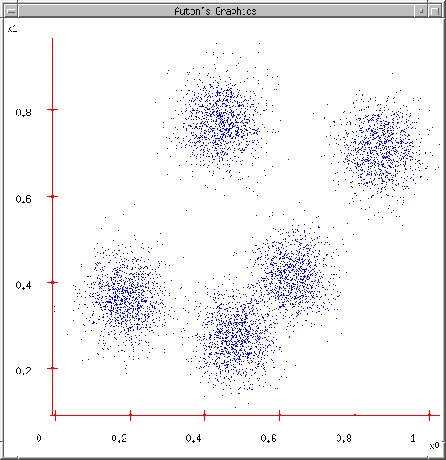
K-means
Ask user how many clusters they’d like. (e.g. k=5)

Slide 7
K-means
Ask user how many clusters they’d like. (e.g. k=5)
Randomly guess k cluster Center locations

Slide 8
K-means
Ask user how many clusters they’d like. (e.g. k=5)
Randomly guess k cluster Center locations
Each datapoint finds out which Center it’s closest to. (Thus each Center “owns” a set of datapoints)

Slide 9
K-means
Ask user how many clusters they’d like. (e.g. k=5)
Randomly guess k cluster Center locations
Each datapoint finds out which Center it’s closest to.
Each Center finds the centroid of the points it owns

Slide 10
K-means
Ask user how many clusters they’d like. (e.g. k=5)
Randomly guess k cluster Center locations
Each datapoint finds out which Center it’s closest to.
Each Center finds the centroid of the points it owns…
…and jumps there
…Repeat until terminated!

Slide 11
K Means Steps
Step 1: Begin with a decision on the value of k = number of clusters .
Step 2: Put any initial partition that classifies the data into k clusters. You may assign the training samples randomly,or systematically as the following:
1.Take the first k training sample as single-element clusters
2. Assign each of the remaining (N-k) training sample to the cluster with the nearest centroid. After each assignment, recompute the centroid of the gaining cluster.

Slide 12
Step 3: Take each sample in sequence and compute its distance from the centroid of each of the clusters. If a sample is not currently in the cluster with the closest centroid, switch this sample to that cluster and update the centroid of the cluster gaining the new sample and the cluster losing the sample.
Step 4 . Repeat step 3 until convergence is achieved, that is until a pass through the training sample causes no new assignments.

Slide 13
A Simple example showing the implementation of k-means algorithm (using K=2)

Slide 14
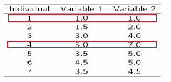
Step 1:
Initialization: Randomly we choose following two centroids (k=2) for two clusters.
In this case the 2 centroid are: m1=(1.0,1.0) and m2=(5.0,7.0).

Slide 15



Step 2:
Thus, we obtain two clusters containing:
{1,2,3} and {4,5,6,7}.
Their new centroids are:

Slide 16
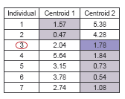
Step 3:
Now using these centroids we compute the Euclidean distance of each object, as shown in table.
Therefore, the new clusters are:
{1,2} and {3,4,5,6,7}
Next centroids are: m1=(1.25,1.5) and m2 = (3.9,5.1)

Slide 17
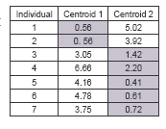
Step 4 :
The clusters obtained are:
{1,2} and {3,4,5,6,7}
Therefore, there is no change in the cluster.
Thus, the algorithm comes to a halt here and final result consist of 2 clusters {1,2} and {3,4,5,6,7}.

Slide 18
Example Link
http://mnemstudio.org/clustering-k-means-example-1.htm

Slide 19
Common uses of K-means
Often used as an exploratory data analysis tool
In one-dimension, a good way to quantize real-valued variables into k non-uniform buckets
Used on acoustic data in speech understanding to convert waveforms into one of k categories (known as Vector Quantization)

Slide 20
Pros – (Strengths of K Means)
Simple
Efficient :Time complexity O(tkn)
t – the number of iterations
k – no of clusters
n – number of data points

Slide 21
Cons
The algorithm is applicable only if the mean is defined
The user needs to specify k
The algorithm is sensitive to outliers
The algorithm is sensitive to initial seeds
Non globular shaped clusters are difficult to identify

Slide 22
