Slide 1
Linear Regression

Slide 2
Print slope , intercept & line

Slide 3
Linear regression
In linear regression, the equation that describes the factor-response relationships is Y=mX+C where Y and X are vectors that describe the response variable and the factor variable respectively.

Slide 4
Multiple regression
In a multiple regression case, we’re interested in the impact of not only one, but many different factors, on the response variable.
The equation can be written as Y=m₁X₁+m₂X₂+C where m1 and m2 are the coefficients of factors X1 and X2 respectively.

Slide 5
Polynomial Regression
For polynomial regression, we might use higher powers of X to describe Y, as described in
Y=m₁X+m₂ X²+C
where m1 and m2 are coefficients of the first and second powers of the factor.

Slide 6
Logistic regression
Logistic regression is a statistical method for analysing a dataset in which there are one or more independent variables that determine an outcome.
The outcome is measured with a variable in which there are only two possible outcomes. It is used to predict a binary outcome (1 / 0, Yes / No, True / False) given a set of independent variables.

Slide 7
Applications
Spam Detection : Predicting if an email is Spam or not
Credit Card Fraud : Predicting if a given credit card transaction is fraud or not
Health : Predicting if a given mass of tissue is benign or malignant
Marketing : Predicting if a given user will buy an insurance product or not
Banking : Predicting if a customer will default on a loan

Slide 8
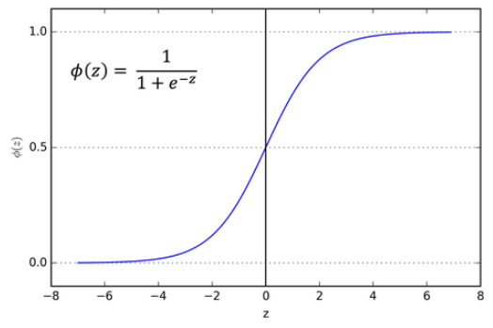
sigmoid/logistic function
In logistic regression, the goal is to determine a mathematical equation that can be used to predict the probability of event
The sigmoid/logistic function is given by the following equation.

Slide 9
Metrics for Performance Evaluation
Focus on the predictive capability of a model
Rather than how fast it takes to classify or build models, scalability, etc.
Confusion Matrix:
 | PREDICTED CLASS
ACTUAL CLASS |  | Class=Yes | Class=No
 | Class=Yes | a | b
 | Class=No | c | d
a: TP (true positive)
b: FN (false negative)
c: FP (false positive)
d: TN (true negative)
*
Data Mining: Concepts and Techniques
9

Slide 10
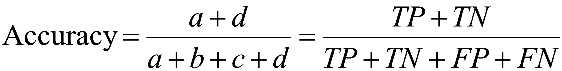
Metrics for Performance Evaluation…
 | PREDICTED CLASS
ACTUAL CLASS |  | Class=Yes | Class=No
 | Class=Yes | a (TP) | b (FN)
 | Class=No | c (FP) | d (TN)
Most widely-used metric:
*
Data Mining: Concepts and Techniques
10

Slide 11
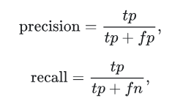
Metrics for Performance Evaluation…
 | PREDICTED CLASS
ACTUAL CLASS |  | Class=Yes | Class=No
 | Class=Yes | a (TP) | b (FN)
 | Class=No | c (FP) | d (TN)
*
11

Slide 12
Precision and Recall
Precision is the fraction of information retrieved that are relevant.
Recall is the fraction of relevant information that are retrieved.
 | PREDICTED CLASS
ACTUAL CLASS |  | Class=Yes | Class=No
 | Class=Yes | a (TP) | b (FN)
 | Class=No | c (FP) | d (TN)

Slide 13

F1 Score
Harmonic mean of precision and recall

