Slide 1
Ensemble methods (Decision by Committee)

Slide 2
Ensemble Methods
Use multiple models to obtain better predictive performance
Combine multiple learners to produce a strong learner
Includes much more computation, since you are training multiple learners
Typically combine multiple fast learners (like decision trees)
Tend to overfit
Tend to get better results since there is deliberately introduced significant diversity among models

Slide 3
Motivation for Ensemble Learning
No Free Lunch theorem: There is no algorithm that is always the most accurate
Generate a group of base-learners which when combined have higher accuracy
Different learners use different
Algorithms
Parameters
Representations
Training sets
Etc.

Slide 4
Bagging (Bootstrap aggregating)
Take M bootstrap samples (with replacement)
Train M different classifiers on these bootstrap samples
For a new query, let all classifiers predict and take an average (or majority vote)
If the classifiers make independent errors, then their ensemble can improve performance.
Stated differently: the variance in the prediction is reduced (we don’t suffer from the random errors that a single classifier is bound to make).

Slide 5
Boosting
Train classifiers (e.g. decision trees) in a sequence.
A new classifier should focus on those cases which were incorrectly classified in the last round.
Combine the classifiers by letting them vote on the final prediction (like bagging).
Each classifier is “weak” but the ensemble is “strong.”
AdaBoost is a specific boosting method.

Slide 6
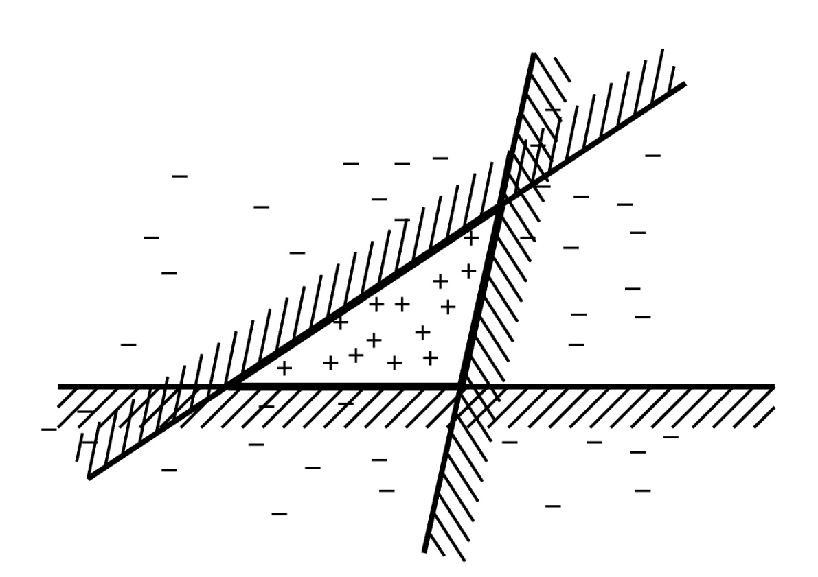
Example
This line is one simple classifier saying that
everything to the left + and everything to the right
is -

Slide 7
Boosting Intuition
We adaptively weigh each data case.
Data cases which are wrongly classified get high weight (the algorithm will focus on them)
Each boosting round learns a new (simple) classifier on the weighed dataset.
These classifiers are weighed to combine them into a single powerful classifier.
Classifiers that that obtain low training error rate have high weight.
We stop by using monitoring a hold out set (cross-validation).

Slide 8
Bagging: Bootstrap aggregating
Each model in the ensemble votes with equal weight
Train each model with a random training set

Slide 9
Boosting
Incremental
Build new models that try to do better on previous model's mis-classifications
Can get better accuracy
Tends to overfit
Adaboost is canonical boosting algorithm

Slide 10
Random Forest
Ensemble consisting of a bagging of un-pruned
decision tree learners with a randomized selection of
features at each split.
Grow many trees on datasets sampled from the original dataset with replacement (a bootstrap sample).
Draw K bootstrap samples of a fixed size
Grow a DT, randomly sampling a few attributes/dimensions to split on at each internal node
Average the predictions of the trees for a new query (or take majority vote)
Random Forests are state of the art classifiers!

Slide 11
Random forest
Random forest (or random forests) is an ensemble classifier that consists of many decision trees and outputs the class that is the mode of the class's output by individual trees.
The term came from random decision forests that was first proposed by Tin Kam Ho of Bell Labs in 1995.
The method combines Breiman's "bagging" idea and the random selection of features.

Slide 12
Decision trees
Decision trees are individual learners that are combined. They are one of the most popular learning methods commonly used for data exploration.
One type of decision tree is called CART… classification and regression tree.
CART … greedy, top-down binary, recursive partitioning, that divides feature space into sets of disjoint rectangular regions.
Regions should be pure wrt response variable
Simple model is fit in each region – majority vote for classification, constant value for regression.

Slide 13
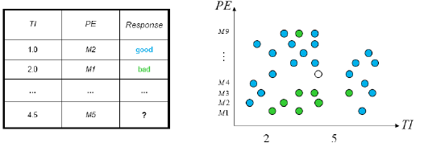
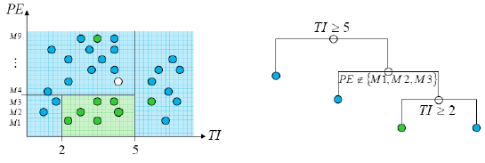
Decision tress involve greedy, recursive partitioning.
Simple dataset with two predictors
Greedy, recursive partitioning along TI and PE

Slide 14
Features and Advantages
The advantages of random forest are:
It is one of the most accurate learning algorithms available. For many data sets, it produces a highly accurate classifier.
It runs efficiently on large databases.
It can handle thousands of input variables without variable deletion.
It has an effective method for estimating missing data and maintains accuracy when a large proportion of the data are missing.
It has methods for balancing error in class population unbalanced data sets.
Generated forests can be saved for future use on other data.

