Slide 1
Support Vector Machine

Slide 2
Linear Classifiers
x
f
y
denotes +1
denotes -1
w x + b>0
w x + b=0
How would you classify this data?
w x + b<0

Slide 3
Linear Classifiers
x
f
y
denotes +1
denotes -1
How would you classify this data?

Slide 4
Linear Classifiers
denotes +1
denotes -1
How would you classify this data?

Slide 5
Linear Classifiers
f(x,w,b) = sign(w x + b)
denotes +1
denotes -1
Any of these would be fine..
..but which is best?

Slide 6
Linear Classifiers
f(x,w,b) = sign(w x + b)
denotes +1
denotes -1
How would you classify this data?
Misclassified
to +1 class

Slide 7
Classifier Margin
Classifier Margin
f(x,w,b) = sign(w x + b)
f(x,w,b) = sign(w x + b)
denotes +1
denotes -1
denotes +1
denotes -1
Define the margin of a linear classifier as the width that the boundary could be increased by before hitting a datapoint.
Define the margin of a linear classifier as the width that the boundary could be increased by before hitting a datapoint.

Slide 8
Margin and Optimal HyperPlane
Margin of Separation (d)
  The separation between the hyperplane and the closest data point for a given vector
Optimal Hyperplane
  The particular hyperplane for which the margin of separation d is maximized

Slide 9
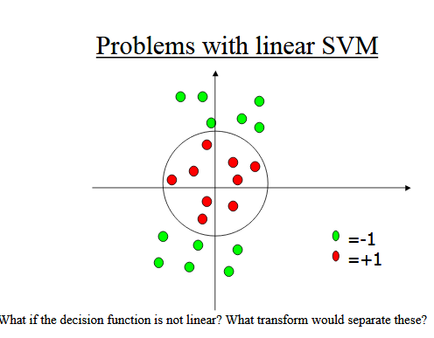

Slide 10
Kernels
Sec. 15.2.3
General idea: the original feature space can always be mapped to some higher-dimensional feature space where the training set is separable:
Φ: x → φ(x)

Slide 11
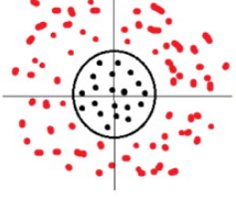
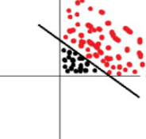
Kernels

Slide 12
Doing multi-class classification in SVM
SVMs can only handle two-class outputs (i.e. a categorical output variable with arity 2).
What can be done?
Answer: with output arity N, learn N SVM’s
  SVM 1 learns “Output==1” vs “Output != 1”
  SVM 2 learns “Output==2” vs “Output != 2”
  :
  SVM N learns “Output==N” vs “Output != N”
Then to predict the output for a new input, just predict with each SVM and find out which one puts the prediction the furthest into the positive region.

Slide 13
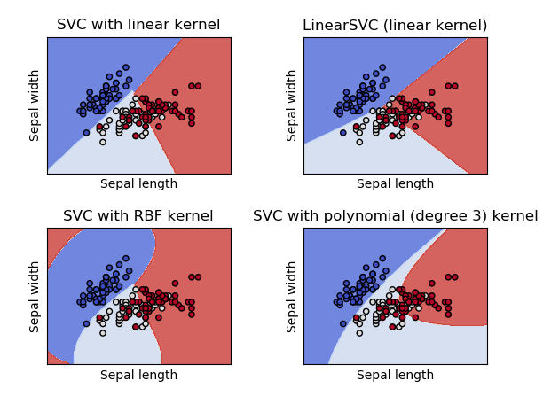
Different Kernel Functions of IRIS dataset

Slide 14
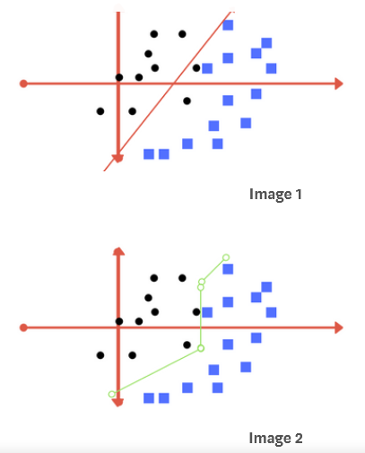
What if data plot overlaps? Which line we draw

Slide 15
regularization parameter
we define two terms regularization parameter and gamma. These are tuning parameters in SVM classifier. Varying those we can achieve considerable non linear classification

Slide 16
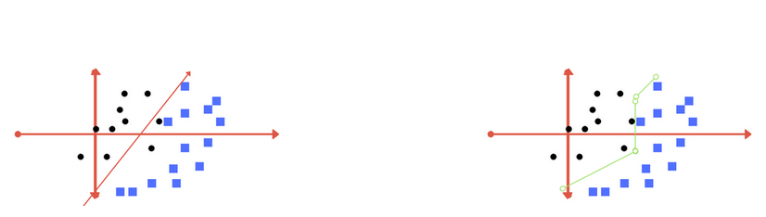
Regularization
The Regularization parameter (often termed as C parameter in python’s sklearn library) tells the SVM optimization how much you want to avoid misclassifying each training example.

Slide 17
Gamma
The gamma parameter defines how far the influence of a single training example reaches
With low values meaning ‘far’ and high values meaning ‘close’.
With low gamma, points far away from separation line are considered in calculation for the separation line. Where as high gamma means the points close to the separation line are considered in calculation.

Slide 18
