Slide 1

Introduction to R

Slide 2
Outline
What is R?
Why R?
Obtaining R
R Environment
Basics of R

Slide 3
What is R?
Software for Statistical Data Analysis
Interpreted Language
Data Storage, Analysis, Graphing
Free and Open Source Software
History -In 1991, R was created by Ross Ihaka and Robert Gentleman

Slide 4
Why R?
It's free!
It runs on a variety of platforms including Windows, Unix and MacOS.
It provides an unparalleled platform for programming new statistical methods in an easy and straightforward manner.
It contains advanced statistical routines not yet available in other packages.
It has state-of-the-art graphics capabilities.
Other statistical languages - (SAS, SPSS)

Slide 5
Obtaining R
Where can I find the latest version?
Go to any CRAN(Comprehensive R Archive Network) site (see https://cran.r-project.org/mirrors.html for a list)

Slide 6
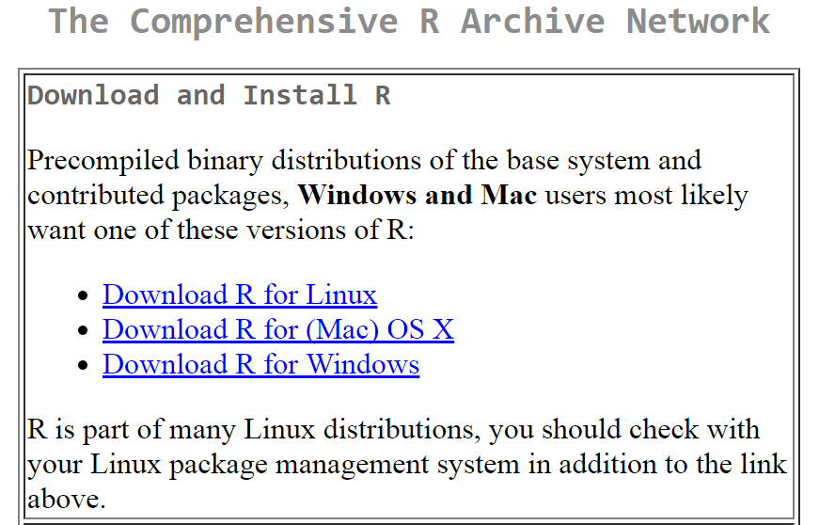
Obtaining R

Slide 7
R Environment
Unlike other languages, R is very interactive.
Results can be seen one command at a time.
The state of the objects and results can be seen at any point in R
R has a command Line interface
Commands can be repeated, edited and repeated on a new set of data very easily.
Text editors can also be used to keep the programs and data.
Rstudio is an IDE to handle R Projects easily.

Slide 8
R Language
R code
R Variables
R Naming Conventions
Assignment Operators
DataTypes
numeric
character
date
logical
complex

Slide 9
R Data structures
Vectors
Lists
Matrices
Arrays
Factors
Data Frames

Slide 10
RCode
> myStr<- "Hello, World!“
> print ( myStr)
[1] "Hello, World!"

Slide 11
R code
> 2+2
[1] 4
> 2+2^2
[1] 6
> (2+2)^2
[1] 16

Slide 12
R code
> sqrt(2)
[1] 1.414214
> log(2)
[1] 0.6931472
> x = 5
> y = 10
> z <- x+y
> z
[1] 15

Slide 13
R Variables
R Does not want variable types to be declared
The variables are assigned with R-Objects and the data type of the R-object becomes the data type of the variable.
A variable can take on any available datatype
An R variable can hold any R object such as function, data analysis result, plot etc.
A single variable can hold a number at a time, character at a later time and a number again later.

Slide 14
Variable Naming Conventions
must start with a letter (A-Z or a-z)
can contain letters, digits (0-9), and/or periods “.”
case-sensitive
mydata different from MyData
Can not start with underscore “_” or number

Slide 15
Check the validity of the variables
var_name2
var_name%
var.name
2var_name
_var_name

Slide 16
Check the validity of the variables
var_name2 (v)
var_name% (i)
var_name (v)
2var_name (i)
_var_name (i)

Slide 17
Assignment
“<-” used to indicate assignment
x<-2
x<-c(1,2,3,4,5,6,7)
x<-c(1:7)
x<-1:4
The other methods used for assignment are
x=2
x<<-2
assign(“x”,2)

Slide 18
Removing variables
>rm(j)

Slide 19
Data Types
There are many types, the 5 basic types are
Numeric
Character
Date
Logical
Complex

Slide 20
Data Types
>x<-2
>class(x)
[1] “numeric”
is.numeric(x)
[1] TRUE

Slide 21
Numeric Data
>i<-5L
i
[1] 5
>is.integer(i)
[1] TRUE
>is.numeric(i)
[1] TRUE

Slide 22
R promotes an integer to numeric when needed.
>class(4L)
[1] “integer”
>class(2.8)
[1] “numeric”
>4L*2.8
[1] 11.2
>Class(4L*2.8)
[1] ”numeric”
>class(5L)
[1] “integer”
>class(2L)
[1] “integer”
>5L/2L
[1] 2.5
>Class(5L/2L)
[1] ”numeric”

Slide 23
Character Data
A character object is used to represent string values in R. We convert objects into character values with the as.character() function
>x<-”data”
>x
[1] “data”
> x = as.character(3.14)
> x
[1] "3.14"
>class(x)
[1] "character"

Slide 24
paste, substr, sub Functions
> fname = "Joe"; lname ="Smith"
> paste(fname, lname)
[1] "Joe Smith“
> substr("Mary has a little lamb.", start=6, stop=8) [1] “has“
> sub("little", "big", "Mary has a little lamb.") [1] "Mary has a big lamb."

Slide 25
nchar Function
To get the length of a character (or numeric) use the nchar function
>nchar(“hello”)
[1] 5
nchar(3)
[1] 1
>nchar(452)
[1] 3

Slide 26
Dates
Date and POSIXct types are used for date and time storage. Both are actually represented as number of days or seconds since 1 Jan 1970.
>date1 <-as.Date(“2016-12-28”)
>date1
[1] “2016-12-28”
>class (date1)
[1] “Date”
>as.numeric(date1)
15519

Slide 27
POSIXct dates
>date2=as.POSIXct(“2016-03-31 17:52”)
>date2
[1] "2016-03-31 17:52:00 IST"
>class(date2)
[1] “POSIXct” “POSIXt”
as.numeric(date2)
[1] 1340919720
class(date1)
[1] “Date”
class(date2)
[1] “numeric”

Slide 28
Logical
Logicals are a way of representing data that can be either TRUE or FALSE. Numerically TRUE=1 and FALSE=0
>TRUE * 5
[1] 5
>FALSE * 5
[1] 0
Logical testing is done with is.logical function.
>k<-TRUE
>is.logical(k)
[1]TRUE

Slide 29
Logical contd.
R provides T & F as short cuts for TRUE and FALSE, respectively.
>TRUE
[1]TRUE
>T
[1] TRUE
>class(T)
[1] “logical”
T<-7
T
[1] 7
>Class(T)
“numeric”
So it is good, not to use them because they are simply variable storing TRUE and FALSE and can be overwritten.

Slide 30
Logical contd.
Logical can result from comparing two numbers or characters
># does 2 not equal 3
>2!=3
[1] TRUE
>2<3
[1] FALSE
>2>3
[1]FALSE
>“data”==“stats”
[1]FALSE
>”data”<“stats”
[1] TRUE

Slide 31
Complex
>v <- 2+5i
>class(v)
[1] “complex”

Slide 32
Missing Data
In R, missing values are represented by the symbol NA (not available) .
NULL is the absence of anything
d<-NULL
Is.null(d)
[1] TRUE
Testing for Missing Values
is.na(x) # returns TRUE if x is missing
y <- c(1,2,3,NA)
is.na(y) # returns a vector (F F F T)

Slide 33
Operators
Command | Description
Arithmetic operators
+,-,*,/ | add, subtract, multiply, divide
^ | raise to the power of
%% | remainder after division (ex: 8 %% 3 = 2)
%/% | division result (quotient) v <- c( 2,5.5,6) t <- c(8, 3, 4) print(v%/%t) [1] 0 1 1
Relational Operators
<, > , <=, >=, ==, !=, | v <- c(2,5.5,6,9) t <- c(8,2.5,14,9) print(v>=t) Result [1] FALSE TRUE FALSE TRUE

Slide 34
Operators
Command | Description
Logical Operators
& | Element-wise Logical AND operator. | v <- c(3,1,TRUE) t <- c(4,1,FALSE) print(v&t) [1] TRUE TRUE FALSE TRUE
| | Element-wise Logical OR operator.
! | It is called Logical NOT operator. | v <- c(3,0,TRUE) print(!v) [1] FALSE TRUE FALSE FALSE
&& | Called Logical AND operator. Takes first element of both the vectors and gives the TRUE only if both are TRUE. | v <- c(3,0,TRUE) t <- c(1,3,TRUE) print(v&&t) [1] TRUE
|| | Called Logical OR operator. Takes first element of both the vectors and gives the TRUE only if both are TRUE. | v <- c(0,0,TRUE) t <- c(0,3,TRUE) print(v||t) S[1] FALSE

Slide 35
Boolean operators (And & OR)
Operators
(5 > 7) & (6*7 == 42)
[1] FALSE
(5 > 7) | (6*7 == 42)
[1] TRUE

Slide 36
Numeric Functions
Function | Description
abs(x) | absolute value
sqrt(x) | square root
ceiling(x) | ceiling(3.475) is 4
floor(x) | floor(3.475) is 3
trunc(x) | trunc(5.99) is 5
round(x, digits=n) | round(3.475, digits=2) is 3.48
log(x) | natural logarithm
log10(x) | common logarithm
exp(x) | e^x

Slide 37
More Functions
is.-----() functions return Booleans for whether the argument is of specified type
as.-----() (tries to) “cast” its argument to the specified type to translate it sensibly into that type.

