Slide 1
Using the quantile() Command
>dat
[1] 1 2 3 4 5 6
> quantile(dat)
0% 25% 50% 75% 100%
1.00 2.25 3.50 4.75 6.00
Quantiles are cut points deviding the range of numbers

Slide 2
Using the quantile() Command
data2<-c(1, 5, 7 ,5, 3, 2, 6, 8, 5, 6)
quantile(data2, 0.3)
30%
4.4
>quantile(data2, c(0.2, 0.5, 0.8))
20% 50% 80%
2.8 5.0 6.2

Slide 3
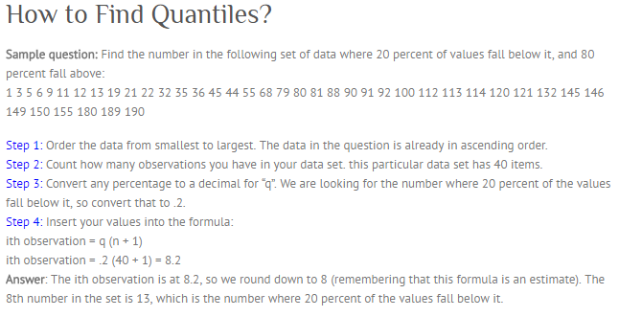

Slide 4
More Cumulative Commands
The seq() : generate sequences of values using from, to and interval
> seq(from = 1, to = 10, by = 2)
[1] 1 3 5 7 9
The following produces the same result:
> seq(1, 10, 2)
If you use the ‘along =‘ instruction you can create an index for a vector:
> seq(along = data2)
[1] 1 2 3 4 5 6 7 8 9 10 11 12 13 14 15 16
Running mean
cumsum(data2) / seq(along = data2)

