Slide 1

FALCON LABS
By Srinivas Rahul Sapireddy

Slide 2

Motivation and Significance
Don’t have to worry about having high-configuration systems or laptops.
Do coding on the web with minimum RAM and hard disk.

Slide 3
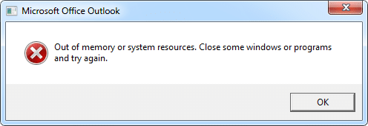
Focus
Helping customers decide which technology they want to use irrespective of the system configuration they have.

Slide 4

Use cases
Able to do coding on the web without the configuration overhead.
Customers/students can create an entire app without installing the required Software and can be able to deploy them with fewer issues.
Customers/student data is saved in the account itself.

Slide 5

FALCON Application(Software as a Service)
I emerged with this idea when I realized many students needed more high-end laptops to test and run their software applications. This makes it difficult for students to run applications that require high memory or high GPU, as this could be costlier on their systems.

Slide 6


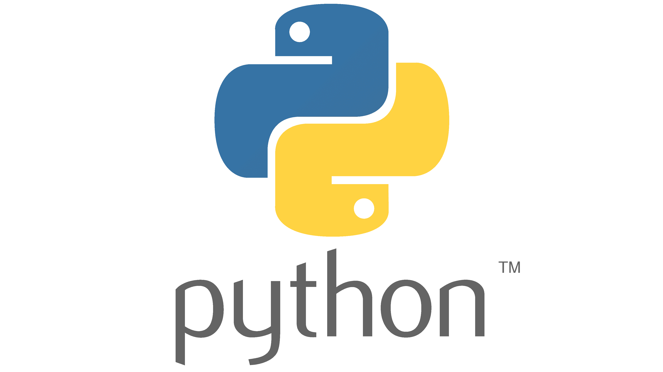

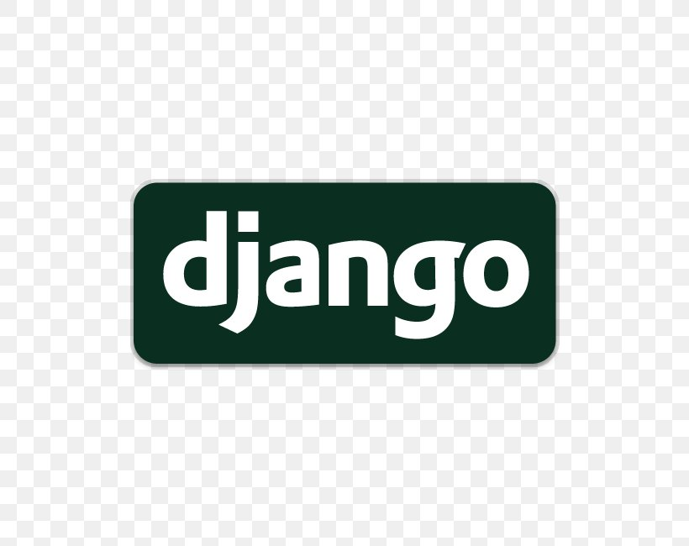


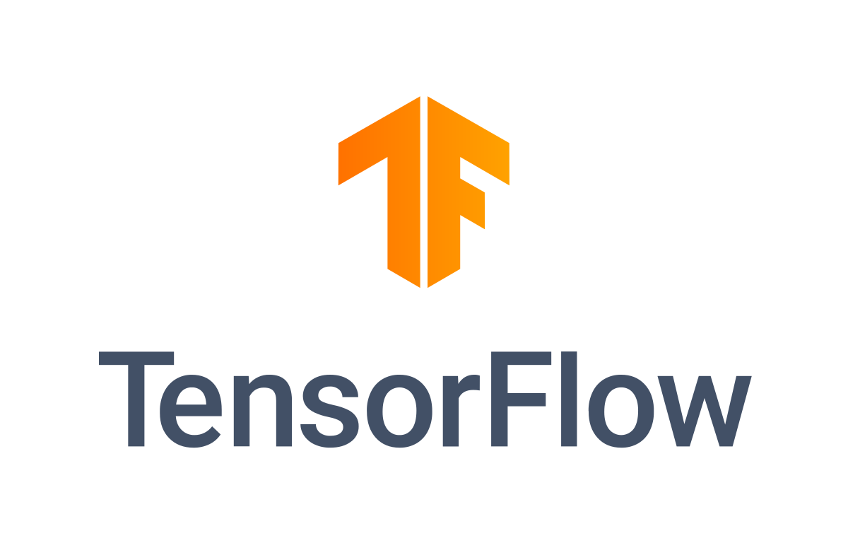

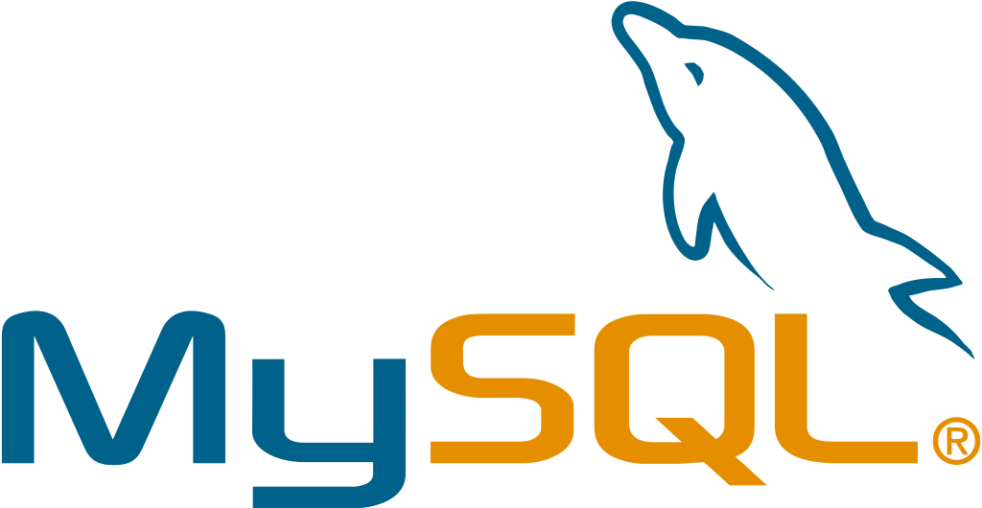
FALCON LABS
Start your lab
Programming
Web Development
Data Science
Big Data

Slide 7
Basic Business Model
Description |  | Revenue Streams
Website application to help students to use different tools and applications with no installation. |  | Students will be given a limited amount of storage and access to the resources. After limited usage, students need to pay for resources they want to use.
Customer targets |  |  | Pricing
Universities Online Learning |  |  | The website is free to use for a limited amount of time with all the resources.
Challenges |  | Growth opportunity
Ability to decide how many universities are willing to adapt to this online resource learning |  | Addition of other features to the app to make the platform industry attractive.

Slide 8

Cost Estimation and Timeline estimate
DEVELOPMENT | ESTIMATED TIME & TIMELINE
UI DESIGN | $5000, 1 month
APPLICATION DEVELOPMENT | $50000, 6 months
MAINTENANCE | $10000/annum
TOTAL: $65000 TO $75000

