Slide 1

Singular Value Decomposition

Slide 2
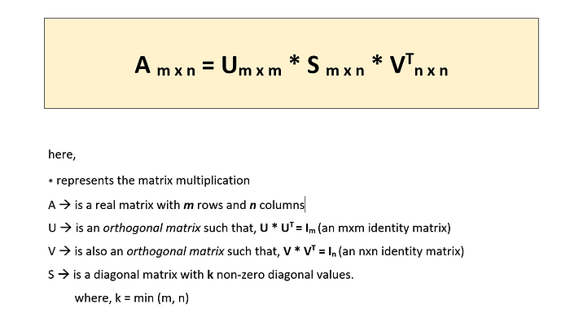
Representation

Slide 3
Intro
Applicable solution to a data science and machine learning problem.
Any matrix, regardless of symmetry, rank, and shape, can decompose into 3 matrices.
It is based on the fact that any matrix can be represented using two orthogonal matrices and a diagonal matrix.
The rank of a matrix is a measure of the unique information stored in a matrix. Higher the rank, the more information

Slide 4
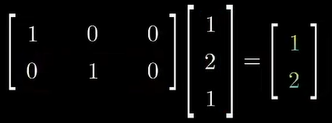
Rectangular Matrix
Representation of linear transformation from 3D vectors to 2D vectors.
Its multiplication of any vector preserves the x and y but completely removes the z value.
A matrix of size m by n has the power to transform a vector in the nth dimension to the mth dimension.

Slide 5
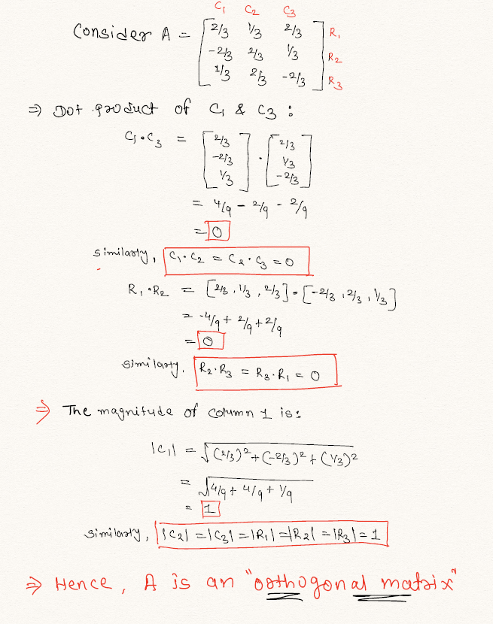
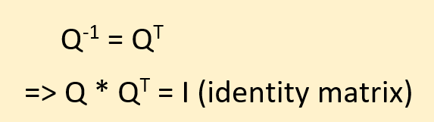
Orthogonal Matrix
This property makes such computation extremely simple

Slide 6
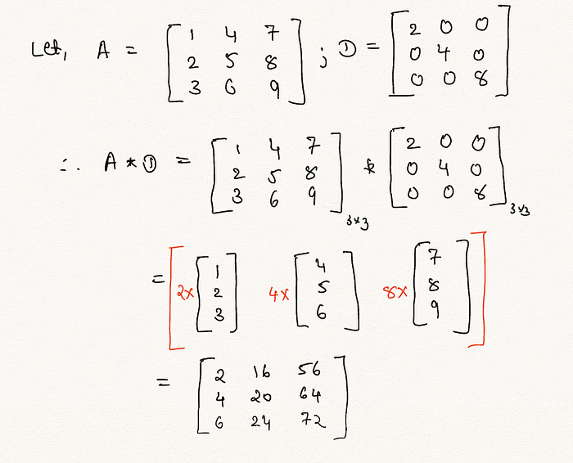
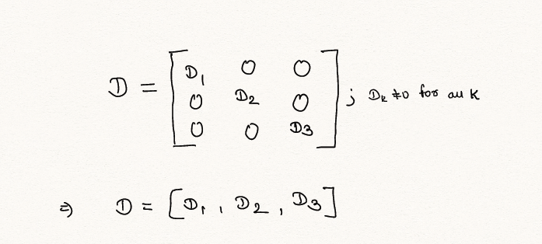
Diagonal Matrix
It is very easy to compute its multiplication with any other matrix

Slide 7


Symmetric Matrix
The eigenvectors of the symmetric matrix are perpendicular to each other.
We can construct a symmetric matrix.
We can create a symmetric matrix from a rectangular matrix A.

Slide 8
SVD Formula
Any matrix can be decomposed into 3 matrices.
Sigma: Rectangularly diagonal. U, V: Orthogonal matrices
Matrix sigma has the same dimension as matrix A.
The numbers on the diagonal of sigma are the singular values of matrix A. These singular values are arranged in descending order. Other entries as zeros.
Matrix U and V form the orthogonal matrices where eigen vectors are arranged in descending order.

Slide 9
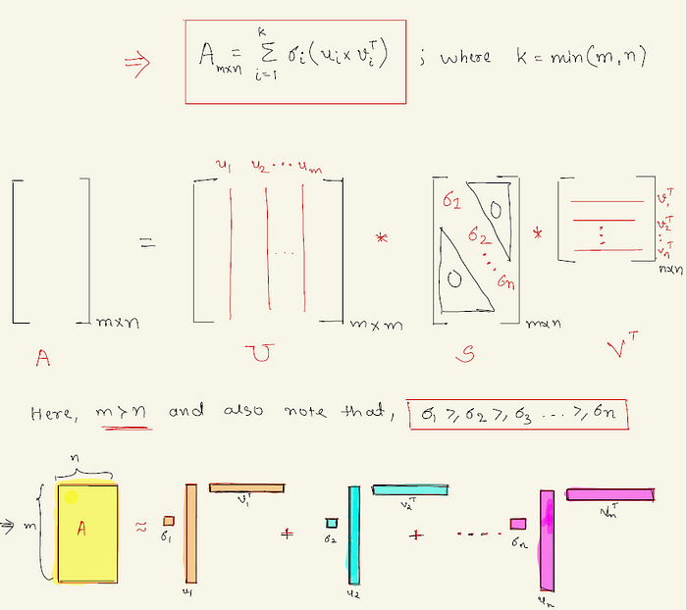
In general, if m>n, then we can limit U to have the size m x n, and if n > m , then we can limit V (or V_t) to have the size m x n.
Such SVD computation may become very slow as A grows in dimension. However, full SVD matrices are not often helpful in most practical applications. So, computing full SVD is not often necessary.

Slide 10
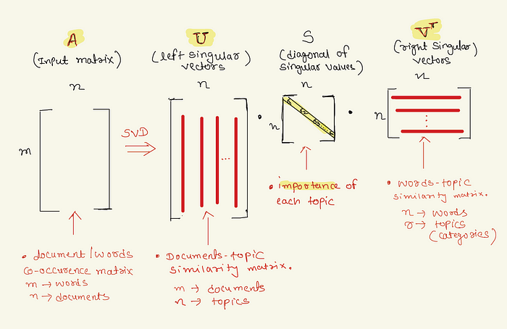
Application
The matrix U provides a relation between rows of the input matrix and the groups/ categories available in the data.
Matrix V defines the relationship between our words (features) and the topics represented by each feature.
Matrix S gives us the significance of each found topic (each column in matrix U ) in the form of singular values
Singular values are given in decreasing order. Hence, we can confirm that the initial columns in U / V (topics) are more
important than the later ones.

Slide 11
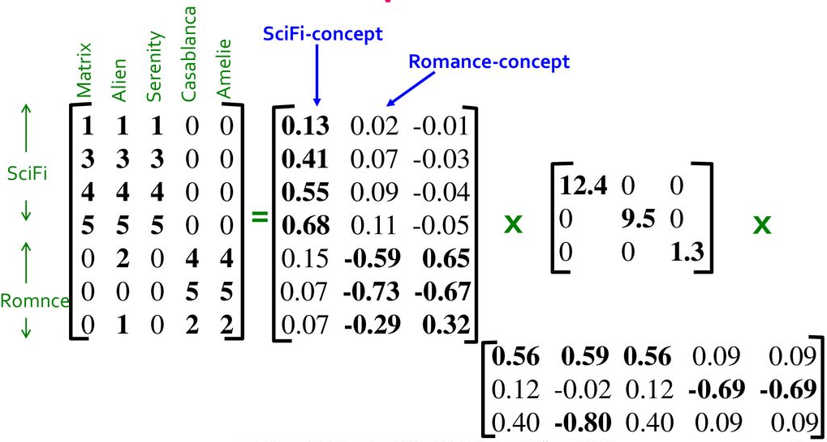
Users-to-Movies

Slide 12
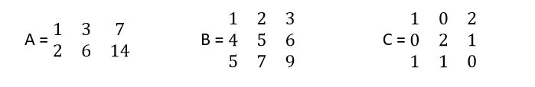
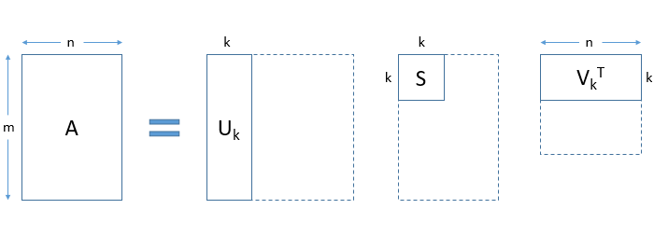
Rank
The rank of a matrix can be considered representative of the amount of unique information represented by the matrix. Higher the rank, the higher the information.
The decomposition allows us to express our original matrix as a linear combination of low-rank matrices.

Slide 13
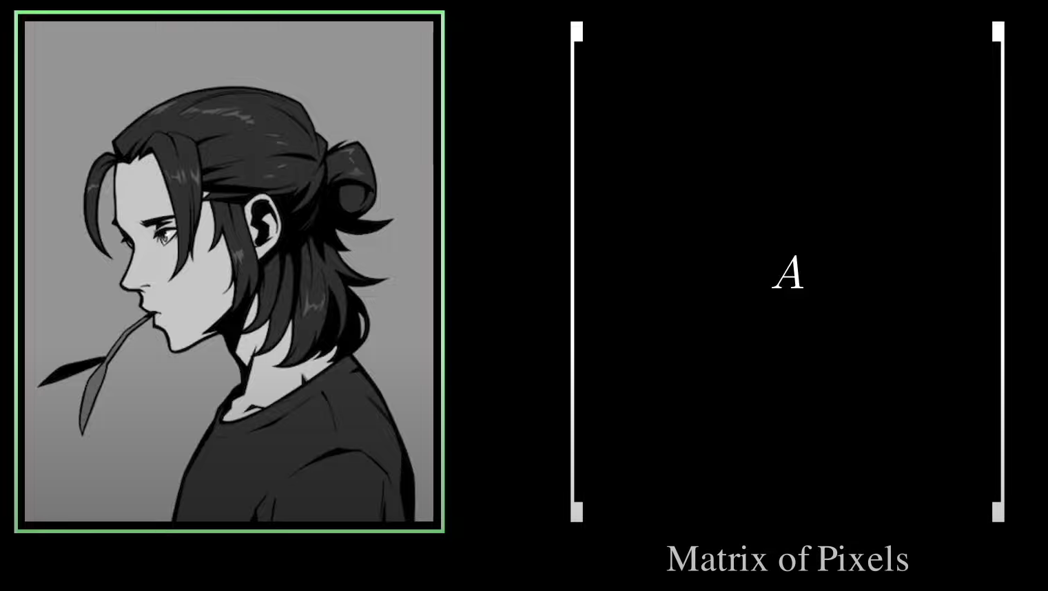
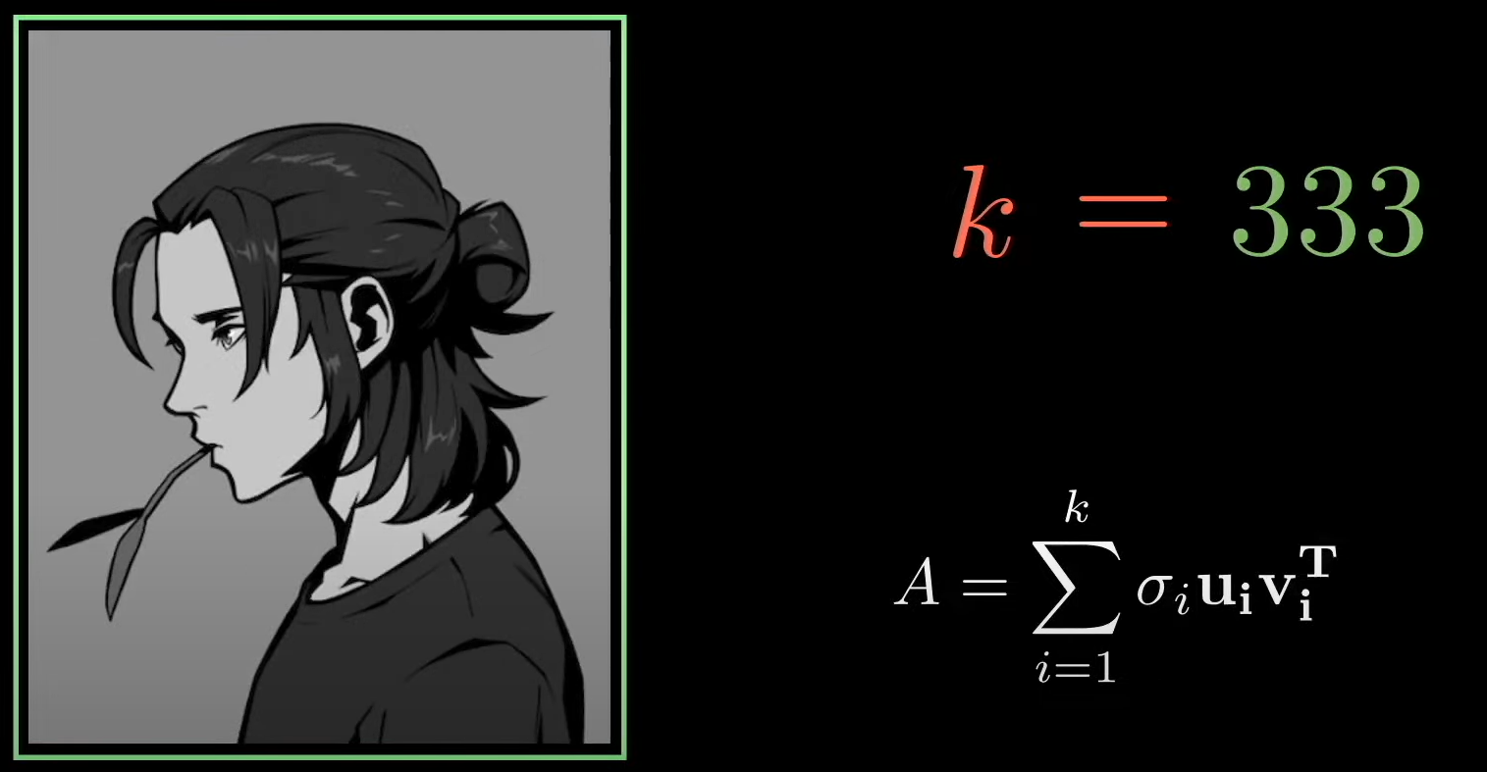
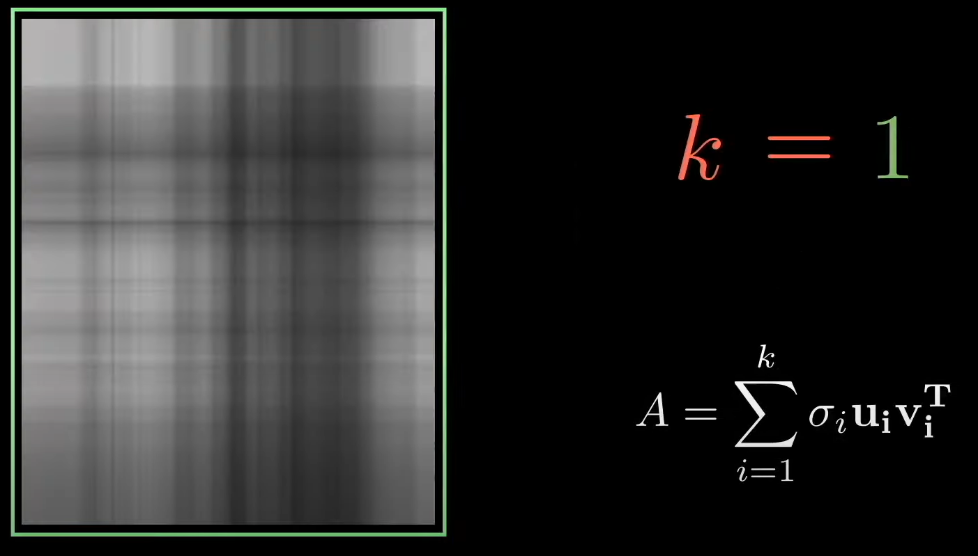
Low rank approximation of image
We can approximate the image by adding the rank one matrices.

Slide 14
